Slide 1
+
MediSync
Doctor-Patient Appointment and Healthcare Management System
Software Engineering Presentation
Team Members
Name | USN
____________________ | ____________________
____________________ | ____________________
Course/Subject: Software Engineering
Kotlin • Jetpack Compose • Node.js • PostgreSQL • MinIO • WebRTC • FCM
Guide: ____________________

Slide 2
Presentation Flow
1
Project introduction and problem statement
2
Technology stack and major technology modules
3
Requirements engineering and SRS-style requirements
4
Use case, sequence, activity and state diagrams
5
Architecture, ER diagram and database design
6
Implementation screens and testing strategy
7
Project estimation, scheduling and risk management
8
Conclusion, learning outcomes and future scope
MediSync | Software Engineering Presentation
2

Slide 3
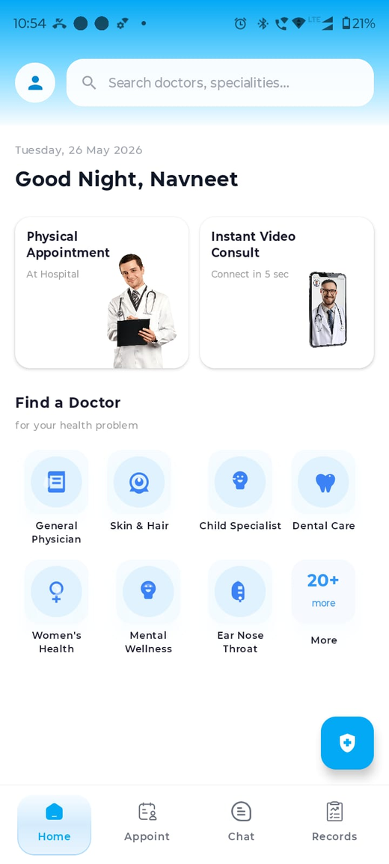
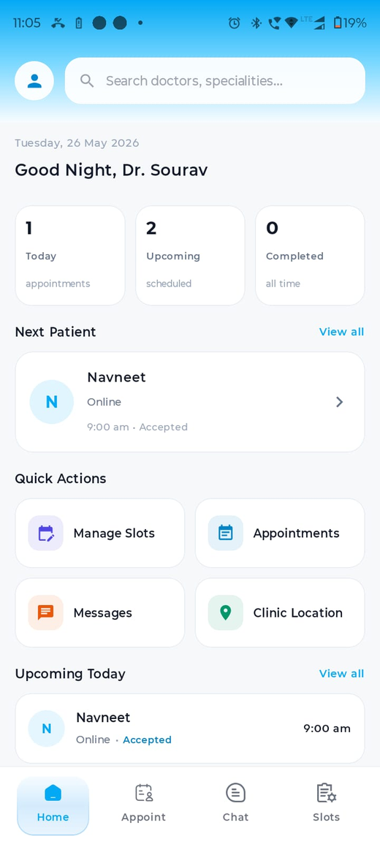
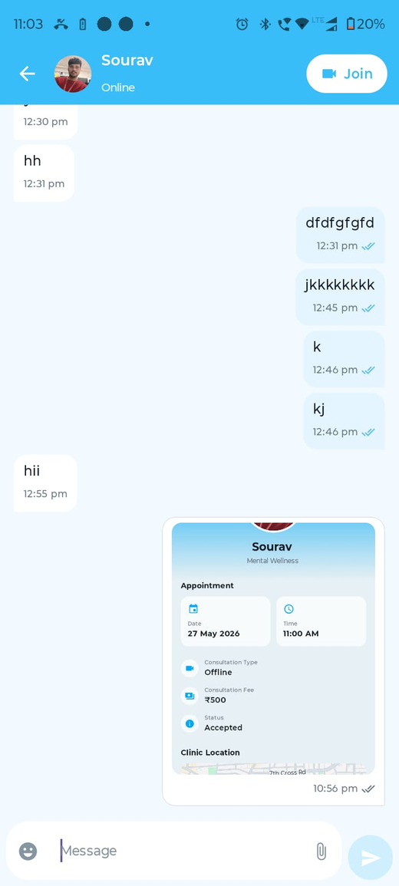
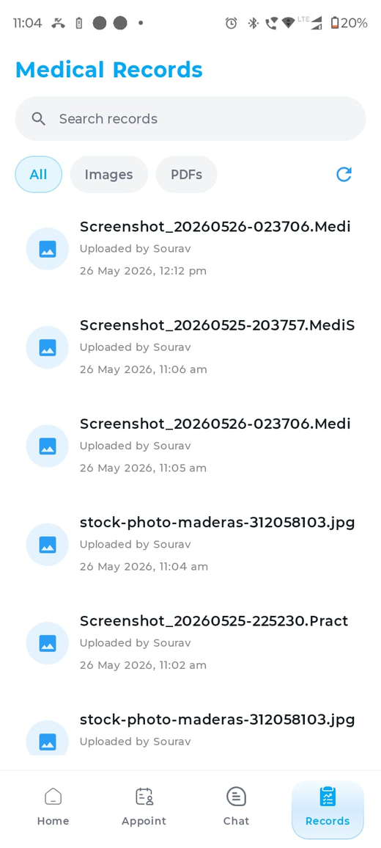
Introduction
A digital bridge between patient and doctor workflows
Problem Background
Proposed Solution
Patients need one place to discover doctors, book appointments, consult, chat and store medical records.
Doctors need a practical system to manage their profile, clinic location, schedule, appointment load and patient communication.
Traditional coordination through calls or scattered messages makes records difficult to track and appointments difficult to manage.
MediSync is an Android-based healthcare platform with patient and doctor modules.
It combines appointment booking, slot management, chat, video consultation, report storage, AI support and notifications.
The system follows a client-server architecture with secure APIs, relational database, object storage and real-time communication.
Patient Home
Doctor Home
Chat
Records
MediSync | Software Engineering Presentation
3

Slide 4
Technology Stack Used
Layer | Technology Used | Role in MediSync
Mobile Frontend | Kotlin, Jetpack Compose | Android UI, navigation, state-driven screens
App Architecture | MVVM + Repository | Separates UI, ViewModel state and data sources
Local Storage | Room / SQLite | Offline cache for records/profile related content
Backend | Node.js, Express.js, TypeScript | REST API, business logic and controllers
Database | PostgreSQL | Relational schema, constraints and joins
Object Storage | MinIO | Profile photos, chat files and medical records
Real-Time | WebSocket + WebRTC | Chat delivery and video consultation signaling/media
Notifications / AI / Maps | FCM, Gemini API, Google Maps SDK | Push alerts, AI health chat and clinic location
MediSync | Software Engineering Presentation
4

Slide 5
Major Technology Modules
Why each major module is used
MinIO Object Storage
WebRTC Video Call
Stores uploaded profile photos, chat attachments, PDFs and medical records outside PostgreSQL. DB stores keys; MinIO stores file bytes.
Provides peer-to-peer audio/video consultation. WebSocket signaling is used to exchange offer, answer and ICE candidates.
Room / SQLite Cache
PostgreSQL Database
Keeps important local data available when network is unavailable, especially records/cache screens.
Maintains normalized application data: users, doctor profiles, slots, appointments, chats, reports and ratings.
Firebase Cloud Messaging
Gemini AI Chat
Sends chat and appointment notifications when receiver is offline or outside the chat screen.
Supports patient-side general health guidance and report/image discussion with safety boundaries.
MediSync | Software Engineering Presentation
5

Slide 6
Project Objectives
O1
Allow patients to find doctors by specialization and consultation mode.
O2
Allow doctors to create online/offline slots using weekly template and custom schedule.
O3
Provide appointment lifecycle from booking to details, chat and rating.
O4
Enable real-time chat, video consultation and offline notification support.
O5
Store medical records and uploaded files safely using object storage and database references.
O6
Provide AI-based health guidance and report/image discussion for patient support.
O7
Support deployment on cloud backend with Docker/PM2 and real device access.
MediSync | Software Engineering Presentation
6

Slide 7
Project Scope
In Scope
Out of Scope
Patient and doctor registration/profile flows.
Doctor search, specialization filter and doctor detail screen.
Appointment booking, slot management, appointment list and appointment detail.
Doctor clinic location selection and map-based viewing.
Chat, file sharing, medical records and profile photos.
Video consultation, AI chat, ratings and notifications.
Online payment gateway and billing settlement.
Hospital administration panel and staff management.
Legal prescription signing and medicine inventory.
Emergency ambulance dispatch or critical-care automation.
Advanced diagnosis system replacing doctors.
Insurance claim processing.
MediSync | Software Engineering Presentation
7

Slide 8
Requirements Engineering Process
Based on Unit 2
Elicitation
Analysis
Specification
Validation
Management
Collected needs for patient, doctor, appointment, records, chat and video workflows.
Classified functional needs, roles, constraints and relationships such as slot to appointment.
Converted requirements into screens, APIs, database schema and data flow.
Checked whether flows work on emulator/phone and match expected user scenarios.
Handled changing needs such as search filters, refresh, cache, map and notification changes.
Requirement Traceability in MediSync
Requirement -> UI screen -> API endpoint -> database table -> test scenario.
Example: Book appointment -> Slot picker -> bookAppointment API -> appointment_slots + appointments -> double-booking test.
MediSync | Software Engineering Presentation
8

Slide 9
Functional Requirements
SRS-style requirement list
Patient-Oriented Functional Requirements
Doctor/System Functional Requirements
FR1: User shall login using phone OTP and select a role as Patient or Doctor.
FR2: Patient shall search doctors by name/specialization and open doctor profile.
FR3: Patient shall book available online/offline appointment slots.
FR4: Patient shall view appointment list, details, clinic location and chat option.
FR5: Patient shall view and search medical records by all/images/PDFs.
FR6: Patient shall use AI chat for health guidance and report/image discussion.
FR7: Doctor shall edit personal, professional and clinic profile details.
FR8: Doctor shall set clinic location using a map picker.
FR9: Doctor shall create weekly template and custom schedule slots.
FR10: Doctor shall view upcoming appointments and patient details.
FR11: Both users shall exchange chat messages and file attachments.
FR12: System shall support video consultation and push notifications.
MediSync | Software Engineering Presentation
9

Slide 10
Non-Functional Requirements
Security
Performance
Reliability
JWT shall protect private API routes.
Only authenticated users can access appointments, chats and records.
File access is controlled using MinIO bucket policy or generated URLs.
Chat and booking screens should load without heavy file bytes in API response.
Images/PDFs are stored externally in MinIO and referenced by key.
Search/filter operations should be responsive on mobile screens.
Network errors should not crash the app.
Cached records should remain visible when refresh fails.
Slot booking must prevent duplicate bookings.
Usability
Maintainability
Scalability
UI should use clear navigation, readable text and consistent patient/doctor workflows.
Search bars, filters and actions should be visible and predictable.
Screens should support common Android device sizes.
MVVM and repository pattern should separate UI from data logic.
Backend controllers/routes should keep module boundaries clear.
Environment variables should configure deployment services.
PostgreSQL, MinIO, Redis/WebSocket and app server can be scaled separately.
Object storage prevents database overload from large files.
Service separation supports future modules like payments or prescriptions.
MediSync | Software Engineering Presentation
10

Slide 11
Use Case Diagram
Login/Register
Manage Profile
Search Doctor
Manage Slots
Book Appointment
Set Clinic Location
Patient
Doctor
Chat / Video Call
View Appointments
View Records
Upload Reports
MediSync | Software Engineering Presentation
11

Slide 12
Sequence Diagram: Appointment Booking
Patient App
Backend API
PostgreSQL
Chat Room
Doctor/FCM
Select slot + confirm
Validate JWT and slot
Insert appointment, update slot
Create/update chat room
Notify doctor
Return confirmation
MediSync | Software Engineering Presentation
12

Slide 13
Activity Diagram: Patient Booking Flow
Start
Open Find Doctor
Select Doctor Profile
Open Slot Picker
Choose Slot
Confirm Booking
Backend Validates Slot
Appointment Created
Chat Room Available
End
MediSync | Software Engineering Presentation
13

Slide 14
State Diagram / Statechart
Appointment object states and event transitions
Consultation Active
Completed
join chat/video
time over
Slot Available
Booking Requested
Accepted / Booked
doctor creates slot
patient selects slot
payment-free confirm
cancel/no-show
Cancelled / Expired
Rated / Closed
patient rates
Statechart Meaning
A state machine model shows system response to events, as described in Unit 2/3.
For MediSync, the appointment changes state when a doctor creates a slot, a patient books it, consultation happens, and the appointment is completed, cancelled or rated.
This helps identify valid and invalid transitions, such as preventing an already booked slot from being booked again.
MediSync | Software Engineering Presentation
14

Slide 15
System Architecture
Layered client-server architecture
PostgreSQL
Node/Express API TypeScript
MinIO
FCM / Gemini / Maps
Android App Compose + MVVM
Repository Layer Retrofit + Room
WebSocket Server Chat + Video Signaling
Redis / PM2
Architectural Decisions
Use layered architecture because the app has separate UI, data, API, storage and real-time concerns.
Use shared repository model through PostgreSQL for structured data and MinIO for files.
Use external services only for specialized capabilities: FCM, Gemini and Maps.
MediSync | Software Engineering Presentation
15

Slide 16
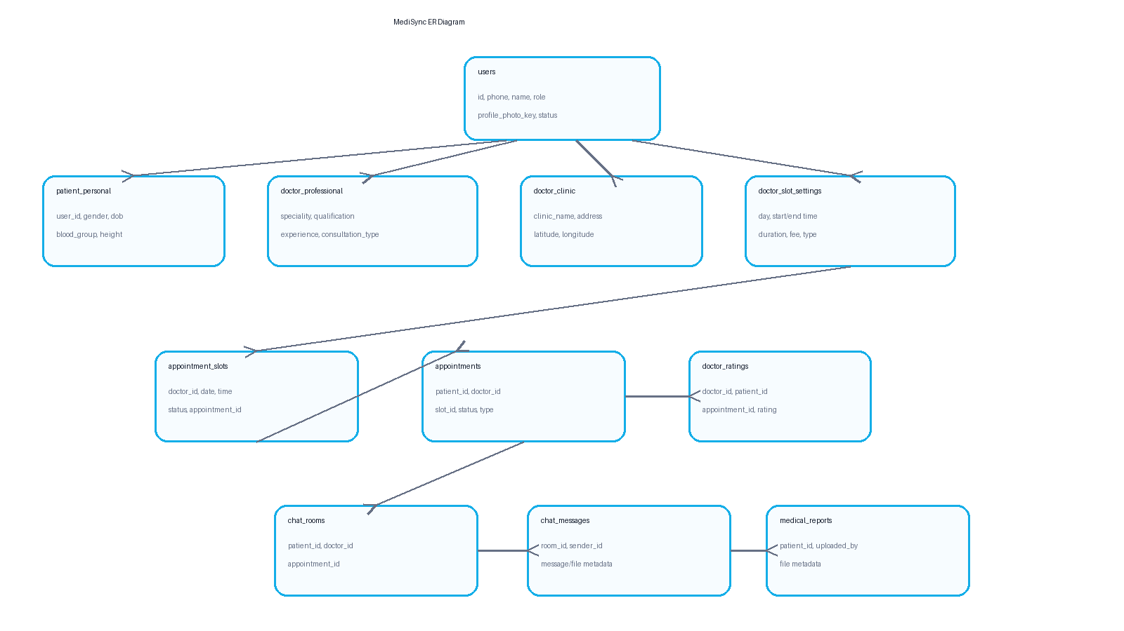
ER Diagram / Database Design
Core Tables Used
users: common patient/doctor identity.
appointments and appointment_slots: booking lifecycle.
chat_rooms and chat_messages: real-time communication.
medical_reports: files linked to patients and chats.
doctor_ratings: rating per appointment.
doctor_clinic and doctor_professional: doctor details and clinic location.
MediSync | Software Engineering Presentation
16

Slide 17
Data Flow Diagram
PostgreSQL DB
Patient
MinIO Storage
MediSync Backend
FCM Notification
Doctor
Gemini / Maps
Room Cache
Booking, chat, profile, records, reports and video events move through the backend. Structured data goes to PostgreSQL, large files go to MinIO, and local cache supports offline viewing.
MediSync | Software Engineering Presentation
17

Slide 18
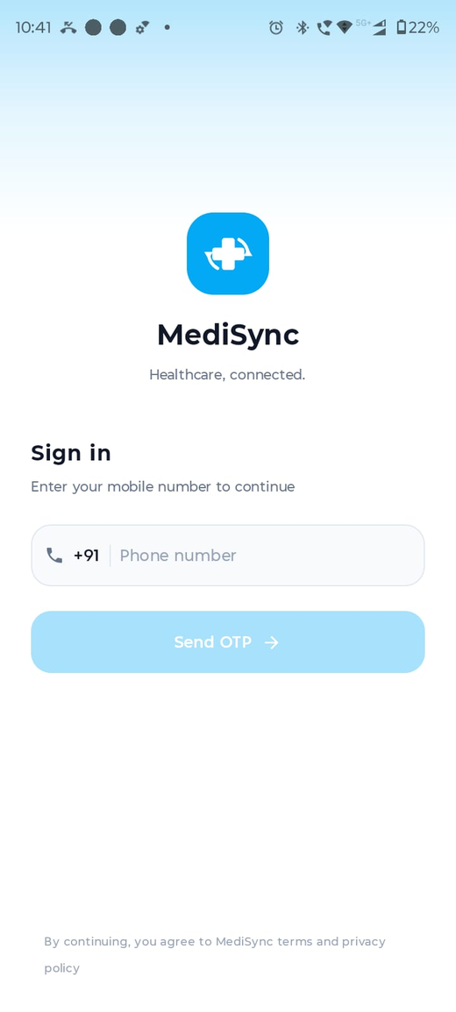
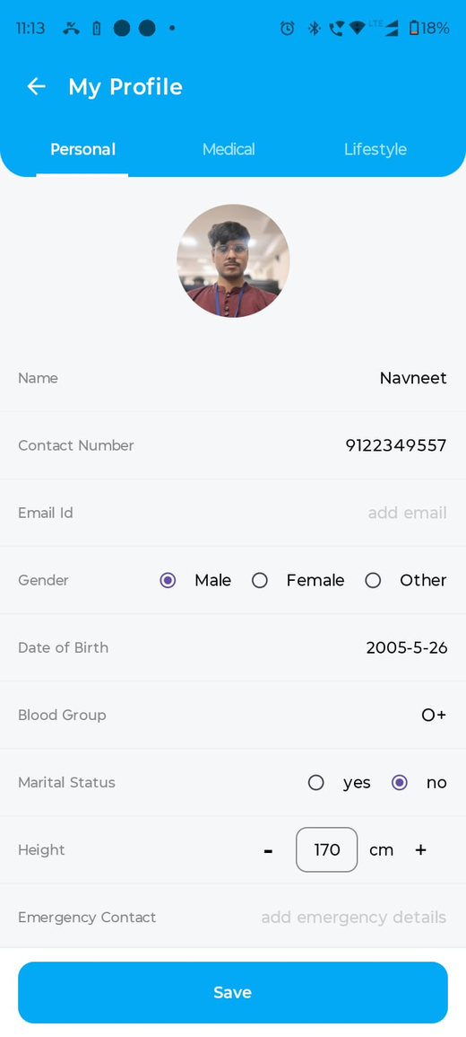
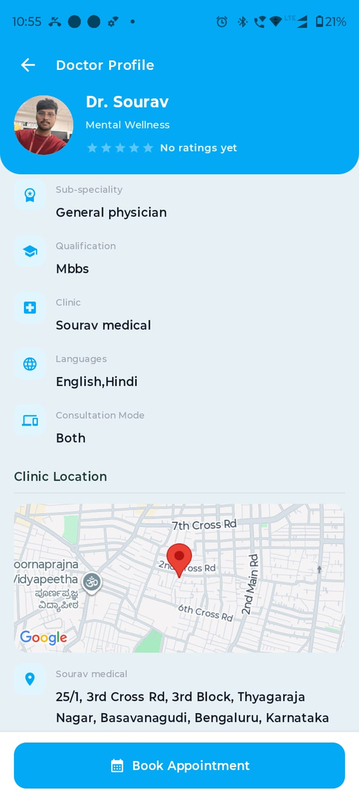
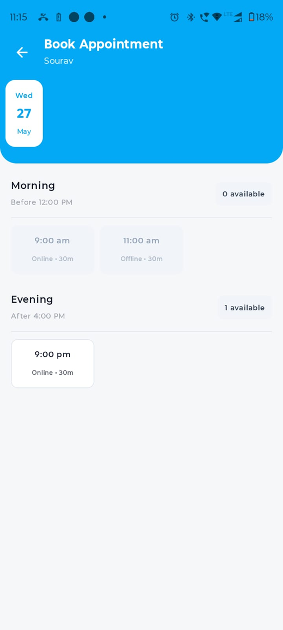
Patient Module Screens
Login
Home
Specialities
Doctor Profile
Slot Picker
MediSync | Software Engineering Presentation
18

Slide 19
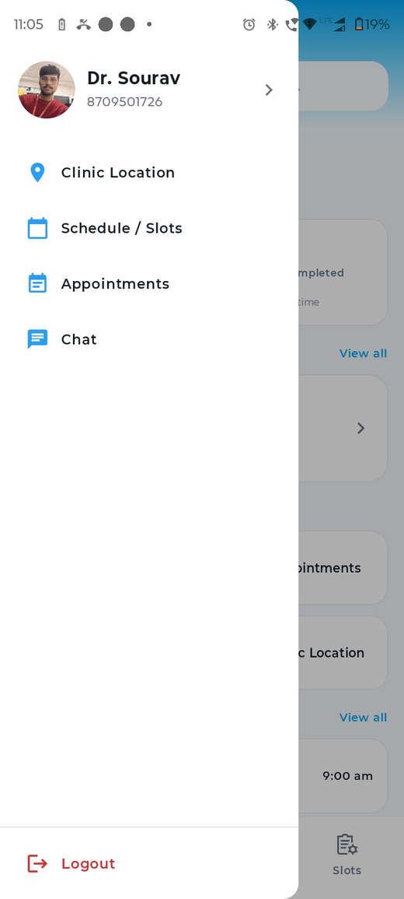
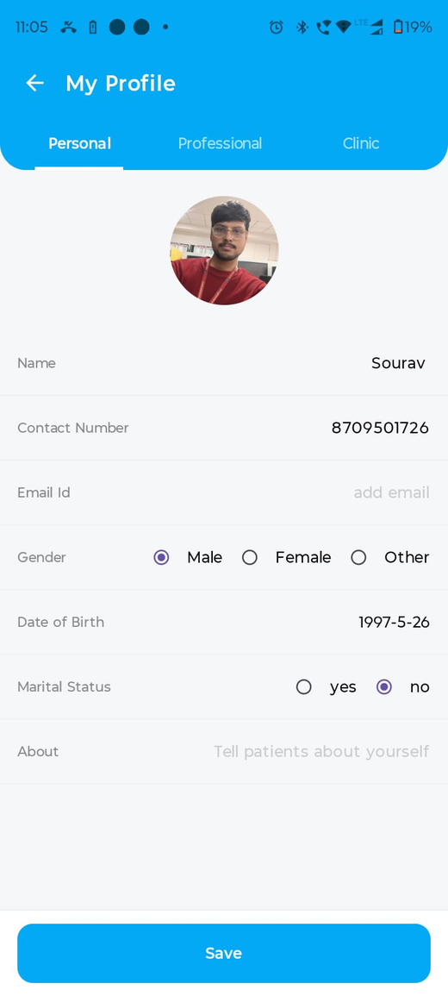
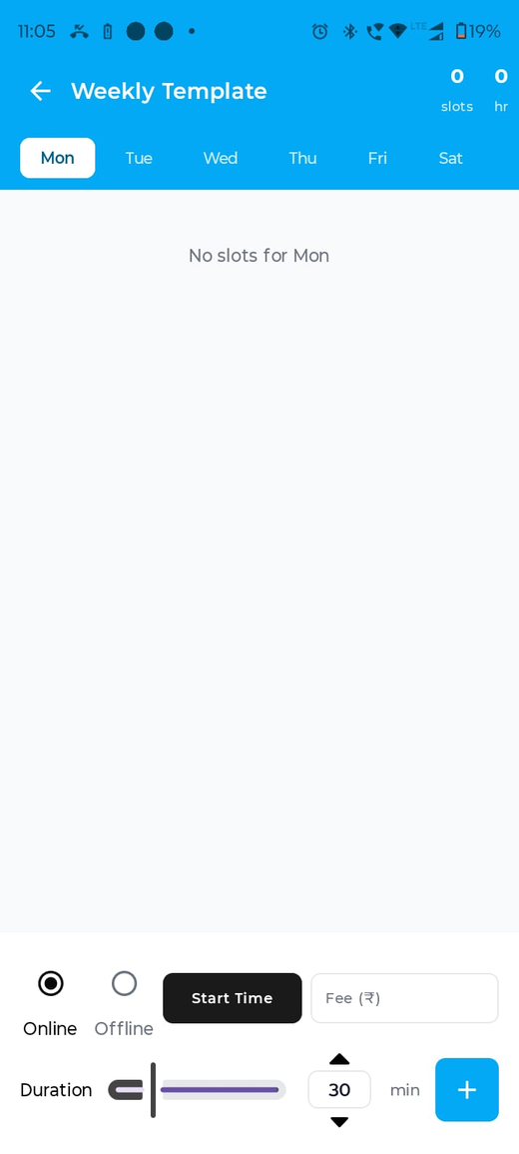
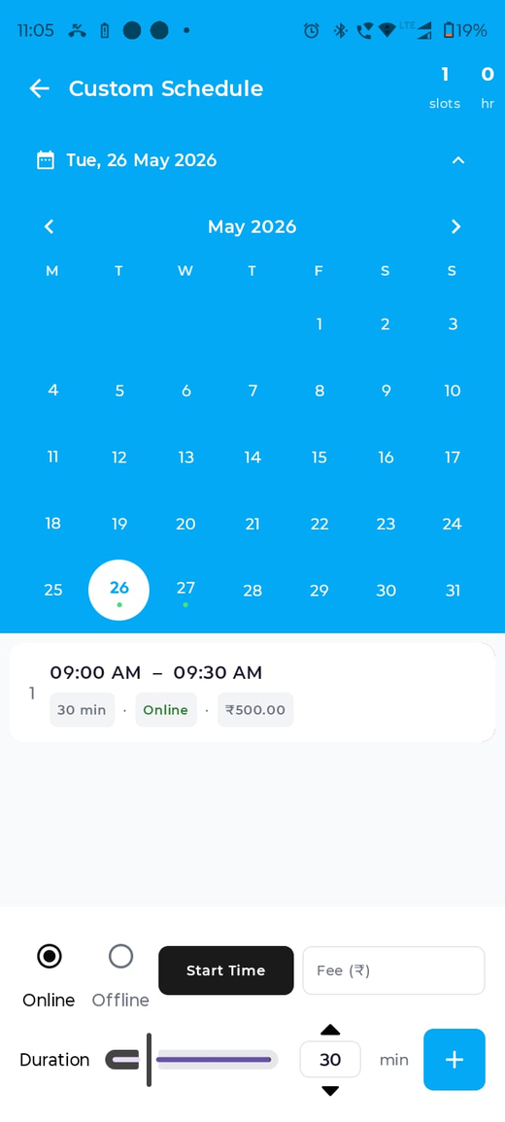
Doctor Module Screens
Doctor Home
Drawer
Profile Edit
Weekly Template
Custom Schedule
MediSync | Software Engineering Presentation
19

Slide 20
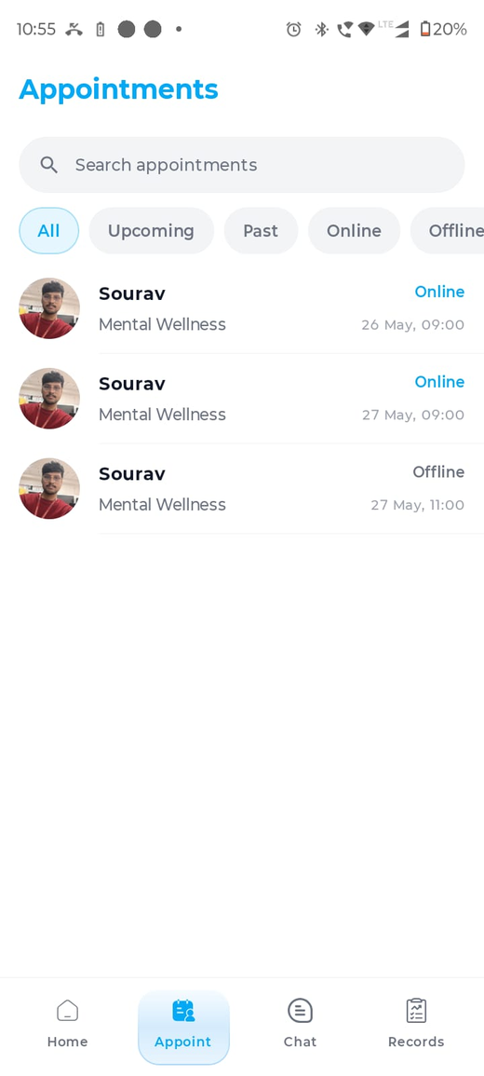
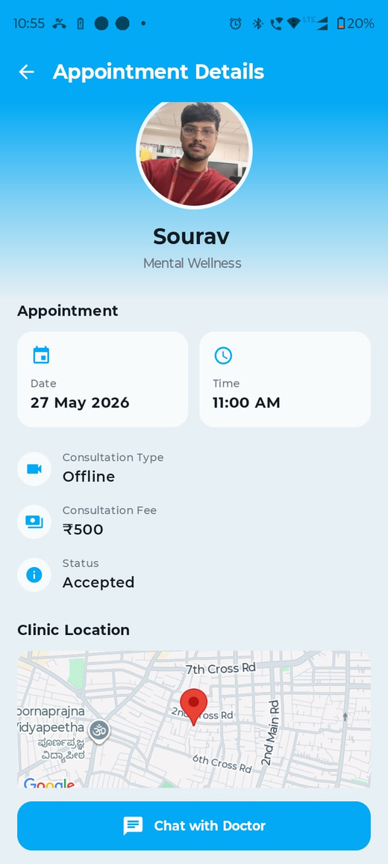
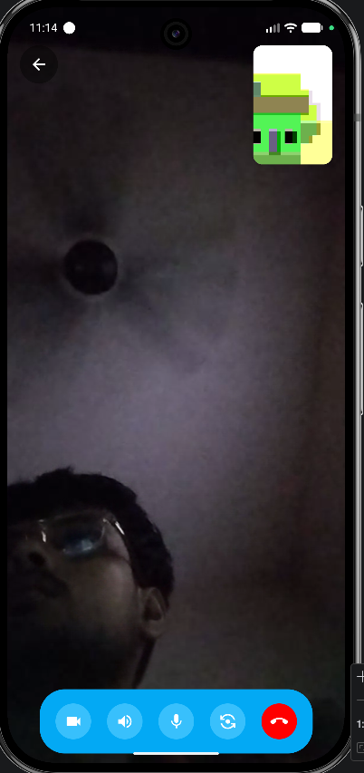
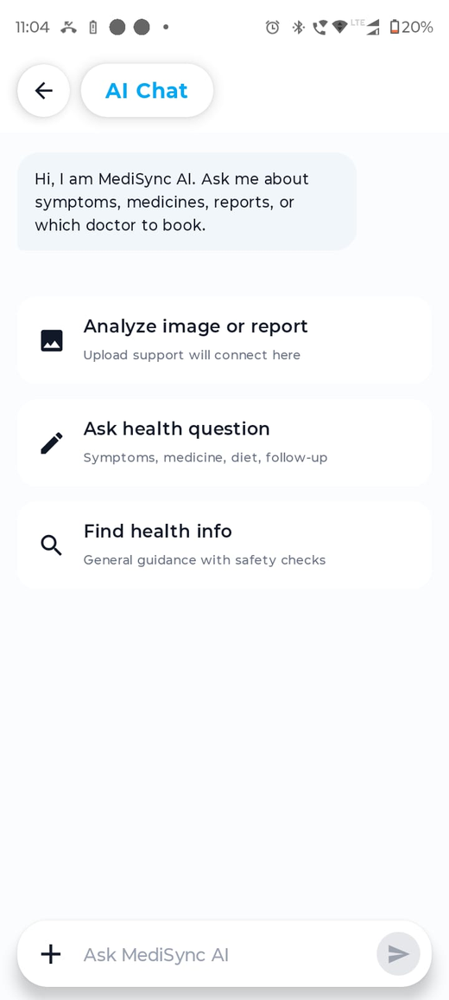
Communication, Records and AI Screens
Appointment List
Appointment Detail
Chat Room
Video Call
AI Chat
MediSync | Software Engineering Presentation
20

Slide 21
Testing Strategy
Testing Levels
Important Test Conditions
Unit testing: validation helpers, ViewModel state and formatting logic.
API testing: auth, doctors, slots, appointments, chats, reports and ratings.
Integration testing: Android app + backend + PostgreSQL + MinIO + WebSocket + FCM.
System testing: full patient-doctor workflows on emulator and physical device.
Regression testing: re-check old flows after UI/backend fixes.
No internet or backend unavailable.
Invalid OTP / expired token / unauthorized API call.
Slot already booked by another user.
Chat receiver offline and FCM token missing/invalid.
MinIO file access denied or missing object.
Video call peer waiting, joined, back pressed, or app backgrounded.
MediSync | Software Engineering Presentation
21

Slide 22
Scenario-Based Test Cases
Module | Scenario | Expected Result
Auth | Wrong OTP entered | Show error; app should not crash
Search | Patient filters by Mental Wellness | Only matching doctors shown
Booking | Two users try same slot | Only first booking succeeds
Appointments | Past appointment opened | Details, chat and rating behaviour visible
Records | Refresh without internet | Cached old records remain visible
Chat | Receiver offline | Message saved and FCM sent if valid token exists
Video | Other user not joined and back pressed | Call ends or returns safely without black screen
Map | Permission denied | Manual map selection still possible
MediSync | Software Engineering Presentation
22

Slide 23
Project Estimation
Unit 4: LOC/FP, process-based and use-case estimation ideas
Estimation Approach
Work Area | Approx. Effort Share
Android UI + MVVM | 35%
Backend APIs + Database | 25%
Realtime Chat + Video | 15%
Storage, Maps, AI, FCM | 15%
Testing + Deployment | 10%
The project was estimated using module decomposition because features are naturally divided into auth, profile, booking, chat, records, video, AI and deployment.
Use-case based estimation was suitable because each major screen represents a user goal.
Higher effort modules were WebRTC video, chat/file handling, MinIO deployment, FCM and offline cache.
COCOMO View
MediSync can be considered an organic/semi-detached academic software project.
Team size is small, requirements evolved iteratively, and integration risk is moderate.
Effort is driven more by integration complexity than pure line count.
MediSync | Software Engineering Presentation
23

Slide 24
Project Scheduling
Sprint 1
Authentication, role selection, base navigation and database schema
Sprint 2
Doctor discovery, profile screens, slot creation and booking
Sprint 3
Chat, records, reports, ratings and notifications
Sprint 4
Video call, AI chat, maps, caching, deployment and polishing
Schedule Control
Progress was tracked feature by feature: screen, API, database, integration and test.
Risky integration tasks were tested repeatedly on real devices and deployed backend.
MediSync | Software Engineering Presentation
24

Slide 25
Risk Management and RMMM Plan
Risk | Probability | Impact | Mitigation / Monitoring / Management
DB password/env mismatch | Medium | High | Validate .env, Docker compose and PM2 restart logs
MinIO access denied | Medium | High | Check bucket policy, public host and object keys
Network failure | High | Medium | Show graceful error and keep cached data
Invalid FCM token | Medium | Medium | Delete stale tokens and re-register after login
Video call rendering issue | Medium | High | Device testing, fallback states and controlled back press
Requirement changes | High | Medium | Use modular design and iterative sprint changes
MediSync | Software Engineering Presentation
25

Slide 26
Learning Outcomes
Learning 1
Learning 2
Applied requirements engineering from elicitation to validation and change management.
Used UML-style use case, sequence, activity and state diagrams for design thinking.
Learning 3
Learning 4
Designed relational schema and understood entity relationships in a real app.
Integrated Android frontend with deployed backend, database, file storage and realtime services.
Learning 5
Learning 6
Handled practical deployment issues such as env variables, bucket policies, DB auth and PM2 logs.
Improved scenario-based testing mindset for crash prevention and offline behaviour.
MediSync | Software Engineering Presentation
26

Slide 27
Conclusion and Future Scope
Conclusion
Future Scope
MediSync successfully demonstrates a full-stack healthcare application for doctors and patients.
It supports appointment booking, schedule management, records, chat, video consultation, AI assistance, map location and notifications.
The project shows how software engineering concepts can be applied from requirements to design, implementation, testing and deployment.
Payment gateway and invoice generation.
Digital prescriptions and medicine reminders.
Admin dashboard for clinics or hospitals.
Advanced analytics for doctor workload and patient records.
Improved security with audit logs, encryption and role-based access policies.
More robust production monitoring and automated testing.
MediSync | Software Engineering Presentation
27

Slide 28
References
1
Unit 2: Requirements Engineering, elicitation, validation, management, state machine models and use cases.
2
Unit 3: Architectural design, layered architecture, object-oriented design, sequence models and statecharts.
3
Unit 4: Project management, W5HH, estimation, scheduling, risk identification and RMMM plan.
4
Android Developers documentation for Kotlin, Jetpack Compose, Room and app architecture.
5
Node.js, Express.js, PostgreSQL, MinIO, WebSocket and Docker documentation.
6
Firebase Cloud Messaging, Google Maps SDK and Gemini API documentation.
MediSync | Software Engineering Presentation
28

