Slide 1
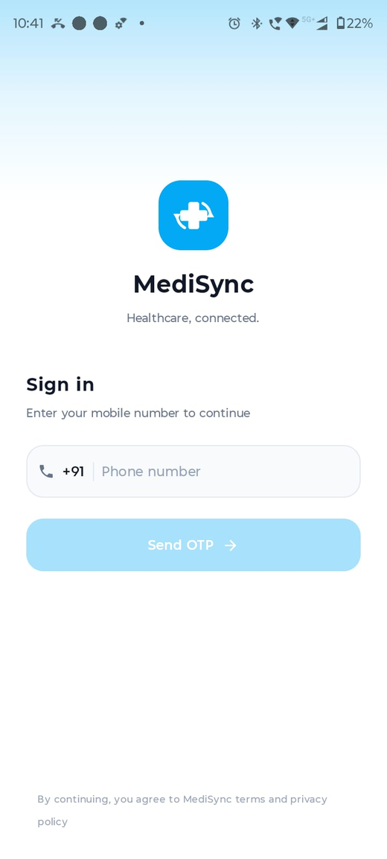
MediSync
Doctor and Patient Healthcare Platform
Android healthcare app for patients and doctors
Appointment booking, chat, records, AI assistant, maps and video call
Team Project: 2 members | Student details to be filled
App Login

Slide 2
Problem Statement
Patients need one place to find doctors, book consultations and store reports.
Doctors need simple tools for profile, clinic location, slots and patient communication.
Manual appointment handling and scattered medical records reduce convenience.
MediSync combines these workflows in one Android application.

Slide 3
Objectives
Build role-based Android app for patient and doctor.
Provide OTP login and JWT protected backend APIs.
Support online/offline appointment booking and slot management.
Enable real-time chat, medical records and AI health guidance.
Use maps for clinic location and FCM for notifications.

Slide 4
Software and Hardware Requirements
Android: Kotlin, Jetpack Compose, MVVM, Repository Pattern.
Backend: Node.js, Express.js, TypeScript, WebSocket.
Database and storage: PostgreSQL, SQLite cache, MinIO.
Services: Firebase Cloud Messaging, Google Maps SDK, Gemini API.
Tools: Android Studio, DataGrip, Docker, PM2 and GitHub.

Slide 5
System Architecture
Mobile app communicates with backend using REST APIs and WebSocket.
PostgreSQL stores users, doctors, slots, appointments, chats, records and ratings.
MinIO stores profile photos, chat files and medical reports.
Firebase Cloud Messaging sends offline chat and appointment notifications.

Slide 6
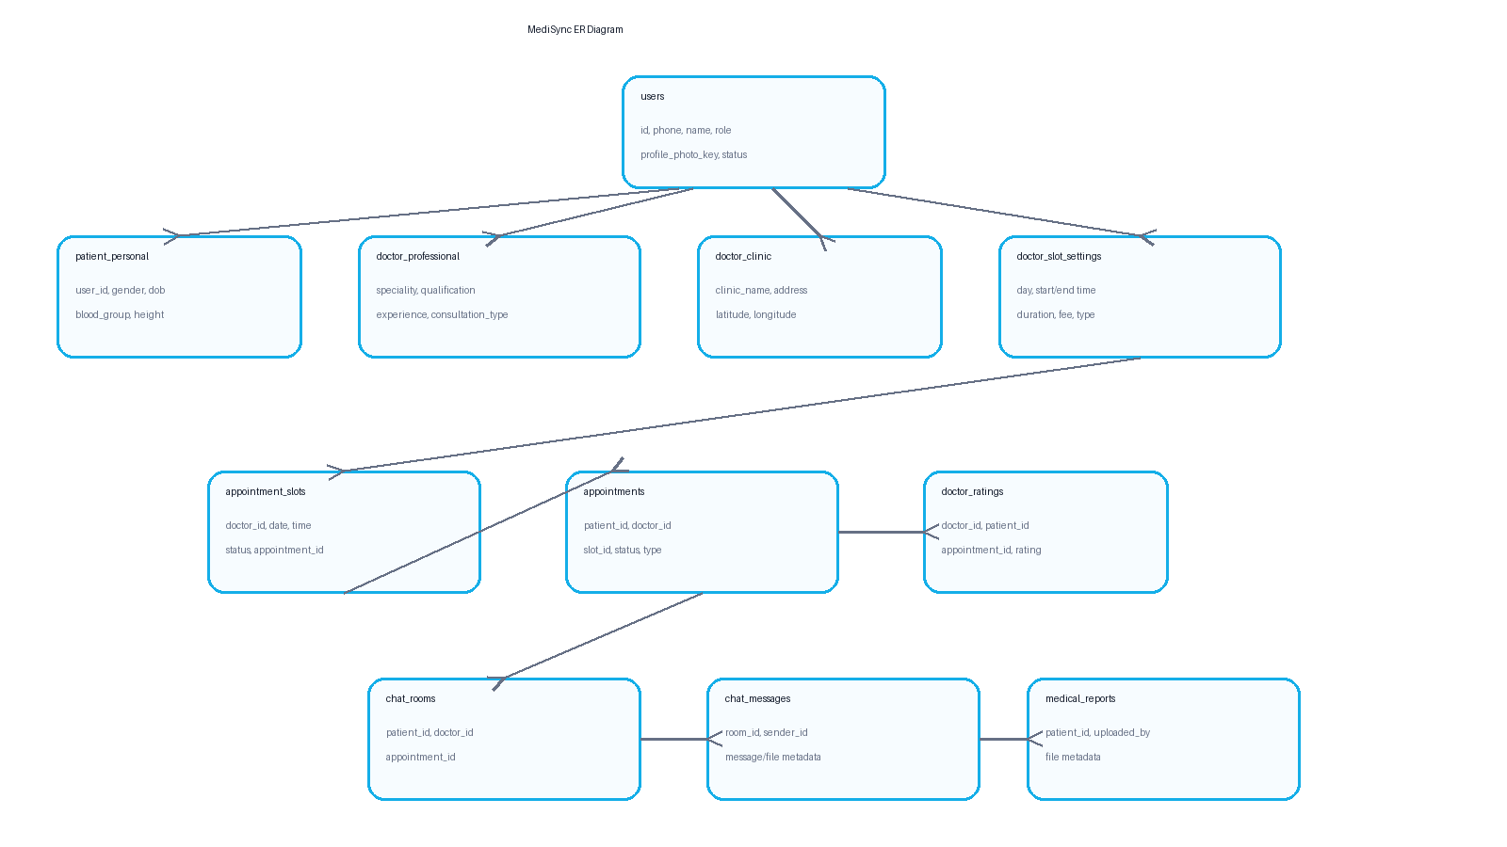
Database ER Diagram
Generated ER Diagram

Slide 7
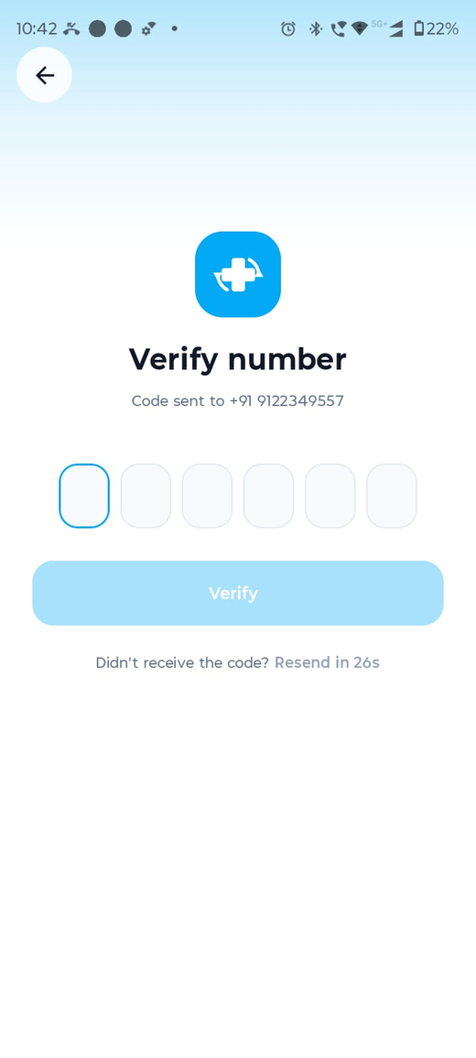
Authentication Flow
User signs in using mobile number and OTP.
New users select role: Doctor or Patient.
JWT token protects backend APIs after login.
Role decides navigation and available features.
Login
OTP

Slide 8
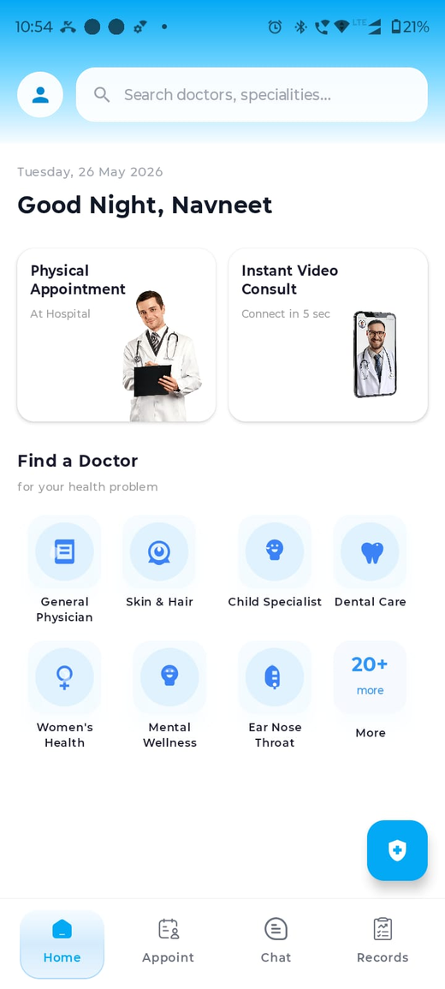
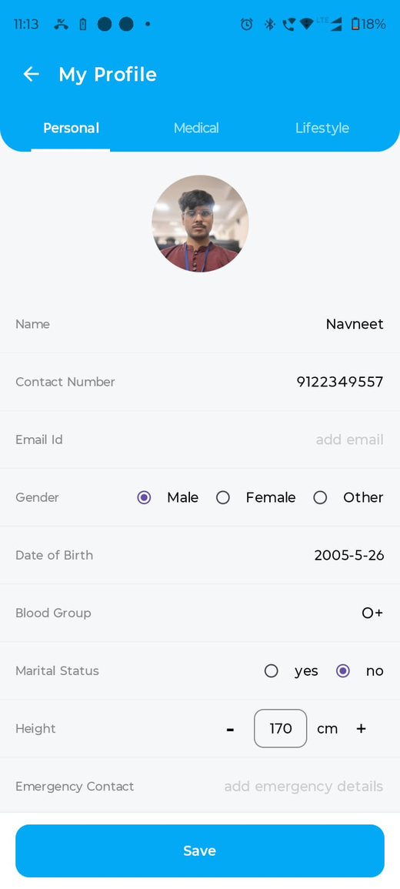
Patient Module
Patient home gives search, specialities and AI chat entry.
Patient can search doctors by speciality.
Doctor detail shows profile, rating, clinic location and appointment button.
Patient profile stores personal and medical information.
Patient Home
Specialities

Slide 9
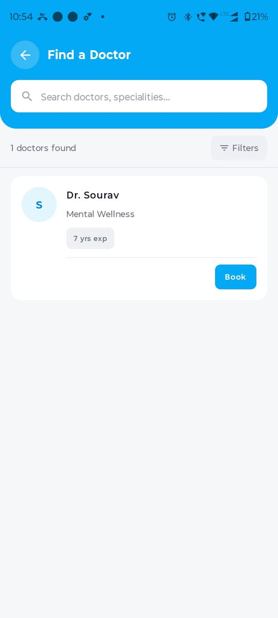
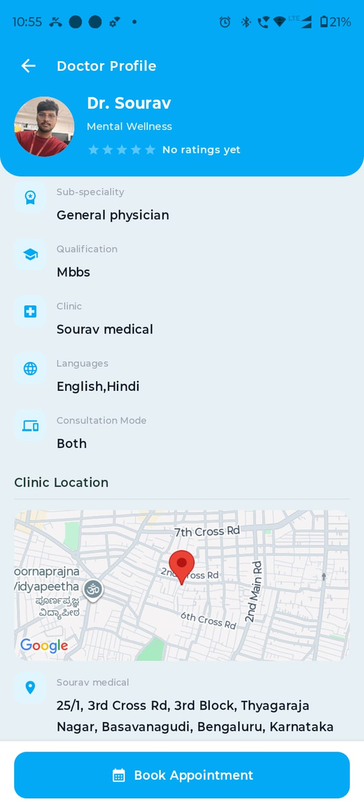
Doctor Search and Profile
Search screen lists doctors from backend data.
Doctor profile displays speciality, qualification, clinic and map.
Clinic map helps patients view offline consultation location.
Find Doctor
Doctor Detail

Slide 10
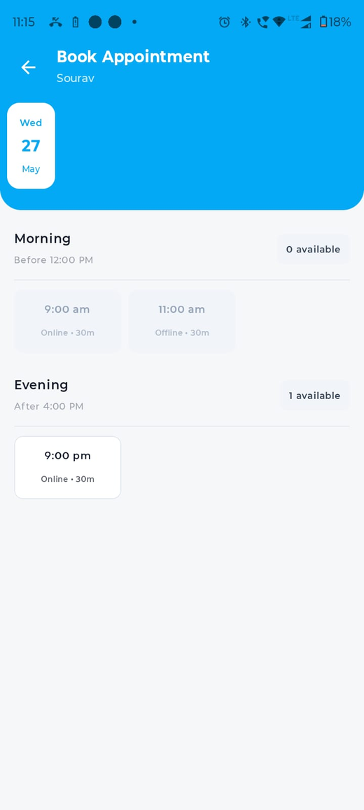
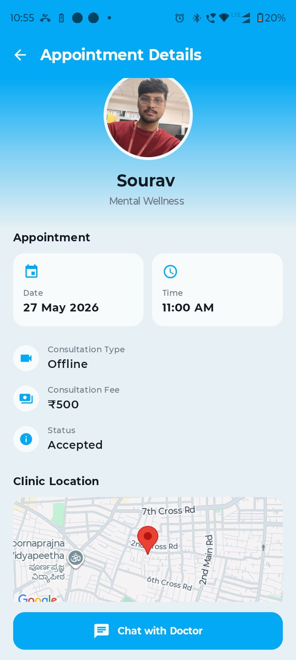
Appointment Booking
Patient chooses date and available slot.
Slot shows online/offline type and duration.
Booking creates appointment and updates slot status.
Appointment detail shows date, time, fee, status, map and chat option.
Slot Picker
Appointment Detail

Slide 11
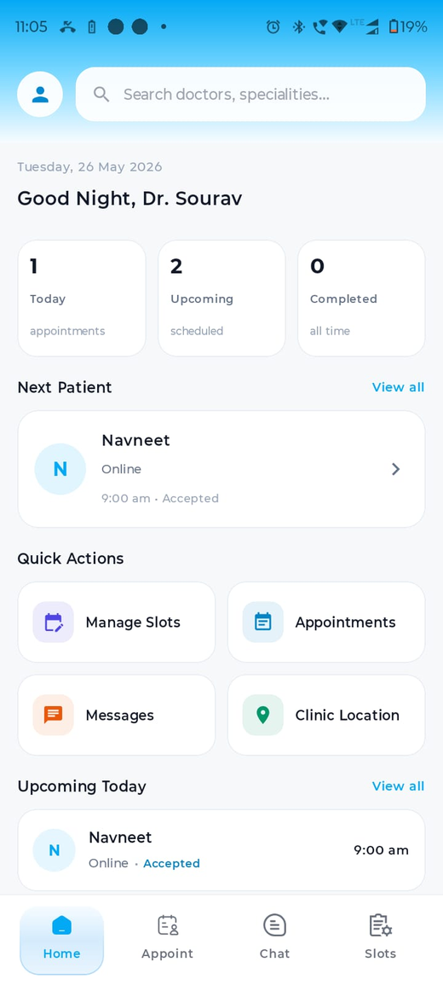
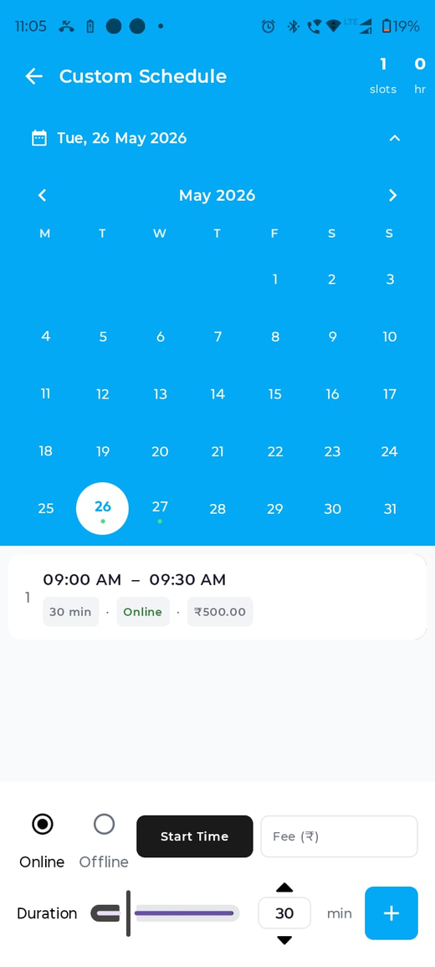
Doctor Home and Slot Management
Doctor dashboard shows appointment summary and next patient.
Weekly template creates recurring slot settings.
Custom schedule creates date-specific slots.
Doctor can set online/offline mode, duration and fee.
Doctor Home
Custom Schedule

Slide 12
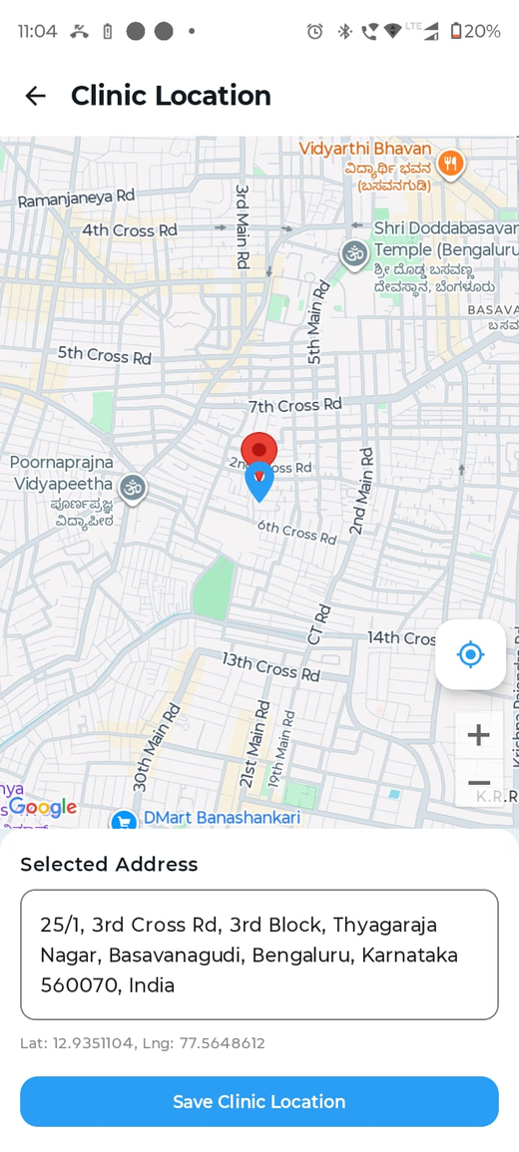
Clinic Location
Doctor selects clinic location using Google Maps.
Latitude, longitude and address are saved.
Patients see map on doctor profile and appointment detail for offline visits.
Clinic Location

Slide 13
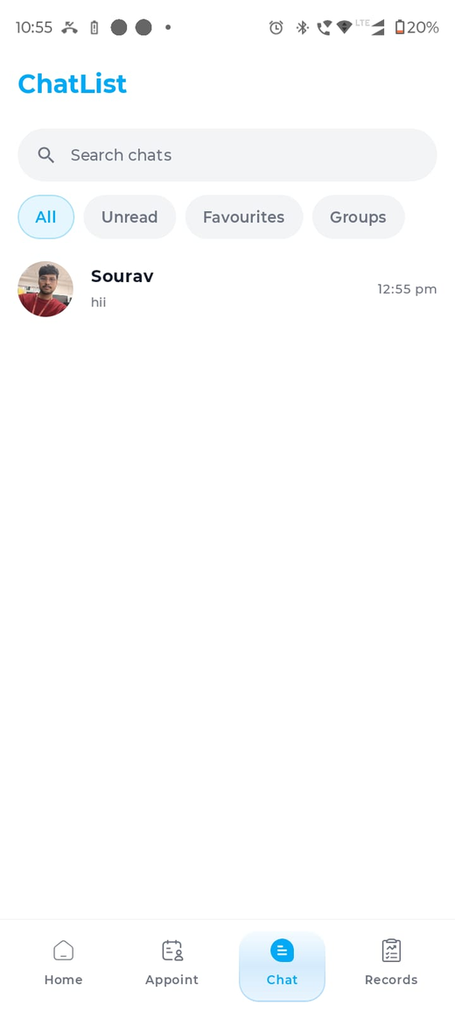
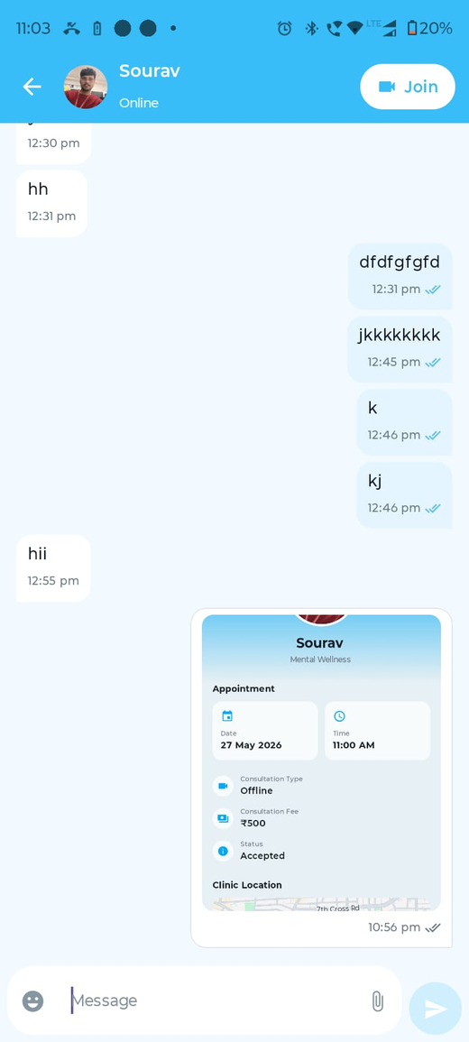
Chat Module
Patient and doctor communicate in real time using WebSocket.
Messages are stored in PostgreSQL.
Images and files are stored in MinIO with metadata in database.
Offline users receive FCM notification.
Chat List
Chat Room

Slide 14
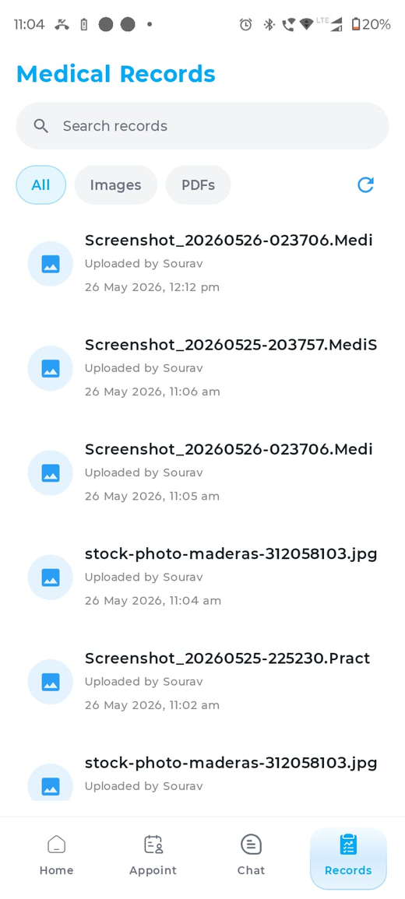
Medical Records
Doctors can save reports from chat as medical records.
Patients can view images and PDFs from records screen.
Records are cached locally for offline visibility.
Medical Records

Slide 15
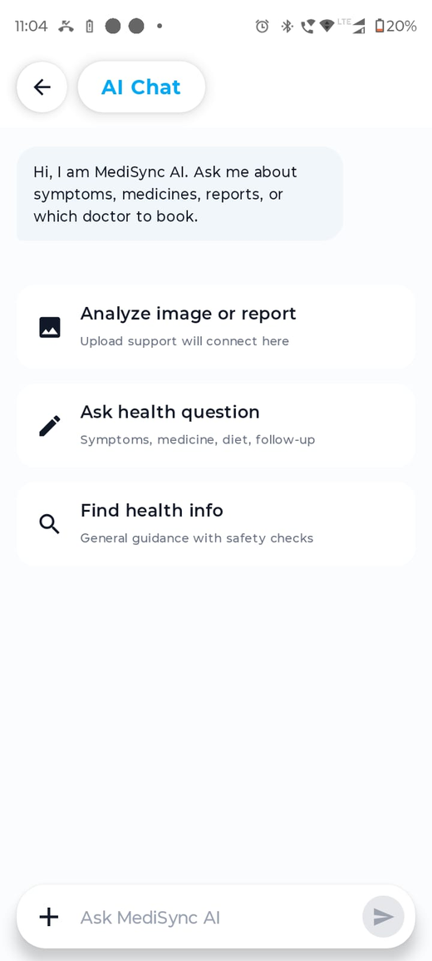
AI Health Chat
Patient can ask health questions in simple language.
AI can assist with symptoms, medicine guidance, reports and doctor suggestions.
AI guidance is supportive and not a replacement for professional diagnosis.
AI Chat

Slide 16
Video Consultation
Online appointments support video call workflow.
Foreground service/PiP concept keeps call active when app is minimized.
Basic call controls include camera, speaker, mute, switch camera and end call.

Slide 17
Database Screenshots Summary
users table stores patient and doctor identities.
appointment_slots and appointments track booking flow.
chat_rooms and chat_messages track real-time conversation.
medical_reports stores file metadata for patient records.
doctor_ratings stores feedback after consultation.

Slide 18
Testing Highlights
Login with valid/invalid OTP.
Doctor search with speciality filters.
Book available slot and block booked slot.
Open appointment detail for online and offline appointments.
Send chat message/file with and without network.
Open records online and from cache offline.
Join video call before/after other user.

Slide 19
Learning Outcomes
Built a full-stack Android healthcare app.
Practiced MVVM, Compose UI and repository pattern.
Integrated REST APIs, WebSocket, FCM, MinIO and maps.
Designed relational schema and deployed backend services.
Improved debugging skills for database, server, notifications and file access.

Slide 20
Conclusion and Future Scope
MediSync provides a connected platform for patient-doctor healthcare workflows.
It supports appointment booking, chat, records, AI assistance, maps and video consultation.
Future scope: payments, prescriptions, admin panel, analytics, stronger AI safety and Play Store deployment.

Slide 21
References
Android Developers Documentation
Firebase Cloud Messaging Documentation
PostgreSQL Documentation
MinIO Object Storage Documentation
Google Maps Platform Documentation
Node.js and Express.js Documentation
Gemini API Documentation

