Slide 1

Lifeline: the road safety app
TEAM ID:FTH38
STUDENT 1:Krishnamurari Chivukula
STUDENT 2:Navneet Nayak

Slide 2
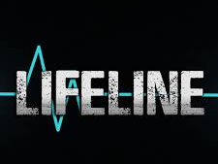
The origin of the idea
Once when my friend and I were walking along the road ,we saw an accident which took place. The first responders to this accident were very few and those who responded were clicking pictures and posting it on social media. Seeing this my friend and I felt really bad and felt that we had to make a change.
Then, the Toyota Hackathon came along and we got a nice opportunity to make a difference. We planned to design an app to save the lives of people involved in an accident. We decided to call our app Lifeline.

Slide 3
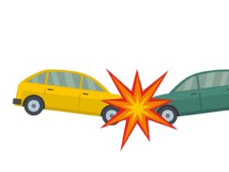
Problem definition
India, a country of a huge population , faces a huge number of road accidents everyday. On an average 17 people die every hour due to a road accident. That’s a staggering amount!
Furthermore, the first responders to any road accident, especially in remote places are very few. Thus, people in an accident are incapable of reaching hospitals on time which plays dice with their lives.
We are planning to make an app to solve this problem and make a change.

Slide 4

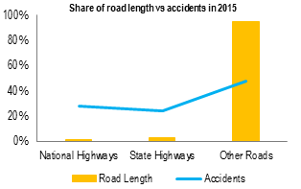
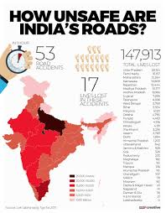
Statistics, numbers and figures
The Global status report on road safety 2013 estimates that more than 231,000 people are killed in road traffic crashes in India every year. Approximately half of all deaths on the country's roads are among vulnerable road users - motorcyclists, pedestrians and cyclists.
The three highest total number of fatalities were reported in Uttar Pradesh, Maharashtra and Tamil Nadu, and together they accounted for about 33% of total Indian traffic fatalities in 2015.^{[2]} India faces about 53 road accidents every hour . We plan to reduce this amount and optimize it.

Slide 5
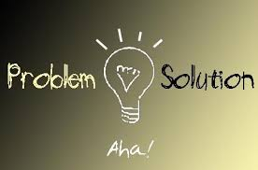
Proposed solution
Our team decided to make an application which tries to save the life of a person after an accident has occurred. Our application makes use of inbuilt sensors present in people’s phone’s, namely the accelerometer, the gyroscope and other sensors to detect a change in a specific value called the G-Force. Whenever an accident occurs, there is an abnormal increase in the G-Force which can be detected by the accelerometer. We planned to integrate this with the message sending platform to contact the either the nearest hospital, police station or blood bank, also providing the location of the occurred accident.

Slide 6
Expected impact
We hope that our application will be scaled up to make road safety aware to everyone and help those who are affected in an accident to reach a hospital on time to receive proper treatment and live a happy life.
We also hope that everyone becomes aware of our app and uses it to their fullest so that they can their lives become safer.
“God does not play dice with the universe” and our app helps to hold up this ideal by giving the affected another chance at life.

Slide 7


Steps of implementation
We plan to launch this app on Play store to make it available to all android users.
Furthermore, we plan to implement this in Xcode so that it becomes available to iOS users as well.
We are going to spread awareness on road safety as well as our app by giving away posters and brochures to people of our locality. We will also put ads of our app on social media platforms such as Facebook, Whatsapp and Instagram to spread knowledge to one and all.

Slide 8

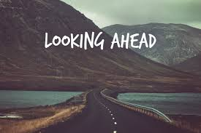
Future goals
We plan to make more and more applications such as this one to improve not only road safety but also provide digital solutions to many more problems which the country is facing such as erratic electricity, educated unemployment, skill formation, improving literacy and many more fields.
We also are looking forward to more Hackathons conducted by many organizations to improve our own skills as well.

Slide 9
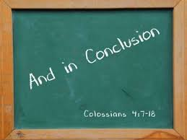
Conclusion
In conclusion, we would like to thank TOYOTA for conducting this wonderful Hackathon to promote Road Safety. Also, we would like to thank RV College , Bengaluru for organizing this amazing initiative. I would request Toyota to conduct more such awareness spreading, digital solution providing events.
Also , I wish that this is taken to next level by conducting it on the international level and spread awareness to all people.

Slide 10
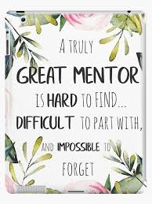
I would thank you all from the bottom of my heart but for you all , my heart has no bottom!
Krishnamurari.C
Navneet N

