Slide 1
Quora Question Pairs Detection
Aman Arya (B00816348) and Navneet Singh (B00810744)

Slide 2
What is our Project about?
Kaggle Challenge
1
Corpus Provided by Quora
2
Aim
3
Technology Used
4
Approaches Taken
5
Results Obtained
6

Slide 3

Question pairs
1
What are some of the tips for investing in stock market?
2
What are some of the tips for investing in stock market?
Same → Question Pair

Slide 4
Question pairs
1
What are some of the tips for investing in stock market?
2
I need some help investing in the stock market.
Similar → Question Pair

Slide 5
Question pairs
1
What are some of the tips for investing in stock market?
2
How is the weather outside?
Dissimilar → Not a Question Pair

Slide 6
Question pairs
1
What are some of the tips for investing in stock market?
2
What are some of the tips for investing in stock market in Westeros?
Similar → Not a Question Pair

Slide 7
Cosine Similarity Model
Cosine Similarity
4–Step Process
Clean Corpus
1
Creating TF-IDF
2
Apply Cosine Similarity Algorithm
3
Confusion Matrix
4

Slide 8
Cosine Similarity
1
Cleaning Data Set
Removing non-alphabets
Removing stop words
Stemming words
2
Creating TFIDF
Frequency of words in a document
Reduced Sparsity

Slide 9
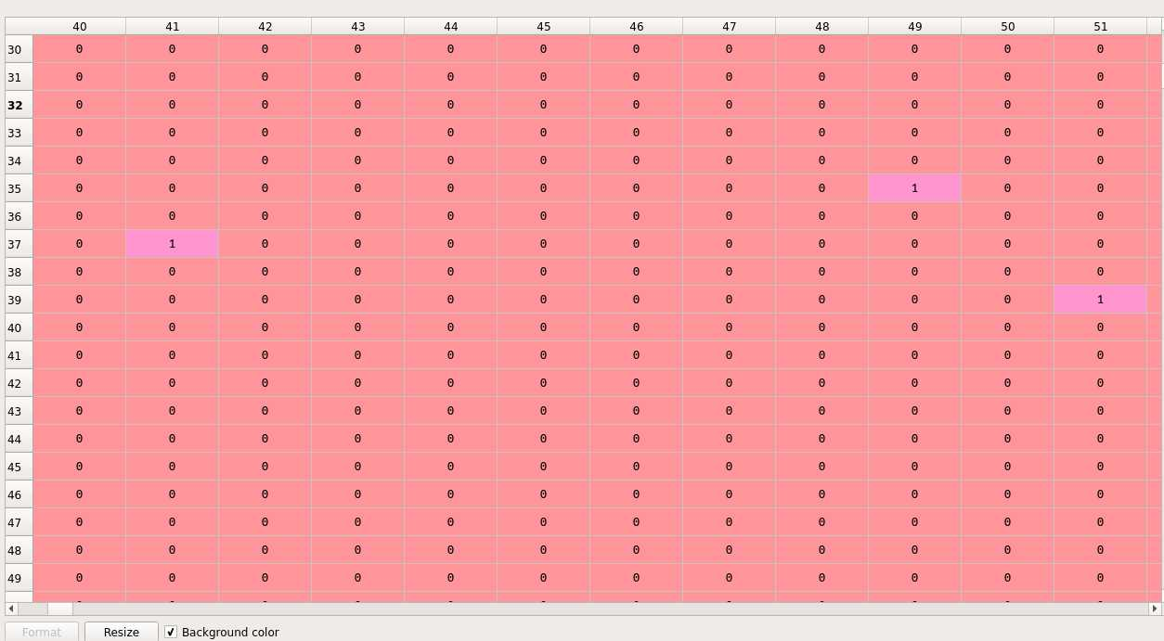
Cosine Similarity

Slide 10
Cosine Similarity
3
Calculate Cosine Similarity
Passed Two Documents/List of Sentences
Formulae: Cosine Similarity (d1, d2) = Dot product(d1, d2) / ||d1|| * ||d2||
Values ranged between 0 to 1, threshold of 0.6

Slide 11
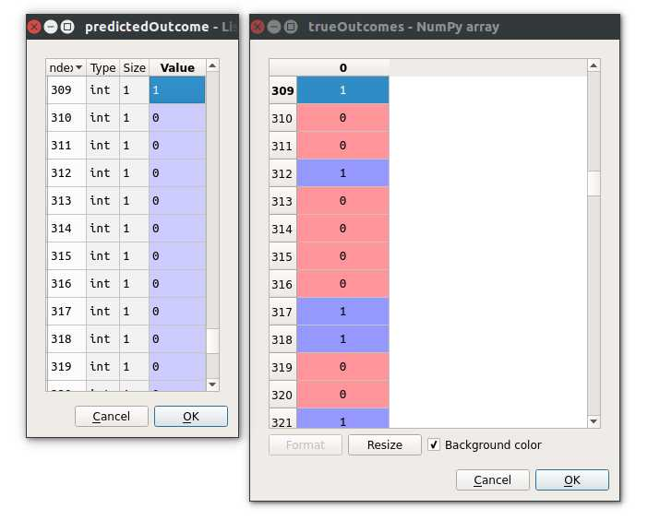
Predicted Outcomes vs True Outcomes

Slide 12
Confusion Matrix for Cosine Similarity
5
Confusion Matrix
Matrix created using calculated values and actual values
 | No | Yes
No | 615 | 377
Yes | 4 | 3

Slide 13
Machine Learning Method
Naïve Bayes Classifier
3–Step Process
Combine dataset
1
Combine the data into a single column for the classifier

Slide 14
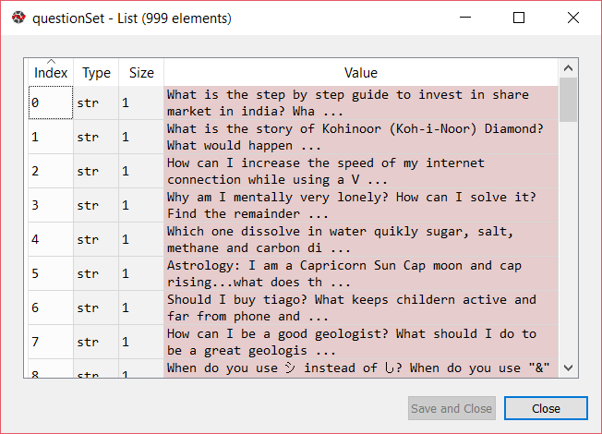
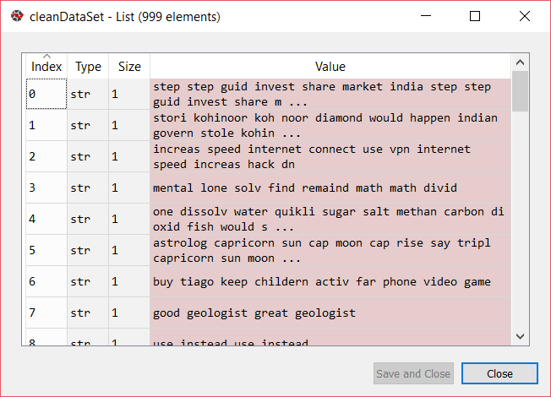
Naïve Bayes Classifier
Cleaning Data Set
Removing non-alphabets
Removing stop words
Stemming words
2

Slide 15
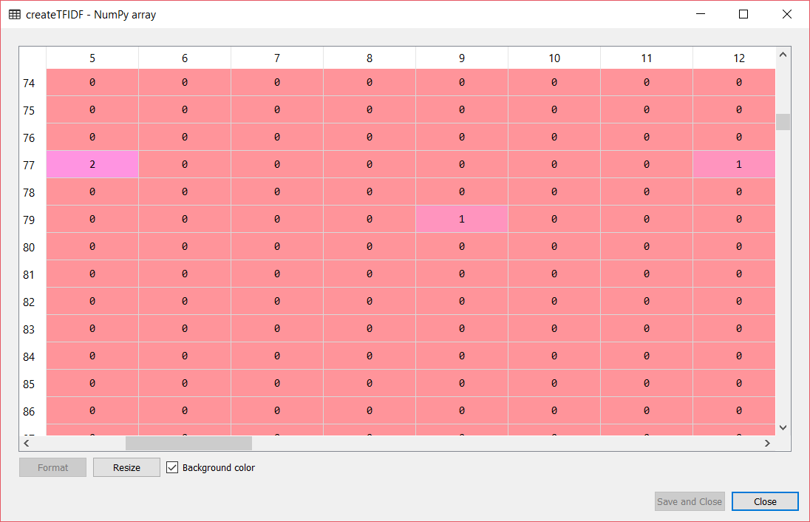
Naïve Bayes Classifier
Creating TFIDF
Frequency of words in a document
Reduced Sparsity
3

Slide 16
Naïve Bayes Classifier
The Algorithm
Split the data into training and test datasets
Apply standard scalar
Train the Gaussian Naïve Bayes Classifier
Predict and test
1
2
3
4

Slide 17
Naïve Bayes Classifier
Results
Accuracy = 67%
Confusion Matrix with test data:
 |  | Actual
 |  | No | Yes
Predicted | No | 55 | 7
 | Yes | 26 | 12

Slide 18
Conclusion and Future Work
Detailed Results
What do they mean?
What more can be done?
Applications

Slide 19
Detailed Results
 | Cosine Similarity | Naïve Bayes
Accuracy | 62% | 67%
F-measure | 0.02 | 0.42
Precision | 0.43 | 0.32
Recall | 0.008 | 0.63
Fallout | 0.57 | 0.68
Specificity | 0.43 | 0.32
Notes:
Talk f measure, accuracy and recall

Slide 20
Detailed Results
Cosine Similarity
Threshold | Accuracy | Precision | Recall | F-measure
0.8 | 61.9% | 0 | 0 | 0
0.6 | 61.9% | 0.5 | 0.003 | 0.006
0.4 | 61.9% | 0.5 | 0.005 | 0.01
0.3 | 61.8% | 0.43 | 0.008 | 0.02
0.2 | 60.8% | 0.26 | 0.016 | 0.03

Slide 21
Detailed Results
Naïve Bayes Classifier
Train Set | Accuracy | Precision | Recall | F-measure
70% | 62.7% | 0.22 | 0.47 | 0.3
80% | 63.5% | 0.24 | 0.49 | 0.32
85% | 65.3% | 0.27 | 0.5 | 0.35
90% | 67% | 0.32 | 0.63 | 0.42
95% | 72% | 0.45 | 0.75 | 0.56

Slide 22
Future Work
Better dataset
Expanded dataset [1]
Modify authorship attribution algorithm and use it [2]
Other machine learning classifiers
Deep learning and neural networks
Weighted combination of various methods

Slide 23
Why is this project useful?
Duplicate Support Ticket detection
Plagiarism detection
Similar content suggestions

Slide 24
Thank You

Slide 25
References
[1]D. Bogdanova, C. dos Santos, L. Barbosa and B. Zadrozn, "Detecting Semantically Equivalent Questions in Online User Forums", in Proceedings of the 19th Conference on Computational Language Learning, Beijing, China, 2015, pp. 123-131.
[2]M. Jankowska, E. Milios and V. Keselj, "Author Verification Using Common N-Gram Profiles of Text Documents", in Proceedings of COLING 2014, the 25th International Conference on Computational Linguistics: Technical Papers, Dublin, Ireland, 2014, pp. 387-397.

