Slide 1


SMART INDIA HACKATHON 2024
TITLE PAGE
Problem Statement ID –1606
Problem Statement Title- Micro-Doppler based Target Classification
Theme-Robotics and Drones
PS Category- Software
Team ID-
Team Name (Registered on portal)-Voltrons

Slide 2

IDEA TITLE
Proposed Solution :
Easy to use surveillance system against threats related to misuse of drones.
MATLAB and Deep learning based UI solution that classifies drones and birds accurately.
Convenient and user-friendly IoT based web application that addresses many social issues.
Addressing the Problem
Bird and Drone Classification : By focusing on the motion of wings and propellers, our system overcomes the limitations of traditional radar systems that rely on Radar Cross Section (RCS).
Multi-drone Classification : The system also identifies different types of drones based on their rotor signatures, addressing security concerns in high-risk areas.
Innovation and Uniqueness
Dual-Frequency Approach Combines both high-resolution W-band and cost-effective K-band radar systems for optimal performance.
Micro-Doppler Signature : Use of real-time micro-Doppler signature extraction for dynamic classification.

Slide 3
TECHNICAL APPROACH
TECHNOLOGY STACK
Backend : Python3(NumPy, SciPy, Matplotlib)
Deep Learning Libraries(TensorFlow2, PyTorch)
Frontend/UI : HTML5, Tailwind CSS, React.js, MongoDB
Figma(UI),
Hugging Face(AI Chatbot)
Data Analysis : ThingSpeak(IoT),
Google Colab,
MATLAB Analytics,
Flutter
Workflow
User login and authorization on web application
Radar data retrieval through IoT
Analysis of received data using MATLAB analytics
Classification of object as drone or bird using micro-doppler spectrogram
Risk analysis and security threat assessment using trained Deep learning model
Result display on UI (In case of risk alert is sent through notification)

Slide 4
FEASIBILITY AND VIABILITY
Challenges/Risks
Danger for Ecosystem(e.g. Birds, etc.)
Privacy Invasion
Foreign Intrusions
Strategies
Increased Accuracy
Alert System
Detailed Risk Assessment
Feasibility
Interactive
And
User-Friendly
Accessible
Optimisation

Slide 5
IMPACT AND BENEFITS
Impact
Enhanced Security
Awareness
Area Denial
Benefits
Rapid UAVs detection near critical infrastructure
Deterrence against foreign intrusions
Assistance in wildlife monitoring

Slide 6
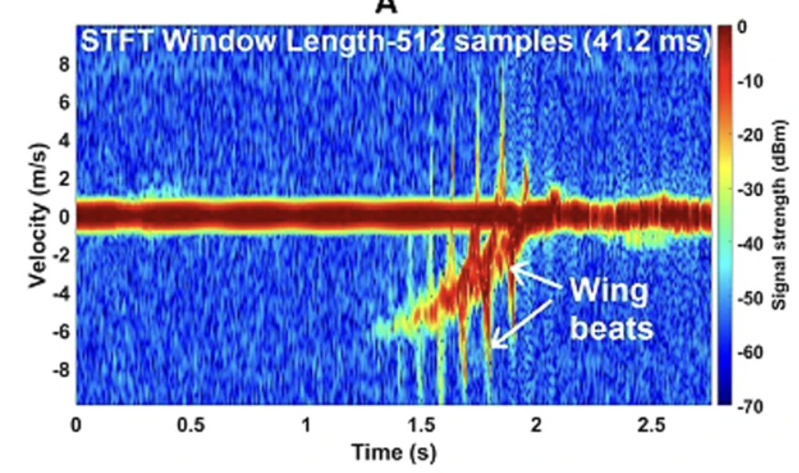
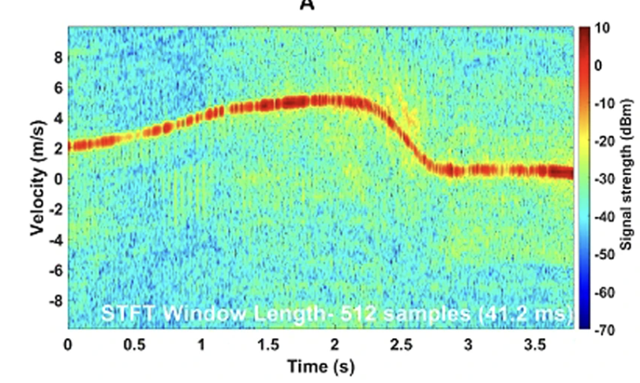
RESEARCH AND REFERENCES
References:
[1] Rahman, S. and Robertson, D.A., 2018. Radar micro-Doppler signatures of drones and birds at K-band and W-band. Scientific reports, 8(1), p.17396.
[2] https://in.mathworks.com/help/radar/ug/introduction-to-micro-doppler-effects.html
[3] Dai, T., Mei, L., Zhang, Y., Tian, B., Guo, R., Wang, T., Du, S. and Xu, S., 2023. UAVs and birds classification using robust coordinate attention synergy residual split-attention network based on micro-Doppler signature measurement by using L-band staring radar. Measurement, 222, p.113692.
[4] Sun, Y., Abeywickrama, S., Jayasinghe, L., Yuen, C., Chen, J. and Zhang, M., 2020. Micro-Doppler signature-based detection, classification, and localization of small UAV with long short-term memory neural network. IEEE Transactions on Geoscience and Remote Sensing, 59(8), pp.6285-6300.
Spectrogram of Hawk Owl (bird) approaching the perch at 30 m away from the radar at 94 GHz, exhibiting wing beats.
Spectrogram of a flying DJI Inspire 1 (drone) at ~85 m range at 94 GHz

