Slide 1
Data Management 2 Exploring Spotify Music Trends
Navneeth Krishna Aravind

Slide 2

Introduction to the data: Spotify
Spotify is one of the world’s leading music streaming platforms, offering millions of tracks across various genres, artists, and labels. It provides rich metadata around songs, which makes it ideal for music trend analysis.

Slide 3
Introduction to the Data Source
Data Source: Spotify API V1
Purpose: Transform and analyze Spotify track data to uncover trends in listener behavior and support data-driven music strategy.
Playlist : Most played songs 2025
Playlist Endpoint :/playlists/{playlist_id}
Track
Track Name, Track Number, Track Duration(ms) , Popularity, Disc Number…
Endpoint
/tracks/{id}
Artist
Artist URI, Artist Name, Artist Genre
Endpoint
artists/{id}
Album
Album Name, Album URI, Label, Copyright
Endpoint
albums/{id}
Data Storage : Google Cloud Storage (GCS)
Format : JSON

Slide 4
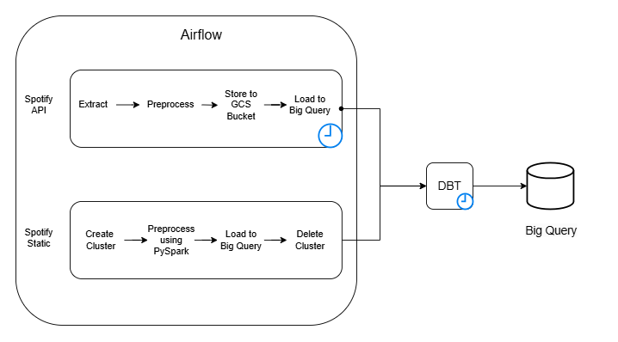
Architechture

Slide 5
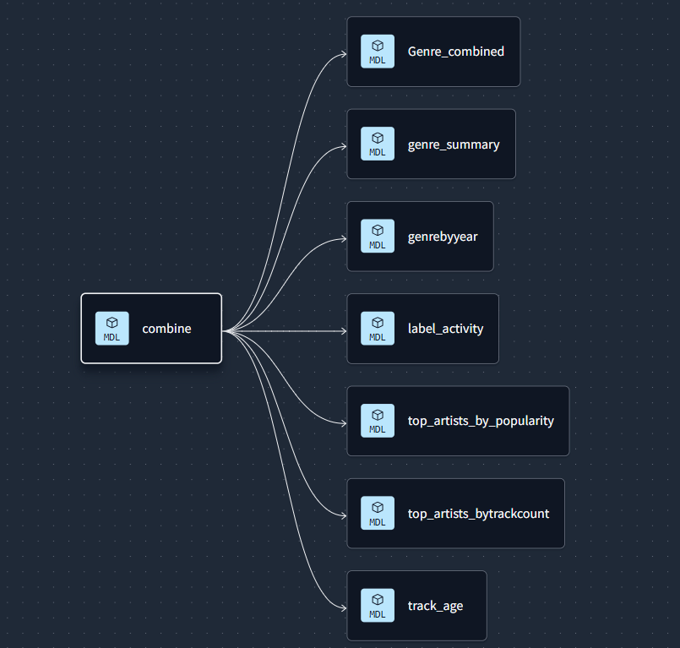
Lineage

Slide 6
Challenges
Installation of Airflow
Was not able to install Airflow , getting not compatible error in my system
Solution: Used Docker for ubuntu machine(virtual).
Implementation of DAG’s
Faced difficulties in setting up DAG’s for each pipeline, not knowing which operators and functions to use.
Solution: Found Documentations from Airflow
Datatype Definition
Encountered difficulties in loading and configuring static data to big query post preprocessing as all the data points were of type string and not able to use it in dbt to join the data.
Solution: Have defined the data type for each data point.

Slide 7
User Story
As a music data analyst, I want to transform and analyze Spotify track data to uncover key trends and patterns in listener behavior, enabling better-informed strategic decisions.

Slide 8
Demo

Slide 9
References
https://airflow.apache.org/docs/apache-airflow-providers-google/stable/_api/airflow/providers/google/cloud/transfers/gcs_to_bigquery/index.html
https://airflow.apache.org/docs/apache-airflow-providers-google/stable/_api/airflow/providers/google/cloud/hooks/gcs/index.html
https://airflow.apache.org/docs/apache-airflow-providers-google/stable/operators/cloud/dataproc.html

Slide 10
Thank You.

