Slide 1
Design of Energy Efficient Ternary Logic Circuit Using GNRFETs
K Navneeth - 231010225
Pithani Balasai Narasimha - 231010235
Project Guide:
Manoj Kumar Majumdar
Date:- 28/04/26
International Institute of Information Technology, Naya Raipur

Slide 2
Introduction
Conventional digital systems operate using binary logic (0,1) corresponding to two voltage states.
So if we want to represent no. 8 in binary it becomes 1000 (four digits) or 255 in binary is 11111111 (eight digits).
As computational complexity increases so we need to represent more bigger numbers which cause Binary Logic Implementation Challenges.
Ternary Logic:
Ternary logic introduces three logic levels (0,1,2),
0 → Low 1 → Mid(VDD/2)
2 → High (VDD)
In this logic each “trit” store log₂(3) ≈ 1.585 bits of information, which means a 32-bit binary word can be represented using only ~21 ternary digits.
So here the information density is more results in conventional reduction of complexities with increase in computation.
International Institute of Information Technology, Naya Raipur

Slide 3
Problem Statement
A binary transistor is a switch ON or OFF, but a ternary circuit is a “multi-threshold circuit” , transistors that turn ON at different voltages so you can create three distinct logic levels.
Standard CMOS can’t be used for multi-threshold circuit.
Issues with CMOS :
CMOS Body biasing (Fabrication)
CMOS scaling challenges: High leakage current, Power density issues, etc.
So this resulted in need for CNTFETs and GNRFETs.
28/04/26
International Institute of Information Technology, Naya Raipur
3

Slide 4
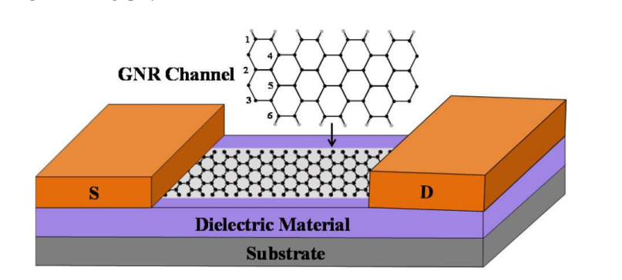
Introduction to GNRFET
CNTFET and GNRFET operate on the same multi-threshold principle, hence both are suitable for ternary logic implementation.
GNRFET offers superior material properties compared to CNTFETs:
Fracture strength
Carrier mobility
Thermal conductivity
Better fabrication
Better than CNTFET due to:
Smooth edges
Fewer defects, resulting in more reliable threshold voltage generation.
Graphene nanoribbons are naturally planar, making them more compatible with lithography, CMOS-style flat fabrication.
Fig 1: Graphene
28/04/26
International Institute of Information Technology, Naya Raipur

Slide 5
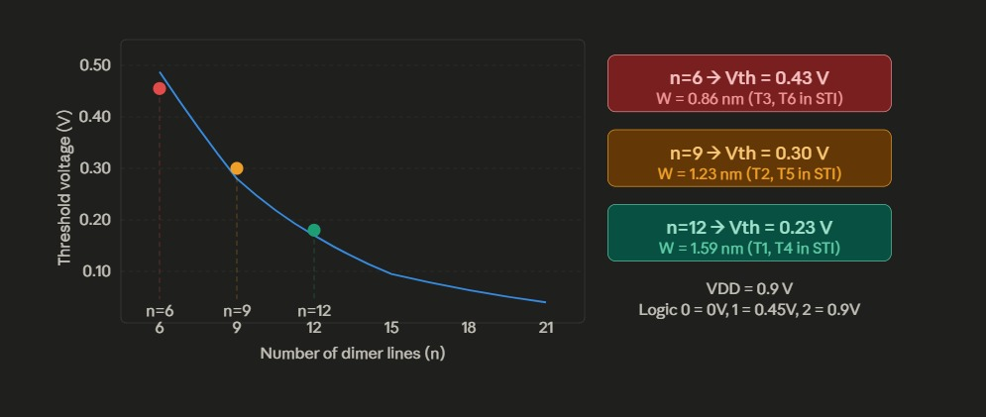
GNRFET Structure
GNRFET = Graphene Nanoribbon Field Effect Transistor
Based on graphene (2D carbon structure)
single layer of carbon atoms packed in a 2D honeycomb lattice.
n-channel GNRFET → doped with donors.
p-channel GNRFET → doped with acceptors.
Channel → undoped graphene
Threshold voltage can be changed by changing the dimer lines.
Key Equations
Threshold Voltage | Vth = Eg / 3e
Bandgap | Eg = 2|α|ΔE
Energy diff. | ΔE = ℏvfπ / W
GNR Width | W = (n+1)·(√3/2)·a
Dimer Lines → Threshold Voltage
Dimer Lines (n) | Width (nm) | Vth (V)
6 | 0.86 | 0.43
9 | 1.23 | 0.30
12 | 1.59 | 0.23
28/04/26
International Institute of Information Technology, Naya Raipur

Slide 6
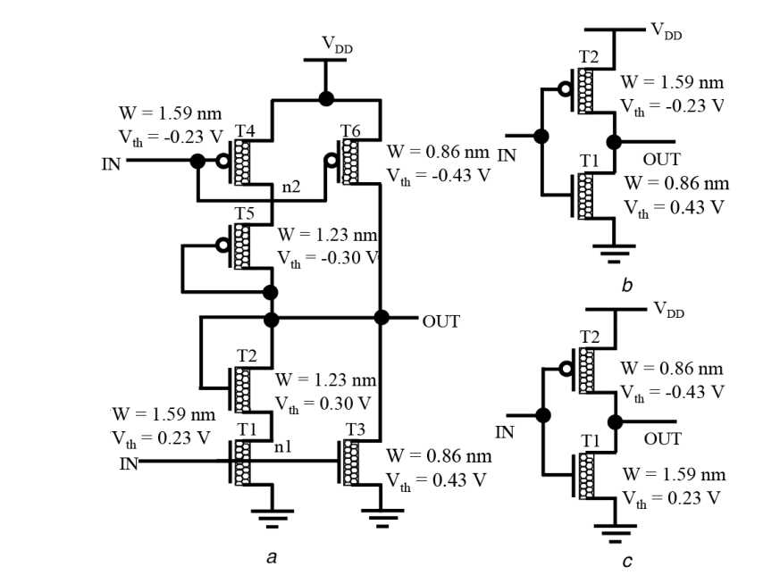
Types of Ternary Inverters
STI — Standard
IN=0→OUT=2
IN=1→OUT=1
IN=2→OUT=0
6 transistors (n=6,9,12), Diode-connected T2 & T4 create the stable 0.45 V midpoint, full 3-level inversion.
PTI — Positive
IN=0→OUT=2
IN=1→OUT=2
IN=2→OUT=0
2 transistors, NMOS n=6 (Vth=0.43V) + PMOS n=12 (Vth=0.23V).
NTI — Negative
IN=0→OUT=2
IN=1→OUT=0
IN=2→OUT=0
2 transistors, NMOS n=12 (Vth=0.23V + PMOS n=6 (Vth=0.43V).
Fig 2: Ternary Inverters
28/04/26
International Institute of Information Technology, Naya Raipur

Slide 7
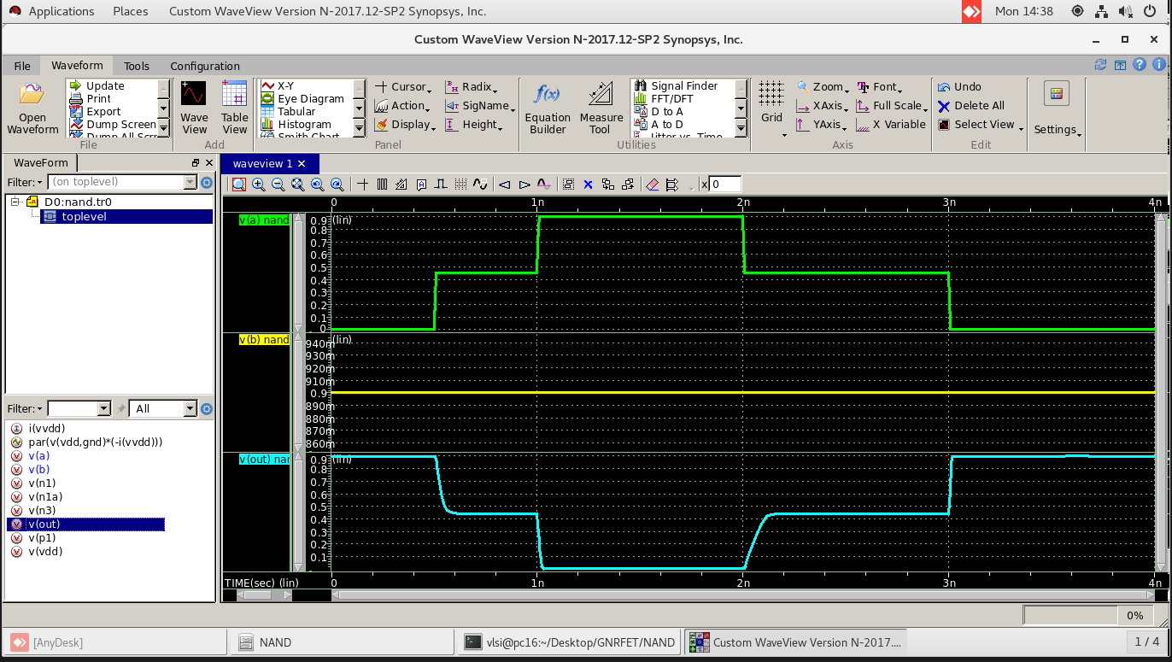
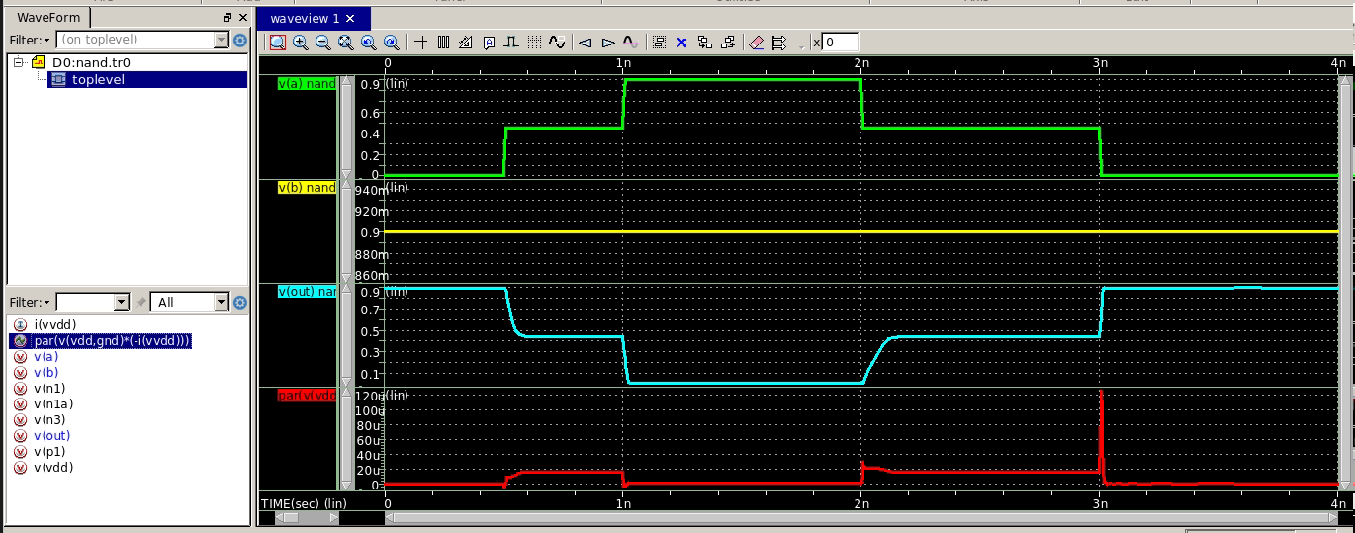
Ternary NAND & NOR
Ternary NAND Gate: STI(min(A,B))
10 transistors, 3 width types (n=6, 9, 12)
NMOS network: SERIES (both inputs high → pull down)
PMOS network: PARALLEL (either input low → pull up)
Diode T2 (NMOS n=9) + T4 (PMOS n=9) create Logic 1 midpoint
Ternary NOR GATE : STI(max(A,B))
10 transistors — exact dual of NAND topology
NMOS network: PARALLEL (either input high → pull down)
PMOS network: SERIES (both inputs low → pull up)
Same diode midpoint structure for Logic 1 stability
Fig 3: Ternary NAND
Fig 4: Ternary NOR
28/04/26
International Institute of Information Technology, Naya Raipur

Slide 8
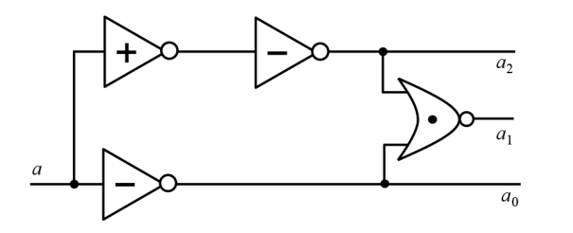
Ternary Decoder and Half Adder
Ternary Decoder
1 input → 3 outputs (a₀, a₁, a₂)
aₓ = 2 if input = x, else 0
Gate composition:
1× PTI (detects ≤ Logic 1)
1× NOR (isolates exactly Logic 1)
1× NTI (on PTI output → gives a₂)
1× NTI (on raw input → gives a₀)
Ternary Half Adder: Uses decoders + AND + OR gates
Sum = a₂b₀ + a₁b₁ + a₀b₂ + 1·(a₁b₀ + a₀b₁ + a₂b₂)
Carry = 1·(a₂b₁ + a₂b₂ + a₁b₂)
9 input combinations, verified against truth table
27 input combinations for full adder
Fig 5 : DECODER
28/04/26
International Institute of Information Technology, Naya Raipur

Slide 9
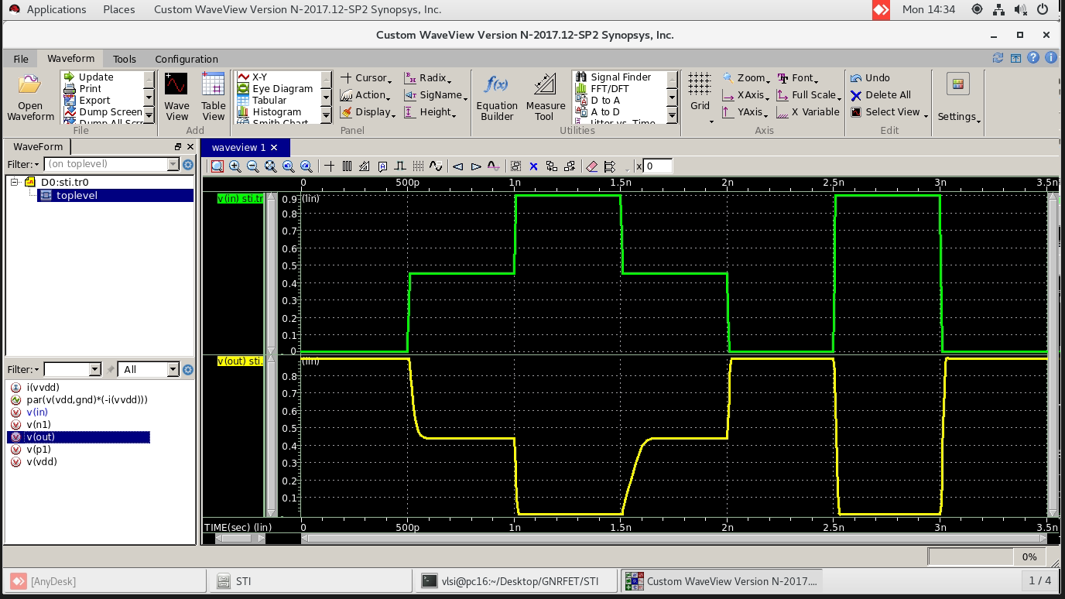
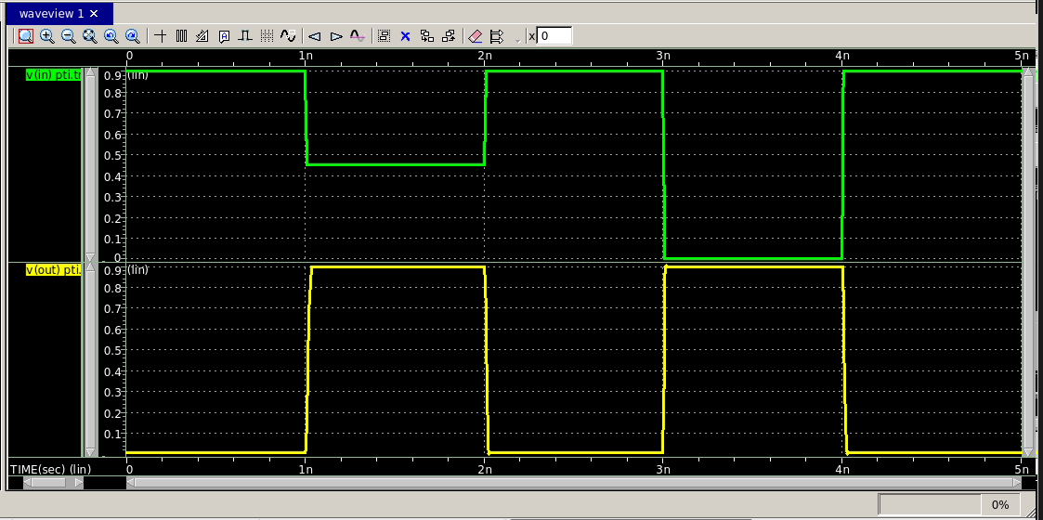
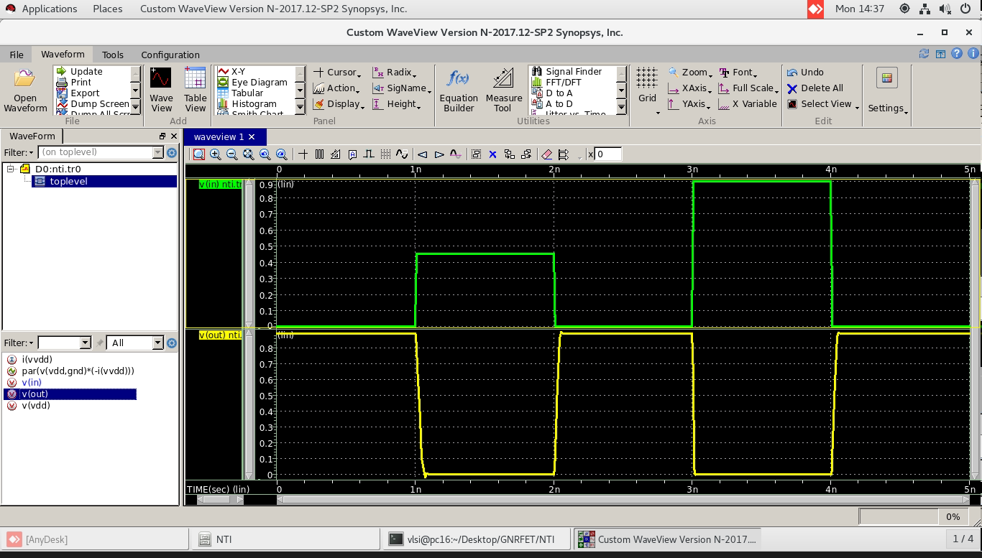
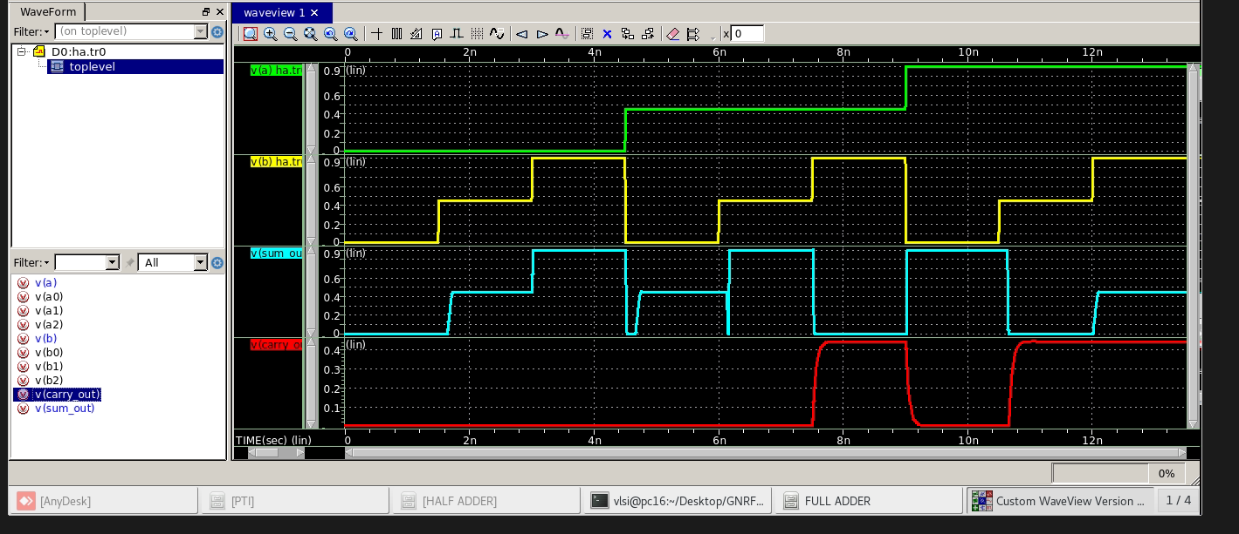
Simulation results
Fig 6(a): STI
Fig 6(b): PTI
Fig 6(c) : NTI
Fig 7: HALF ADDER
28/04/26
International Institute of Information Technology, Naya Raipur

Slide 10
Performance Analysis
Circuit | Paper Delay (ps) | Paper Power (µW) | Sim. Delay (ps) | Sim. Power (µW) | CNTFET Delay (ps) | CNTFET Power (µW)
STI | 15.88 | 6.163 | 16.09 | 5.961 | 27.10 | 5.700
PTI | 7.96 | 2.873 | 8.28 | 2.736 | 13.60 | 2.657
NTI | 15.90 | 3.261 | 16.29 | 3.149 | 27.18 | 3.018
TNAND | 19.94 | 6.643 | 20.29 | 6.504 | 34.10 | 6.144
TNOR | 20.17 | 6.701 | 20.64 | 6.556 | 34.50 | 6.201
International Institute of Information Technology, Naya Raipur

Slide 11
Performance Analysis
28/04/26
International Institute of Information Technology, Naya Raipur

Slide 12
Circuit Area Comparison
Circuit | GNRFET Area (m²) | CNTFET Area (m²)
STI | 2.35 × 10⁻¹⁶ | 6.85 × 10⁻¹⁶
PTI | 7.84 × 10⁻¹⁷ | 21.79 × 10⁻¹⁷
NTI | 7.84 × 10⁻¹⁷ | 21.79 × 10⁻¹⁷
Half Adder | 2.92 × 10⁻¹⁵ | 7.81 × 10⁻¹⁵
41.3% Lower Delay
64% Smaller Area
7.8% More Power
28/04/26
International Institute of Information Technology, Naya Raipur

Slide 13
Conclusion
Novel Design Methodology: Designed mentioned topologies for ternary logic gates (STI, PTI, NTI) and universal gates (NAND, NOR) using multi-threshold GNRFETs controlled by GNR width.
Fabrication Advantage : GNRFET's planar structure ensures CMOS-compatible fabrication, high tensile strength, and smooth edge quality.
Arithmetic Circuit Design : Ternary Logic based half adder and designed verified, foundational blocks for complex arithmetic circuits.
Performance Achievements : Results verified correct against truth tables and metrics measurements 41.3% lower propagation delay, 64% smaller circuit area vs CNTFET — with only a marginal 7.8% increase in power dissipation.
28/04/26
International Institute of Information Technology, Naya Raipur

