Slide 1




SMART INDIA HACKATHON 2026
TITLE PAGE
  Problem Statement ID – SIH26118
  Problem Statement Title - Passive Colorimetric H2S Exposure-Dosimeter Wristband with AI-Based Quantitative Reading
  Theme - Smart Automation
  PS Category - Hardware
  Team ID -
  Team Name - TRACE

Slide 2
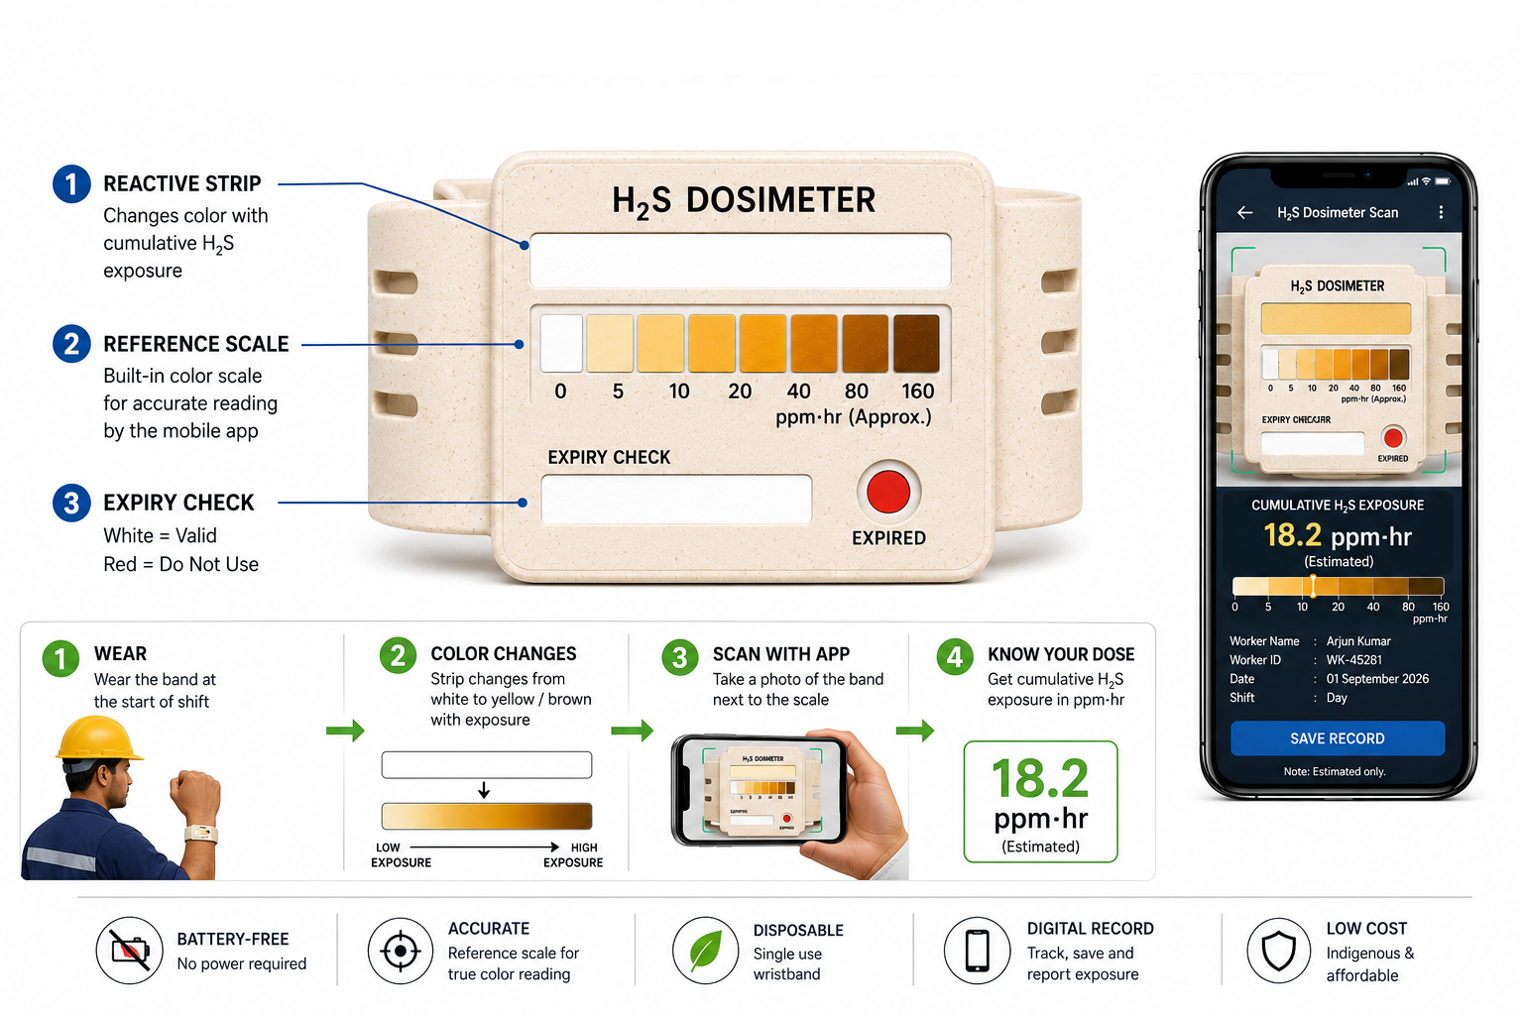
IDEA TITLE
TRACE
Notes:
2

Slide 3
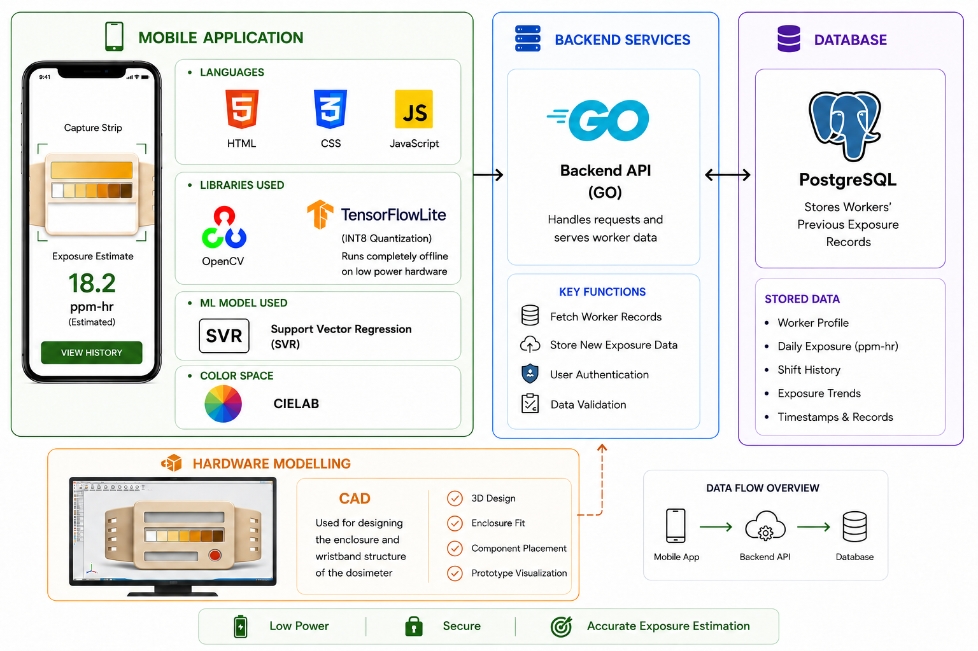
TECHNICAL APPROACH
TRACE
Notes:
3

Slide 4
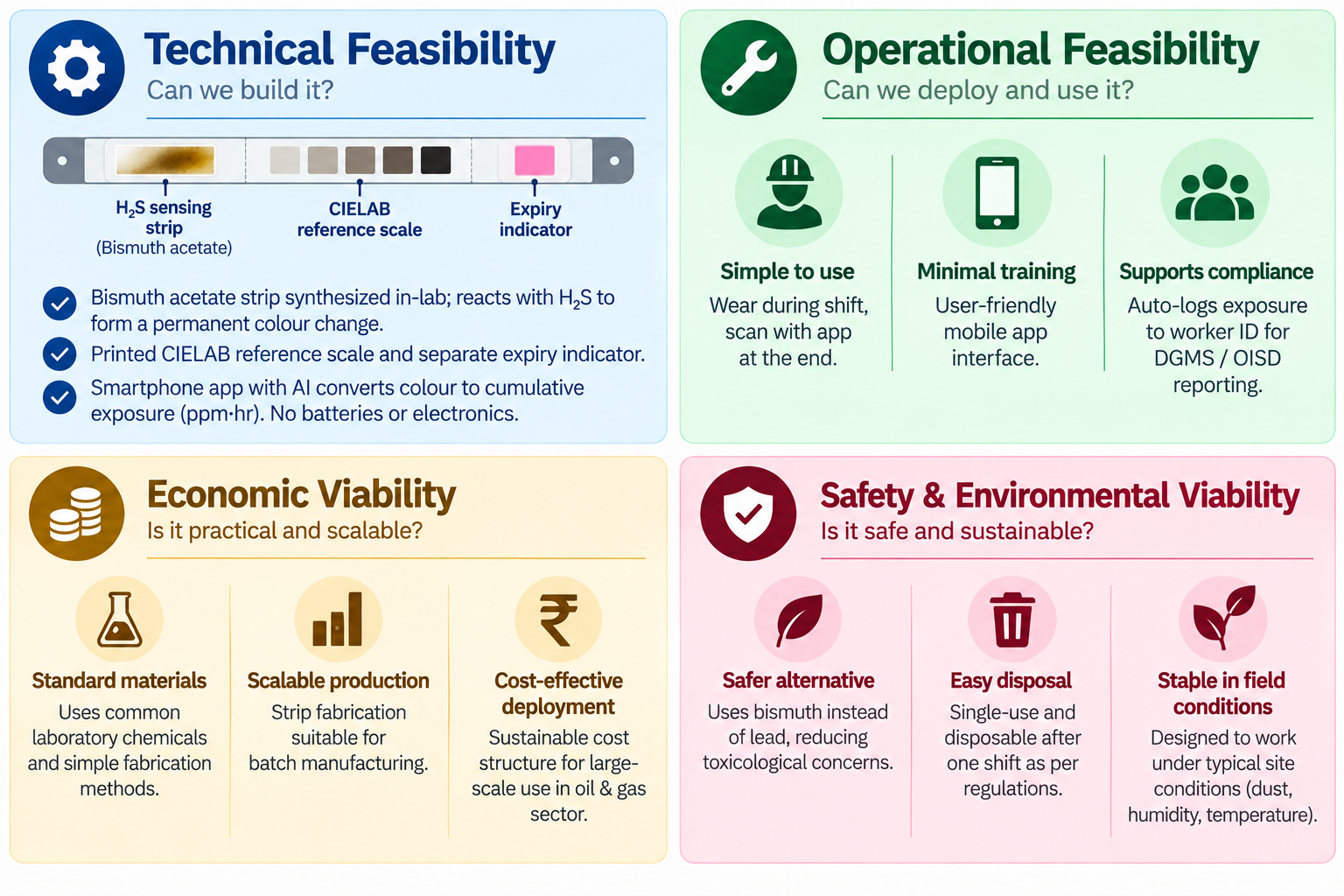
FEASIBILITY AND VIABILITY
TRACE
Notes:
4

Slide 5

IMPACT AND BENEFITS
TRACE
Notes:
5

Slide 6
RESEARCH AND REFERENCES
TRACE
Quantitative, colorimetric paper probe for hydrogen sulfide gas : https://www.sciencedirect.com/science/article/pii/S0925400517311334
Bismuth Paper as a Lead-Free Alternative to High-Throughput Colorimetric Detection Method for Hydrogen Sulfide: https://chemrxiv.org/doi/10.26434/chemrxiv-2025-1r058
Bismuth-Based, Disposable Sensor for the Detection of Hydrogen Sulfide Gas: https://pubs.acs.org/ancham/article-abstract/88/3/1553/847036/Bismuth-Based-Disposable-Sensor-for-the-Detection
Bi₂O₃ Nanoflakes and Nanosheets for Gas Sensing:
https://www.researchgate.net/publication/380729544_Gas_sensing_and_photocatalytic_activity_of_synthesized_hierarchical_Bi2O3_nanoflakes_by_sol-gel_and_nanosheets_by_hydrothermal_method
Notes:
6

