Slide 1

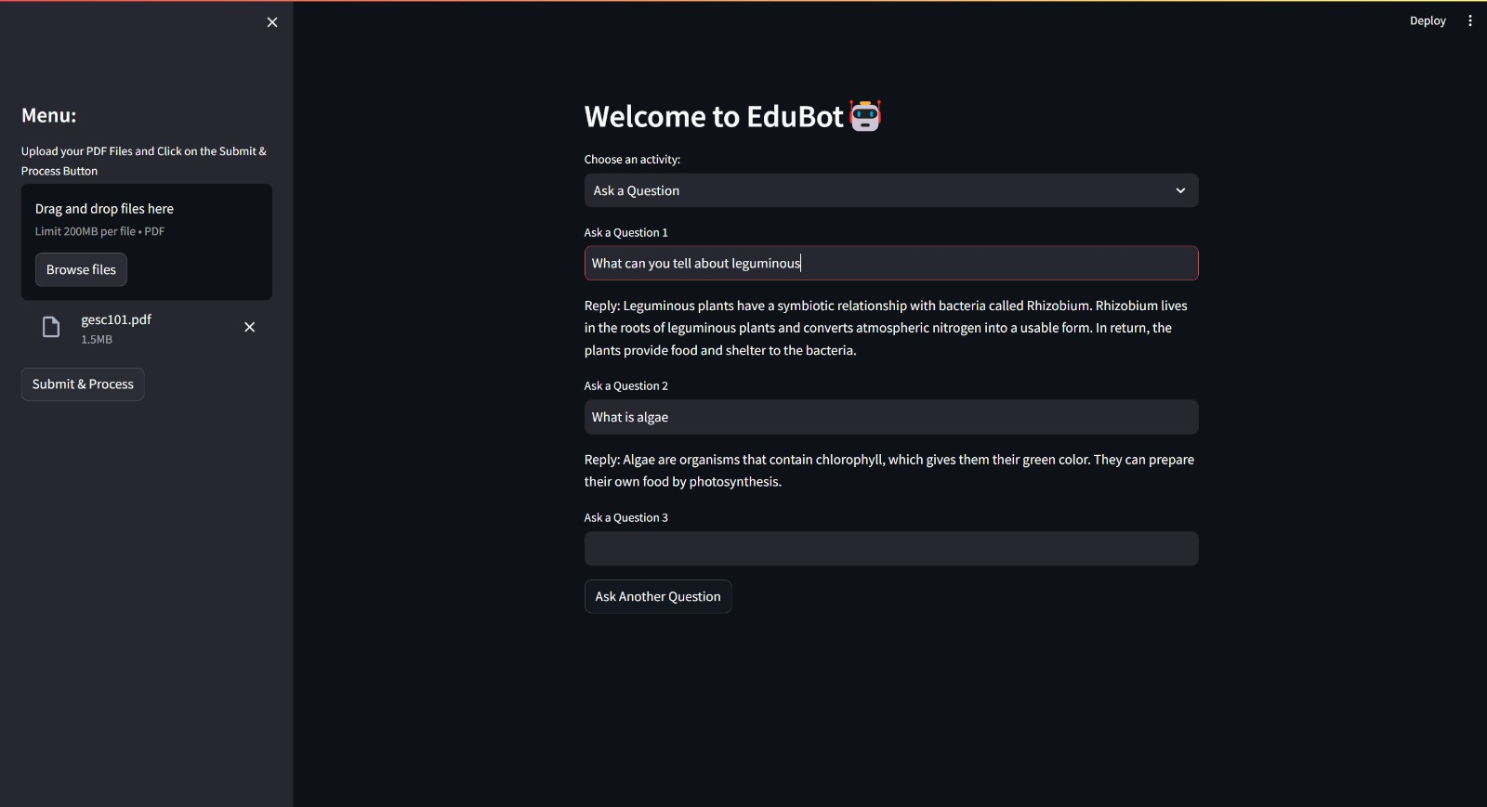
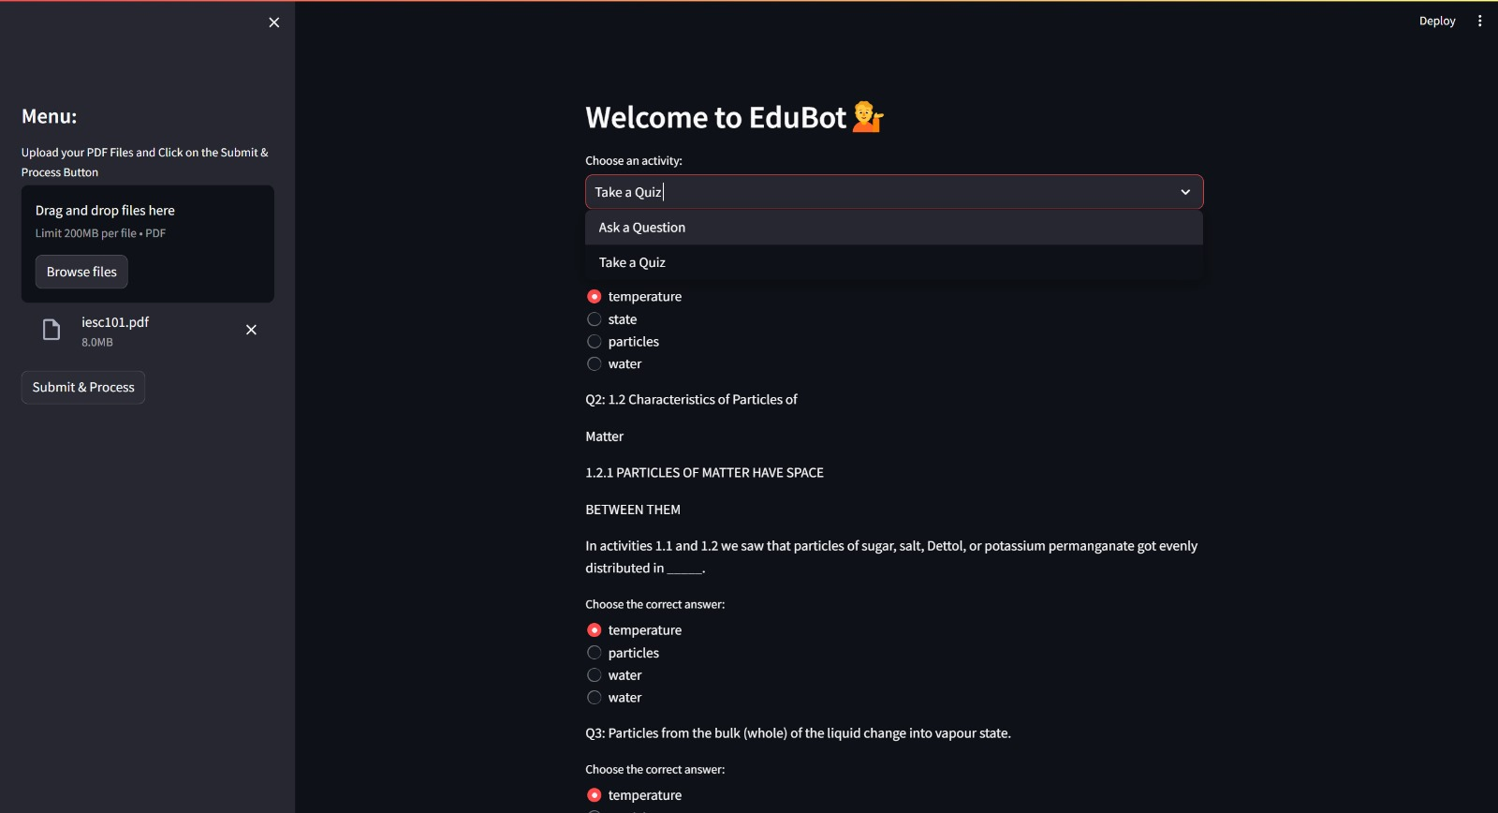
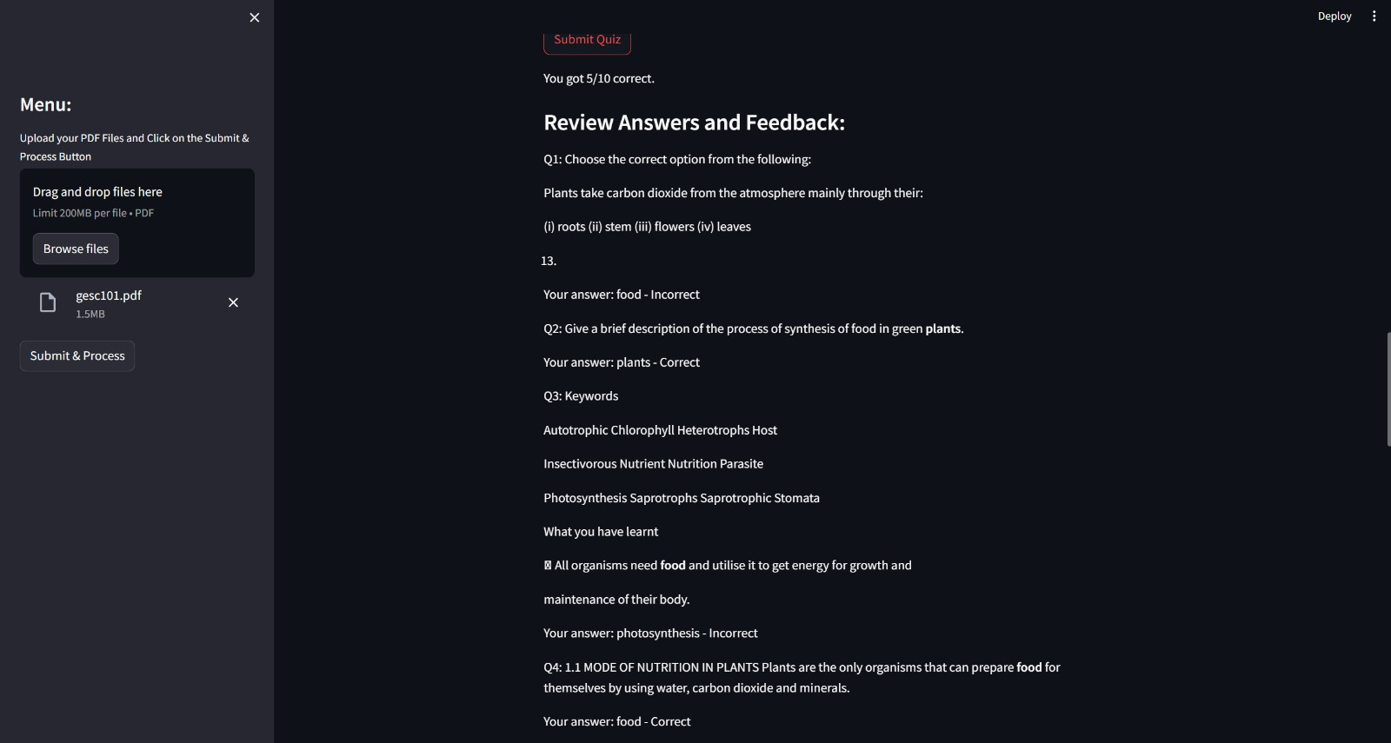
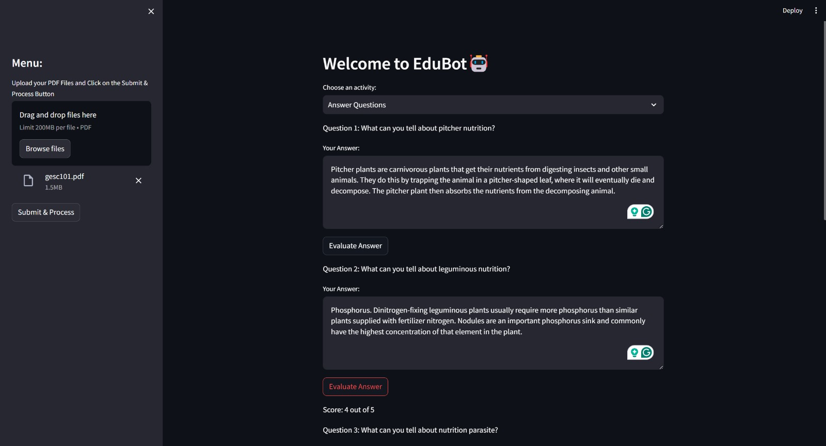
Educational Tutor for Students
Avyaya Chenna, Rajashekar Marri, E Navaneet Kumar, Asritha Oruganti
Business Intelligence & Analytics
Introduction
In today's fast-paced educational environment, students often face challenges in accessing personalized and timely academic support outside of traditional classroom hours.
In response to this, we aim to create a virtual educational tutor which would serve as a personalized and interactive companion for students, offering tailored guidance, explanations, and practice exercises enhancing their learning experiences and academic outcomes.
Results
We have created a system that is named EduBot.
It is personalized in a way that it can answer any type of questions asked from the input pdf provided and is capable of summarizing topics.
To make learning fun it generates quiz dynamically which includes 10 multiple-choice questions, reward them with scores(1pt each), also provides deeper insights on the wrong answered questions from both pdf and wikipedia.
It also provides an opportunity to answer 5 descriptive questions which are graded on scale of 0-5points.
Experiment
Data Source
User input(a pdf document which can be available
online).
Our virtual educational system works as a tutor for the students which can answer any kind of questions asked by the student from the input provided.
It can generate quiz, grades it and provides more info from the document and Wikipedia for the questions that were answered wrong.
It provides a window where student can answer descriptive questions which will also be evaluated.
Scope
This system is useful for students and instructors specifically or anyone who is interested to learn but needs help with.
Architectural Approach
Streamlit used as the framework for creating a user-friendly web interface.
LangChain leveraging capabilities for natural language processing (NLP) and conversational AI providing modules and tools for text analysis.
Google Generative AI Embeddings(Gemini Pro specifically) is used for generating text embeddings that capture the semantic meaning of the text.
FAISS is used for efficient indexing and similarity searches within large datasets of text embeddings.
FAISS and LangChain together can handle user queries(generate responses).
Conclusion
This cognitive learning platform marks a leap forward for science education up to the 10th grade. It offers clarity on complex topics and aids in mastering the curriculum by providing interactive and personalized feedback.
As a tool for both students and educators, it streamlines the learning and assessment process. Looking forward, the system's potential for expansion and adaptation promises to enhance the educational journey for users.
http://www.stevens.edu/school-business/masters-programs/business-intelligence-analytics

