Slide 1
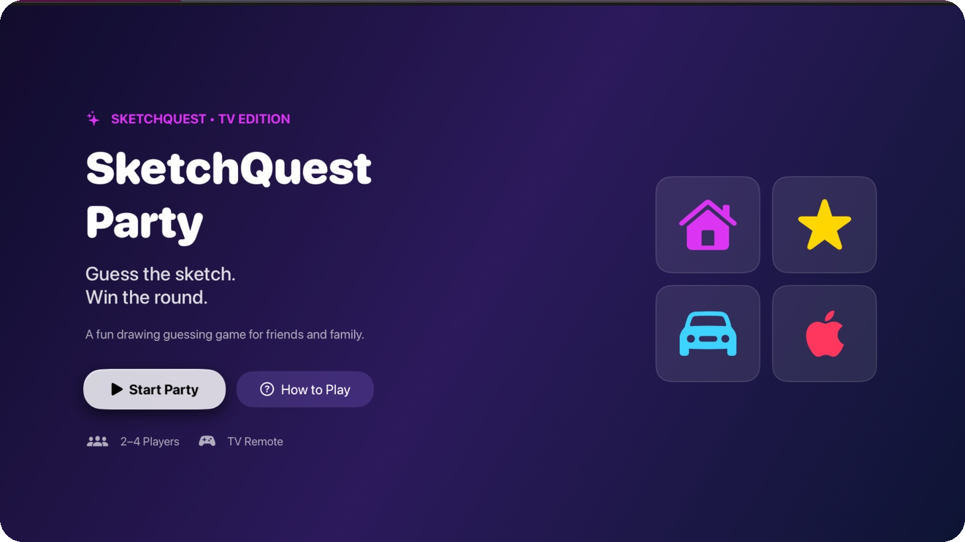
APPLE TV • SWIFTUI
SketchQuest
PARTY
One screen. One remote.
Everyone plays.
Local multiplayer sketch-guessing, designed for the living room.
LIVE PROTOTYPE • APPLE TV 4K SIMULATOR
2–4 PLAYERS
8 SKETCHES
3 ROUNDS EACH
SE4041 Mobile Application Design & Development • Assignment 02 / Part B
IT22214102
Notes:
Introduce SketchQuest Party as a functional tvOS prototype. The core idea is simple: a shared television, one input device, and quick sketch identification rounds for 2 to 4 players. The current prototype was tested in Apple TV Simulator.

Slide 2
01 / OPPORTUNITY
Party games can be easier to join.
A shared television already brings people together; the interaction should be just as simple.
THE FRICTION
OUR DIRECTION
Extra setup can
slow down play.
Sit down. Look up.
Start guessing.
Some drawing games rely on personal phones, browsers, drawing turns or text-entry.
One shared remote, clear vector drawings, quick choices and a visible scoreboard.
DESIGN GOAL: LOW-FRICTION LOCAL PLAY
SKETCHQUEST PARTY / SE4041 — PART B
02
Notes:
Frame this as the experience problem rather than a measured market statistic. Drawing games like Drawful 2 and browser games demonstrate the category, but SketchQuest Party deliberately simplifies participation to one shared device and a multiple-choice format.

Slide 3
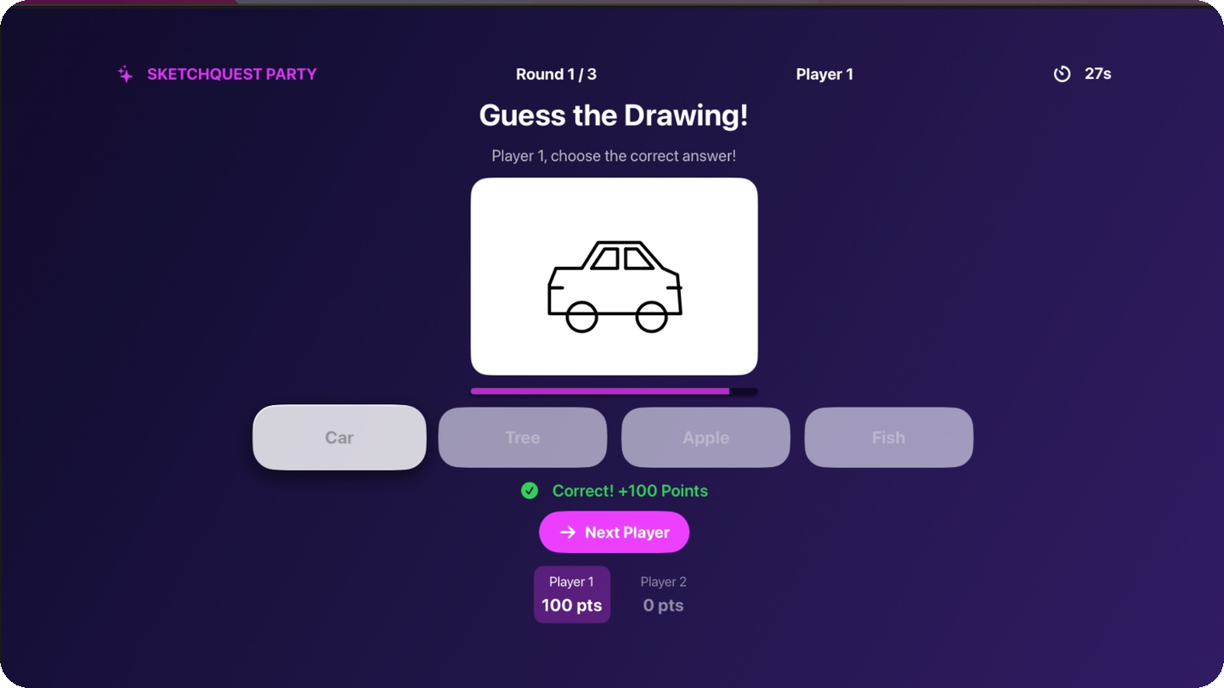
02 / THE SOLUTION
A sketch quiz built for the big screen.
Large visual prompts, four choices, turn-based fun — no drawing skills required.
LOOK
Clear, code-drawn artwork
GUESS
4 remote-selectable options
SCORE
Points + final ranking
SKETCHQUEST PARTY / SE4041 — PART B
03
Notes:
Show the actual prototype screenshot. The design uses eight original code-based vector sketch categories. Each question presents four possible answers and players earn 100 points for a correct guess.

Slide 4
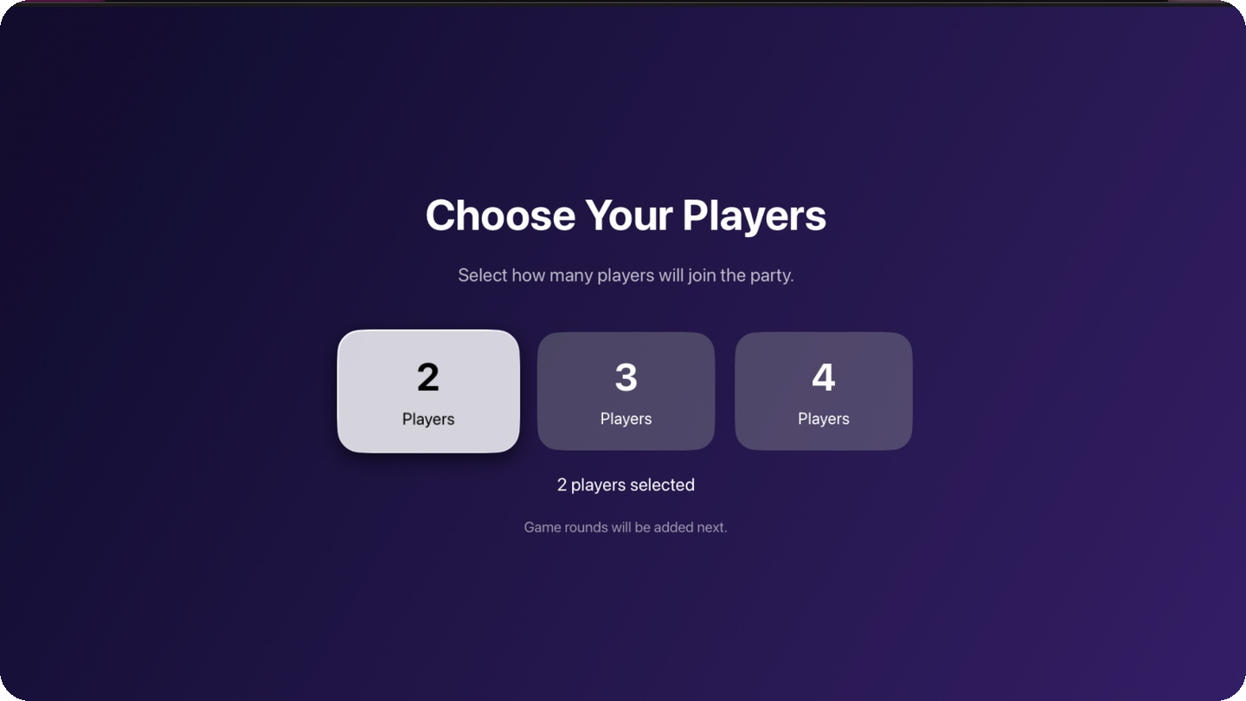
03 / PLAYER JOURNEY
From launch to first guess in three steps.
The entire flow is readable from a sofa and navigable with tvOS focus.
›
›
01
Start Party
02
Choose players
03
Guess a sketch
Choose the shared-screen game mode.
Set 2, 3 or 4 participants.
Answer before the 30-second timer ends.
SKETCHQUEST PARTY / SE4041 — PART B
04
Notes:
Walk through the live demo sequence: Home screen, player setup, ready prompt, and then a time-limited sketch question. This is a fully local, turn-based loop.

Slide 5
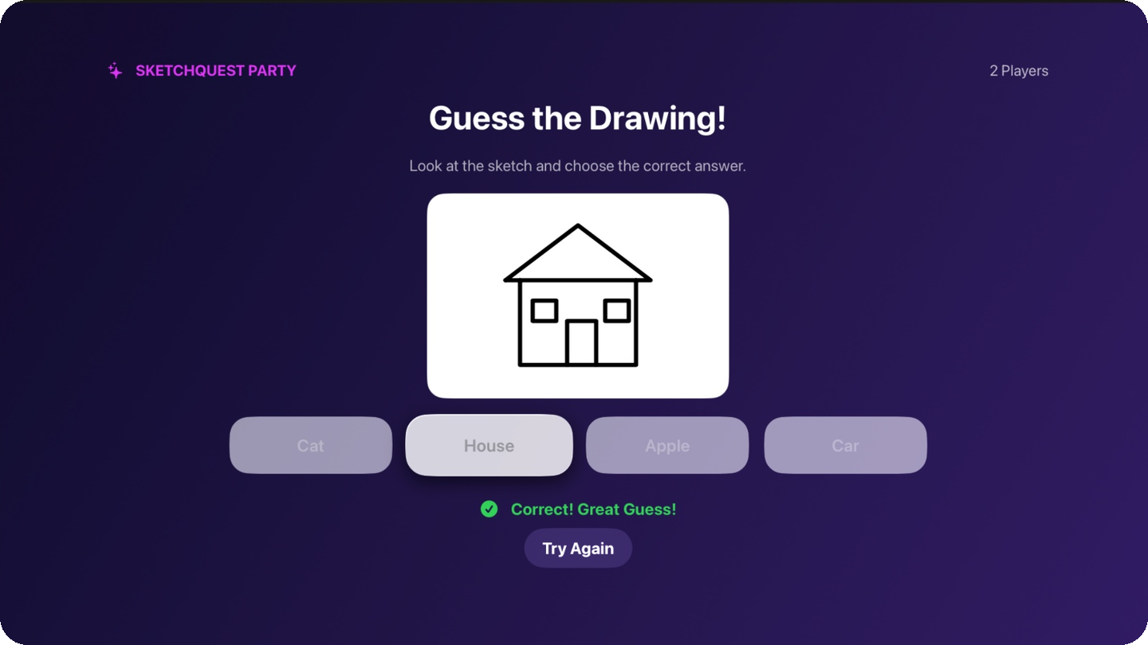
04 / GAMEPLAY
A repeatable loop with real stakes.
Every player gets three turns; each turn starts only when that player is ready.
30s
Count down
The clock starts on Start Turn.
4×
Choose an answer
One correct answer; three distractors.
+100
Earn the point
Correct answers update local scores.
Timeout or incorrect selection earns 0 points. Correct feedback is shown immediately.
SKETCHQUEST PARTY / SE4041 — PART B
05
Notes:
The ready screen avoids starting the 30-second timer while players pass the remote. Four randomized choices include the correct sketch label. Correct = 100 points; wrong/timeout = zero.

Slide 6
05 / BUILT FEATURES
Small rule set. Complete party loop.
What is implemented in the current, manually tested tvOS prototype.
02–04
08
03
30s
LOCAL PLAYERS
VECTOR SKETCHES
ROUNDS EACH
ANSWER TIMER
Turn-based sharing
No PNG dataset dependency
Fair turn allocation
Starts after Ready
04
100
AUTO
FINAL
ANSWER OPTIONS
POINTS / HIT
FOCUS CONTROL
LEADERBOARD
One correct choice
Immediate score update
Ready and Next Player
Winner / tie + replay
SKETCHQUEST PARTY / SE4041 — PART B
06
Notes:
Do not confuse the tvOS Part B prototype with the separate iOS Part A CNN. This tvOS app has no machine learning model. All eight sketches are drawn using SwiftUI Path and Shape.

Slide 7
06 / EXPERIENCE DESIGN
Designed for a 10-foot interface.
Readable typography, big targets and predictable focus movement.
1
TV-FIRST SCALE
Large labels and full-screen feedback
2
FOCUS-BASED INPUT
Arrow / remote selection supported
3
TURN HANDOFF
Ready screen prevents wasted time
4
CLARITY
Single question, four high-contrast choices
SKETCHQUEST PARTY / SE4041 — PART B
07
Notes:
Apple tvOS emphasizes focus navigation rather than direct touch. The prototype uses SwiftUI focus control to automatically focus the Next Player and Ready buttons as needed. Emphasize that we verified navigation in Apple TV Simulator.

Slide 8
07 / TECHNICAL IMPLEMENTATION
Simple state, clear responsibilities.
An event-driven SwiftUI flow with no backend or external assets required.
01
02
03
04
05
PLAYER SETUP
→
ROUND ENGINE
→
DRAWING VIEW
→
ANSWER LOGIC
→
RESULTS
ContentView
PartyGameView
SketchDrawingView
SketchCategory
Leaderboard
2–4 players
turns / timer / score
SwiftUI Path + Shape
random 4 options
winner / tie / replay
SwiftUI
Combine Timer
@State
@FocusState
Local-only game state
Scope note: This tvOS game uses rule-based quiz logic, not a Core ML image classifier.
SKETCHQUEST PARTY / SE4041 — PART B
08
Notes:
Explain the code structure: ContentView provides navigation and player selection. PartyGameView manages @State for game progress, timer, scoring and options. SketchDrawingView renders eight vector illustrations via Path/Shape, and @FocusState resolves remote navigation. No network service or machine learning model is used in Part B.

Slide 9
08 / EXISTING ALTERNATIVES
Different games. Different entry points.
SketchQuest Party positions itself as an approachable, shared-remote sketch quiz.
DRAWFUL 2
SKRIBBL.IO
SKETCHQUEST PARTY
Apple TV party title
Online browser game
This tvOS prototype
Player-created prompts
Player draws a word
Pre-drawn vector sketches
Phone / tablet input
Browser / text input
One shared TV remote
Drawing + decoy guessing
Live typed guesses
4-choice, timed quiz
POSITIONING: QUICK-GUESS, SHARED-SCREEN, NO PERSONAL DEVICE REQUIRED
Comparison sourced from Drawful 2 Apple TV listing and the official skribbl.io game description.
SKETCHQUEST PARTY / SE4041 — PART B
09
Notes:
Distinguish rather than claim these are identical. Drawful 2 is itself available for Apple TV but depends on player phones/tablets. skribbl.io is a free browser-based pictionary game where users draw and type guesses. SketchQuest Party uses ready-made sketches and a shared remote. Source 1: Apple App Store Drawful 2; Source 2: skribbl.io official site.

Slide 10
09 / TARGET USERS
Built around real-life group moments.
These are proposed early-adopter segments — not measured market-size claims.
01
02
03
FAMILIES
FRIEND GROUPS
STUDENT CLUBS
A quick living-room game
that everyone can follow.
Friendly head-to-head
rounds on one screen.
A simple icebreaker
for small-group events.
AT-HOME ENTERTAINMENT
CASUAL GAME NIGHTS
CAMPUS SOCIALS
PROPOSED EARLY ADOPTERS — TO BE VALIDATED WITH USER TESTING
SKETCHQUEST PARTY / SE4041 — PART B
10
Notes:
These three segments are strategic hypotheses. There are no survey results, revenue numbers, or download statistics associated with this prototype.

Slide 11
10 / BUSINESS STRATEGY
Start with playful adoption; earn through content.
Illustrative commercialization pathway — not implemented in the academic prototype.
PROPOSED REVENUE MODEL
GO-TO-MARKET (PROPOSED)
FREE
Starter sketch set
1
CAMPUS PILOT
small playtesting groups
2
ITERATE
focus, pacing, readability
PREMIUM
3
CONTENT
new sketch themes + polish
Themed content packs / party modes
4
LAUNCH
Apple TV distribution assessment
Commercial pricing, customer demand and distribution requirements would need separate validation.
SKETCHQUEST PARTY / SE4041 — PART B
11
Notes:
Present this as a future business hypothesis, not features already present. Proposed model: keep a free starter activity and potentially sell category content or game modes as premium upgrades. Proposed launch strategy: pilot, learn, expand content, explore Apple TV release.

Slide 12
11 / PROTOTYPE VALIDATION
Working, tested gameplay — with clear limits.
Manual functional checks were performed in Apple TV 4K (3rd generation) Simulator, tvOS 26.1.
2 / 3 / 4
players complete three rounds
30s
countdown and timeout
+100
correct / wrong scoring
AUTO
Ready + Next focus
REPLAY
score reset + new questions
PHYSICAL APPLE TV HARDWARE: NOT YET TESTED
SKETCHQUEST PARTY / SE4041 — PART B
12
Notes:
Clearly state the test boundary: the user tested functionality in Apple TV 4K third-generation Simulator with tvOS 26.1, not on physical Apple TV hardware. Tests covered 2, 3 and 4 players, ready screen, scoring, rounds, focus navigation and replay.

Slide 13
12 / ROADMAP
The next step is confidence, not complexity.
First validate on real hardware, then expand content and game depth.
NOW
NEXT
LATER
FUNCTIONAL MVP
USER PILOT
CONTENT GROWTH
8 original vector sketches
Physical Apple TV testing
More sketch packs
2–4 local players
Focus / accessibility checks
Difficulty + mode options
timer + scoring + leaderboard
Session pacing feedback
Localized vocabulary
PROJECT STATUS / Demonstrable prototype; distribution and market fit are future work.
SKETCHQUEST PARTY / SE4041 — PART B
13
Notes:
The next honest project milestone is to test this on physical Apple TV hardware with real participants. Only after that would we consider accessibility, additional sketch packs, localization and commercialization.

Slide 14
THE PITCH IN ONE SENTENCE
One screen.
One remote.
A whole party.
PROTOTYPE + SOURCE CODE
SketchQuest Party makes sketch-based competition instant, local and shareable.
github.com/NavodaNethmini/
SketchQuestParty-tvOS
LIVE DEMO READY
SE4041 • MADD • ASSIGNMENT 02 / PART B
Thank you
Notes:
Close with the value proposition and move to a quick live demonstration. The GitHub repo contains full source code, README, AI-assisted development documentation, and testing screenshots. Ask for constructive feedback and permission to conduct a small user pilot.

Slide 15
APPENDIX / SOURCES
References & project evidence
Official product pages are used for the competitor comparison; product claims are based on the implemented prototype.
[1]
Jackbox Games / Apple App Store — Drawful 2
https://apps.apple.com/us/app/drawful-2/id1181181995
[2]
skribbl.io — Official About and How to Play
https://skribbl.io/
[3]
Apple Developer — Focus Interactions for Apple TV
https://developer.apple.com/documentation/uikit/about-focus-interactions-for-apple-tv
[4]
SE4041 MADD Assignment 02 — Part B rubric
Provided assignment brief
[5]
SketchQuest Party — Source, README, screenshots & AI usage
https://github.com/NavodaNethmini/SketchQuestParty-tvOS
All prototype screenshots: SketchQuest Party Apple TV Simulator test captures, 14 October 2026.
SKETCHQUEST PARTY / SE4041 — PART B
15
Notes:
References are listed to support claims about comparable products and tvOS design. The assignment rubric is the user-provided university assignment. Market segments and revenue strategy are explicitly proposed, not validated.

