Slide 1
Week 4: Forming bounding boxes
Notes:
Main title: 40 pt. Arial
Presenter Name: 16 pt. Arial
Presenters Title: 16 pt. Arial Italic

Slide 2
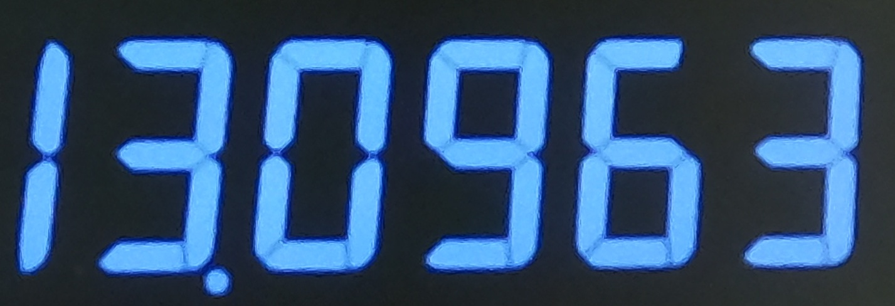
Cropping the seven-segment display
Crop the relevant portion of the image such that only the decimal numerals are captured
Plausible approaches:
Use manual cropping (Involves hardcoding and may not generalize to all cases)
Make use of the mouse for cropping (Used this method)
Cropped image

Slide 3
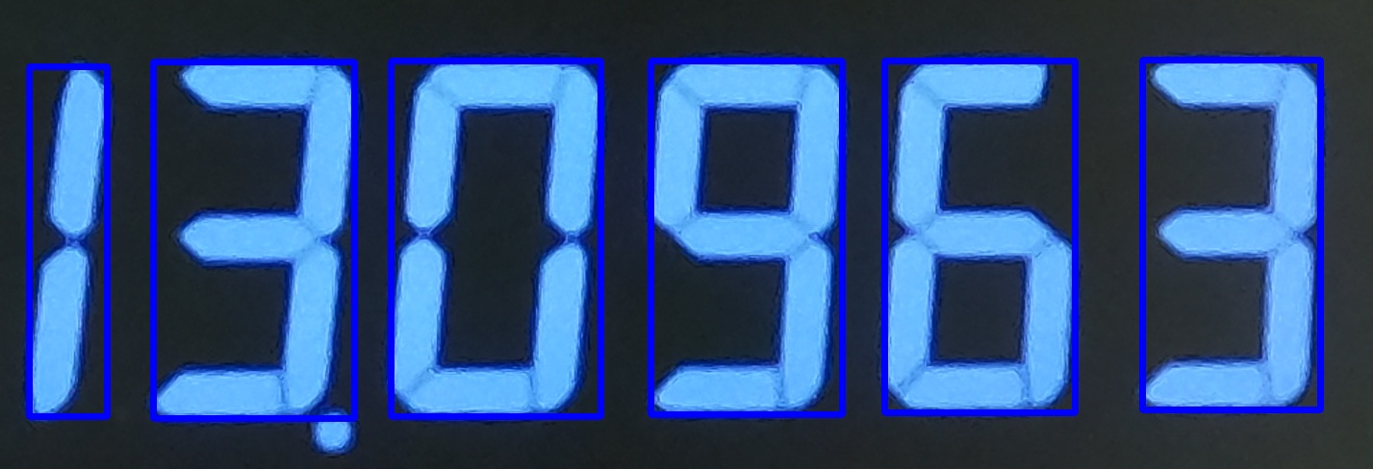
Bounding boxes need to be formed the detected digits
Contour detection works well for the digits in the image!
These contours need to be sorted according to their x-coordinates
An iterative trial and error procedure need to be followed to determine appropriate width and height constraints for the bounding boxes
Bounding boxes over the cropped image

