Slide 1
Week 1: Adjust brightness in the image
Notes:
Main title: 40 pt. Arial
Presenter Name: 16 pt. Arial
Presenters Title: 16 pt. Arial Italic

Slide 2
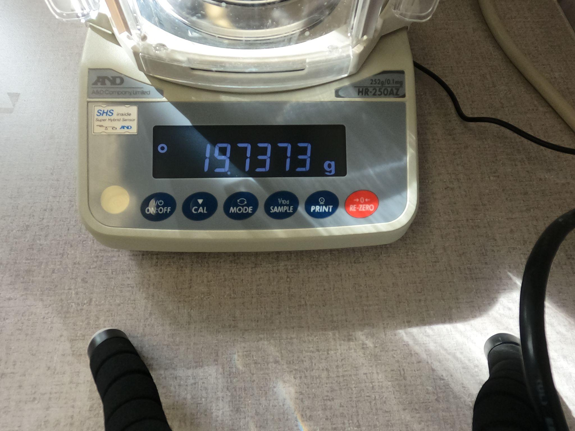
A streak of sunlight might appear across the seven segment display screen on a particular day
Sample image from the dataset

Slide 3
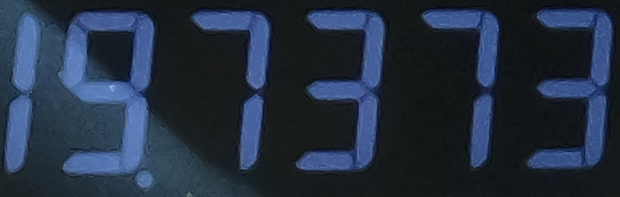
How to address this issue?
Crop the relevant portion of the image such that only the decimal numerals are captured
Plausible approaches:
Use manual cropping (Involves hardcoding and might not generalize well)
Make use of the mouse for cropping (Used this method)
Cropped image

Slide 4
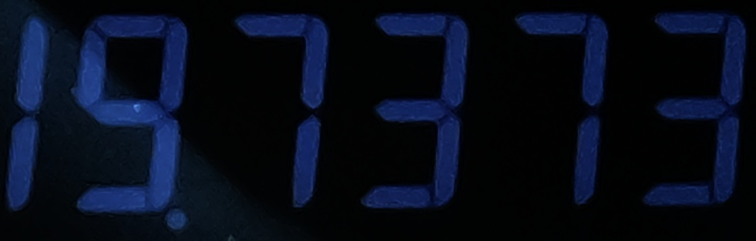
Use Gamma correction
Gamma correction is applied to adjust the brightness for uniformity across the cropped image
The image gets improved for steps lying ahead such as forming bounding boxes for identifying the digits
Improved image

