Slide 1
Week 2: Sharpening
Notes:
Main title: 40 pt. Arial
Presenter Name: 16 pt. Arial
Presenters Title: 16 pt. Arial Italic

Slide 2
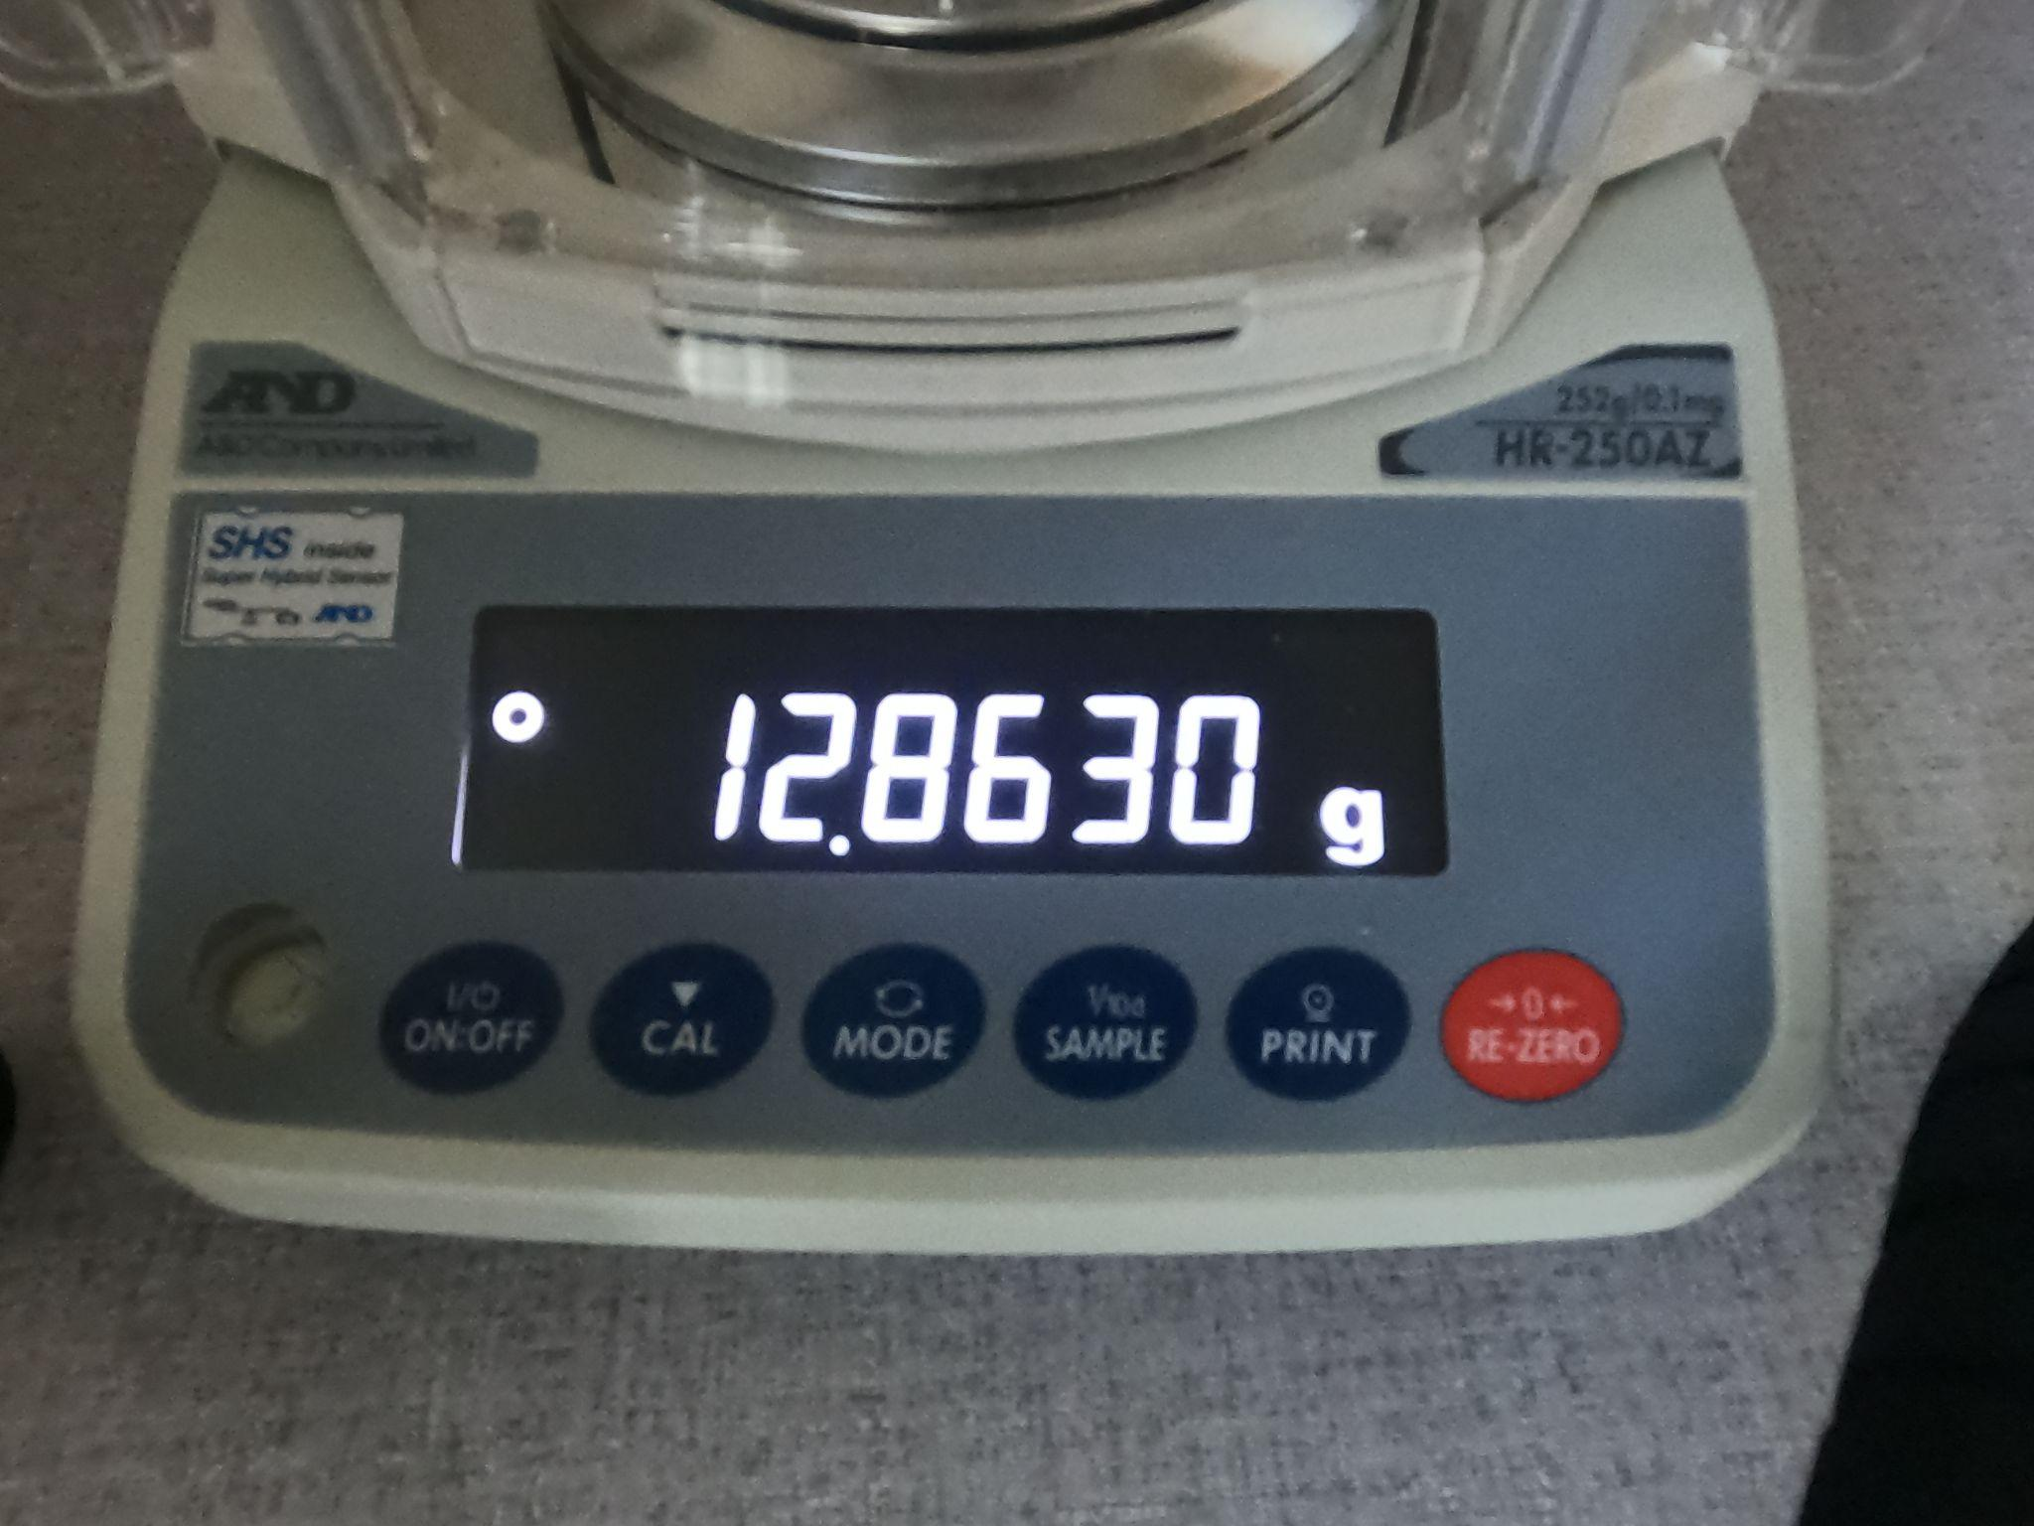
Blurred seven segment display with no emphasized edges
Sample image from the dataset

Slide 3
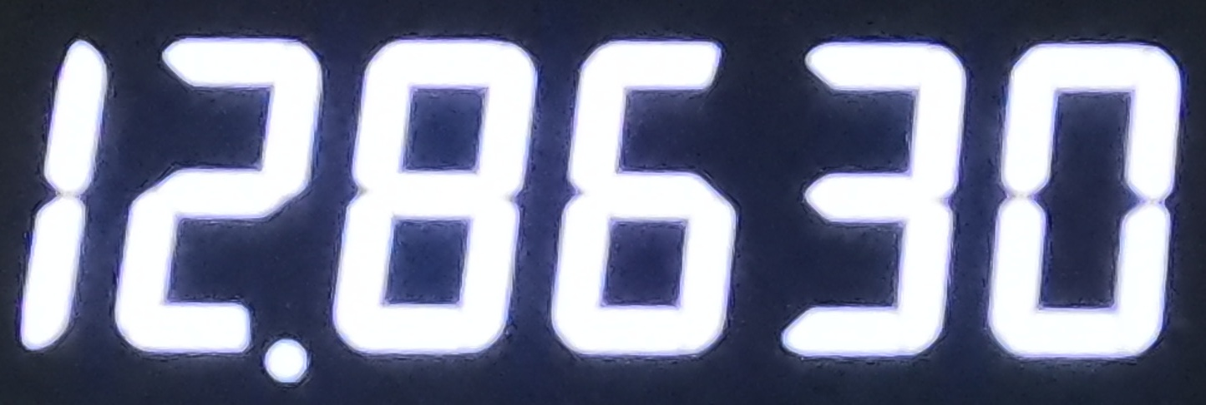
How to address this issue?
Crop the relevant portion of the image such that only the decimal numerals are captured
Plausible approaches:
Use manual cropping (Involves hardcoding and may not generalize to all cases)
Make use of the mouse for cropping (Used this method)
Cropped image

Slide 4
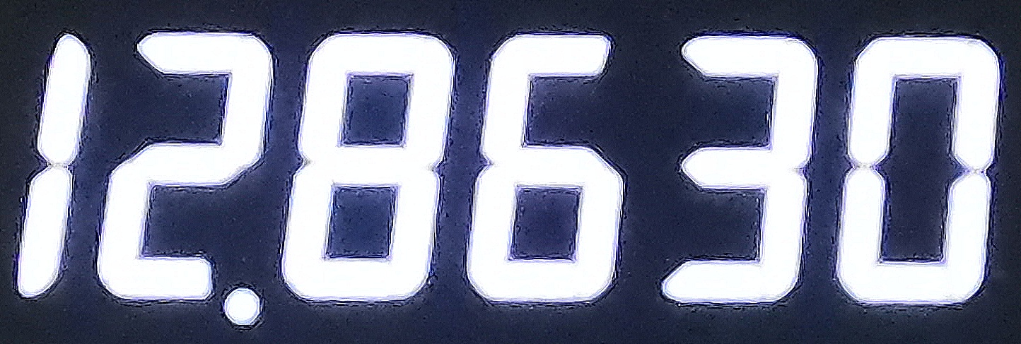
Implement sharpening techniques to emphasize edges
Unsharp masking is an efficient technique in which the difference of the original and smoothed image is taken and then the edges are emphasized
The image get sharpened and this would ensure that no mistake is made in digit identification using the seven segment digit recognition algorithm
Sharpened image

