Slide 1
Week 3: Detection of the seven-segment display
Notes:
Main title: 40 pt. Arial
Presenter Name: 16 pt. Arial
Presenters Title: 16 pt. Arial Italic

Slide 2
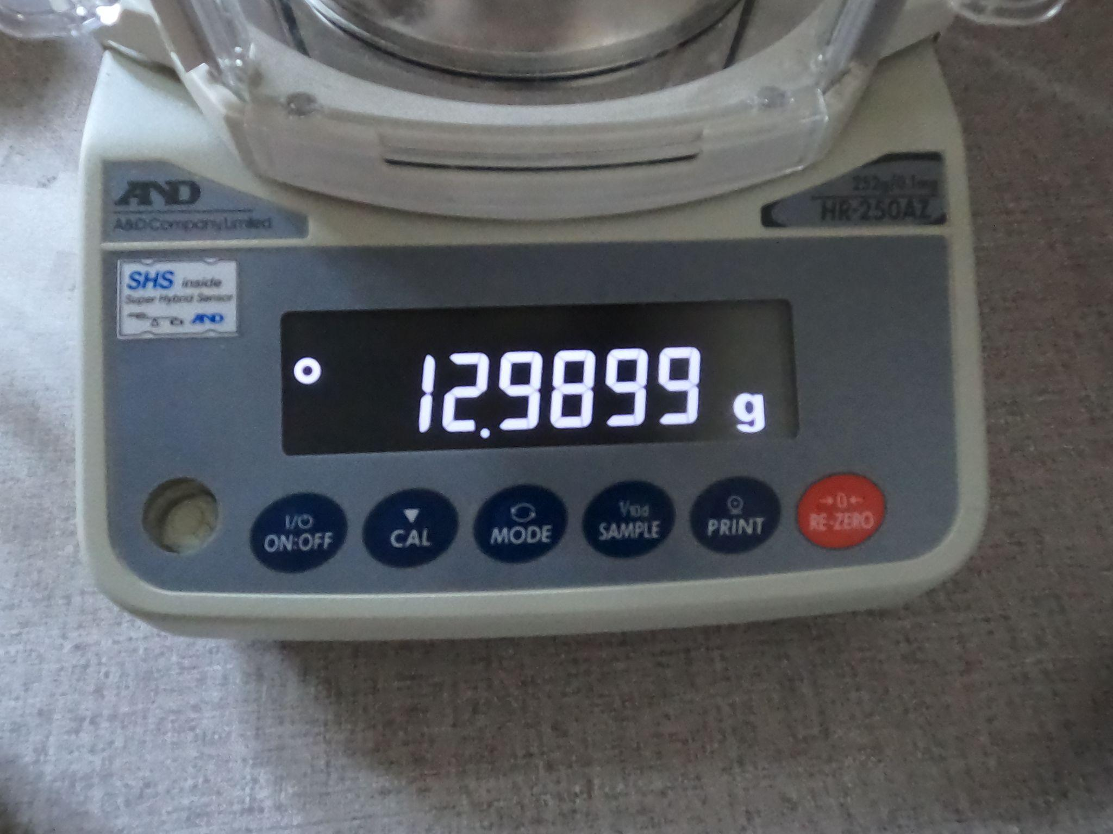
Detection of the seven-segment display depicting the decimal numerals
Sample image from the dataset

Slide 3

Contour detection
Due to the low resolution and quality of the image contour detection does not work well

Slide 4
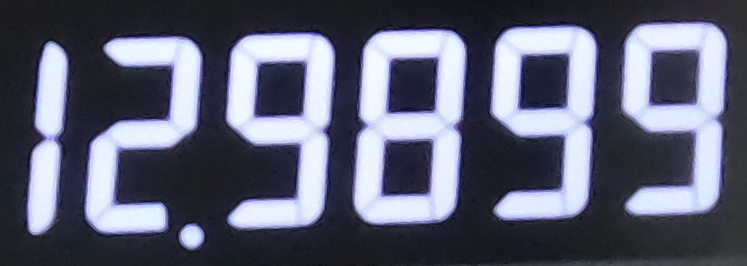
Manual cropping
Accurate results
Involves hardcoding the region of interest
Iterative procedure for finding the coordinates of the region of interest

Slide 5
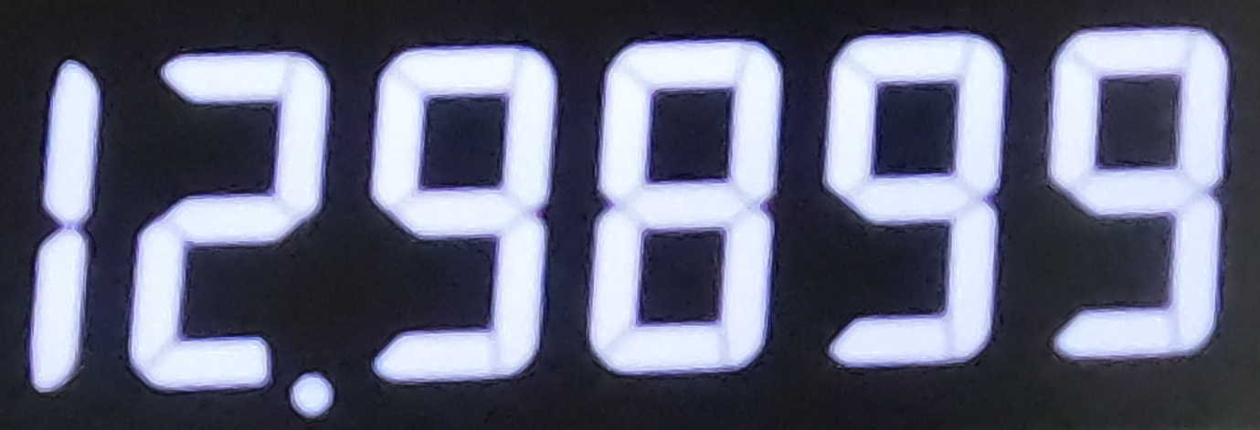
Extracting the region of interest using the mouse
Accurate results
Usage of the mouse
Might not be a very convenient alternative if there are a large number of readings which need to be taken successively

