Slide 1
A Minor Project Defense
On
“AGROTECHGUIDE”
Presented By:
Ankit Sapkota[PAS077BEI005]
Navraj Awasthi[PAS077BEI026]
Yogendra Baskota[PAS077BEI045]

Slide 2
Outline
❖Introduction
❖Problem Statement
❖Objectives
❖Literature Review
❖Requirement Analysis
❖Methodology
❖Results
❖Future Enhancements
❖References

Slide 3
Introduction
● The geographical diversity, varied soil compositions and climatic conditions support abundant varieties of crops across different regions.
● Achieving high yields in agricultural production requires cultivating a diverse range of crops suited to each specific locale.
● Identifying the most suitable crop for a given location is pivotal to meet production potential.

Slide 4
Problem Statement
● Lack of a comprehensive crop selection mechanism results in farmers being unaware of potential cash crops for their farms.
● This leads to suboptimal yields and hampers overall productivity, representing untapped economic potential in a geographically diverse country like Nepal.
● AgrotechGuide emerges as an important project to address the critical need for accurate crop selection tailored to specific locations.

Slide 5
Objective:
The objective of AgrotechGuide is to recommend high-yielding crops to farmers based on their specific farm conditions, consequently maximizing productivity.

Slide 6
Literature Review
[1] Crop Recommendation System
This research aims to assist farmers worldwide by using machine learning to predict the best crops for specific conditions.
Factors considered include soil nutrients, pH levels, humidity, and rainfall patterns.

Slide 7
[2]Future Prospects of Precision Agriculture in Nepal
This paper explores precision agriculture, a modern approach using technology to optimize farming practices for increased productivity and sustainability.
Despite Nepal's agricultural importance, current practices underutilize resources.
Precision agriculture offers potential to boost productivity and conserve the environment, but successful adoption requires technical expertise.

Slide 8
[3]Prime Minister Agriculture Modernization Project (PMAMP)
It focuses on creating specialized crop regions, enhancing competitiveness, and generating employment opportunities.
PMAMP emphasizes scientific land use and adoption of modern techniques, offering hope for a prosperous and sustainable agricultural future in Nepal.

Slide 9
Requirement Analysis
Hardware Requirements:
Breadboard
Jumper Wires
LM35 Temperature Sensor
Humidity Sensor
The ESP8266 NODEMCU

Slide 10
Software Requirement
Flutter
Dart
Arduino IDE
Python
Scikit Learn

Slide 11
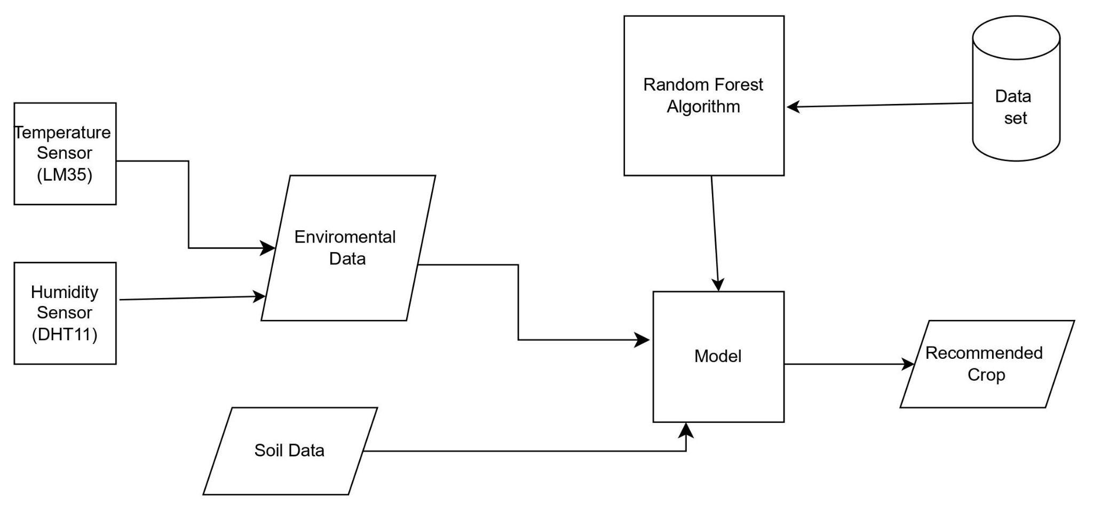
METHODOLOGY:
Fig: Flowchart

Slide 12
Working
Our application uses DHT11 and LM35 temperature sensors to gather real-time environmental data, including temperature, humidity, and LM35 temperature readings.
This data is transmitted to our backend system for analysis alongside user-provided inputs consisting of NPK levels, pH balance, and rainfall measurements.
Leveraging advanced machine learning algorithms, our backend processes this integrated dataset to generate actionable insights for optimized decision-making and resource management in agriculture.

Slide 13
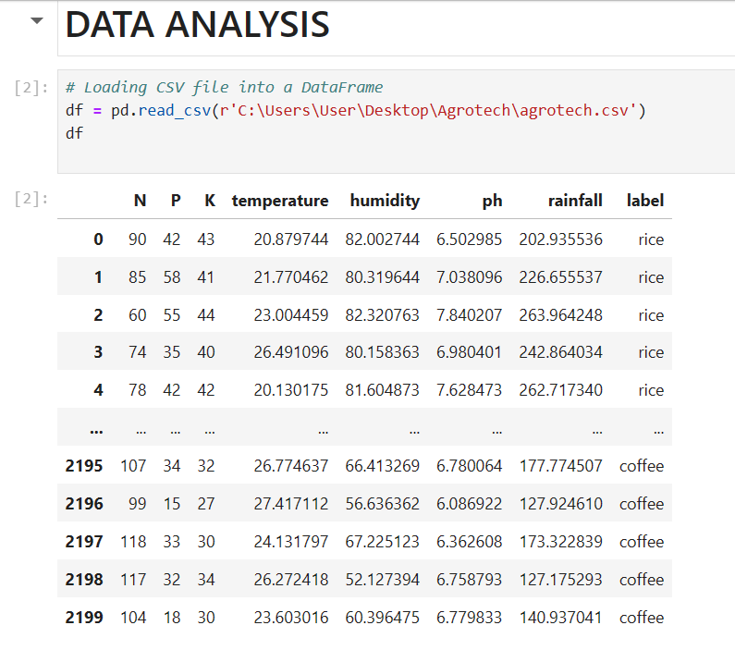
Model Training
Fig: Data used for model training.

Slide 14
N,P…pH
D1,D2….D2200
N,temp,humidity
rainfall,H,N
D7,D33…D143
D83,D2….D823
…………
…………
Divide Parameters
N numbers of subsets of parameters
Divide Datasets
N numbers of subsets of Datasets

Slide 15
Building a Tree: Tree is build from the subset of data and parameter
200 rice 170 maize
N,temp,humidity
D7,D33…D143
T>25
180 rice 8 maize
20 rice 162 maize
D7,D33…D143
200 rice 170 maize
TREE

Slide 16
Crop Recommender
Bags of tree that decide

Slide 17
Soil Data
Crop Recommender
Recommended Crop
Environmental Data

Slide 18
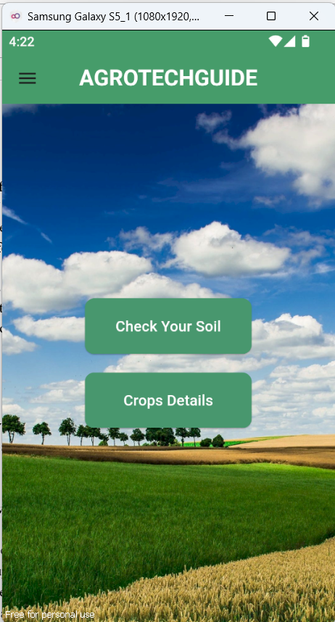
RESULT
Fig: Home page

Slide 19
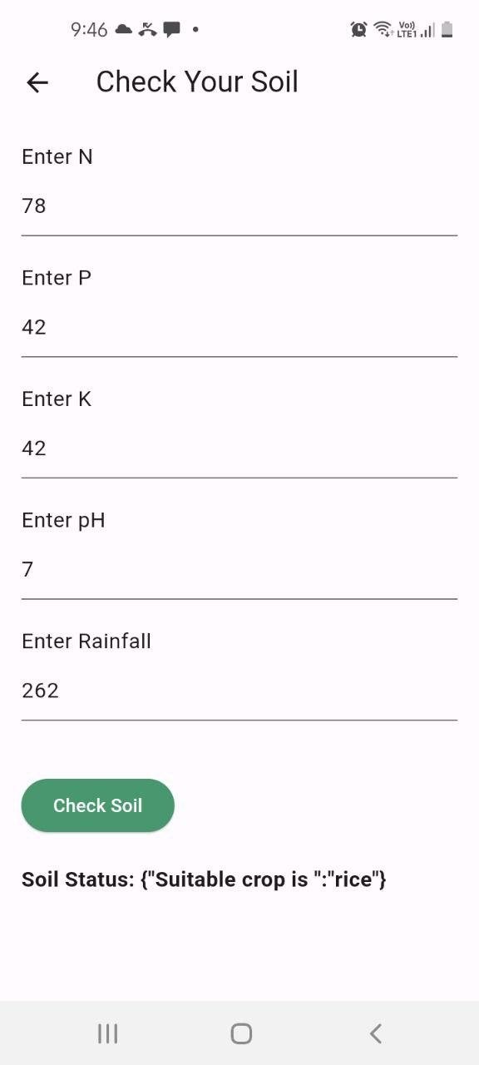
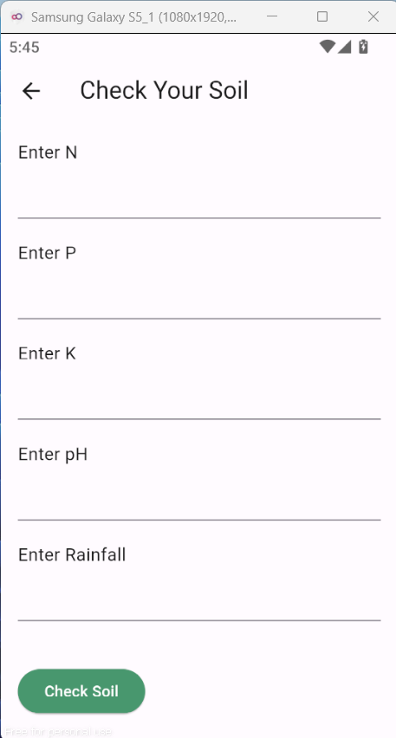
RESULT
Fig: ‘Check Your soil’ page

Slide 20
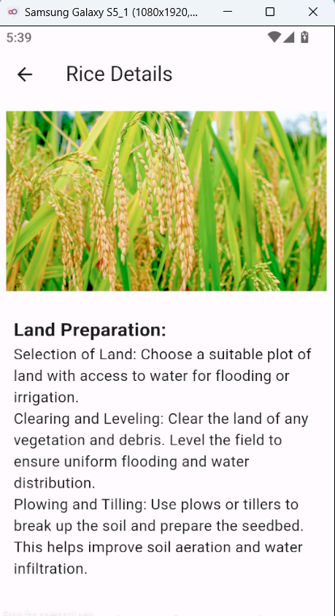
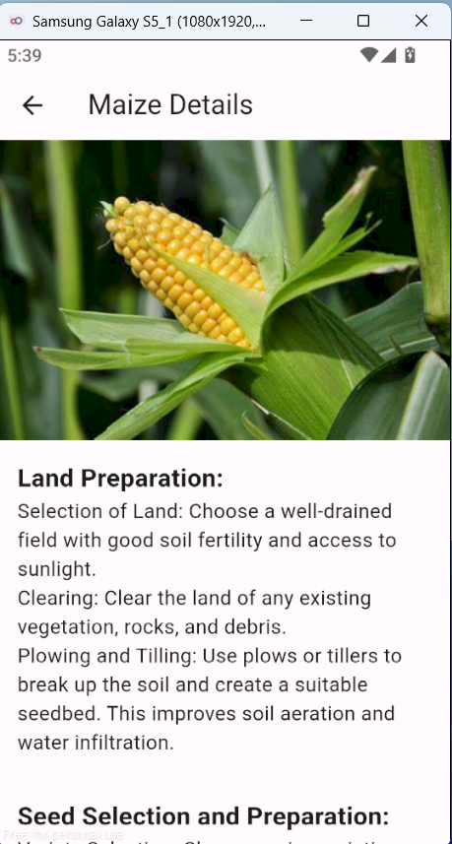
RESULT
Fig: ‘Crops Details’ page

Slide 21
Limitations
The effectiveness of the recommendation system heavily relies on the quality and representativeness of the labeled data used for training.
Inaccurate or biased data can lead to suboptimal recommendations and may not capture the full complexity of agricultural conditions.
Input Data may not account for socio-economic factors, farmer preferences, or specific crop management practices, limiting their scope in providing comprehensive recommendations.

Slide 22
Future Enhancement
Continuous Model Refinement
Integration as a Testing Tool for Farmers
Partnerships with Agriculture-Based Software Companies
Adding locating tracking features,which can directly take data like N,P,K of soil from API based on the current location of user.

Slide 23
Conclusion
AgrotechGuide uses machine learning to recommend crops based on soil and environmental data, aiding Nepalese farmers in informed planting decisions. Future plans involve refining the model and integrating with agriculture-based software companies to further support agricultural productivity in Nepal.

Slide 24
References
[1]https://www.researchgate.net/publication/370056714_Crop_Recommendation_System
[2]https://www.researchgate.net/publication/354533829_Prime_Minister_Agriculture_Modernization_Project_PMAMP_Nepal?fbclid=IwAR0IxjZYJ364RvztPAnOnPTauCKiIb1fR S F5K3tyscC9u6VIcRd2aJHQ4u0
[3]https://www.researchgate.net/publication/344376491_Future_prospects_of_precision_ agr iculture_in_Nepal [4]https://www.geokrishi.farm

Slide 25
Thank You

