Slide 1

TRIBHUVAN UNIVERSITY INSTITUTE OF ENGINEERING PASCHIMANCHAL CAMPUS, POKHARA
A Major Project Proposal Defense On Project Entitled:
“SPEECH RECOGNITION: NEPALI SPEECH TO TEXT USING DEEP LEARNING”
Submitted By:
CHANDRA SHEKHAR GIRI: PAS077BEI017
DIPESH KARKI: PAS077BEI018
NAVRAJ AWASTHI: PAS077BEI026
YOGENDRA BASKOTA: PAS077BEI045
Submitted To:
DEPARTMENT OF ELECTRONICS AND COMPUTER ENGINEERING

Slide 2
OUTLINE
Introduction
Problem Statement
Objectives
Literature Review
Methodology
Expected Output
Gantt Chart
References

Slide 3
INTRODUCTION
This project focuses on developing a system that translates Nepali speech into Nepali text. It aims to enhance communication and accessibility for Nepali speakers by providing an accurate and efficient speech-to-text solution.
Speech-to-text technology is crucial for various applications, and this project aims to bridge the gap for Nepali speakers.
Existing speech recognition technologies primarily focus on major languages, neglecting the unique aspects of Nepali.
This project supports technological innovation and cultural preservation, promoting digital inclusion for Nepali speakers.

Slide 4
PROBLEM STATEMENT
Current speech-to-text systems inadequately support the Nepali language, leading to inaccuracies and limited accessibility for Nepali speakers.
There is a significant gap in the availability of advanced speech recognition technology for Nepali, hindering effective communication and digital inclusion.

Slide 5
OBJECTIVES
To develop an accurate and efficient system to translate Nepali speech into Nepali text, enhancing accessibility and communication for Nepali speakers.

Slide 6
Literature Review:
Automatic speech recognition for the Nepali language using CNN, bidirectional LSTM and ResNet ^{[3]} :
→ This paper present the development and evaluation of a deep learning model for Automatic Speech Recognition (ASR) specifically for the Nepali language.
→ It discusses the model's architecture, training process, data preprocessing techniques, and performance metrics.

Slide 7
Nepali Speech Recognition using RNN-CTC Model ^{[4]} :
→ This paper introduces a Nepali Speech Recognition model using RNNs and CTC.
→ RNN (Recurrent Neural Networks) is used for processing sequential audio data. CTC (Connectionist Temporal Classification) technique is applied allowing RNN to train over audio data.
→ After processing through RNN and CTC layers, Nepali text is obtained as output.

Slide 8
Nepali Text-to-Speech Synthesis using Tacotron2 for Melspectrogram Generation^{[1]} :
→ This Paper proposes generating high quality Nepali speech using the Tacotron2 model and HiFiGAN/WaveGlow vocoders.

Slide 9
METHODOLOGY
Hardware Requirements
Raspberry Pi
Microphone Module
LCD module
Software Requirements
Raspberry Pi OS
Python
Tensorflow

Slide 10
Software Requirements
Numpy
Pandas
Matplotlib
RNN
CNN
Transformer

Slide 11
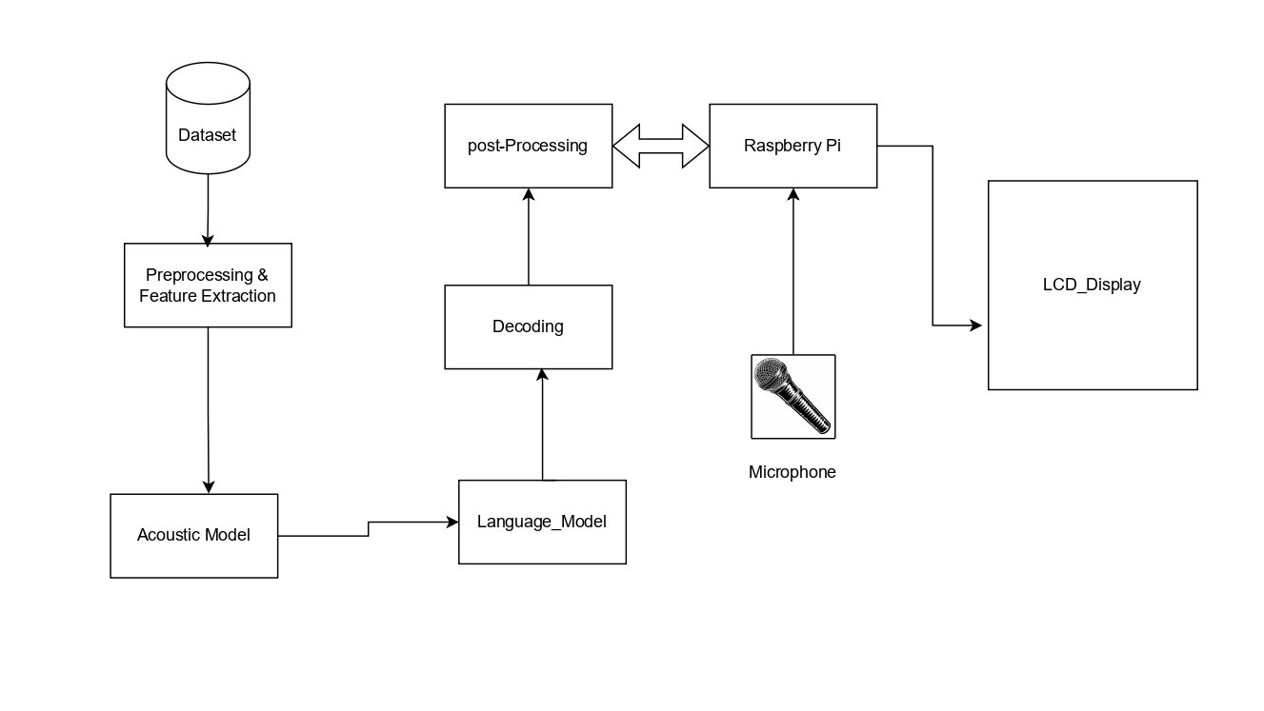
Block Diagram:

Slide 12
Expected Output
Real-time, accurate transcription of spoken Nepali into text.
Seamless integration with Raspberry Pi, using a microphone and LCD module.
User-friendly interface for easy control and display of transcribed text.
Comprehensive documentation on system architecture, installation, and usage.
Evaluation report with performance metrics and user feedback.

Slide 13
Estimated Budget
The Estimated budget for our project is:
S.N | Hardware Name | Price
1. | Raspberry Pi | Rs.14000
2. | Microphone | Rs.250
3. | LCD Display | Rs.350

Slide 14
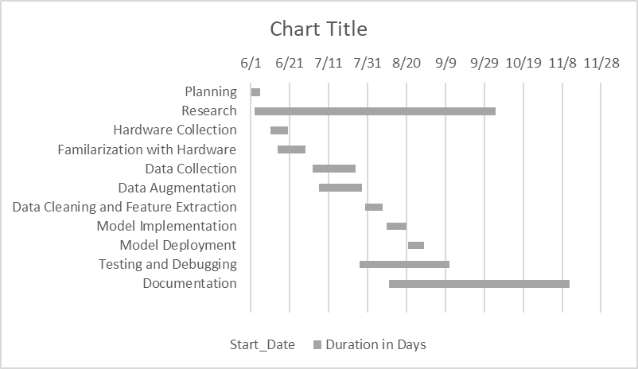
Work Schedule:

Slide 15
REFERENCES:
https://www.researchgate.net/publication/375139583_Nepali_Text-to-Speech_Synthesis_using_Tacotron2_for_Melspectrogram_Generation
https://www.researchgate.net/publication/359950525_A_Novel_Deep_Learning_Based_Nepali_Speech_Recognition
https://www.researchgate.net/publication/362745838_Automatic_speech_recognition_for_the_Nepali_language_using_CNN_bidirectional_LSTM_and_ResNet
https://www.researchgate.net/publication/334523238_Nepali_Speech_Recognition_using_RNN-CTC_Model
https://www.researchgate.net/publication/330759624_Speech_Processing_and_Recognition_System_Concepts_Techniques_and_Research_Overviews

Slide 16
Thank You !!

