Slide 1






G
G-PEARL v1.0
GNSS Performance analysis, Experimental Assessment, and Reporting tooL
G
G-PEARL is developed and manteind by the NavSAS research group of the Department of Electronics and Telecommunications at Politecnico di Torino, on behalf of the Consorzio Nazionale Interuniversitario per le Telecomunicazioni (CNIT), under funding from the Agenzia Spaziale Italiana (ASI) within the framework of the Centro Nazionale Competenze GNSS (CNCG) project.
Credits: NavSAS research group
Scientific Supervision: Prof. Fabio Dovis
DevOps Engineers: Dr. Alex Minetto, Dr. Simone Zocca
UI/UX Design: Dr. Alex Minetto, Dr. Simone Zocca
Embedded science tools Development: Eng. Oliviero Vouch, Dr. Andrea Nardin
G_PEARL
NavSAS research group
navsas@polito.it
Politecnico di Torino
G-PEARL is a MATLAB-based application designed to support scientific investigations of GNSS data
G-PEARL is a MATLAB-based application designed to support scientific investigations of GNSS data across multiple data formats. It enables the processing of both raw signal samples and observables, providing automated report generation for a range of scientific analyses, including multi-frequency and multi-constellation GNSS signal acquisition, total electron content estimation, multipath analysis from observables, and state estimation solutions.

Slide 2
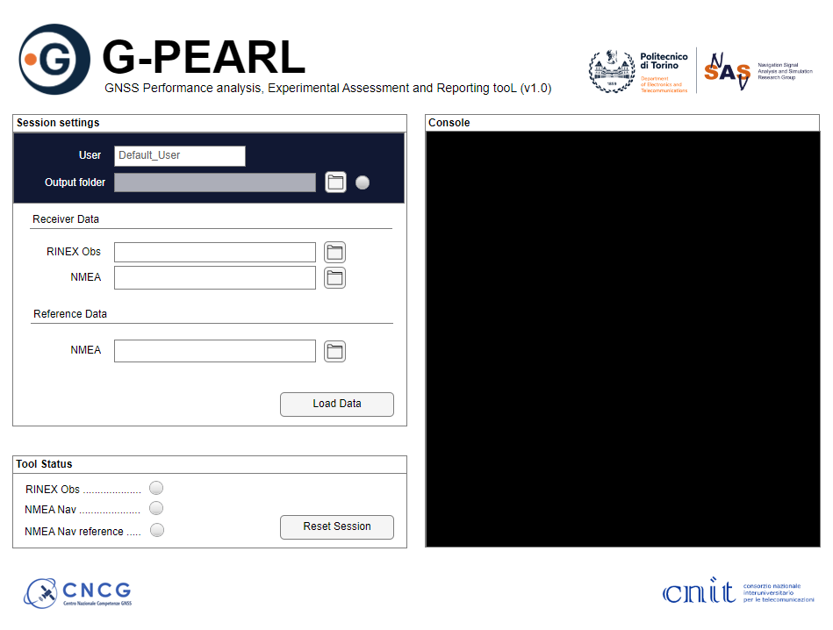
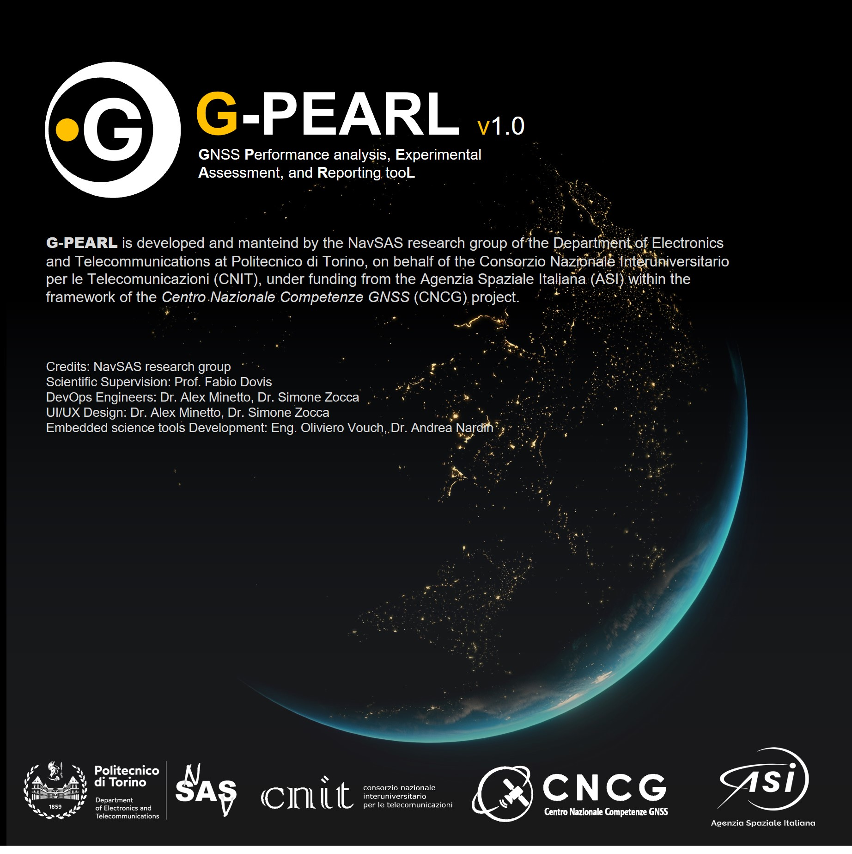

Slide 3
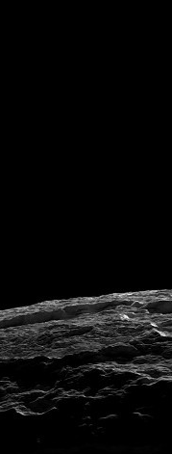
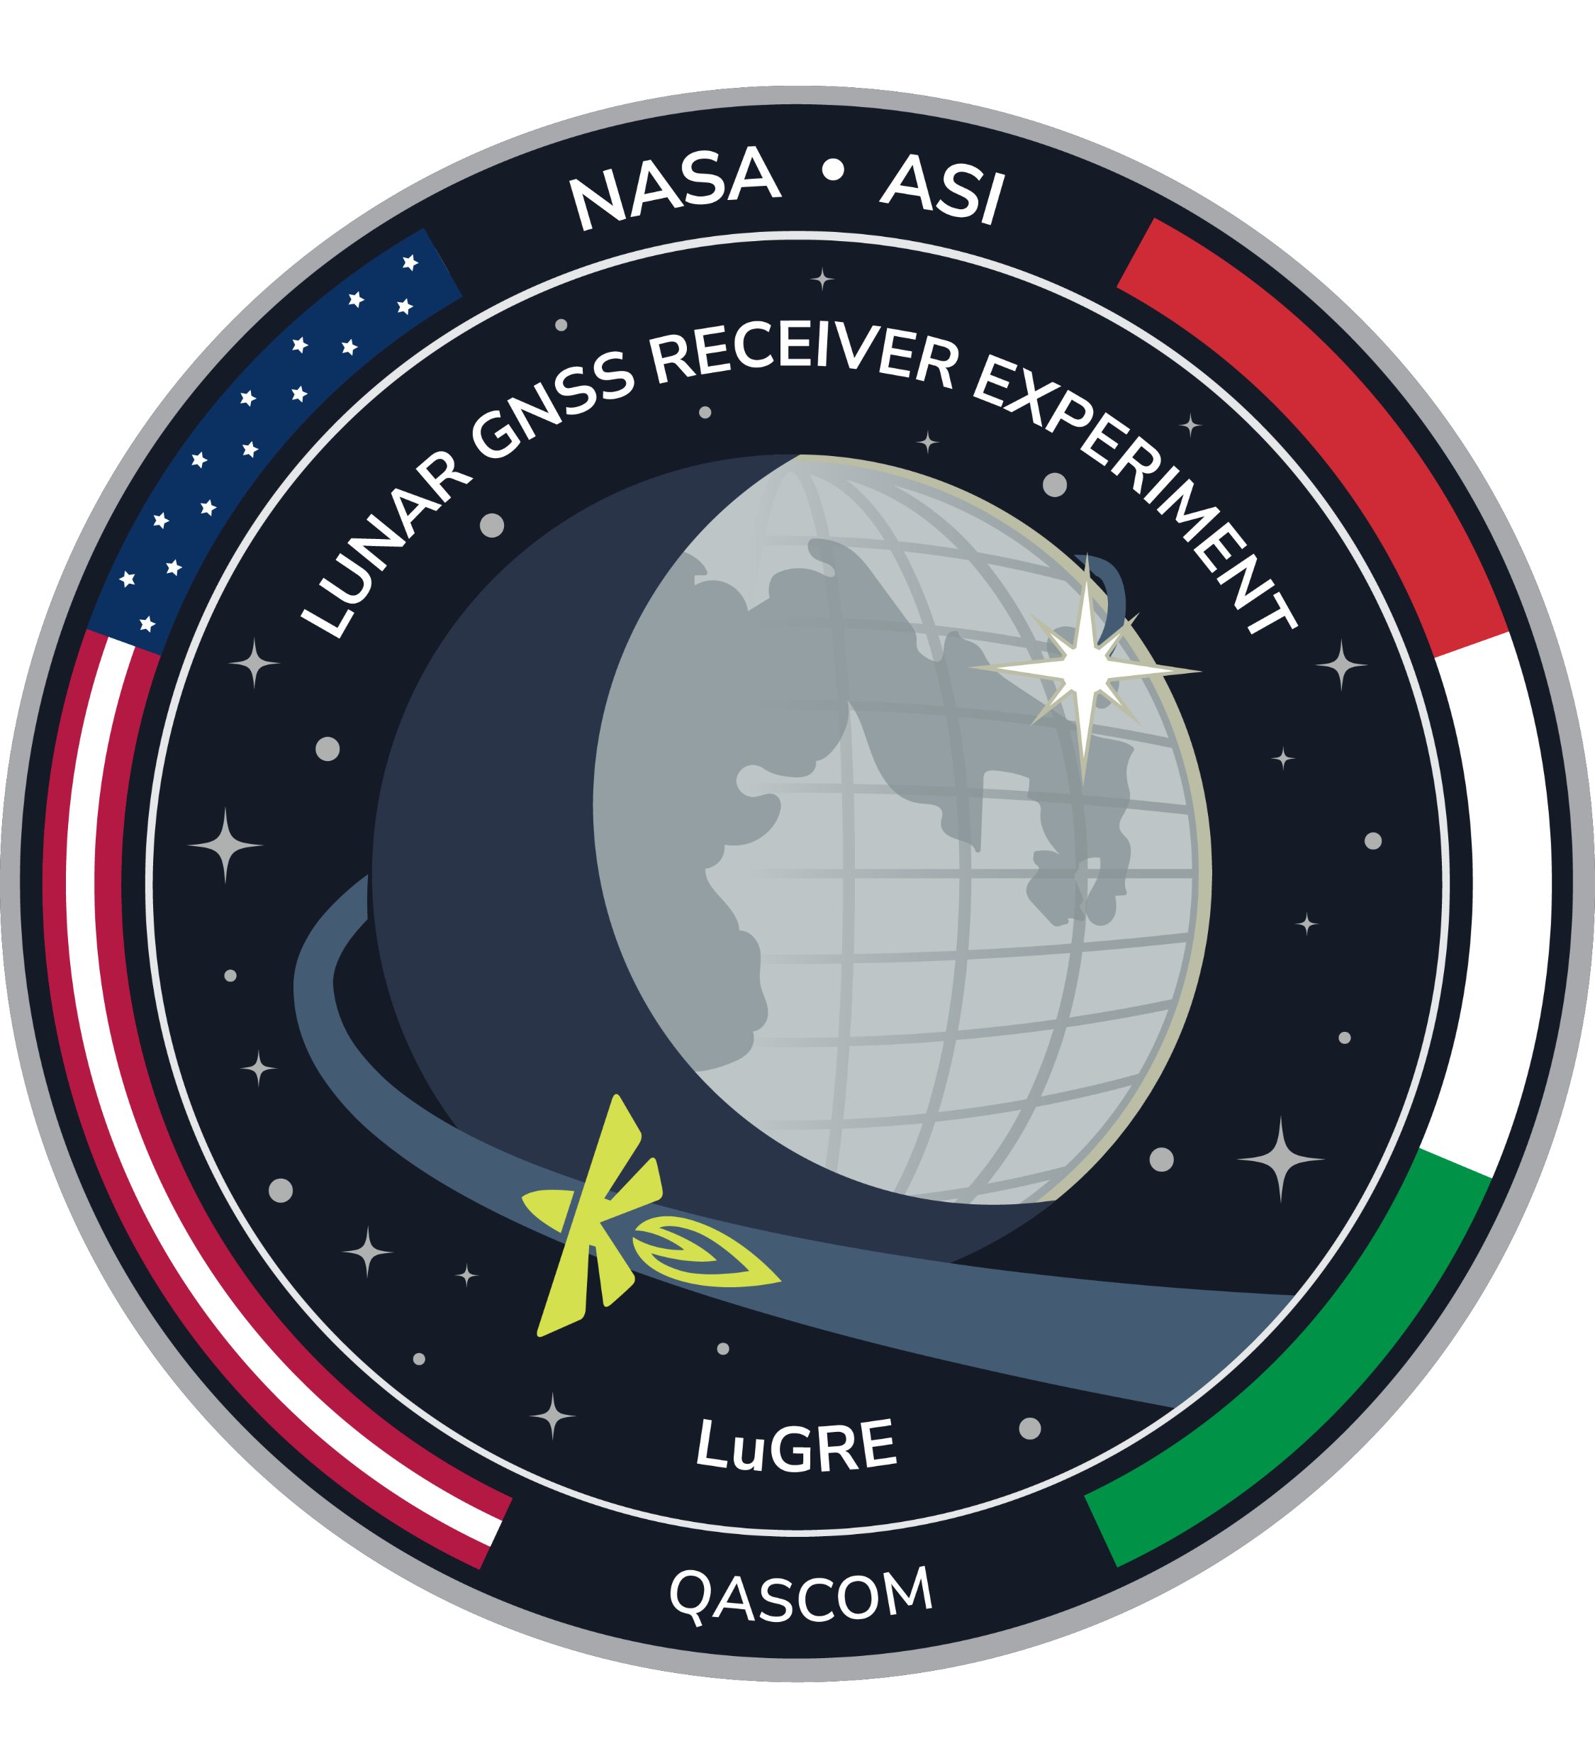
G-PEARL v1.0
G
GNSS Performance analysis, Experimental Assessment, and Reporting tooL

