Slide 1

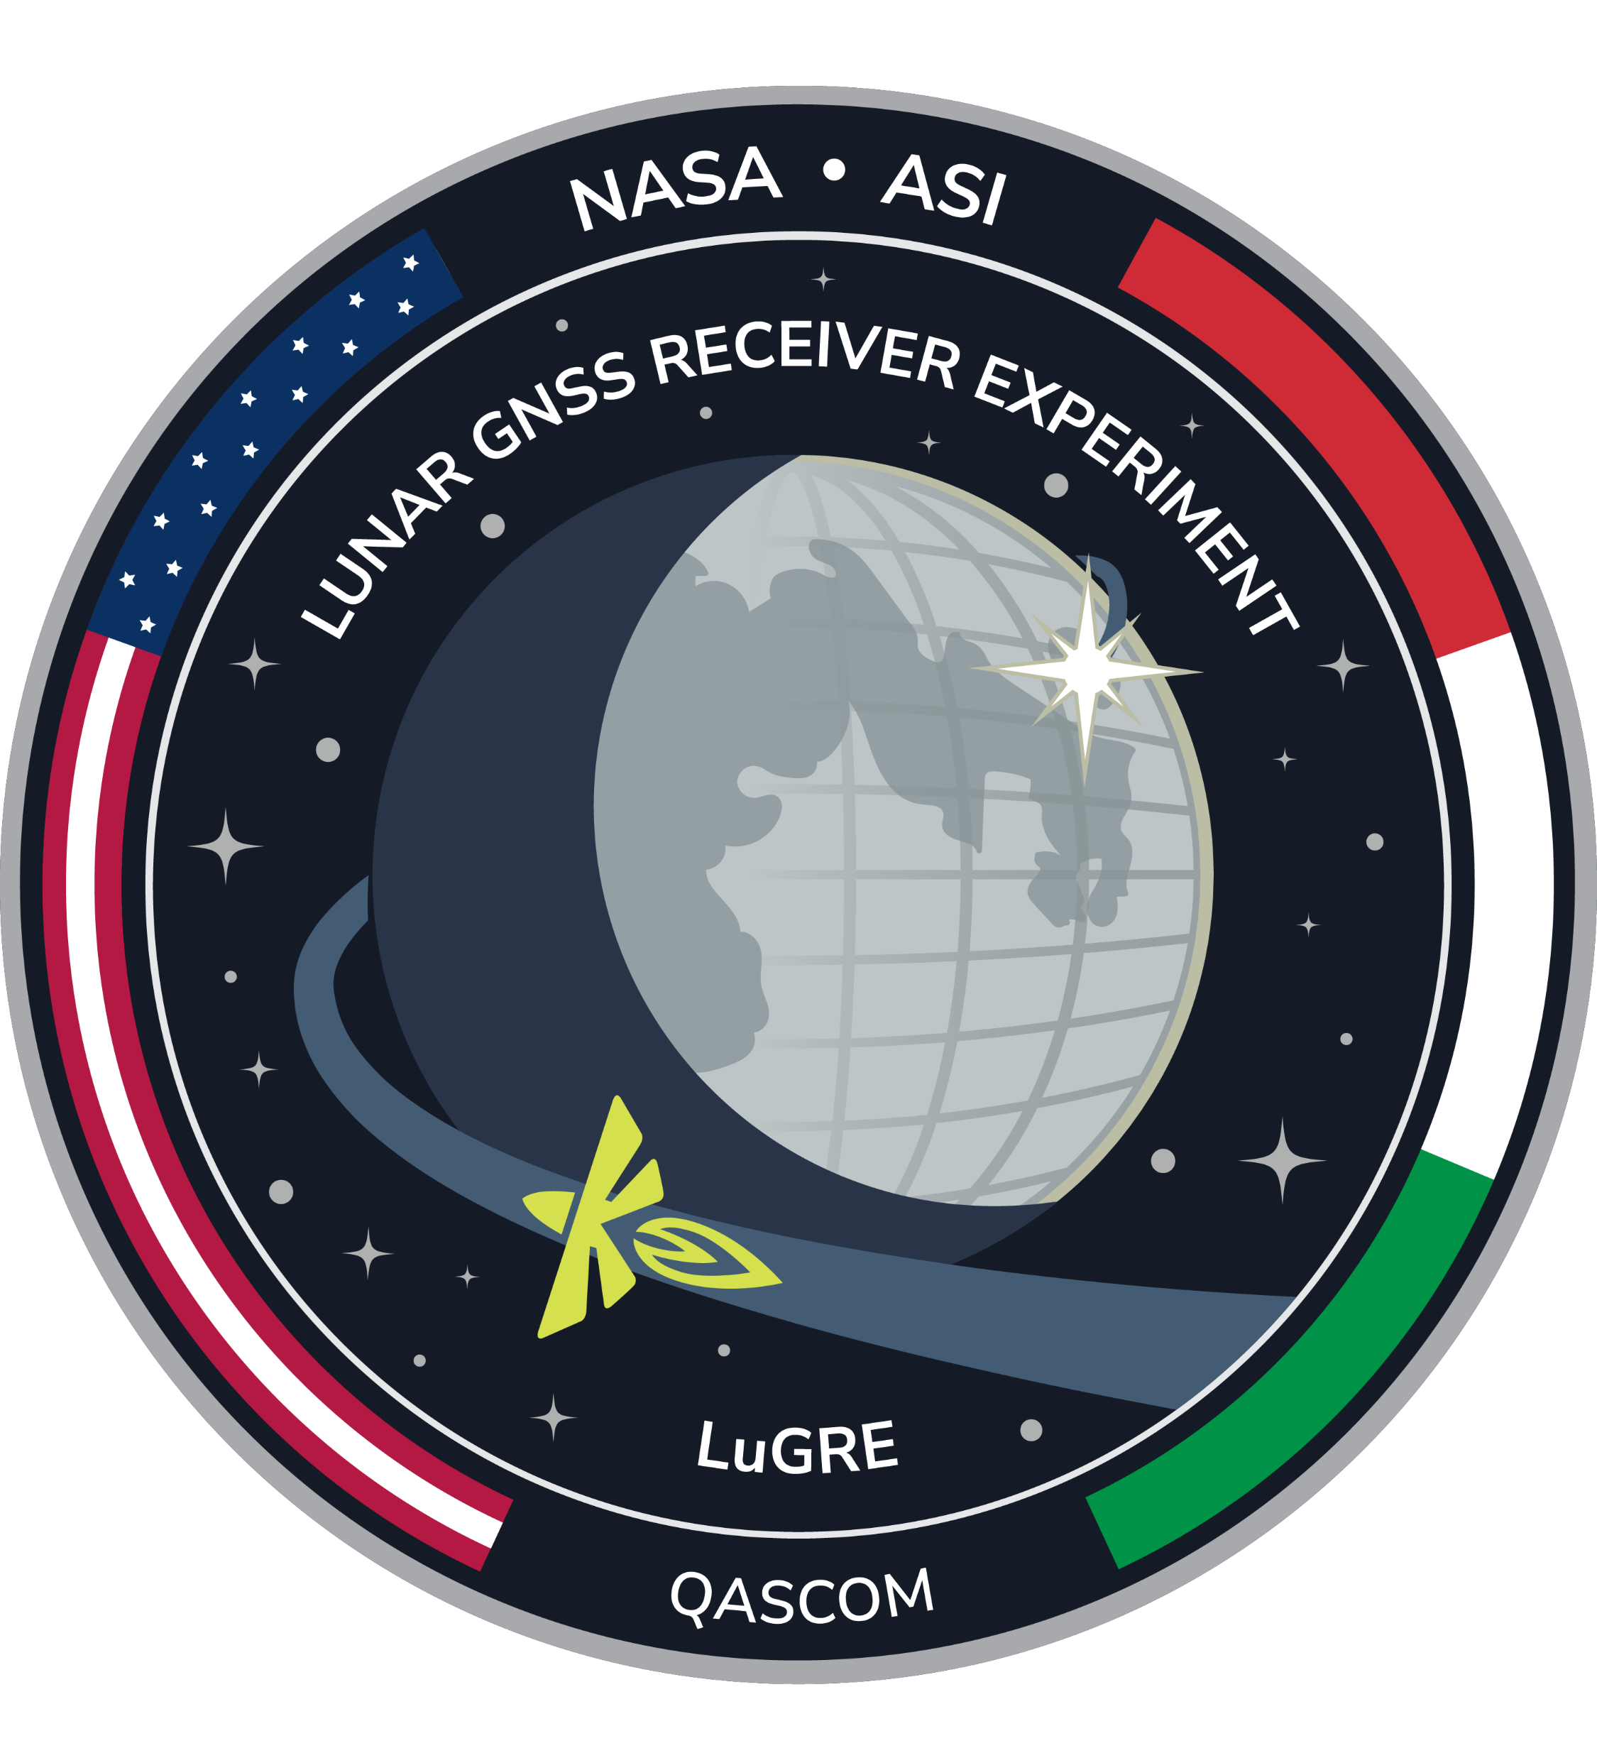




LuNART
LuGRE Navigation Analysis and Reporting Tool
The LuNART sofware suite has been developed by the Navigation Signal Analysis and Simulation Research Group (NavSAS) within the Department of Electronics and Telecommunications of Politecnico di Torino (Turin, Italy). The tool has been developed under the supervision of the Agenzia Spaziale Italiana (ASI).
Credits:

Slide 2
LuNART-q v2.0
LuGRE Navigation Analysis and Reporting Tool
The LuNART sofware suite has been developed by the Navigation Signal Analysis and Simulation Research Group (NavSAS) within the Department of Electronics and Telecommunications of Politecnico di Torino (Turin, Italy). The tool has been developed under the supervision of the Agenzia Spaziale Italiana (ASI).
Credits:

Slide 3
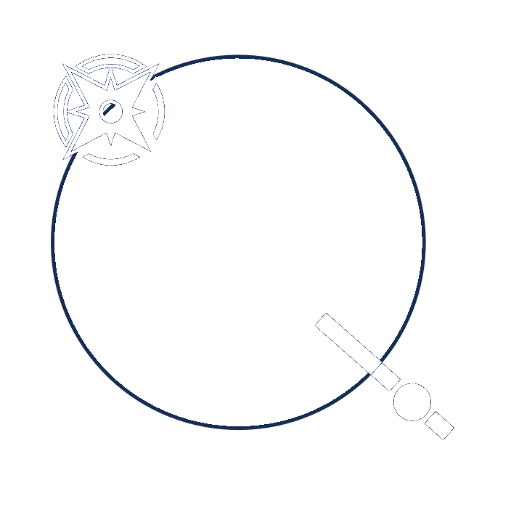
LuNART-q v1.1
LuGRE quick Navigation Analysis and Reporting Tool
The LuNART sofware suite has been developed by the Navigation Signal Analysis and Simulation Research Group (NavSAS) within the Department of Electronics and Telecommunications of Politecnico di Torino (Turin, Italy). The development was funded by Agenzia Spaziale Italiana (ASI), and supervised by ASI and NASA.
Credits: NavSAS Research Group

Slide 4
LuNART-q v2.0
LuGRE quick Navigation Analysis and Reporting Tool
The LuNART sofware suite has been developed by the Navigation Signal Analysis and Simulation Research Group (NavSAS) within the Department of Electronics and Telecommunications of Politecnico di Torino (Turin, Italy). The development was funded by Agenzia Spaziale Italiana (ASI), and supervised by ASI and NASA.
Credits: NavSAS Research Group

Slide 5


LuNART-q v3.0
LuGRE quick Navigation Analysis and Reporting Tool
Developed by the Navigation Signal Analysis and Simulation Research Group (NavSAS), part of the Department of Electronics and Telecommunications, Politecnico di Torino (Turin, Italy) and member of the Lunar GNSS Receiver Experiment (LuGRE) Science Team.
The LuGRE project was funded by Agenzia Spaziale Italiana (ASI) and supervised by ASI and NASA.
Credits: NavSAS Research Group
Scientific Supervision: Fabio Dovis
DevOps Engineers: Alex Minetto, Simone Zocca UI/UX Design: Alex Minetto, Simone Zocca
Embedded science tools Development: Oliviero Vouch, Andrea Nardin

Slide 6
LuNART-q v3.0
LuGRE quick Navigation Analysis and Reporting Tool
Developed by the Navigation Signal Analysis and Simulation Research Group (NavSAS), part of the Department of Electronics and Telecommunications, Politecnico di Torino (Turin, Italy) and member of the Lunar GNSS Receiver Experiment (LuGRE) Science Team.
The project was funded by Agenzia Spaziale Italiana (ASI) and supervised by ASI and NASA.
Credits: NavSAS Research Group
Scientific Supervision: Prof. Fabio Dovis
DevOps Engineers: Dr. Alex Minetto, Dr. Simone Zocca UI/UX Design: Dr. Alex Minetto, Dr. Simone Zocca
Embedded science tools Development: Eng. Oliviero Vouch, Dr. Andrea Nardin

Slide 7
LuNART-q v3.1
LuGRE quick Navigation Analysis and Reporting Tool
Developed by the Navigation Signal Analysis and Simulation Research Group (NavSAS), part of the Department of Electronics and Telecommunications, Politecnico di Torino (Turin, Italy) and member of the Lunar GNSS Receiver Experiment (LuGRE) Science Team.
Project funded by Agenzia Spaziale Italiana (ASI) and supervised by ASI and NASA.
Credits: NavSAS Research Group
Scientific Supervision: Prof. Fabio Dovis
DevOps Engineers: Dr. Alex Minetto, Dr. Simone Zocca UI/UX Design: Dr. Alex Minetto, Dr. Simone Zocca
Embedded science tools Development: Eng. Oliviero Vouch, Dr. Andrea Nardin

Slide 8
LuNaRT-q v2.5 beta
LuGRE quick Navigation Analysis and Reporting Tool
The LuNART-q sofware suite has been developed by the Navigation Signal Analysis and Simulation Research Group (NavSAS) within the Department of Electronics and Telecommunications of Politecnico di Torino (Turin, Italy). The development was funded by Agenzia Spaziale Italiana (ASI), and supervised by ASI and NASA.
Credits: NavSAS Research Group
Project scientific supervision: Fabio Dovis
DevOps engineers: Alex Minetto, Simone Zocca UI/UX design: Alex Minetto, Simone Zocca
Embedded science tools engineers: Oliviero Vouch, Andrea Nardin
Unofficial software release

Slide 9
LuNaRT-q v2.5 beta
LuGRE quick Navigation Analysis and Reporting Tool
The LuNaRT-q sofware suite has been developed by the Navigation Signal Analysis and Simulation Research Group (NavSAS) within the Department of Electronics and Telecommunications of Politecnico di Torino (Turin, Italy). The development was funded by Agenzia Spaziale Italiana (ASI), and supervised by ASI and NASA.
Credits: NavSAS Research Group
Project scientific supervision: Fabio Dovis
DevOps engineers: Alex Minetto, Simone Zocca UI/UX design: Alex Minetto, Simone Zocca
Embedded science tools engineers: Oliviero Vouch, Andrea Nardin

Slide 11
