Slide 1
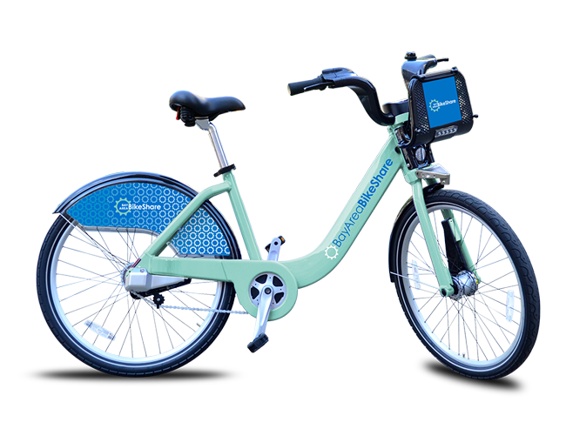
San Francisco Bay Area Bike Share Analysis
Project By :
Shefali Dagar
Shashank Khede
Navtej Singh Chawla

Slide 2
Contents:
Introduction
About Dataset
Data Analysis and Findings
Challenges
Conclusion of Analysis
Future work

Slide 3
Introduction
We are using the recorded data of the bike trips which were used in Bay area of San Francisco From August 2013 to August 2015.
The objective of this project is to determine the peak hours, days, months in which bikes are mostly occupied by the subscribers/customers.
We have chosen this project as it provides insights into the factors which affects the bike sharing on basis of weather conditions , days or locations. We can use this analysis to predict future consumption of these bikes.

Slide 4
About Data
The data sets used belongs to the Kaggle and it is provided by Ben Hamner.
We have used 3 CSV data files Station, Trip, Weather for anlysis.
Station CSV has 84 rows with details of different stations
Trip CSV has 669960 records and details of different trips
Weather CSV has 3665 records and data details of weather between Aug 2013 to Aug 2015.

Slide 5
Problem Statements
What is the average duration of the bike trips.
What is the busiest time of the week for the bike trips, the weekends or the weekdays.
Can we predict that what role the weather plays in bike share trip?
Do the bike trip patterns vary with the time and day of the week?

Slide 6
Steps Performed During Data Analysis
Problem 1) - What is the average duration of the bike trips.
Data Smoothing (Removing noisy and blank values).
Joining trip and station data for analysis.
Analyzing trips which are shorter than a day and hour respectively.
Histogram plot

Slide 7
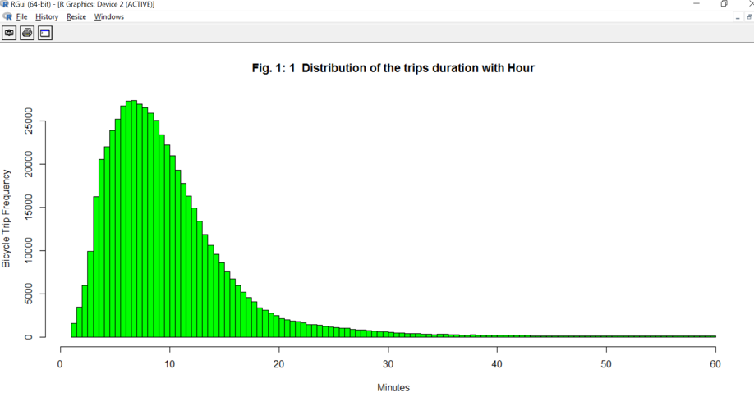
Problem 1 - Plots
Average duration of bike trips is around ‘9 minutes’.
Our data is skewed right and mean is larger than the median.

Slide 8
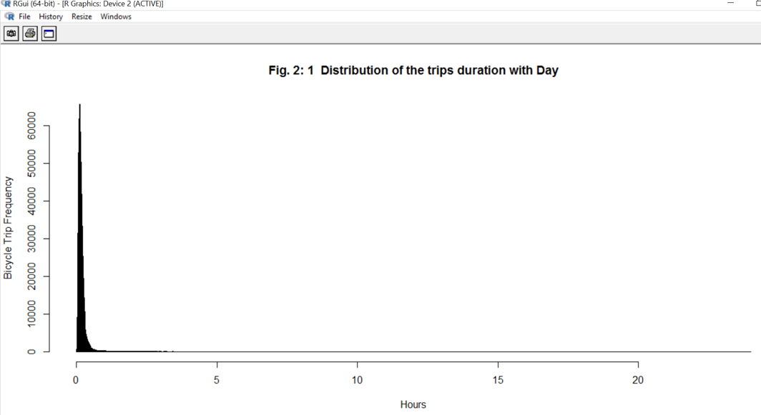
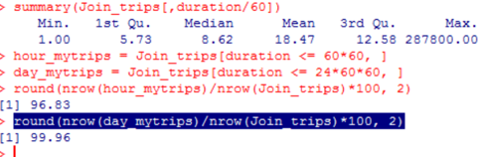
Problem 2 - Plots
Most of trips are less than 5 hours.
99.96% trips are less than a day trip.
96.83% trips are less than an hour

Slide 9
Steps Performed During Data Analysis
Problem 2) - What is the busiest time of the week for the bike trips, the weekends or the weekdays.
Creating new variables for trips in minutes.
Splitting weekday and weekend data.
Bar plot for days(weekend & weekday) vs minutes plot according to different cities.

Slide 10
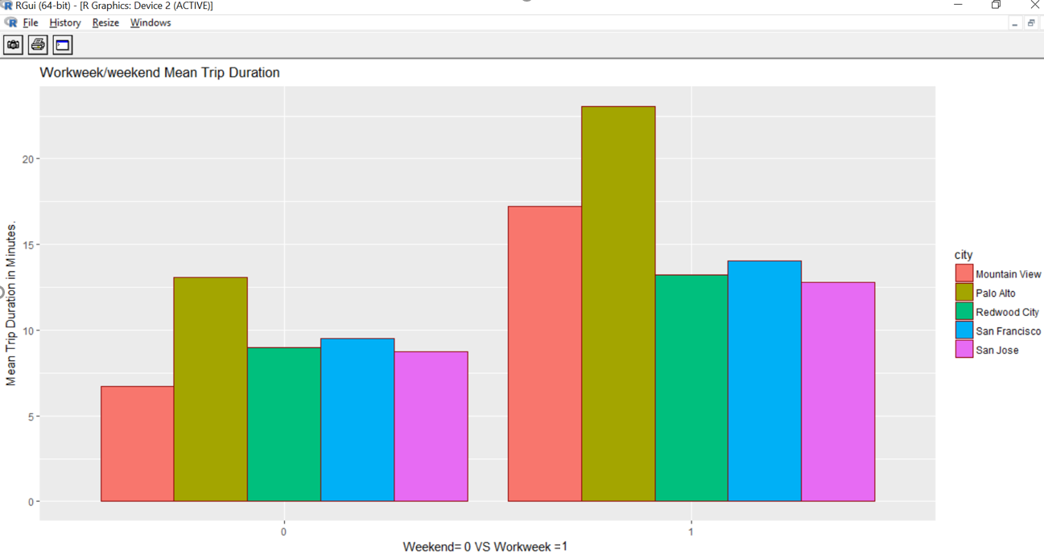
Problem 2 - Plots
People prefer to rent the bike more over the weekdays than weekend.

Slide 11
Steps Performed During Data Analysis
Problem 3) - Can we predict that what role the weather plays in bike share trip?
We check weather conditions throughout the year in the bay area.
Customer and Subscriber plot according to weekday and weekend.
Plotting humidity and bike trips, wind speed and bike trips.
Rider sensitivity according to different weather conditions.
Ride duration in seconds according to temperature (in Fahrenheit).

Slide 12
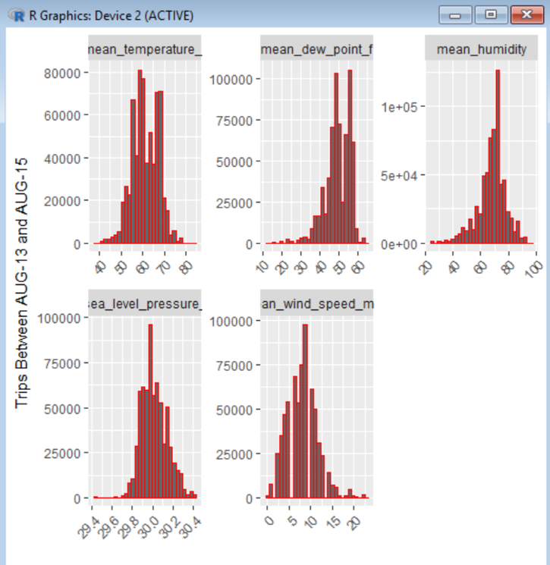
Problem 3 - Plots
Mean temperature through Aug’13 to Aug’15 is around 60 Fahrenheit.
Humidity is around 70 during this time.
Wind speed is approximately at 9mph during this time period.

Slide 13
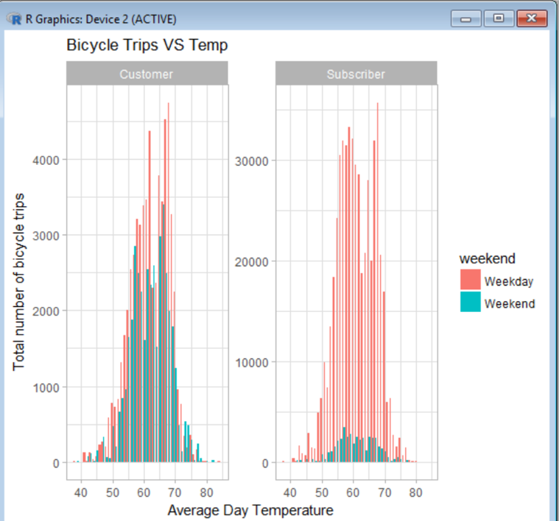
Problem 3 - Plots
Customers are those who have access for 24hours.
Subscribers have 3 days or more pass.
Most trips are recorded when temperature is around 68 Fahrenheit.

Slide 14
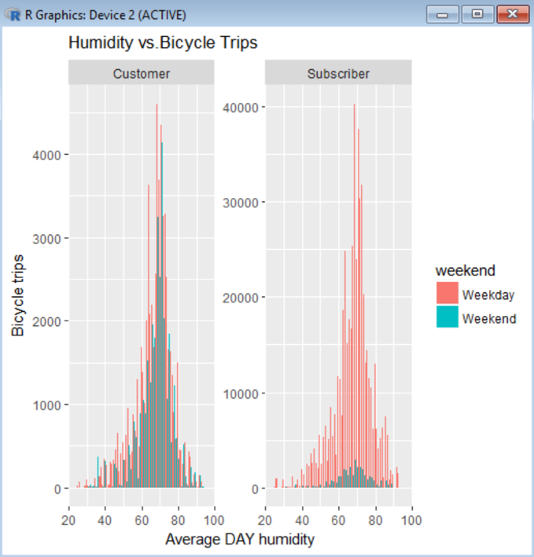
Problem 3 - Plots
Customers and subscribers both love to ride when humidity is between 60 to 80.
Less trips are recorded when humidity is more.

Slide 15
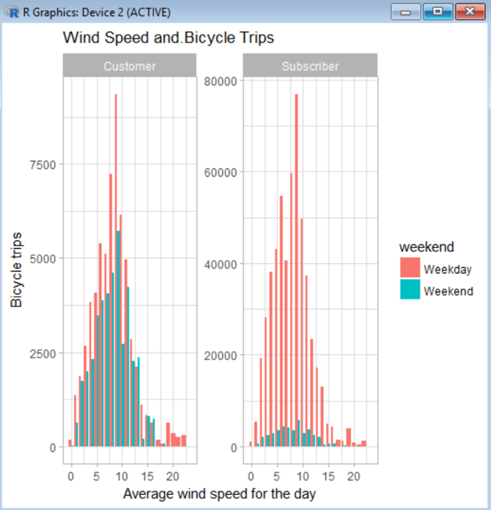
Problem 3 - Plots
Customers and subscribers both love to ride when the wind speed is around 9-10mph.
Least trips are recorded when its windy.

Slide 16
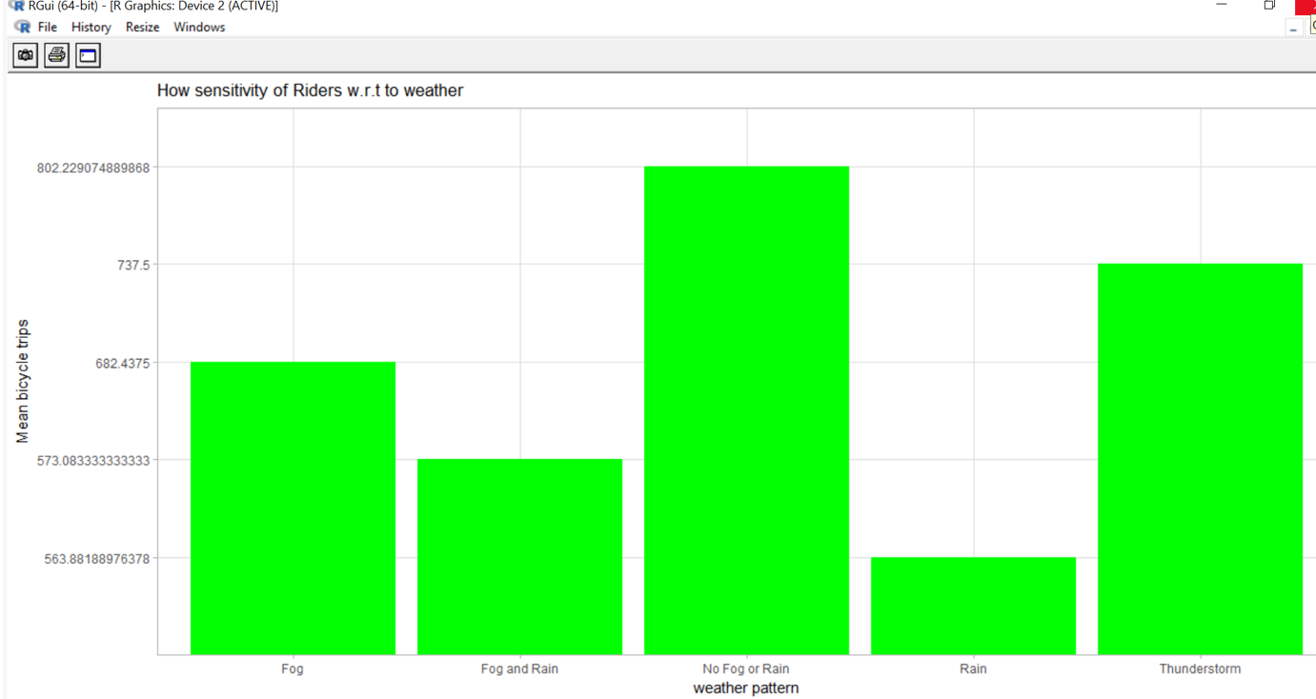
Problem 3 - Plots
Best time when riders love to ride is when the weather is clear or there is ‘No fog or rain’.
Interestingly, people love to ride during ‘Thunderstorm’.
People don’t like riding in the ‘Rain’ according to our analysis.

Slide 17
Steps Performed During Data Analysis
Problem 4) - Do the bike trip patterns vary with the time and day of the week?
Dividing date into each month, days of week.
Verifying peak time when bikes are rented the most.
Bar plot for each day vs minutes.
Histogram for peak timings for total number of rides.

Slide 18
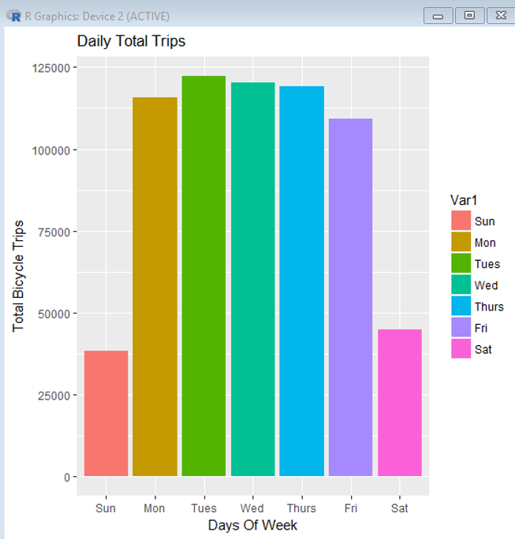
Problem 4 - Plots
After we analyzed that people take more trips on weekdays, we further see that ‘Tuesday’ are busiest days.
Sundays are the least busiest day in terms of bike renting.

Slide 19
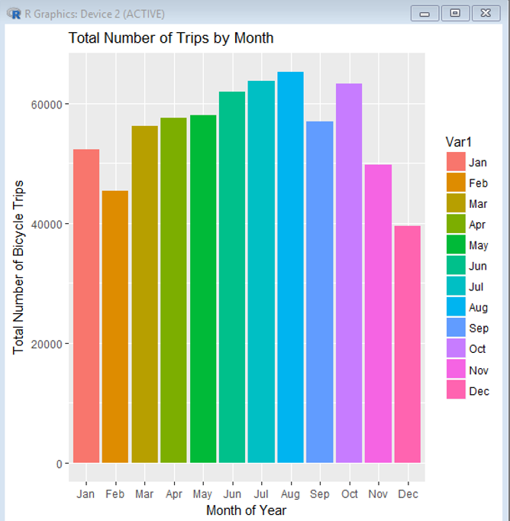
Problem 4 - Plots
July and August are of the most busiest months where most bikes are rented.
December records the least number of bikes rented.

Slide 20
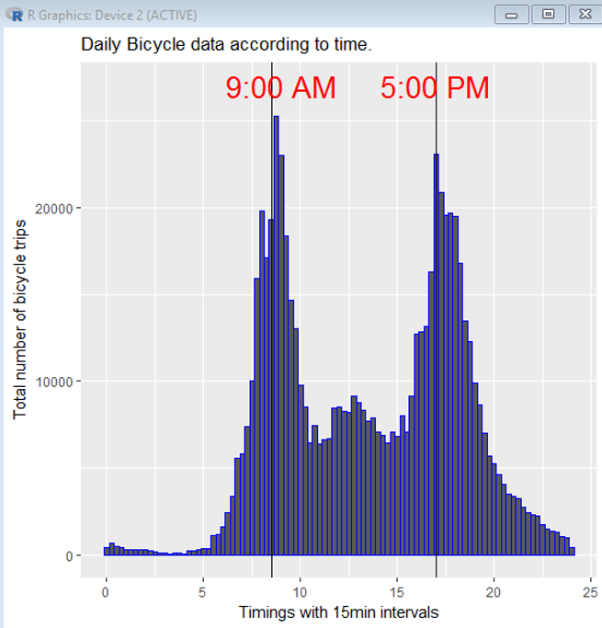
Problem 4 - Plots
This plot shows the busiest time which is 9:00 AM in the morning and 5:00 PM in the evening.
Least bike rental is done at 12:00 AM to 5:00 AM in the morning.

Slide 21
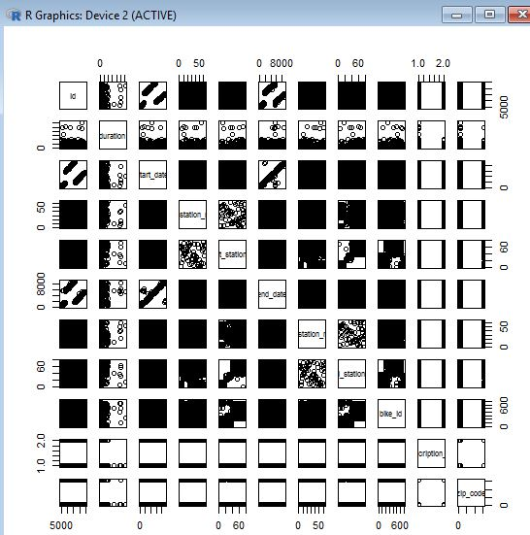
Model Creation
Verifying scatter plot to check linear relationship between attributes.

Slide 22
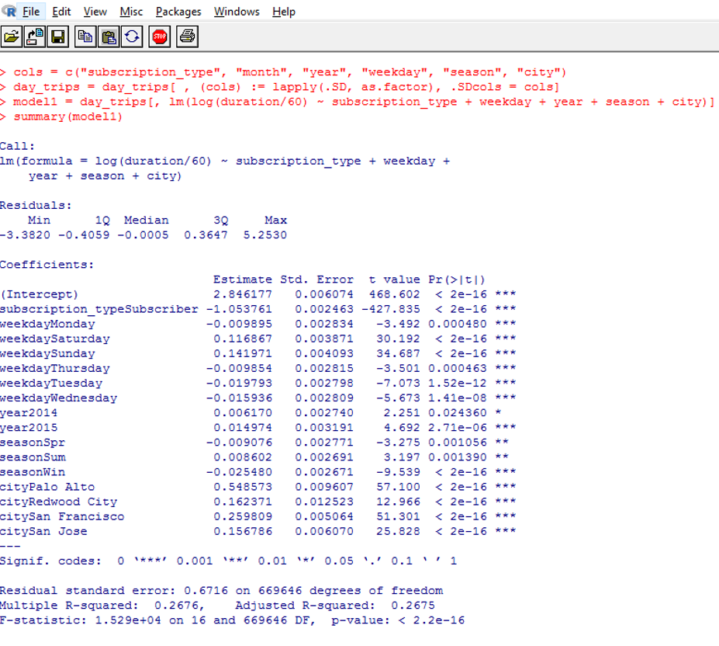
Model Creation
We created an initial model where we get 26.75% accuracy to get average bike trip duration.
All variables have significant impact as p-value is <0.05 at 95% confidence interval.

Slide 23
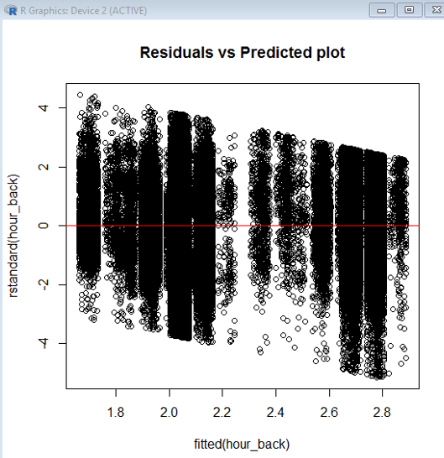
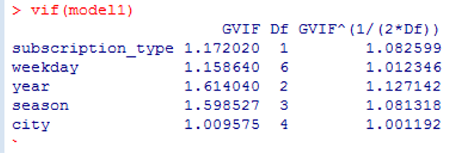
Model Creation
We plot the residuals vs predicted plot and we see there are many outliers having value > 3.
VIF value for each variable is < 5 and hence we don’t have any multicollinearity problem.

Slide 24
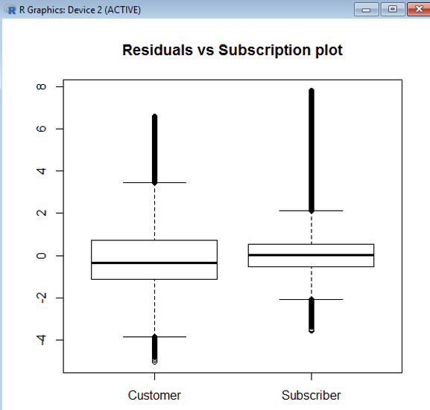
Model Creation
Plotting residuals vs
subscription type.

Slide 25
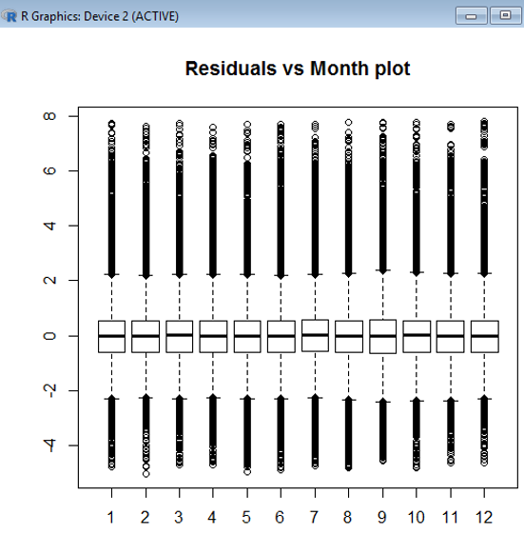
Model Creation
Residuals vs Month plot.

Slide 26
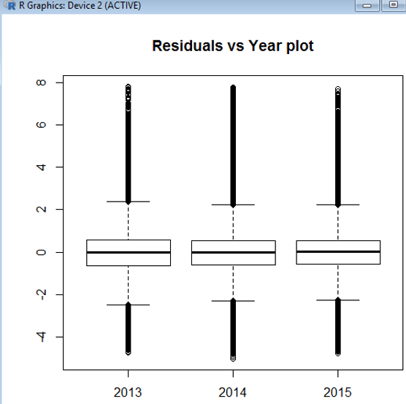
Model Creation
Residual vs year plot

Slide 27
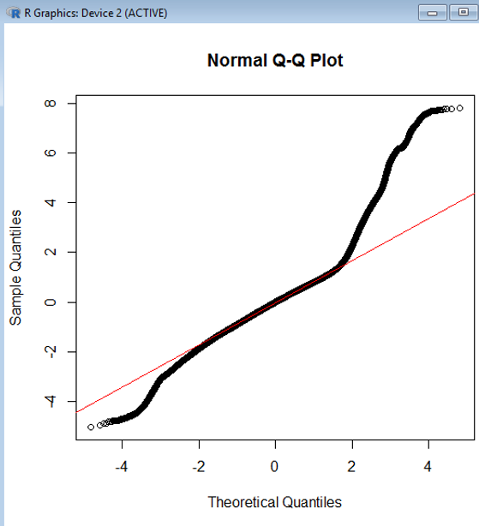
Model Creation
Plotting QQ Plot we check for outliers having values > 3.

Slide 28
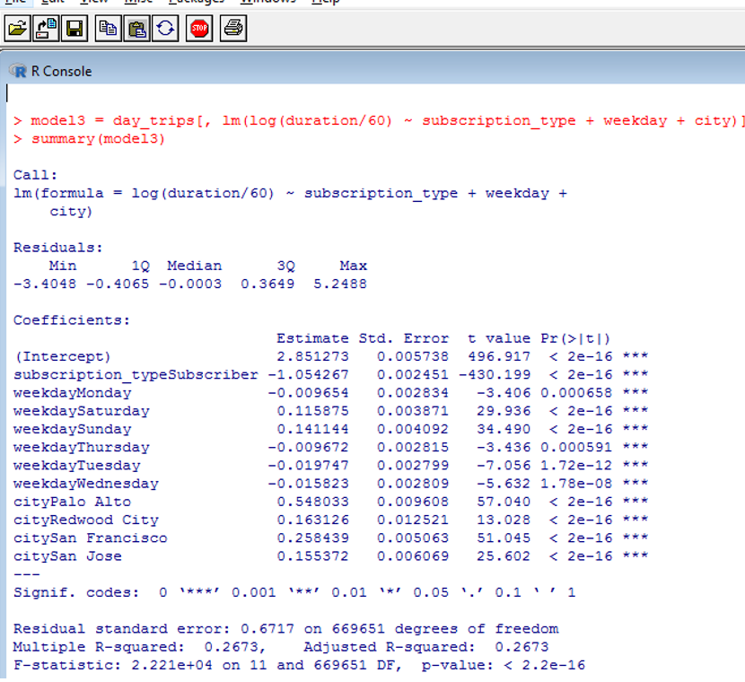
Model Creation
By backward elimination we get a new model with accuracy 26.73%.

Slide 29
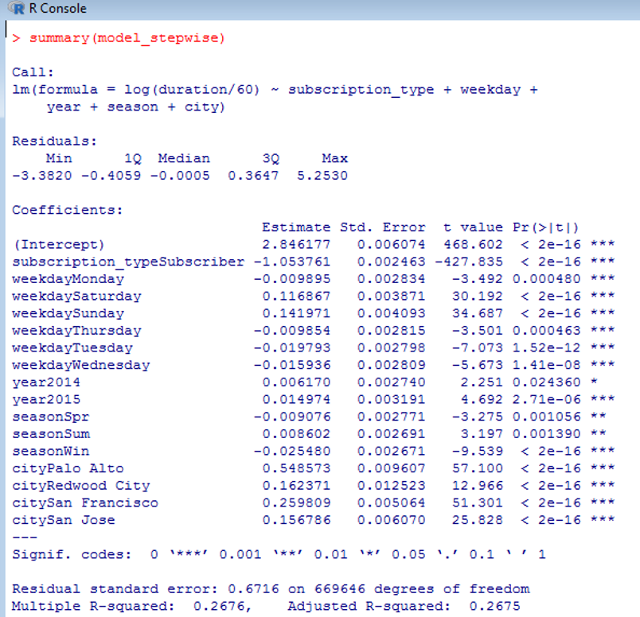
Model Creation
Using step wise elimination we get 26.75% accuracy.

Slide 30
Conclusion
We addressed all our problem statements and below were the outcomes:
Average duration of bike trips is around ‘9 minutes’.
People prefer to rent the bike more over the weekdays than weekend.
Best time when riders love to ride is when the weather is clear or there is ‘No fog or rain’.
People love to ride when weather is like ‘Thunderstorm’.
People don’t like riding in the ‘Rain’ according to our analysis.
This plot shows the busiest time which is 9:00 AM in the morning and 5:00 PM in the evening.
Least bike rental is done at 12:00 AM to 5:00 AM in the morning.

Slide 31
THANK YOU !

