Slide 1
SEcure data hiding in image using steganography
Presented By:Navuluri Sowmya
Qualification & Department : BTech Graduated ,CSE

Slide 2
OUTLINE
Problem Statement
Technology used
Wow factor
End users
Result
Conclusion
Git-hub Link
Future scope

Slide 3
Problem Statement
As cyberattacks increase, securing sensitive information during transmission or storage is a major concern. Traditional encryption methods often make data appear altered, attracting attention from attackers. The challenge is to find a way to hide sensitive data securely and discreetly, using techniques like steganography, to prevent detection.

Slide 4
TECHNOLOGY USED
Platform Specifications:- Operating System: Windows
Version: Windows 10 or later (Recommended for compatibility)
Architecture: 64-bit or 32-bit (64-bit recommended for better performance)
RAM Recommended: 4 GB or more
Programming Language:Python
Version: Python 3.13.2
Other Software Requirements:
IDE (Integrated Development Environment): Optional, but tools like Visual Studio Code, PyCharm, or any text editor can be used for editing the code. Python Package Dependencies:
OpenCV (cv2): pip install opencv-python
Pillow (PIL): pip install pillow
Tkinter: Usually pre-installed with Python. If not, it can be installed separately (pip install tk).

Slide 5
Wow factors
The project uses custom encryption and decryption functions for improved flexibility and security, making it more adaptable and harder to crack.
Tkinter-based graphical user interface (GUI) that simplifies interaction, allowing users to load images, enter secret messages, and manage passwords easily, making it more user-friendly compared to command-line tools.
The application offers real-time feedback, such as success and error messages, to keep users informed about the system's status and any missing inputs.

Slide 6
End users
Adobe Photoshop (Digital Watermarking):
Example: Adobe Photoshop uses steganographic techniques in its digital watermarking feature, allowing users to embed invisible watermarks within images. This ensures that copyright owners can prove ownership of digital artwork without altering the visible appearance of the image.
Telegram (Secret Chats):
Example: Telegram uses a variant of steganography for hiding metadata or concealed messages in its secure "secret chats," ensuring that even if a message is intercepted, its contents cannot be easily deciphered by outsiders.

Slide 7
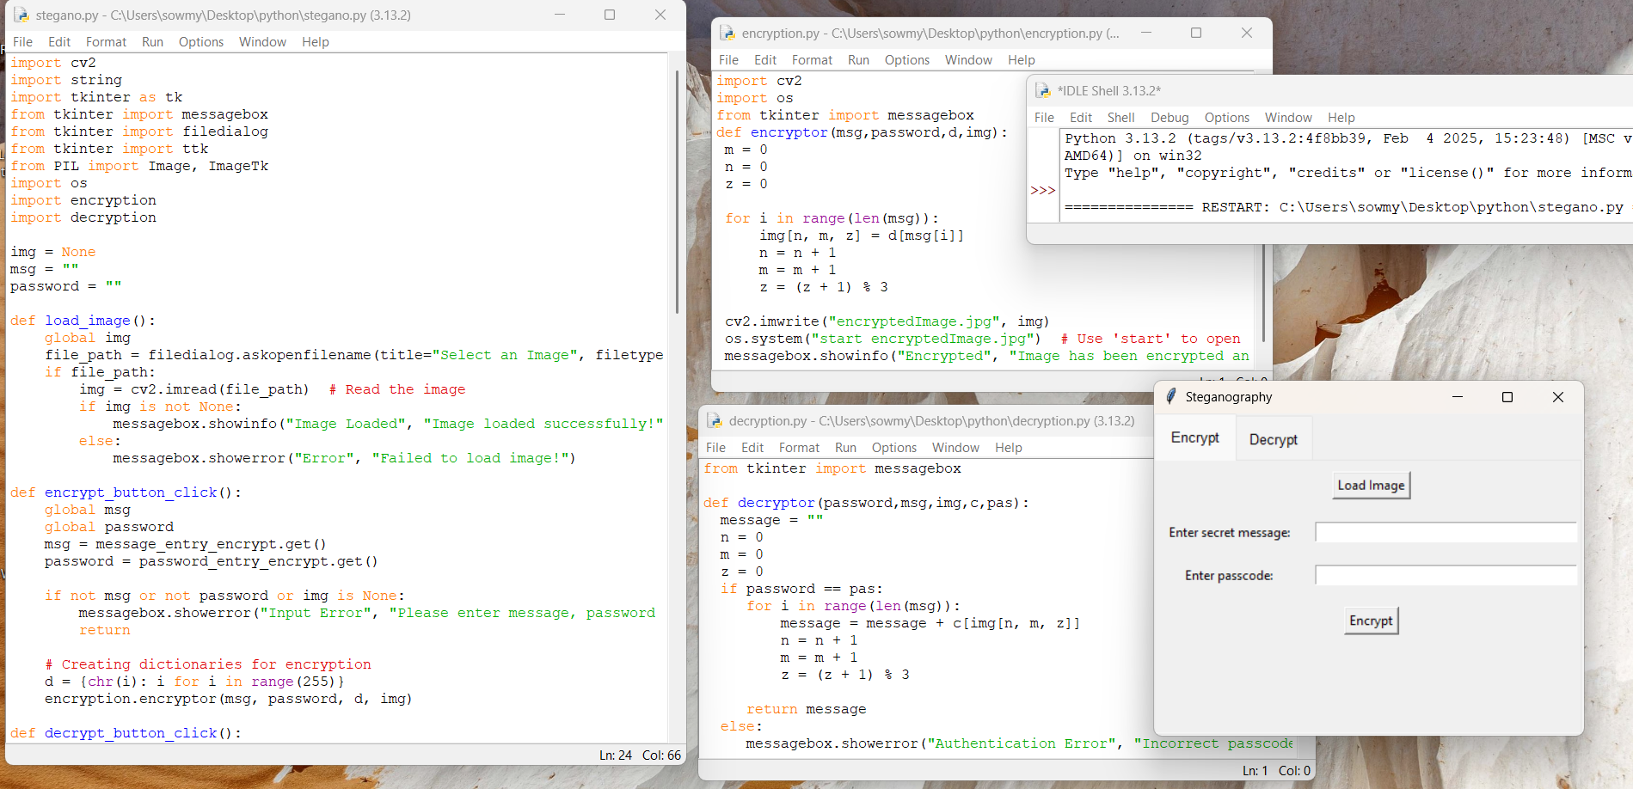
RESULTS
Run stegano.py (Main file) for output->

Slide 8
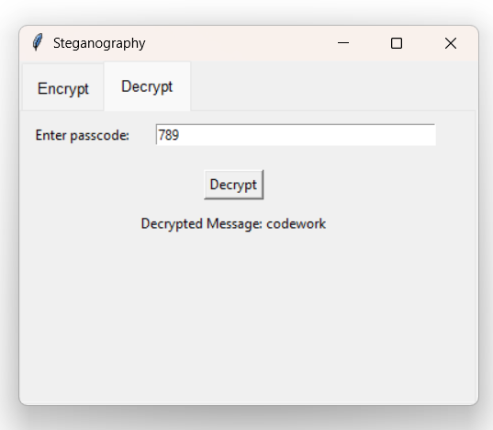
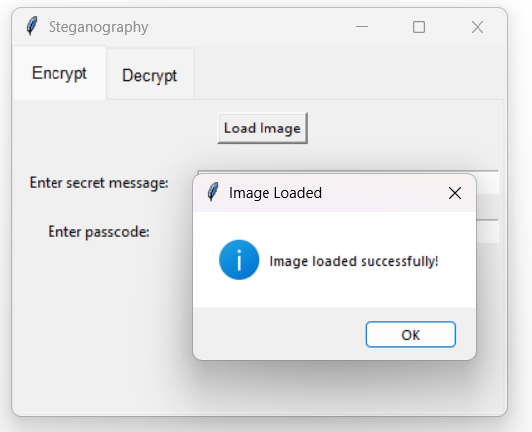
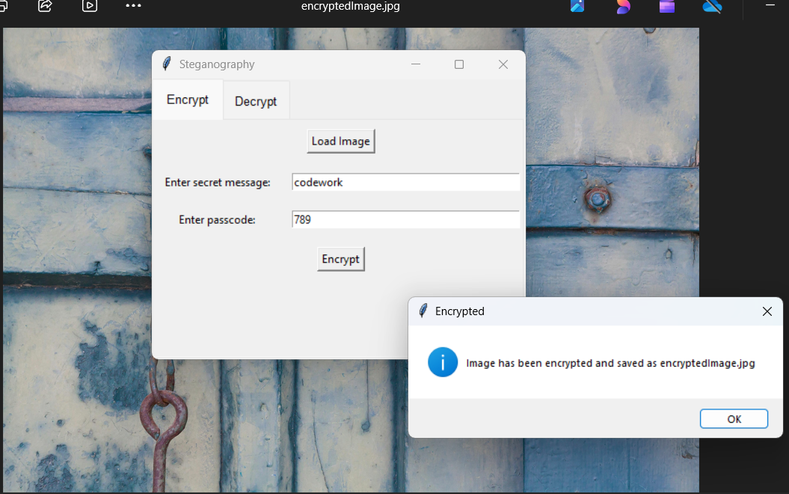
Results

Slide 9
Conclusion
Steganography securely hides sensitive data within media, offering an extra layer of protection against cyberattacks and unauthorized access, while complementing traditional encryption for enhanced privacy and security.

Slide 10
GitHub Link
https://github.com/NavuluriSowmya/Steganography.git

Slide 11
Future scope
Multiple Message Embedding: Instead of hiding just one message, you could allow the embedding of multiple messages or even files (e.g., text files, PDFs) within the image.
Image Authentication: Use machine learning models to authenticate whether an image has been altered by steganography. This could be useful for detecting tampered images in sensitive areas like journalism or security.

Slide 12
THANK YOU

