Slide 1
GSW INTERFACES
- An Overview

Slide 2
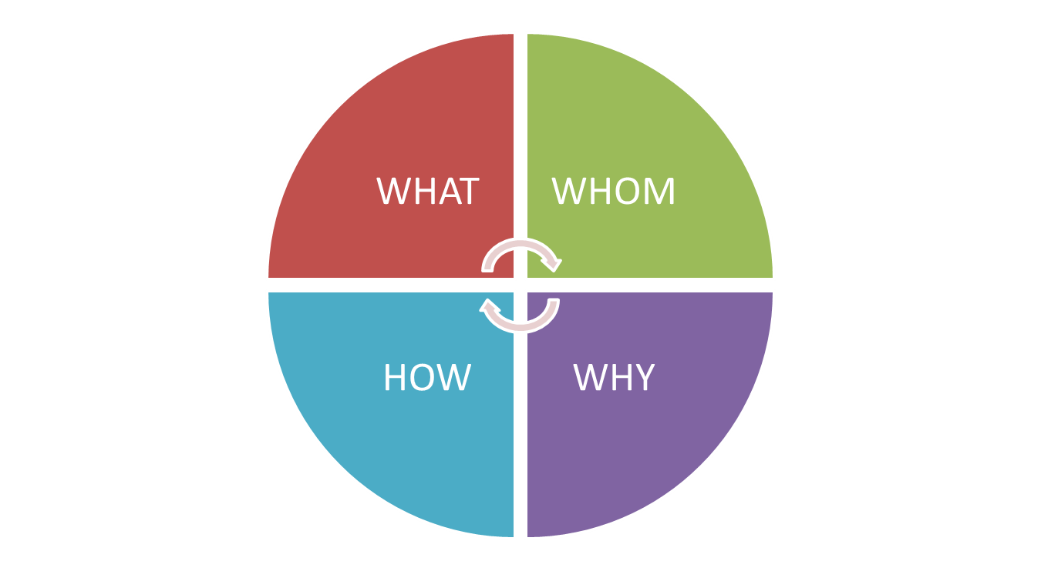
Scope

Slide 3
Interface - Definition
An interface is a shared boundary across which two separate components of a system exchange information.

Slide 4
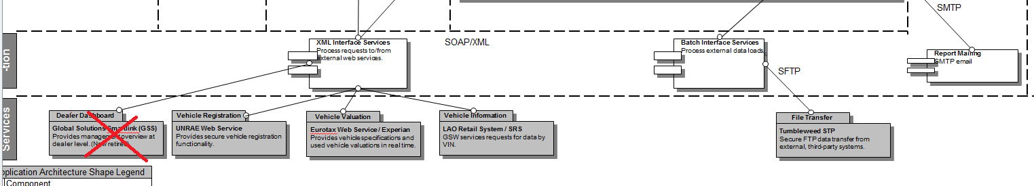
Types of Interfaces services

Slide 5
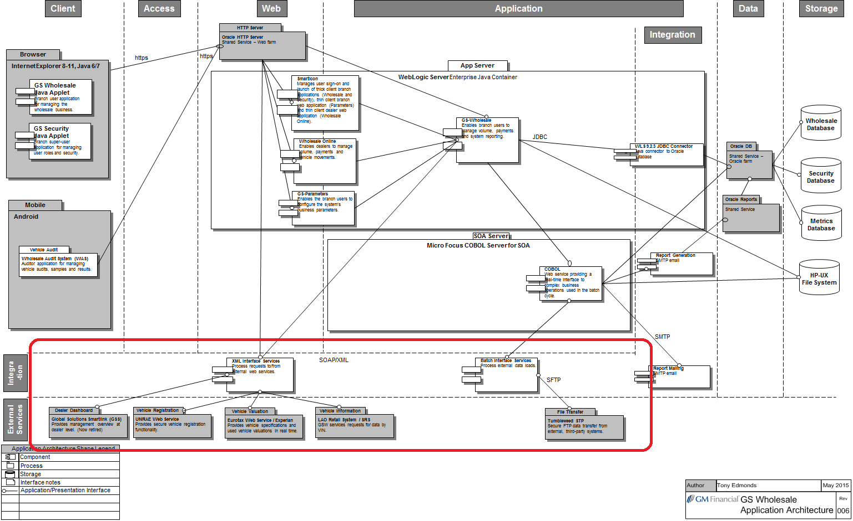

Slide 6
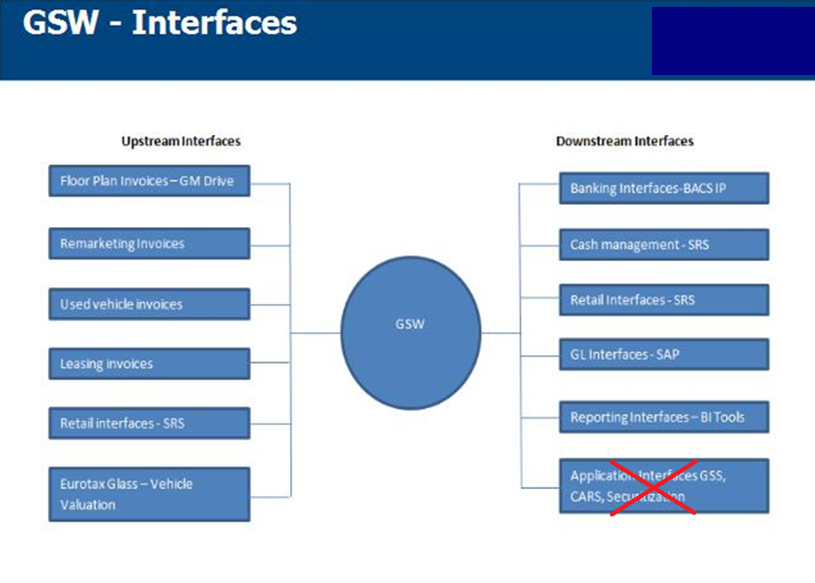

Slide 7
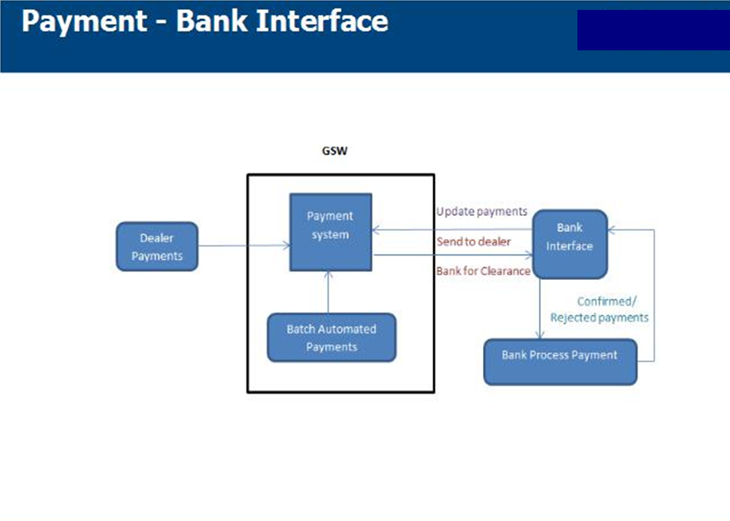

Slide 8
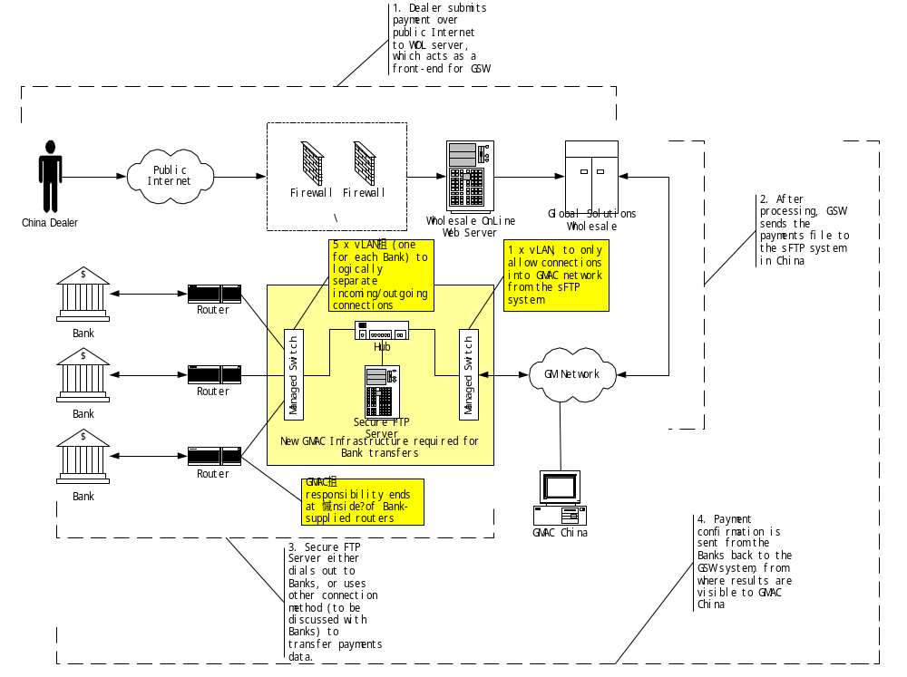

Slide 9
Process Flow
GMAC-SAIC make a payment transaction in GS Wholesale (running on China HP Superdome)
Transaction file is sent to GMAC-SAIC Shanghai Exchange Server using CA-XCOM.
The centralized transfer software RSV on the Exchange Server picks up file and sends to bank over direct line.
Once receiving the file, Bank immediately completes the transaction during Business Hours.
Bank sends confirmation file to GMAC-SAIC Shanghai Exchange server.
CA-XCOM picks up confirmation file and send it to GSW Server in China for processing.
Example Bank File: - Direct debit File (XD69Dbbb.ddd) GMAC SAIC → Bank)
Direct Debit confirmation file Bank → GMAC SAIC

Slide 10
Bank Transaction file directory
WSFRGMAC | Input file directory for files sent from GMAC GSW
WSFRBANK | Output file directory for GSW files returned from Bank
WSBKGMAC | After fetching file from WSFRGMAC bank to move file to here
WSBKBANK | After fetching file from WSFRBANK GSW to move file to here

Slide 11
Transfer Frequency
GSW will be configured to send and retrieve files to the bank server every 5 minutes.
The banks are required to configure their transfers using the same interval.

Slide 12
BACS - IP
Bankers' Automated Clearing Services, is a United Kingdom scheme for the electronic processing of financial transactions
Direct Debits and BACS Direct Credits are made using the BACS system.
Windows2k3 server uses a HSM (hardware security module)automatically encrypt and transmit the data files securely to BACS
Files sent to the BACS server will be picked up by the Experian Payments Gateway and processed internally via a pre-defined workflow, which includes validation prior to transmission to BACS.

Slide 13
GSW Files to BACS
  The non-Dealer Loans file is sent to BACS, filename; PXD59IXD.XMT.
  Receives x2 workday files after the European batch cycle, typically at *19:00hrs.
  Monthly; x2 additional files are processed at month end.
  Jobs affected; WS26ED21.BAT (daily) and WS26IN21.BAT (monthly) using the transmission script; WS26FTPE.BAT.
  The transmission happens Via WS_SFTP.
  Other files to BACS includes : - GMAC Cardiff (SAP), Retail DD, Leasing DD (ARUDD)
  Monitoring check done by IO Apps teams for these files
  “BACS-IP 08:00 Hrs UK- Check Report”

Slide 14
WS_SFTP
IPSwitch WS_FTP Server is an sFTP product that runs on Windows server(s), for GMF primarily hosted in Doxford.
It has been implemented as part of the GIF/Tumbleweed transfer solution for GSW.
it is used for countries who were not happy with utilising Tumbleweed directly for file transfers, so enables files to be dropped and collected from local file server directories.
Currently only in use for Germany, Italy and China (separate server).
Tumbleweed picks up files from the GSW GIF outbound directories, transfers to Tumbleweed then pushes out to WS_FTP. The WS_FTP Server has virtual folder mappings to remote file and print servers
WSFTPSVRCK is the job that is called to WS_FTP the files

Slide 15
BI Reporting
Every month end GSW export data and provide to Business Intelligence system
The job starting with BI*.BAT extracts the required data to BI
You can see list of BI extracts and tables under $ICR
The file named Sweden-2012-03.tar.z(Eg) were were produced from GSW and moved to $GSW_SECFTP_HOME/outbound/BI
Files are picked up by GIF (Wipro) from:- pwhsappkg1/app/gsw/batcheu/gs/filetransfers/gif/outbound/common/otf/monthly after Columbia Month End.
Tumbleweed job (WSTUMB36/37) collects them from the individual packages and puts them in the one GIF directory for WIPRO to collect

Slide 16
BI File Transfer flow
/pwhsappkg?/app/gsw/batchgy/gs/filetransfers/tumbleweed/outbound/BI/* .tar.z to outbound/BI/* .tar.z
sftp> put outbound/BI/* /pwhsappkg4/app/gsw/batchap/gs/filetransfers/tumbleweed/outbound/BI
sftp> get /pwhsappkg4/app/gsw/batchap/gs/filetransfers/tumbleweed/outbound/BI/* /pwhsappkg1/app/gsw/batcheu/gs/filetransfers/gif/outbound/common/otf/monthly

Slide 17
GL Interface – SAP Blackline system
GSW provides the financial information to GL through a flat file using local company codes, accounts ,closing balances for reconciliation of the SAP G/L balances with GSW closing balances
GSW will generate one file for each country and send the files
      Chile GSWMX090711051906.TXT
      Colombia GSWCO090711051500.TXT
      Mexico GSWCL090711051214.TXT
Files will be received by the GIF and process executed each 15 minutes Monday through Saturday.
Business contacts will receive audit emails from GIF regarding the file status and from SAP in case of any error in the IDocs
The G/L Account are set in G/L Account Consolidation parameter screen. the Aggregate Ledger Account field is set for aggregated account.

Slide 18
GL Interface - SAP
GSW
Generate file
User to extract report from GSW
GIF UK
Collect file from GSW
Submit file - sFTP
1
GIF SAP
Process files and format validation
2
SAP Fields derived (mapping table)
3
4
5
SAP
6
Documents posted
User to extract information from SAP
IDoc posting process
User
Reconcile information
7
 | Checkpoint | Error/Success scenario | System Response | Notification | Response
 | File was successful generated and transmitted sFTP | File generated and transmitted using sFTP to GIF SAP | After push the file check sFTP log for success / failure transmission status. | No automatic notification | In case of failures GSW team to contact SAP sustain team to check for transmission or possible password issues or to communicate file generation / transmission issues.
 | Files with correct format or no input files in drop zone | Out of balance Required fields Record length No file expected | File rejected – no postings in SAP No input files in drop zone | Automatic email notification to the business – file rejected | Business to contact service desk and report GSW – SAP interface issue; request to assign to GSW team providing file name and Country. Expected: GSW to fix and resend the file If no file or no more files are expected no action is needed.
 | Transformation rules | Company code doesn’t exist | File rejected – no postings in SAP | Automatic email notification to the business – file rejected | Business should analyze and If it’s an issue in GSW follow response on check point 2 to fix information and generate new file If it’s an issue on mapping tables contact SAP CoE to request changes and reprocess the file
 | Transformation rules | Account doesn’t exist | Post to suspense account | Automatic email notification to the business. Records that went to suspense account indicated. | Business should analyze and If it’s an issue in GSW follow response on check point 2 to fix information and generate new file If it’s an issue on mapping tables contact SAP CoE to request changes and reprocess the file User needs to reclassify entries in suspense accounts
 | File process successful | File processed | IDocs created | Automatic email notification to the business. | Documents posted if no failures in IDocs after max. 15 min. Business to reconcile information GSW vs. SAP
 | IDocs posting process | IDocs posting errors | IDocs in error status – Users can expect partial posting or no postings at all | Automatic email notification Idoc failure CoE notification to business and information in error | Business should analyze and decide depending on the error reported. IDocs in error will be deleted Business should fix and manually upload the information using the ZGLUPLOAD transaction
 | Business process reconciliation | Information doesn’t reconcile | Manual process | No notification | Business to analyze information generated vs. posted and contact CoE and GSW to report discrepancies.

Slide 19
INTERFACES WITH LAO RETAIL FOR WHOLESALE PROCEEDS PAYMENTS (UNITS)
The Retail system has a button on the ‘Components – Compra de Contrato’ screen that allows a branch user to verify the Outstanding Balance information of a vehicle in GSW.
The user types a VIN number on the screen and then clicks the ‘W/S’ button, and then the application sends this VIN number in an XML message to the GSW system, using an HTTP connection within the GMAC network.
In GSW there is a Web Service that listens to the Retail system requests. When an XML request arrives from Retail, the Web Service will look for the VIN number in the GSW database and if it is found then it will send an XML response message to the Retail system
The LAO Retail-GSW interface is enabled through the ‘System Parameter’ component on the LAO Retail System

Slide 20
LAO Retail
Incoming File : - Retail to GSW
Duplicate Finance File PWD91IFI.DAT
Retail Contra File PWP56IFI.DAT
Mexico WIP Penetration file WIPPenetrationMMYY.txt ( monthly ) – PWI77IFI.DAT
Outgoing Files: - GSW to Retail
GL Posting Reporting Detail – GIFNXX03
GL Posting Summary – GIFNXX02
Dealer Summary of Charges – GIFPWI14
Plant Payment Report – GIFNWD11
New Volume Register – GIFNVOLREG
Plant Maturity Report – GIFNWM01

Slide 21
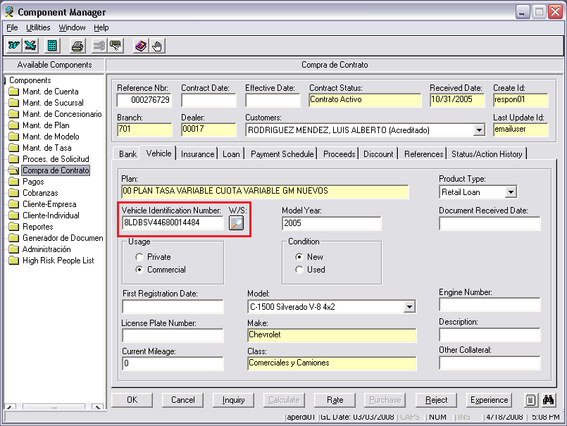

Slide 22
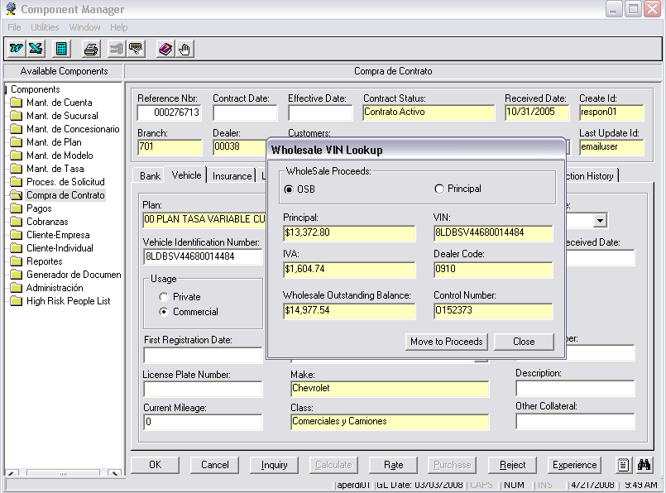
Response from GSW database

Slide 23
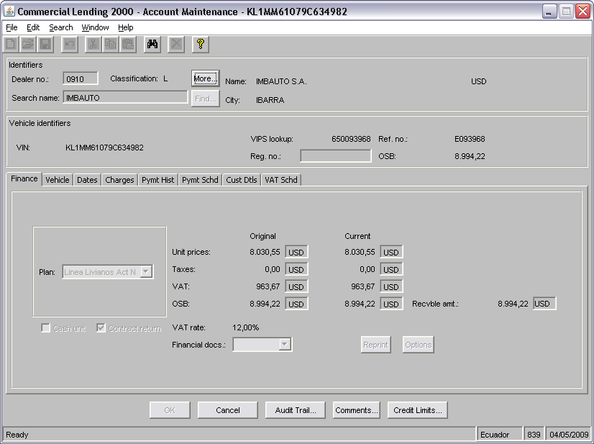

Slide 24
Euro Tax & Unrae
Eurotax: "Schwacke net" is the interface that Germany use to get prices for used cars from GSW.
GSW makes web service calls out to the public internet to obtain vehicle valuation information.
UNRAE is the Italian licensing authority. When dealers require the release documents for a vehicle in Italy (only) a request is made to the external web service at UNRAE.
At regular intervals (10 minutes) throughout the day any requests made by dealers and queued in GSW are transmitted to UNRAE over a web services interface as XML data.
GSW uses an identity certificate to obtain authorisation to connect to the UNRAE web service for GMF

Slide 25
HP ExStream & Experian
A document generation aspect, HP ExStream, is hosted upon separate servers and leveraged across multiple application domains (both wholesale and retail).
A file transfer interface is employed to send source data over to the ExStream server and retrieve the generated documents from it once complete.
GSW and WO have a direct link with the Experian system, both for lookup of the vehicle details via the registration number, and return any flags with financials, such as dual financing or if the vehicle is reported stolen.

Slide 26
Sftp transfers
Direct transfer : - In order for GS Wholesale to exchange files to the Reflections server. UNIX script called XFERSFTP.BAT.
This script calls SFTP to transmit a file directly from UNIX to an SFTP server
Batch Transfer :- writes a sftp batch transfer job (sftpsends.pending) in order to create the file list to send later in $ICR.
Every half an hour the Job WSXXBSFTP runs to picks up the file in “Pending”. Once the file transfer starts the status moves to “In progress” and then complete when the file is transferred.

Slide 27
Transfer Jobs
STUMBLE.BAT – Files sftp’d via tumbleweed
SHUFFLE.BAT - Files transferred via GIF
XFERSFTP.BAT – File transferred via reflections
XFERELIT.BAT – File transferred via ELIT

Slide 28
Thankyou

