Slide 1


By team NavyPier. © B4B

Slide 2

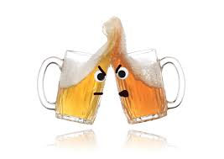
B4B is a simple RPG game which helps people decide (fairly) who should be the one to buy all the beers tonight.
There are two types of batles in the game:
Duel battle - A fight between 2 players.
Arena battle - A massacre between 2 teams, each consisting of 2 players.
The game starts when the players select the “NEW GAME” option from the game menu and choose what type of battle they would like.
Following is the creating of their own character for the game.
Each player types a name, selects a hero type and a specific class
for their hero and after every player has chosen, the game starts.
© B4B

Slide 3

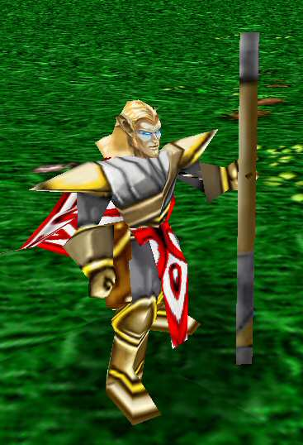
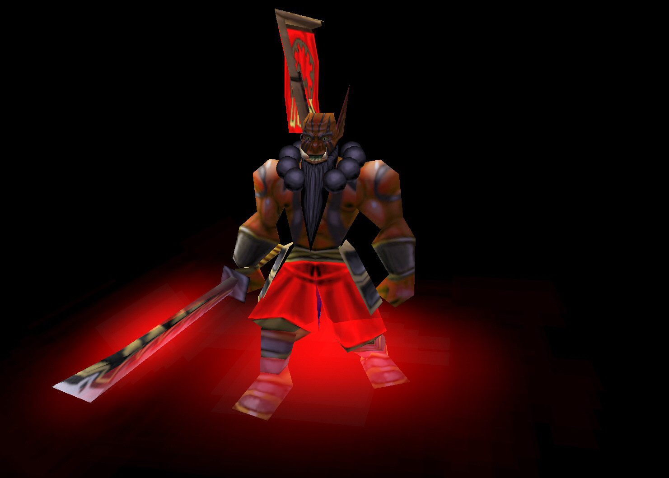
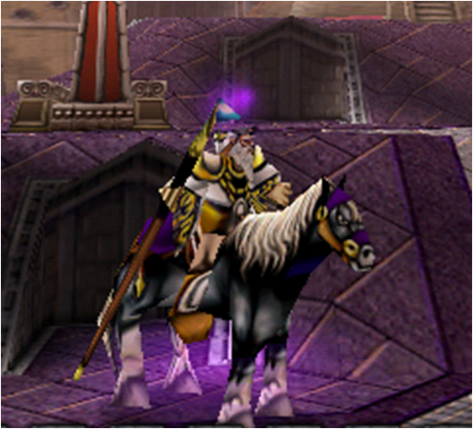
There are 3 different kinds of hero, each of which has 3 class types:
Warrior
Swordmaster
Berserker
Protection
Mage
Fire Mage
Frost Mage
Arcane Mage
Priest
Holy Priest
Discipline Priest
Shadow Priest
© B4B

Slide 4

The game provides its players with the “BEERS EARNED” menu option which helps them find out how many beers they have earned from their opponents.
After a battle is finished, the player can select the option and type the name he used during battle.
The game will automatically display all of his defeated enemies and the amount of beers that each of them
owes him.
© B4B

