Slide 1
University Health Insurance Database
Use case project
By
Sanjana Kote
Navya Pragathi Molugaram

Slide 2
Problem Definition:
Students enrolled in full-time or quarter-time programs at any University in Massachusetts are required to enroll in a health insurance policy according to state rules. A student can either choose a policy offered by their university or from any other provider offering similar coverage.
Comparing and choosing the right health insurance is crucial for students if opting out of university health insurance. Our aim of the project is to create and analyze a database for health insurance policies opted by students.

Slide 3
Requirements:
A student must be enrolled in one insurance, offered either by the university or other providers.
A student can be an undergraduate or graduate.
A claim is valid only if the balance status is positive.
Claims can be made at different hospitals.
A student can make multiple claims but a claim is associated with one student.
A policy must be linked to a provider.
A policy covers only for a year and must be renewed every year over the course duration.

Slide 4
Conceptual Design: (EER and UML)
The aim of a conceptual design is to formalize the data requirements of a business process in an accurate and user-friendly way.
EER diagram, also abbreviated as Enhanced Entity-relationship diagram. Developed on basic ER diagrams and are its extended version.The EER model offers three additional modeling constructs: specialization/generalization, categorization, and aggregation
The UML class diagram is an object-oriented conceptual data model and consists of classes, variables, methods, and associations. It also supports specialization/generalization and aggregation.

Slide 5
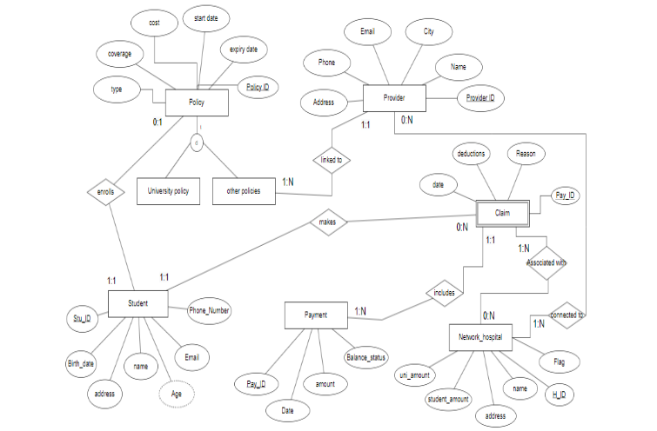

Slide 6
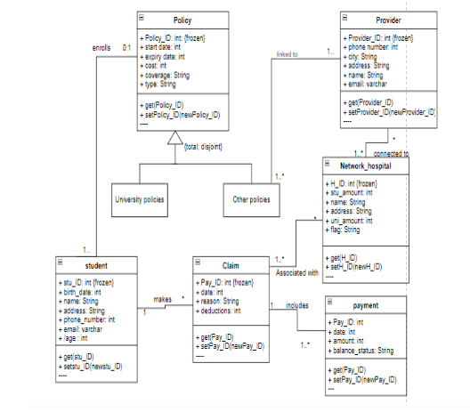

Slide 7
Relational model:
Policy( policyID, type, coverage, cost, startdate, expirydate,holderID )
UniversityPolicy( unipolicyID )
OtherPolicy( otherpolicyID, providerID )
Provider( providerID, name, city, email, phone, address)
Student (studID, name, address, dateofbirth, email, phone,age )
Payment (payID, date, amount, balance_status )
Claim (claimpayID, date,deductions, reason, studclaimID, hospID)
NetworkHospital ( hospitalID, name, address, student_amount, policy_amount)
connects( connhospitalID, connproviderID )

Slide 8
Thank you

