Slide 1
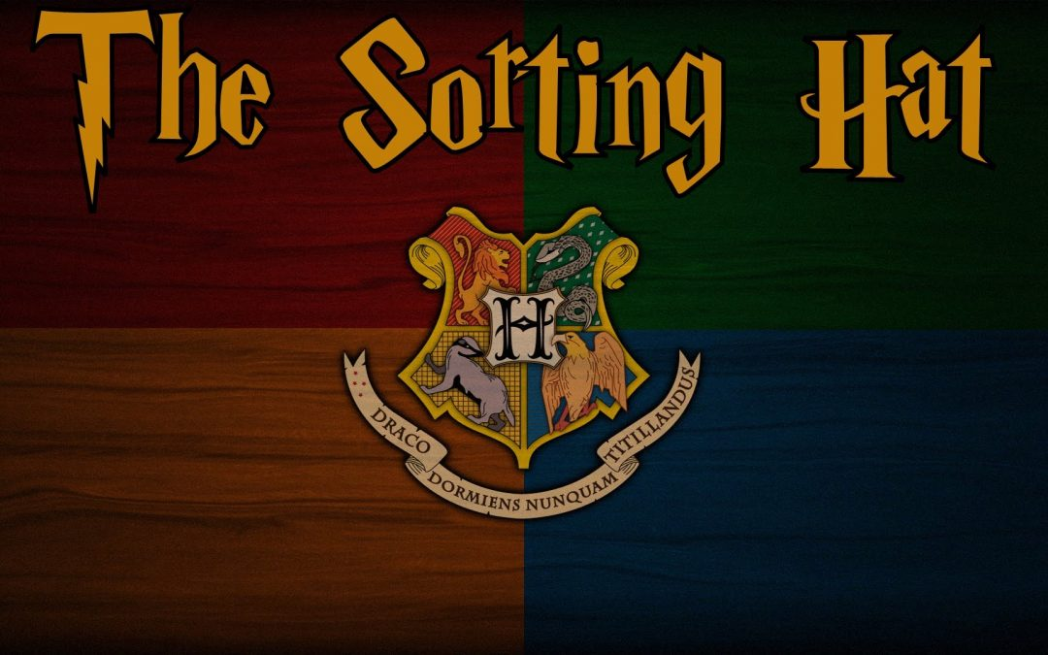
GRYFFINCLAW
TEAM NAME:
TEAM MEMBERS:
K NAGA SRI NAVYA
Email ID: kotanavya456@gmail.com
KONA SOWMYA SATYA DURGA BHAVANI
Email ID: sowmyakona1@gmail.com
VINJARAPU VISALA MOHANESWARI
Email ID: visala1225@gmail.com
KOSTU NAVEENA RANI
Email ID: kostunaveena123@gmail.com
GATTI BHARAT KUMAR
Email ID: bharathkumars.9898@gmail.com

Slide 2
OBJECTIVES:
Image Modelling.
Object detection using COCO dataset using optimal models.
Displaying the number of searches made.
Next image category prediction based on history.
Predicting top ten web-results for the next likely category of image.

Slide 3
PROBLEM STATEMENT:
With technology awareness taking an enormous leap each day, Visualizations are preferred to textual information. So, it is crucial that we update our existing technology to meet the most ignored needs of the users.
Despite having highly efficient search engines such as Google, which has taken the first step towards visualization by including search by image, we see that it fails to predict the next image search that the user might make.
With increasing browsers and social media users, the marketing field has got a brighter side, but in most cases, advertisements end up annoying users than causing the desired effect.

Slide 4
SOLUTION:
The solution to the problem statement discussed here lies in most basic aspect of image classification and object detection.
Based on the categories the previous image searches are classified into, the next category of image search can be predicted.
This can also be implemented in collaborative filtering:
                In case of browsers, based on their browsing history, advertisement falling into the most searched category will be displayed.
                In case of social media users, based on the posts they’ve liked, advertisements falling into the most liked category will be displayed.

Slide 5
DATA COLLECTION:
Secondary dataset - dataset which was available on Kaggle website online.
COCO stands for Common Objects in Context. This dataset is an excellent object detection dataset with 80 classes, 80,000 training images and 40,000 validation images. As hinted by the name, images in this dataset are taken from everyday scenes thus attaching “context” to the objects captured in the scenes. This dataset was an initiative to collect natural images, the images that reflect everyday scene and provides contextual information. In everyday scene, multiple objects can be found in the same image and each should be labelled as a different object and segmented properly. This provides the labelling and segmentation of the objects in the images. A machine learning practitioner can take advantage of the labelled and segmented images to create a better performing object detection model.

Slide 6
IMPLEMENTATION AND DATA MODELLING:
LIBRARIES USED:
      ImageAI:
ImageAI is a python library built to empower developers, researchers and students to build applications and systems with self-contained Deep Learning and Computer Vision capabilities using simple and few lines of code.
    Matplotlib:
Matplotlib is a plotting library for the python programming language and its numerical mathematics extension Numpy. It provides an object-oriented API for embedding plots into applications using general-purpose GUI-toolkits like TKinter, wxPython, QT, or GTK+. There is also a procedural "pylab" interface based on a state machine, designed to closely resemble that of MATLAB.
    GoogleSearch:
GoogleSearch library in python is used to obtain the web results of a particular query.

Slide 7
MODEL SELECTION FOR IMAGE PREDICTION:
The Image Prediction class provides functions to use state-of-the-art image recognition models like
SqueezeNet
ResNet
InceptionV3
DenseNet.
All the above shown models are used for image prediction, while, the model DenseNet gives the highest accuracy.

Slide 8
MODEL SELECTION FOR OBJECT DETECTION:
ImageAI allows us to perform all of these with state-of-the-art deep learning algorithms like
RetinaNet
YOLOv3
TinyYOLOv3
YOLOV3 algorithm of all the above-mentioned algorithms provides the highest accuracy score.

Slide 9
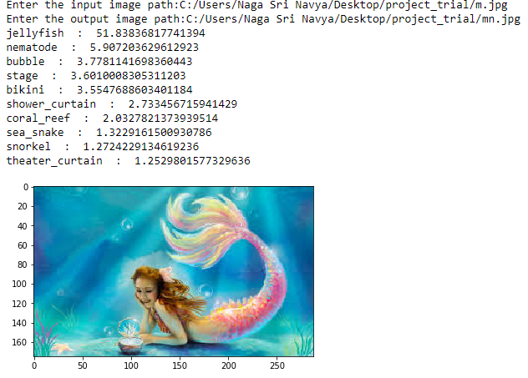
OUTPUTS OBTAINED:

Slide 10
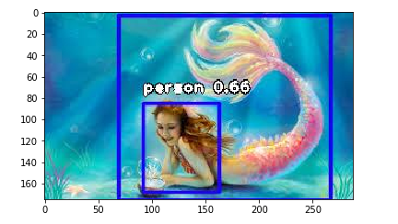
The image refers to the first image search made by the user.
The inputs given are:
The path where the image to be searched is present.
The path where the image after object detection is to be saved.

Slide 11
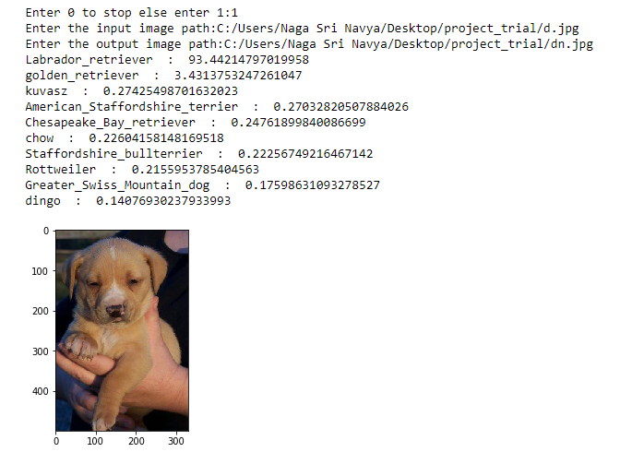

Slide 12
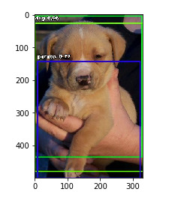
We can observe that a provision for the user to decide whether to continue the search or not is provided. As the user chose to continue the search, second object detection took place.

Slide 13
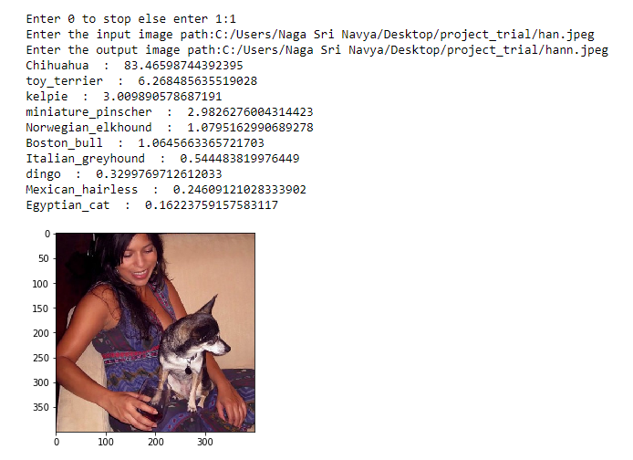

Slide 14
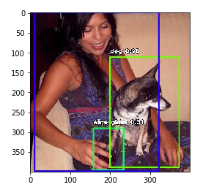
We note that the third search also ran successfully.

Slide 15
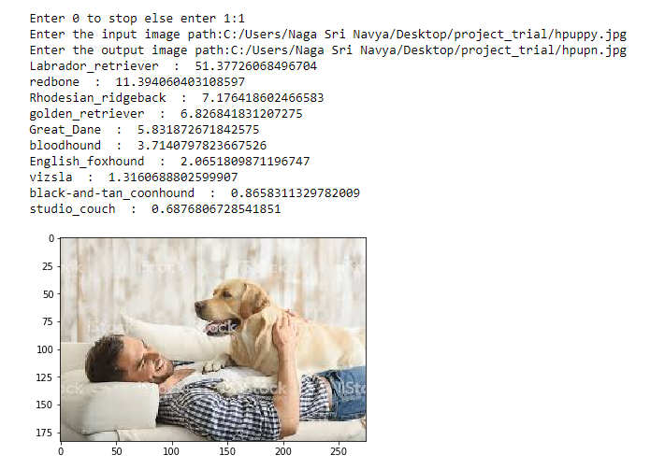

Slide 16
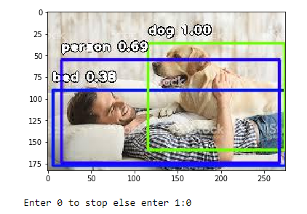
We can note that the user has now decided to stop the searching process by entering 0.

Slide 17
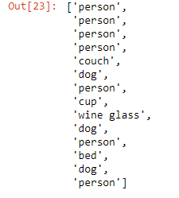
It refers to the number of searches made by the user.
The above figure shows the history of categories that have been searched for.

Slide 18
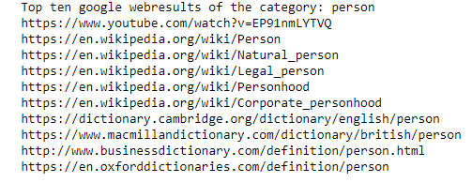
The above obtained output shows the prediction of the next likely category of the image search.
The top ten web search results of the next likely category of the image search are given by the above output.

Slide 19
CONCLUSION:
Image Modelling is done using python programming language.
Object detection using COCO dataset using optimal models is done.
The number of searches made were displayed.
Next image category prediction based on history is made.
The top ten web-results for the next likely category of image were predicted.

Slide 20
REFERENCES:
https://gitlab.iit.it/pgay/tango_demo_server/blob/2c0883d0ee1c4d82b397bfd5349595e11200f584/darknet/data/coco.names
https://www.kaggle.com/account/login?returnUrl=%2Fabhigupta4981%2Fcoco2017%2Fversion%2F2

Slide 21


