Slide 1
Entertainer Data Analytics By: Jamalpur Navya Sree CRIN2301980

Slide 2
Introduction
Normal life can be stressful, and people need to relax. Being entertained by others is a
wonderful way to take some time out of life. It can reduce stress and make life's issues
easier to face. The media and entertainment industry consists of film, television, radio
and print. These segments include movies, TV shows, radio shows, news, music,
newspapers, magazines, and books. The entertainment industry is a group of
sub-industries devoted to entertainment. The entertainment industry is used to
describe the mass media companies that control the distribution and manufacture of
mass media entertainment.

Slide 3
Main KPIs
Gender: Male and Female Entertainers
Birth Year: Year in which Entertainers born
Year of Last Major Work : Entertainers Retirement Year
Insights drawn:
Most of the entertainers were male
And most of the entertainers were born in the decade 1900-1910.

Slide 4
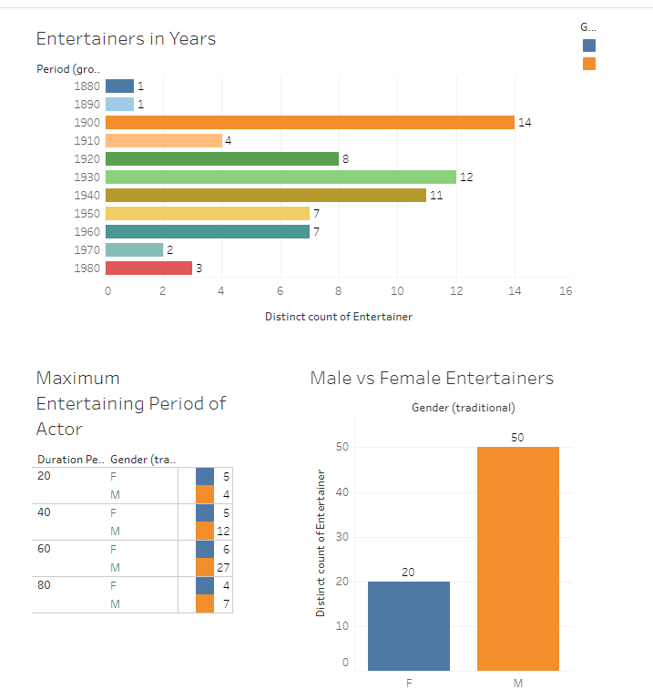
Mock – up Dashboard

Slide 5
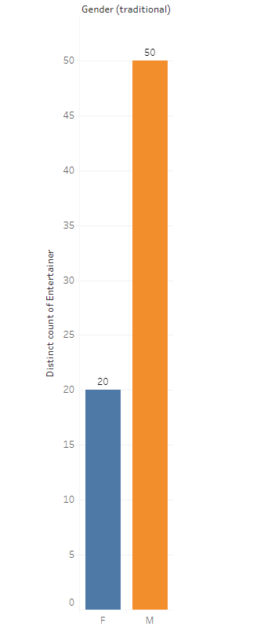
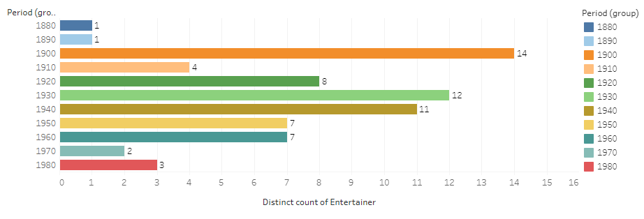
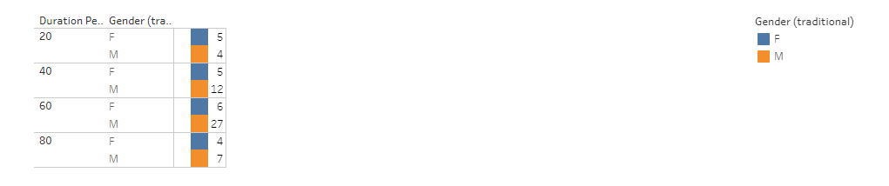
My Design

Slide 6
References
Colab Link: https://colab.research.google.com/drive/1GRmZc4eE11C_PQIsJ4IzUyIyVirQzjGJ#scrollTo=yWiOlW45y0X_
Tableau Links:
https://public.tableau.com/app/profile/navya.sree.jamalpur/viz/DashBoardEntertainmentAnalytics_16925533090760/Dashboard1?publish=yes
https://public.tableau.com/app/profile/navya.sree.jamalpur/viz/DashBoardEntertainmentAnalytics_16925533090760/Story1?publish=yes
https://public.tableau.com/app/profile/navya.sree.jamalpur/viz/DashBoardEntertainmentAnalytics_16925533090760/Story2?publish=yes
https://public.tableau.com/app/profile/navya.sree.jamalpur/viz/DashBoardEntertainmentAnalytics_16925533090760/Story3?publish=yes

Slide 7
Thank you

