Slide 1
Carbon Emission Tracking & Afforestation Monitoring Platform
Presented by
Impana E20221CBD0027
B Navya 20221CBD0031
Konki Mithil20221CBD0022
Date: 20-08-2025

Slide 2
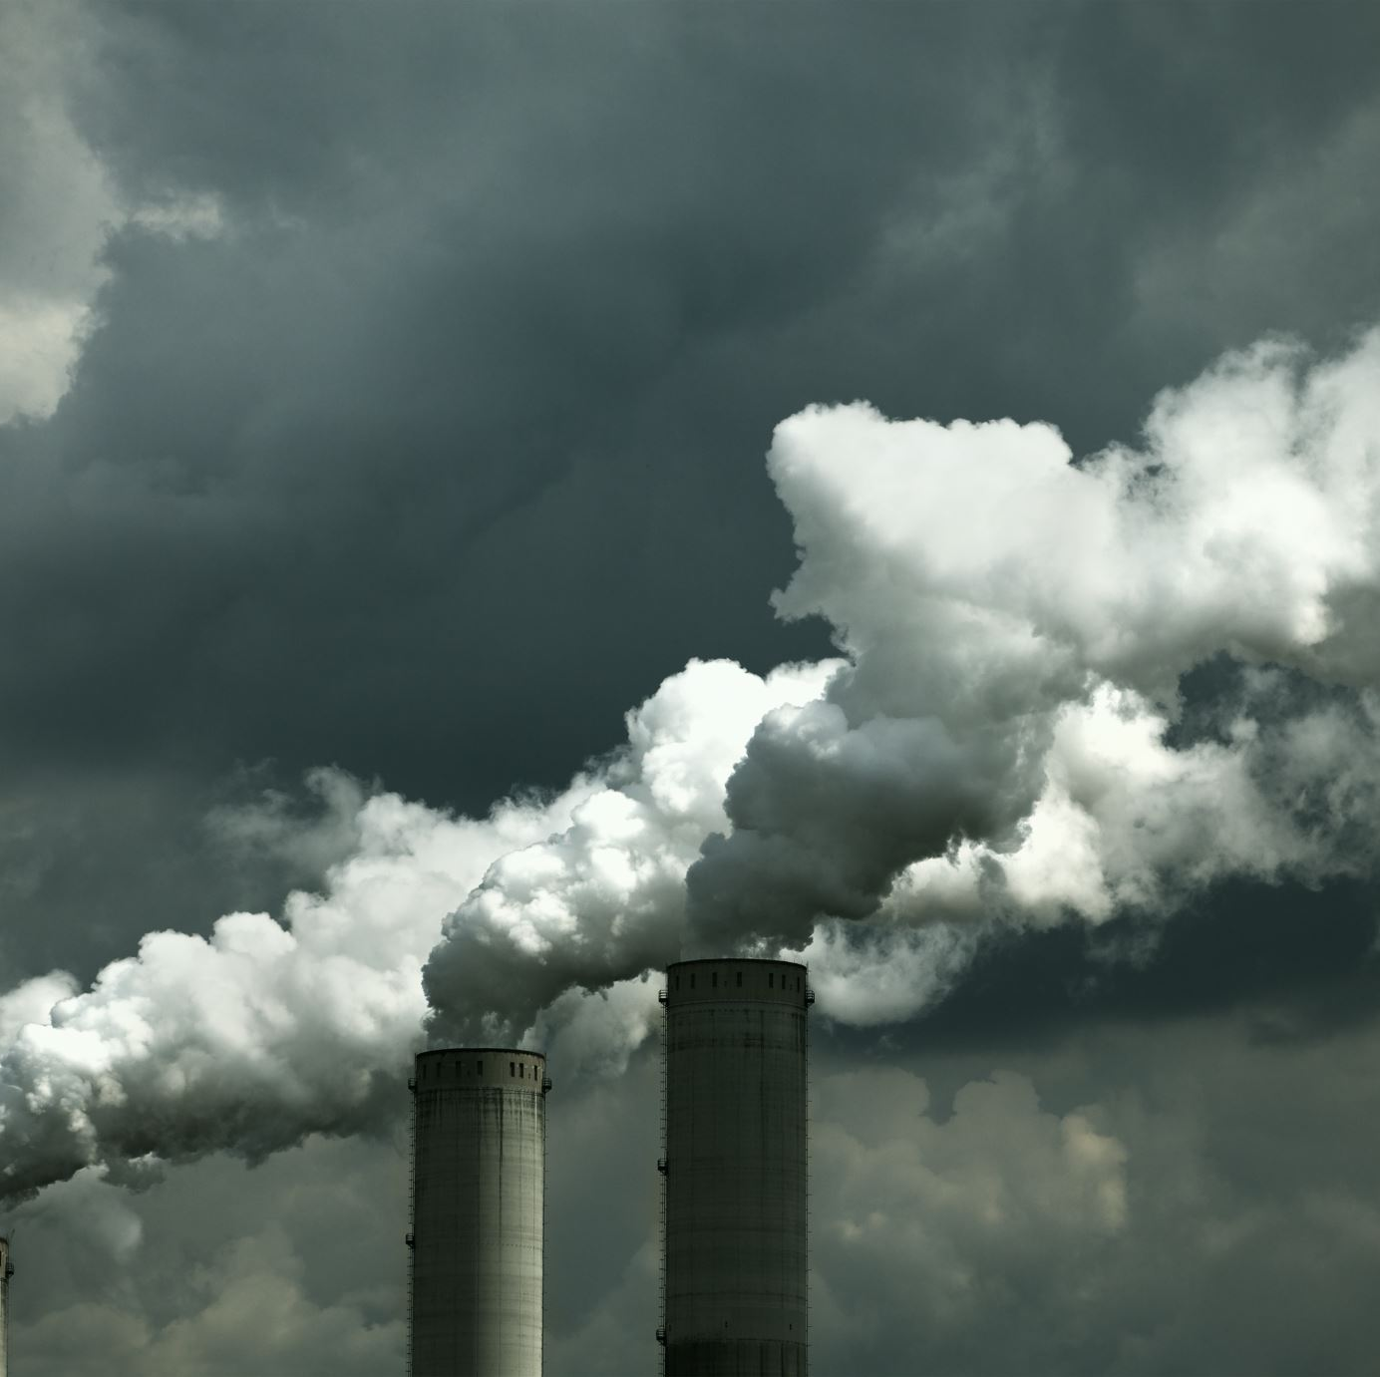
Problem Statement
Coal mining in India significantly contributes to carbon emissions.
No centralized digital system exists to quantify or track these emissions.
Manual emission tracking is inefficient, error-prone, and not scalable.
There is a need for a tech-driven, India-specific platform to assist in carbon neutrality efforts.

Slide 3
Background Context
India depends heavily on coal but is committed to net-zero targets.
Coal mines lack tools to assess emissions vs. natural absorption (carbon sinks).
Afforestation and clean technologies are underutilized due to limited data.
A smart tool can bridge this gap by offering real-time tracking and planning.

Slide 4
Proposed Solution
A web-based platform tailored to Indian coal mines.
Activity-wise emission calculation using standard emission factors.
Assessment of existing carbon sinks like tree cover, land, etc.
Gap analysis + recommendations to offset emissions via:
Clean technologies
Afforestation planning
Carbon credit estimation

Slide 5
Unique Features
Emission calculator for mining activities
Per capita CO₂ emission estimation
Gap analysis between emissions and sinks
Simulation of carbon neutrality strategies
Afforestation offset planner with state-wise presets
Carbon credit estimation at current market rates
Dashboard with charts, graphs, and trends

Slide 6

Technology Stack
Category | Tools / Technologies Used
Frontend | - React + Vite - Tailwind CSS - Chart.js
Backend | - Python (Django + FastAPI) - Custom Calculation Modules - JWT Authentication
Database | - MySQL - Hosted on Railway
Geospatial & Satellite | - Leaflet.js (interactive maps) - Google Earth Engine API (satellite validation)
Authentication | - Firebase Auth (Role-based login for secure access)

Slide 7
User Flow
User logs in (authorized personnel only)
Inputs mining data (activity-based)
App calculates emissions via predefined factors
Retrieves carbon sink data
Performs gap analysis (emission vs sink)
Suggests reduction strategies (clean tech, afforestation, credits)
Dashboard shows trends, metrics, and projections

Slide 8
UI Wireframes / Mockup's
Login Page (Simple Auth)
Data Input Form (Activity-based)
Emission Dashboard (Bar/line graphs)
Recommendation Page (Offset visual, options)

Slide 9
Project Plan & Timeline
Week | Phase | Key Activities | Review Milestone
Week 1 | Planning & Requirements | Define scope, user flow, features, tech stack | 1st Review
Week 2 | UI/UX Design & Architecture | Wireframes, system architecture, database schema | 2nd Review
Weeks 3–6 | Core Development | Build frontend (React), backend (Django), major features | 3rd Review
Week 7 | Testing & Integration | Test modules, fix bugs, integrate frontend + backend
Week 8 | Deployment & Final Presentation | Deploy on Netlify/Railway, final PPT + live demo | Final Review

Slide 10
Thankyou

