Slide 1
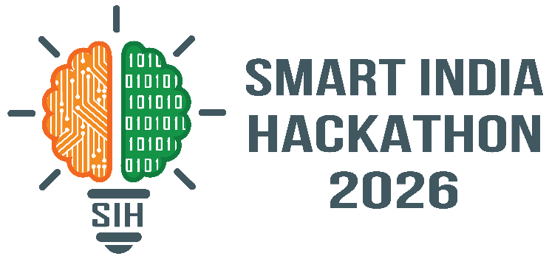
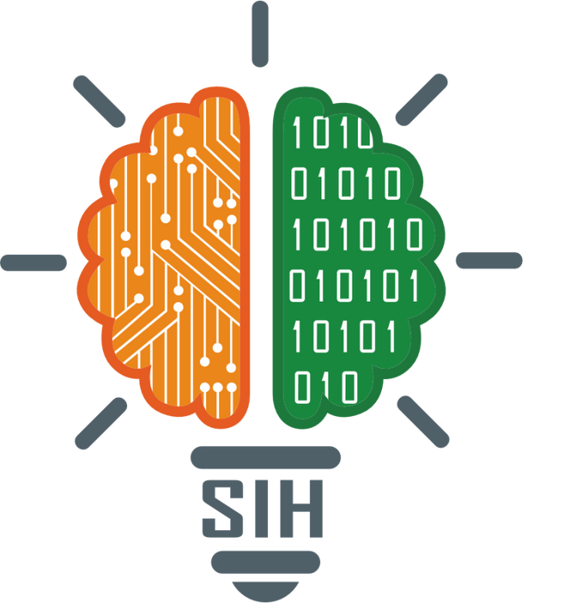
SMART INDIA HACKATHON 2026
TITLE PAGE
Problem Statement ID – SIH26042
Problem Statement Title – AI-Powered Vernacular Pedagogy and Real-Time Translation Tool for Mother Tongue-Based Primary Education
Theme – Smart Education
PS Category - Software
Team ID – SIH07
Team Name – Mystic Wizard

Slide 2

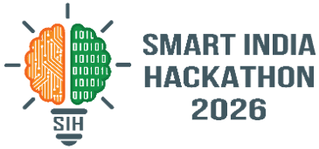




VISTA
VISTA (Vernacular Intelligence for Smart Teaching & Adaptation) is an offline classroom assistant with online teaching capabilities that helps a Hindi-speaking teacher deliver mother-tongue-based instruction to tribal-language-speaking primary students.
Innovation and Uniqueness
What is Our Solution
Multilingual Teaching: VISTA converts the teacher’s Hindi lesson into the child’s tribal language through text/audio and checks understanding.
Smart Support: It identifies learning status and provides re-teaching aids, worksheets, and flashcards when needed.
TEACH → TRANSLATE → UNDERSTAND → CHECK → RE-TEACH
How It Addresses the Problem
Curriculum-Based Learning: Keeps translations connected to the grade, subject, concept, and approved content.
Real Translation: AI-assisted translation prepares content before class; approved language packs run offline during class.
Catches Gaps Early: The understanding check flags a confused student right after the lesson, then makes a matching worksheet in one tap.
Live Translator: Teacher speaks or types a line in Hindi. VISTA turns it into Santali text and audio right away, with an offline backup so it never stops working.
1
Understanding + Re-teach: VISTA detects learning gaps of entire class students and provides a different explanation instead of simply repeating the same content.
2
AI Copilot: A floating bilingual answers open questions in Hindi or Santali with short, safe steps and never invents an answer it isn't sure of.
3
Scalable & Practical: Designed for offline, low-cost classrooms, with backup content as well to avoid glitches—teach once, reach many learners.
4

Slide 3



TECHNICAL APPROACH
VISTA TECHNOLOGY ARCHITECTURE
Frontend
Classroom App / Frontend
React.js — Teacher & student interface
HTML5 + CSS3 + JavaScript — Offline classroom UI
Capacitor — Packages web app as Android application
Android 9+ — Target low-cost classroom devices
Web Speech API / Android TTS — Speech interaction fallback
AI / NLP / Speech
Groq LLM — AI-assisted lesson/translation/worksheet drafting
AI4Bharat IndicTrans2 — Hindi ↔ Santali translation during content preparation
Vosk — Offline Hindi speech-to-text for bounded classroom phrases
Sarvam AI — Connected-mode translation / STT / TTS fallback
PyTorch + Transformers — Local NLP model execution
CONTENT AUTHORING LAYER
React Dashboard → FastAPI → Groq / IndicTrans2
↓
HUMAN / NATIVE REVIEW
APPROVED CONTENT PACK
OFFLINE CONTENT LAYER
SQLite + Audio + Worksheets + Flashcards + Fonts
Backend & APIs
Python
FastAPI — REST API & application backend
Uvicorn — ASGI server
SQLAlchemy — Database ORM
Pydantic — Data validation
HTTPX — External service
communication
Data & Offline Storage
PostgreSQL — Central curriculum, questions, students & learning data
SQLite — Offline classroom content+approved text
SQLAlchemy — Database access
JSON — Offline bundle metadata
ANDROID CLASSROOM APP
React + Capacitor + Android 9+
TEACH → TRANSLATE → CHECK → UNDERSTAND → RE-TEACH
Offline Content Layer
Pre-recorded native-speaker audio — MP3/OGG
Bilingual worksheets — PNG/PDF
Visual flashcards
Ol Chiki / Santali font
Approved translation & lesson packs
Python Export Pipeline → SQLite Bundle
Deployment / Infrastructure
Ubuntu / Local Server
Docker
FastAPI + Uvicorn
Local network / connected mode
Offline-first Android package
AI / SPEECH PROCESSING
Vosk ASR │ IndicTrans2 │ Local Phrase Bank │ TTS Sarvam = Connected Fallback

Slide 4





FEASIBILITY AND VIABILITY
Feasibility
Challenges
Solutions
Technical: Uses proven technologies like IndicTrans2, Vosk and FastAPI PostgreSQL for structured data for offline Hindi speech recognition, and for local Hindi/Santali translation.
Limited Santali Resources: No native speaker was available for authentic answer recordings and classroom audio
Human-Validated AI: Recorded answer can also be uploaded in unavailability of speaker. AI checks and validates the answer according to the question.
Low-Resource AI: Santali lacks reliable offline ASR/TTS, while machine translation quality is still limited.
Local Hub : Reviewed Santali recordings are used where TTS reliability is weak, Optional local server for synchronization and connected-mode translation , which is a practical engineering decision
Operational: Designed for offline and online both classrooms, low-connectivity tribal regions, and teacher-friendly use; content can be reviewed and preloaded before deployment.
Toolchain Constraints: Framework/tooling mismatches during development caused avoidable time loss under tight deadlines.
Practical & Reliable Deployment: Kept the React + Figma Make toolchain wrapped into a real Android APK via Capacitor.AI generates drafts, while PostgreSQL approval controls ensure only reviewed content reaches students
.
Hardware Constraints: Heavy AI models like IndicTrans2 + Vosk cannot efficiently run on 2GB RAM tablets. Scarcity of android 9 tablet for demo.
Alternative Availability Check: AI-assisted translation prepares content before class; approved content runs offline on the tablet. Uses tap-based responses, voice activity, and tested on Android Emulator pixel 3a
Financial: Uses open-source AI/software and low-cost tablet reducing licensing, cloud and infrastructure costs while allowing gradual scaling across schools.
Ol Chiki Compatibility: Stock Android devices lacked built-in Ol Chiki font support, risking broken text rendering
Resilient Bridge: Bundled Ol Chiki font locally so the app does not depend on whether stock Android already has Ol Chiki support.

Slide 5






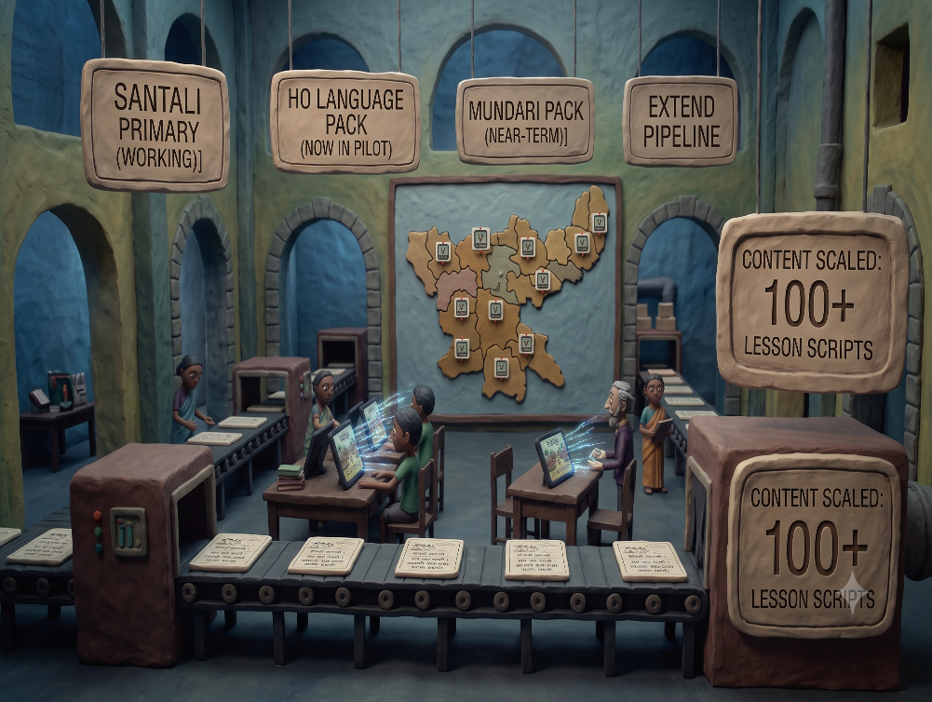



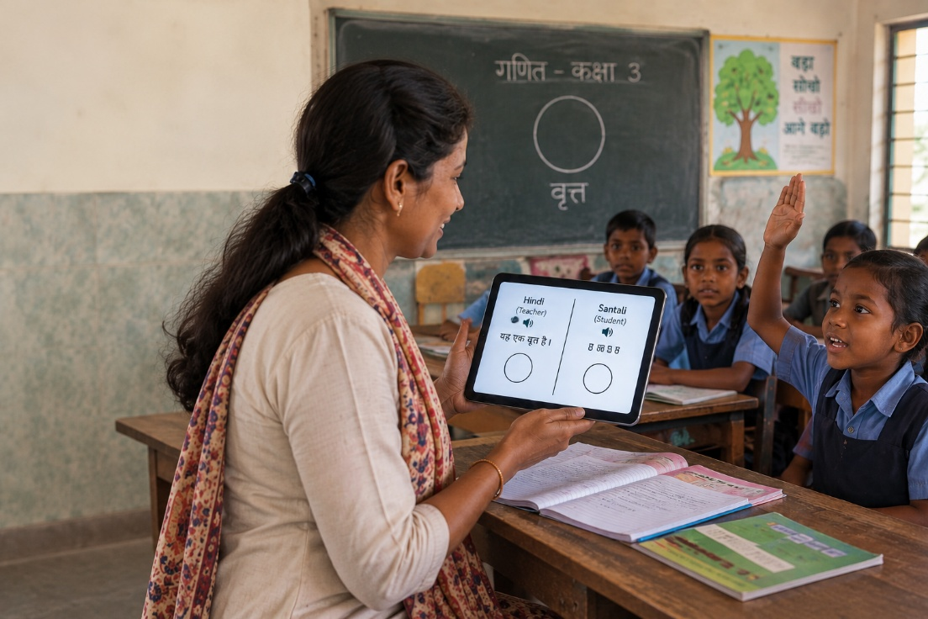
IMPACT AND BENEFITS
Mother-Tongue Learning — Helps Class 1–5 children learn concepts in the language they understand best.
Community Participation — Santali speakers validate AI-generated content before it reaches students.
01
06
Better Understanding — Uses bilingual content and quick checks to identify learning gaps early.
02
07
If there is Network Availability — Creates TTS Santali speech recognition using SARVAM.
Understand Every Child
Teacher Support — Enables non-native teachers to teach effectively without requiring Santali-language training.
Lower Deployment Cost — Reduces dependence on scarce native-speaking teachers, physical translators, and recurring cloud services.
03
08
Reduced Dropout Risk — Strengthens early learning, addressing a key factor behind primary-school disengagement.(Who are unable to attend school)
Offline Accessibility — Supports learning in low-connectivity and remote tribal regions through local processing.
04
09
Quality Content at Scale — One authoring pipeline can create reviewed tribal-language materials for many schools.
Scalable Future — Starts with Santali and can extend the same system to Ho and Mundari without rebuilding the platform.
05
10
.
V
I
S
T
A
VISTA goes beyond translation—it connects language, curriculum, student understanding, and teacher action offline
The teacher should never have to choose between teaching the subject and overcoming the language barrier. VISTA helps them do both

Slide 6



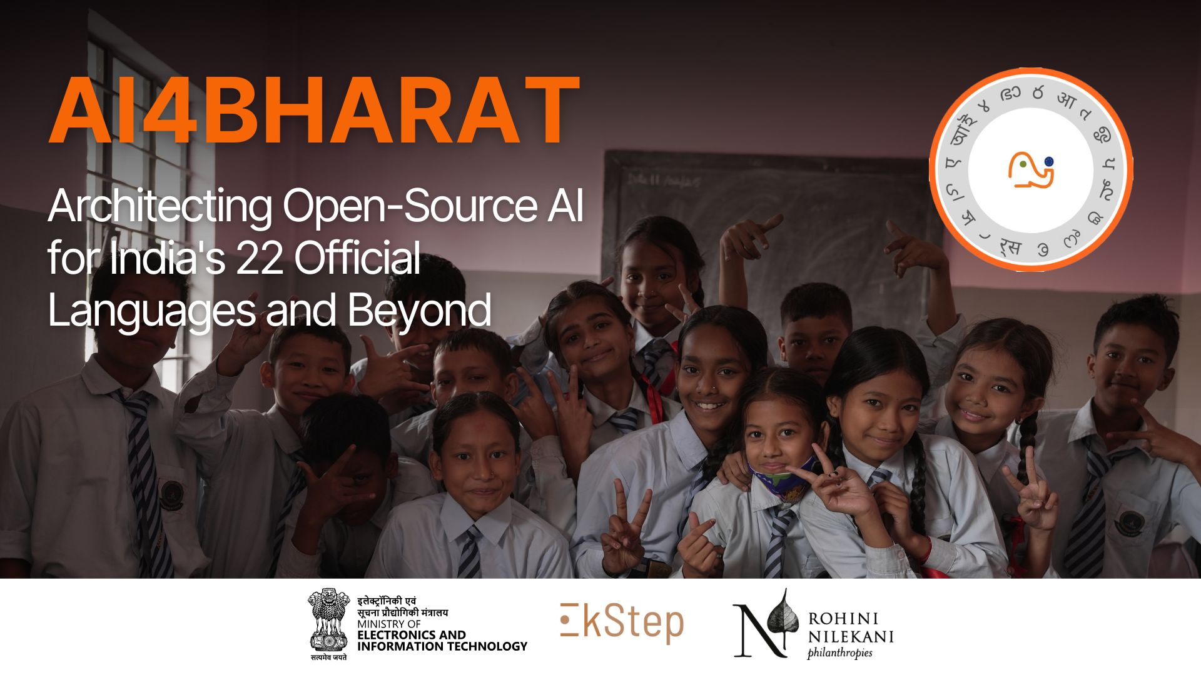


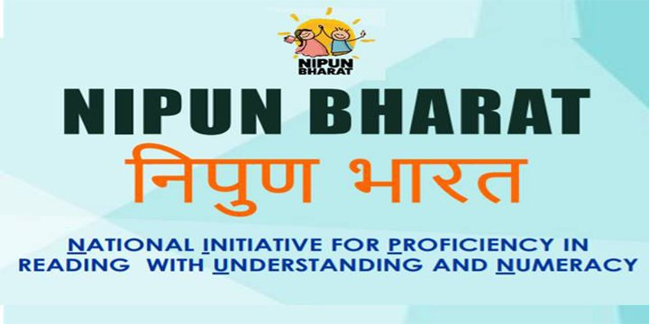

RESEARCH AND REFERENCES
Santali Need: Census 2011 records 7.36 million Santali mother-tongue speakers, making it a strong priority for a dedicated multilingual learning solution.
Proven AI Foundation: AI4Bharat IndicTrans2 (2023) provides the open-source translation technology powering VISTA’s Hindi-to-Santali translation.
Policy Alignment: NEP 2020 & NIPUN Bharat promote mother-tongue learning in early grades and aim for Foundational Literacy by Grade 3.
.
Learning Gap: ASER 2024 reports that 76.6% of Grade 3 rural government-school children cannot read a Grade 2-level text, highlighting the need for early understanding checks.
Teacher-Language Gap: Research from Azim Premji University and DST-CPR/NISER highlights the shortage of teachers fluent in both tribal mother tongues and the state language—VISTA helps bridge this gap without requiring bilingual teachers.

