Slide 1

PRIMARY TUMOR CATALOG: A CLASSIFICATION-DRIVEN DATASET FOR TUMOR CHARACTERIZATION
Department of Computer Science and Engineering
S R Gudlavalleru Engineering College, Gudlavalleru
By
Bathula Navya Sri 21481A0523

Slide 2
INDEX
Abstract
Introduction
Methodology
Orange tool
Result
Conclusion and Future Scope

Slide 3
1.ABSTRACT
Day by Day the cases of tumor are increasing rapidly at a rapid rate and it’s very important and concerning to predict any such diseases beforehand. This diagnosis is a difficult task i.e. it should be performed predisely and efficiently.
The dataset is structured to facilitate data mining tasks, including classification algorithms such as decision trees, support vector machines, and neural networks. Researchers and practitioners can leverage this dataset to develop predictive models, uncover diagnostic biomarkers, and enhance personalized treatment strategies.

Slide 4
2. INTRODUCTION
Primary tumors, originating from diverse tissues and exhibiting varying histological and molecular characteristics, pose formidable challenges in cancer diagnosis and treatment.
In the era of data-driven healthcare, the convergence of oncology and data mining (DM) offers promising avenues for unraveling the complexities of tumor biology and enhancing clinical decision-making. To facilitate this endeavor, we introduce a meticulously curated primary tumor dataset tailored for data mining applicationsData .
We aim to empower researchers, clinicians, and data scientists to harness the power of data mining for accelerating cancer research and improving patient care outcomes.

Slide 5
Problem Definition
Predictive models for classifying primary tumors. By leveraging advanced machine learning algorithms and integrating heterogeneous data sources and how to predict the unknown class label using prediction.
By performing data mining algorithms, we seek to achieve high classification accuracy and predictive performance, thereby facilitating clinical decision-making and improving patient outcomes.

Slide 6
3.Methodology
We intend to use Supervised Machine Learning models that are used in this dataset for finding the accuracy are
Decision Trees
Support Vector Machines (SVM)
k-Nearest Neighbors (k-NN)
Naive Bayes

Slide 7
Block-Diagram
Start
Collect Primary Tumor Dataset
Data Preprocessing
Splitting Data
Training Data
Testing Data
Training( KNN, Naïve Bayes, SVM, Tree Classfier)
Classifier
Tumor
Normal

Slide 8
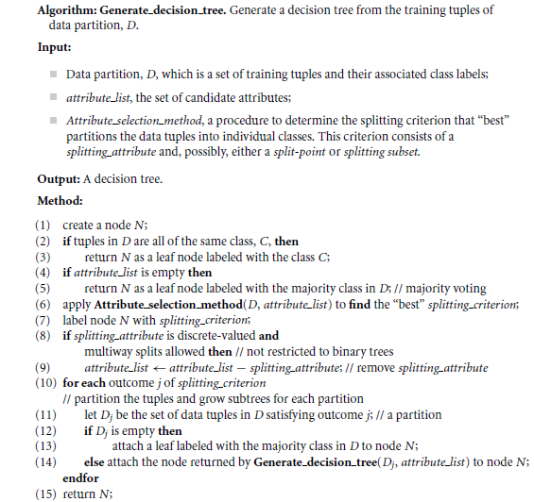
Decision-Tree-Algorithm

Slide 9
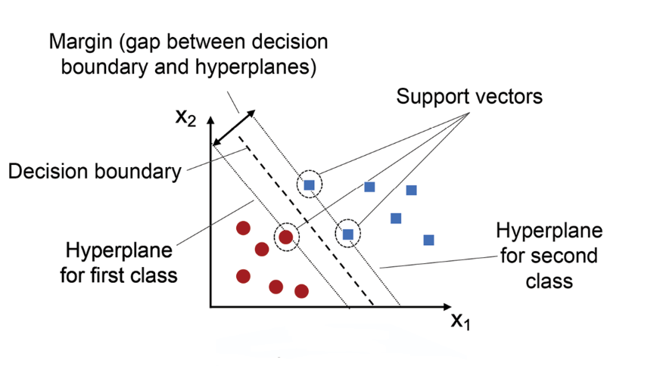
Support Vector Machine Algorithm
A Support Vector Machine (SVM) is a powerful algorithm in data mining used for classification and regression tasks. It works by finding the optimal hyperplane that best separates data points into different classes. SVM aims to maximize the margin between the classes, which helps in better generalization to unseen data

Slide 10
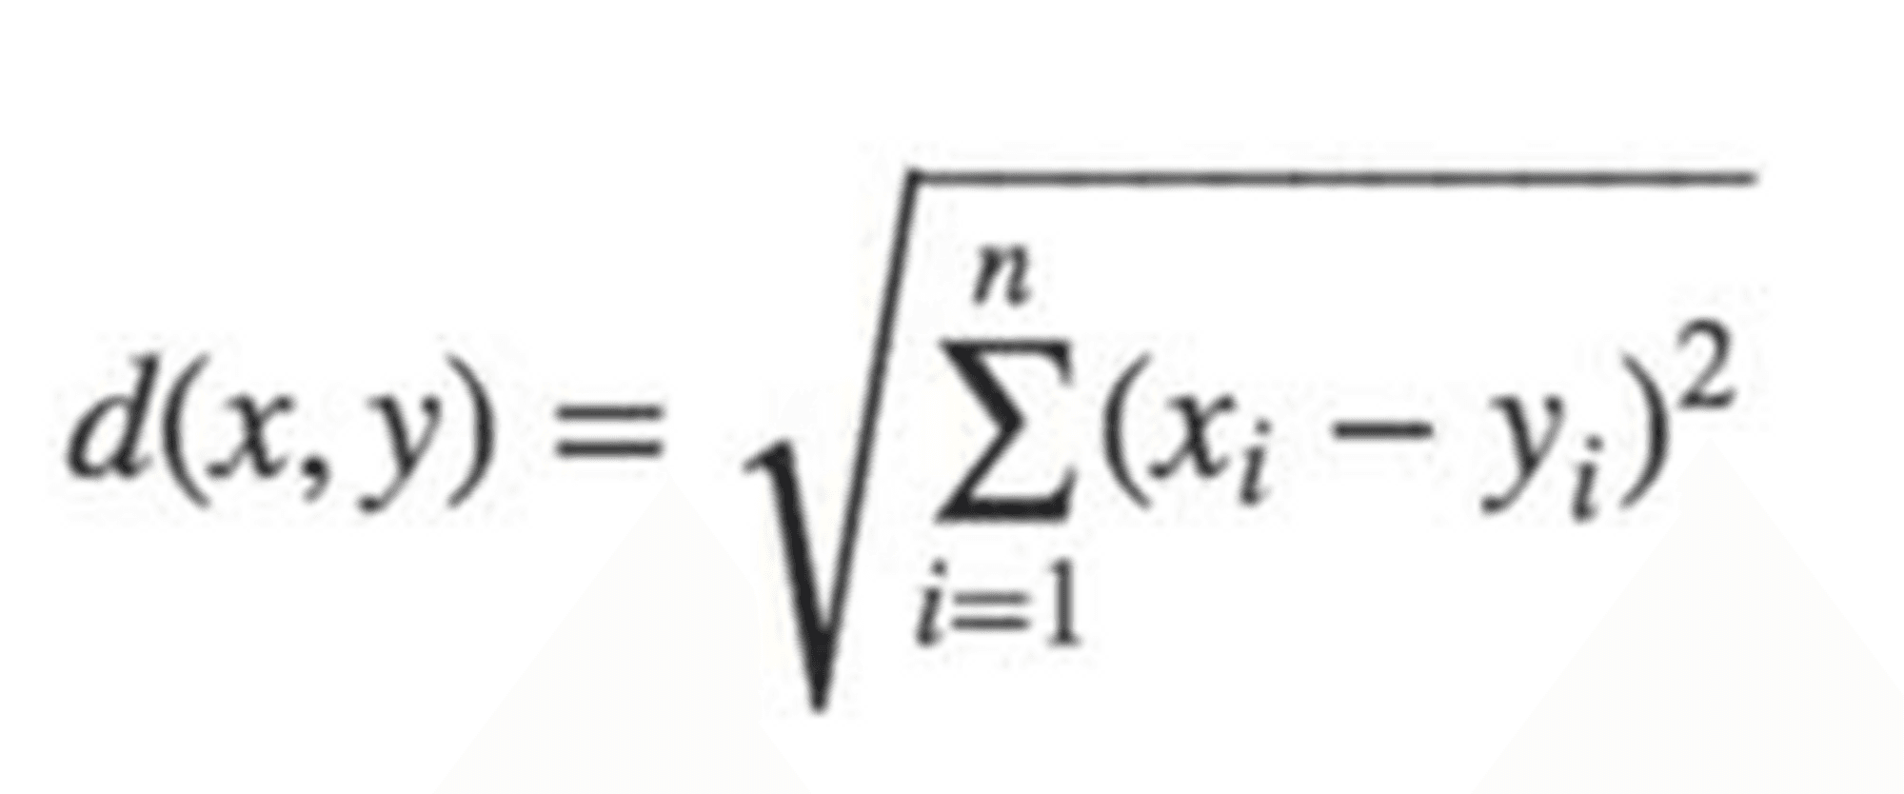
K-Nearest Neighbor Algorithm
Step 1: Selecting the optimal value of K. K represents the number of nearest neighbors that needs to be considered while making prediction.
Step 2: Calculating distance.
Step 3: Finding Nearest Neighbors.
Step 4: Among these k neighbors, count the number of data points in each category.
Step 5: Assign the data points to that category for which the number of the neighbor is maximum.
The Euclidean distance between two points is calculated as:

Slide 11
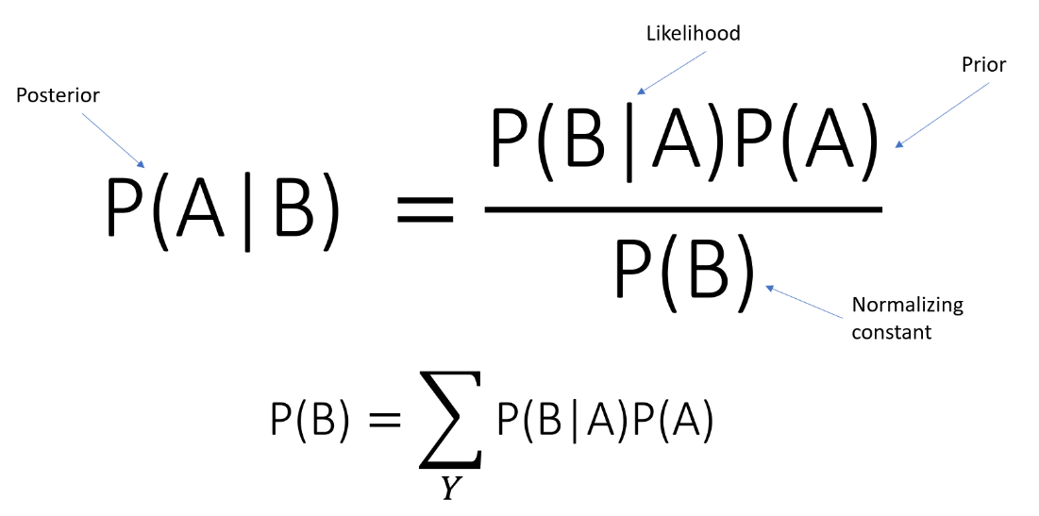
Naïve Bayes Algorithm
Naive Bayes is a fast and simple classification algorithm based on Bayes' theorem. It assumes independence among features, making it efficient even with large datasets. During training, it calculates the probability of each class given the feature values. For prediction, it selects the class with the highest probability.

Slide 12
Data Set Description
The dataset consists of classs labels and target variables. The "Primary Tumor" dataset in data mining is a collection of patient records with detailed information about demographics, symptoms, diagnostic tests, and treatment history. It's designed to predict the classification of tumors as benign or malignant.
This dataset is essential for medical diagnosis and treatment planning. Challenges include ensuring data quality, selecting relevant features, and developing interpretable models. Despite these challenges, the dataset is crucial for advancing tumor diagnosis and patient care in healthcare.

Slide 13
4.Orange tool
Orange is an open-source data visualization and analysis tool, particularly popular in the field of data mining and machine learning.
It provides a visual programming interface for creating workflows and analyzing data through various techniques like classification, regression, clustering, and more. With its intuitive interface, users can easily manipulate and visualize datasets, build predictive models, and evaluate their performance.
Orange is known for its versatility and user-friendly approach, making it suitable for both beginners and experienced data scientists. Its combination of usability, flexibility, and extensive features

Slide 14

Main Features
• data preprocessing tools
• classification/regression algorithms
• clustering algorithms
• algorithms for finding association rules

Slide 15
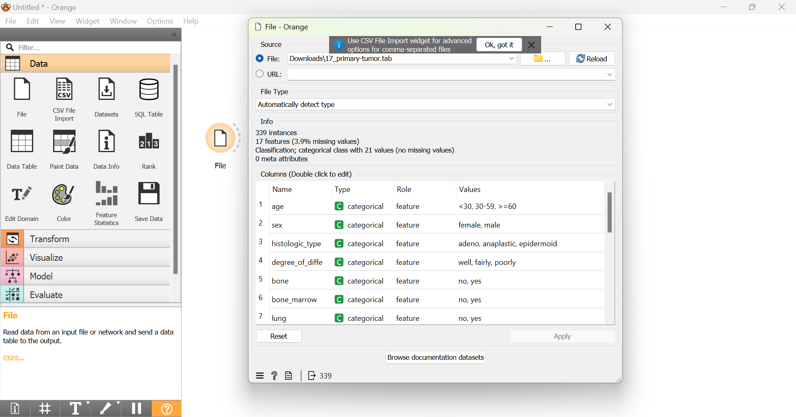
Loading the Data

Slide 16
PRE PROCESSING TECHNIQUES
There are several data preprocessing techniques.
Data cleaning can be applied to remove noise and correct inconsistencies in data.
Data integration merges data from multiple sources into a coherent data store such as a data warehouse.
Data reduction can reduce data size by, for instance, aggregating, eliminating redundant features, or clustering.
Data transformations (e.g., normalization) may be applied, where data are scaled to fall within a smaller range like 0.0 to 1.0.

Slide 17
DATA CLEANING
Missing Values
Ignore the tuple
Fill in the missing value manually
Use a global constant to fill in the missing value
Use a measure of central tendency for the attribute (e.g., the mean or median) to fill in the missing
Use the attribute mean or median for all samples belonging to the same class as the given tuple
Use the most probable value to fill in the missing value

Slide 18
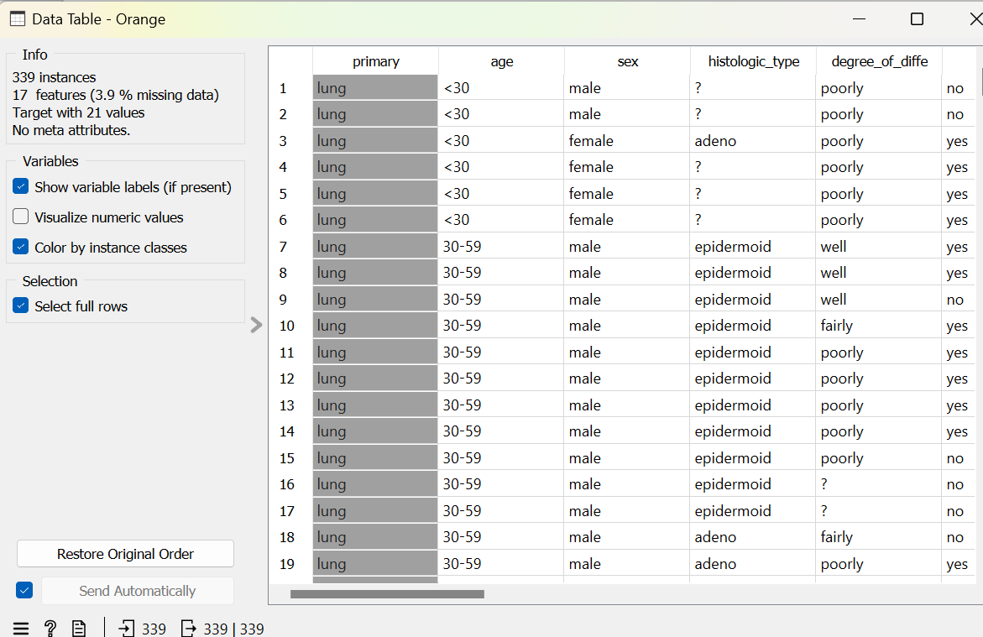
Before Pre Processing

Slide 19
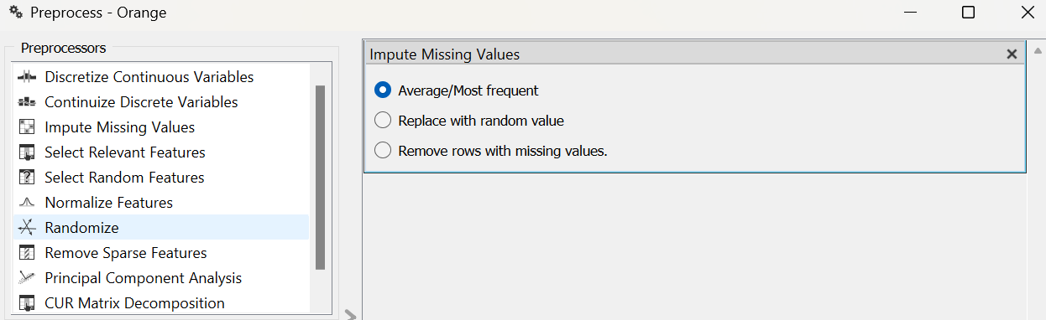
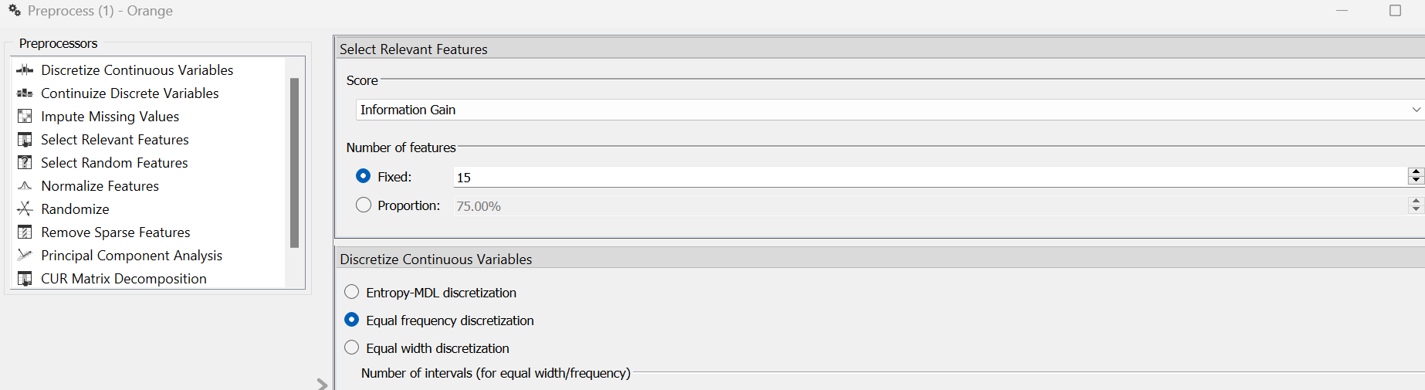
Pre Processing

Slide 20
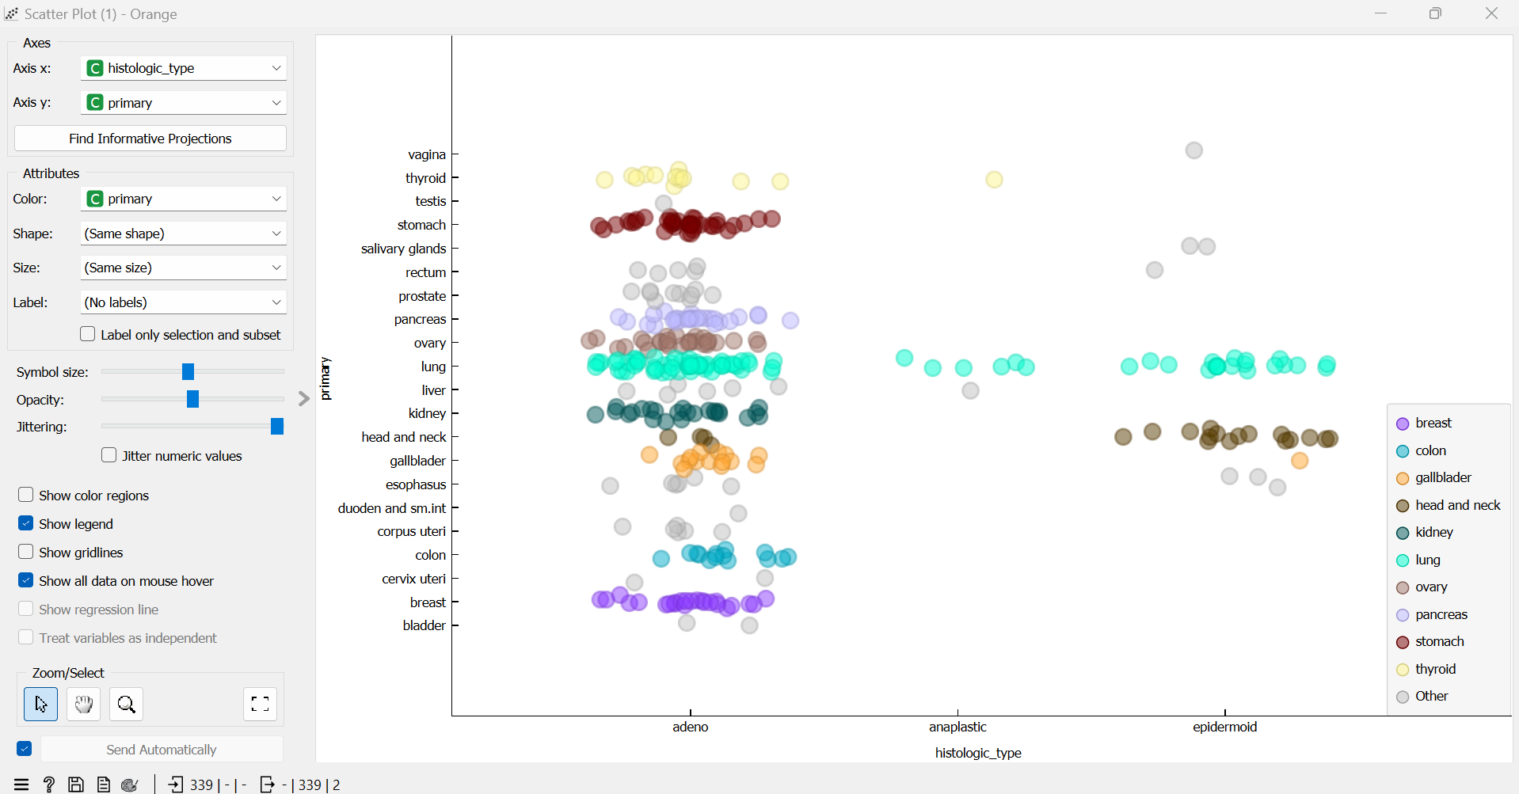
Scatter Plot

Slide 21
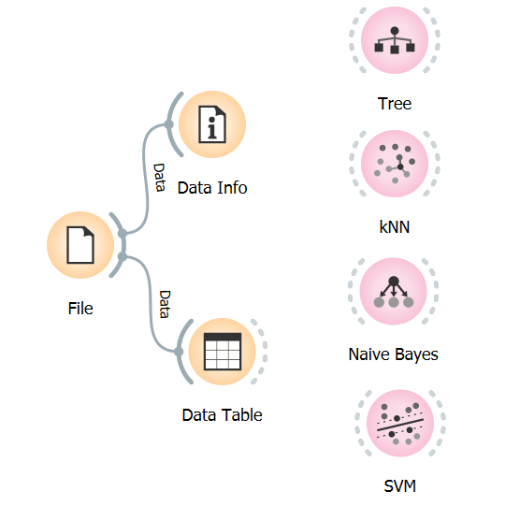
Applying Supervised Machine Learning Algorithms

Slide 22
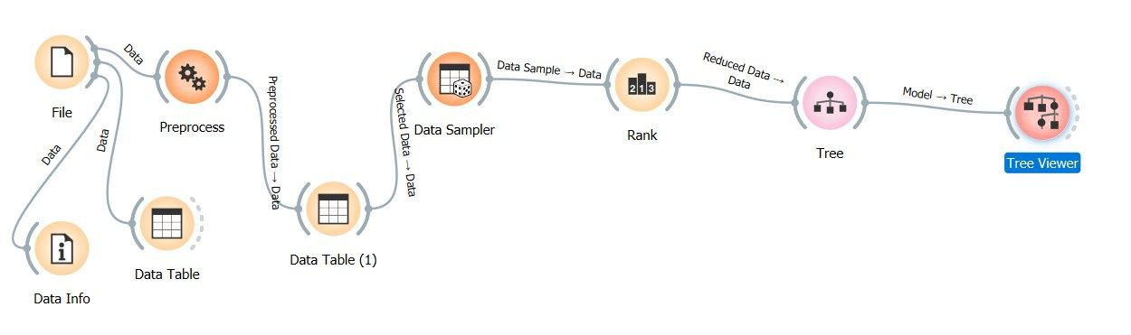
Rank

Slide 23
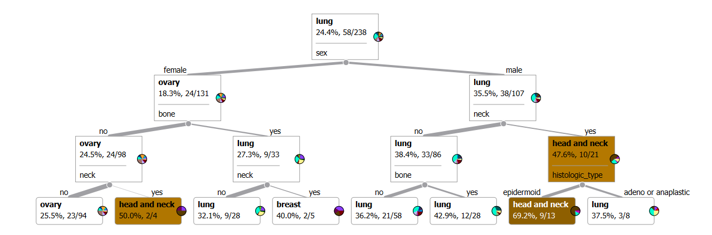
Tree after applying the Rank

Slide 24
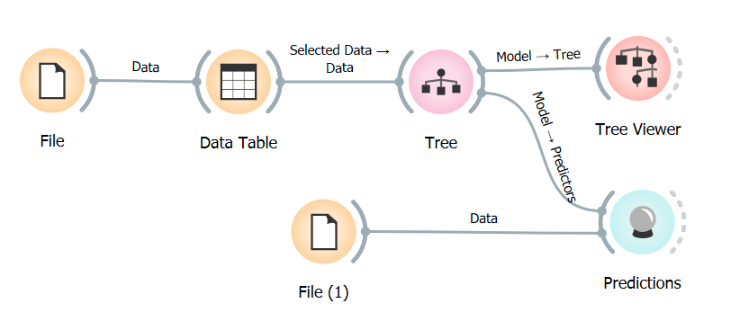
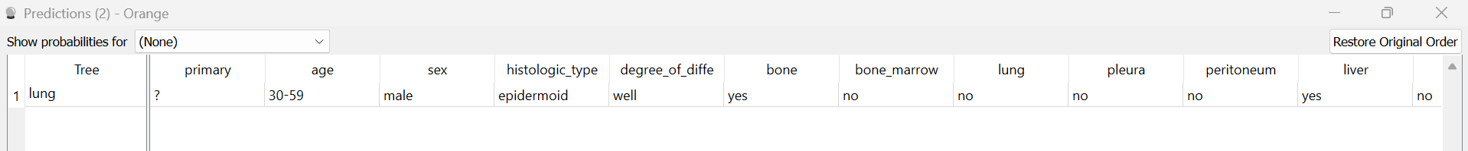
Predicting the class
Result

Slide 25
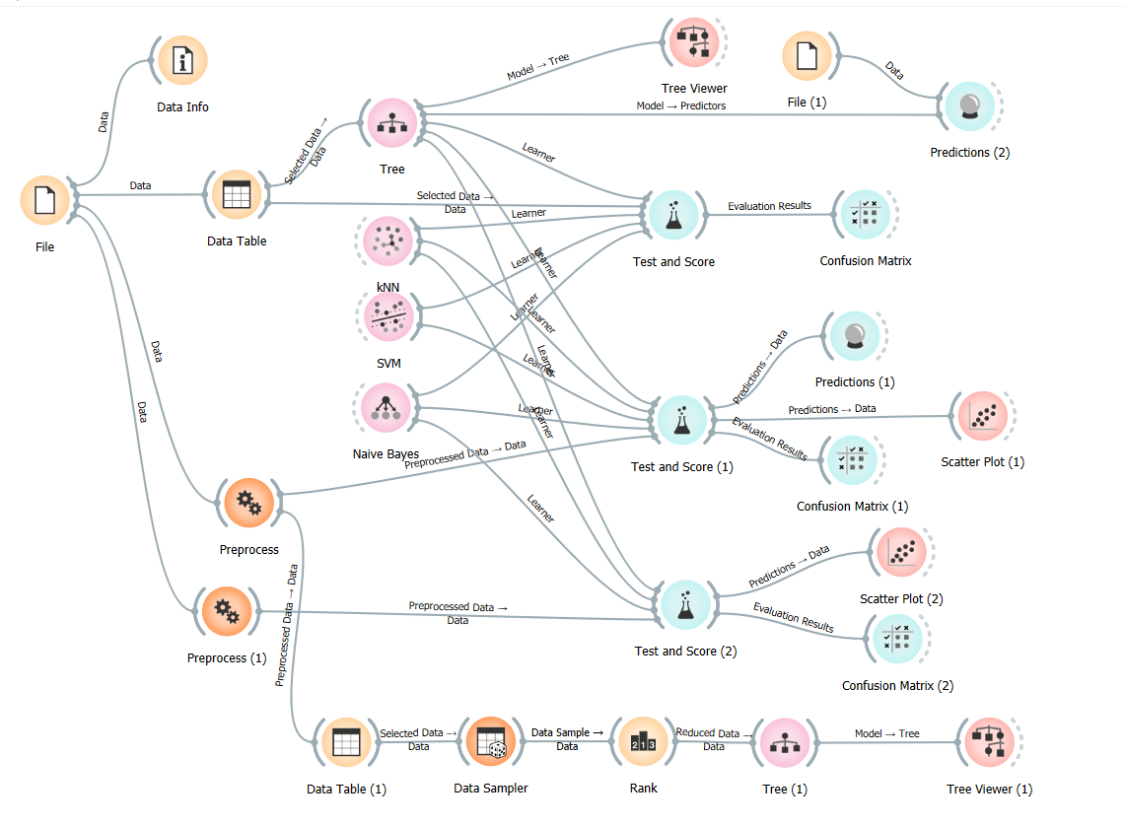
DATA WORKFLOW

Slide 26
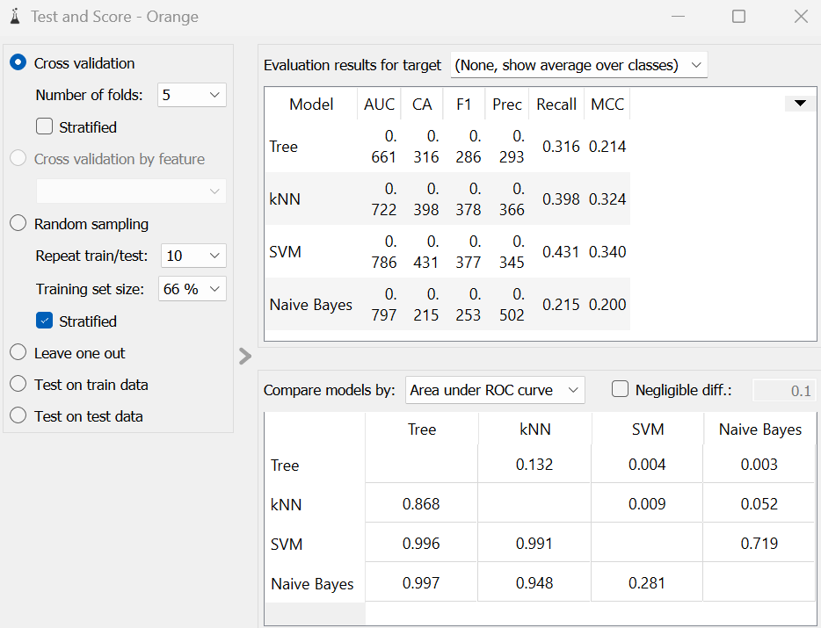
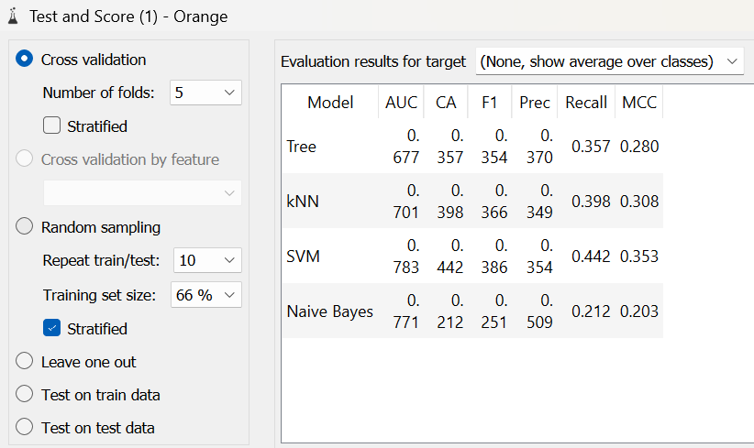
5.Result
Before preprocessing
After preprocessing(replacing the missing values with random values)

Slide 27
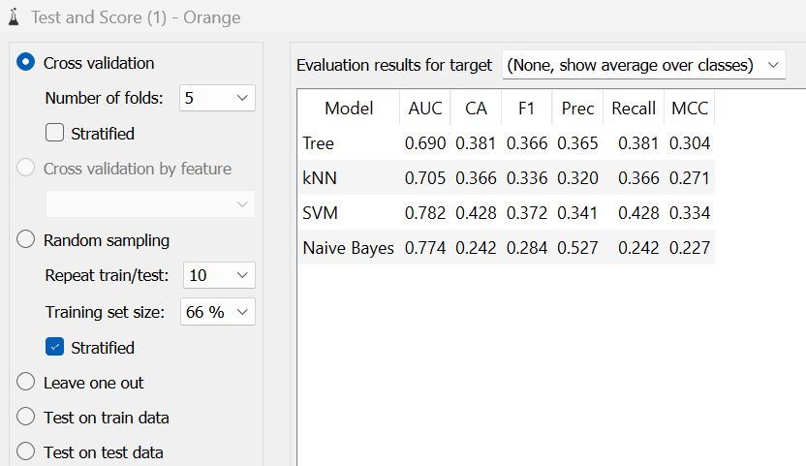
Before Preprocessing
After preprocessing
(replacing the missing values by Average/Most frequent value)

Slide 28
6. CONCLUSION
In conclusion, our analysis of the Primary Tumor dataset has demonstrated that applying preprocessing techniques significantly enhances the performance of machine learning models. By addressing data issues such as missing values, noise, and irrelevant features.
After experimenting with several algorithms, including Decision Trees, Support Vector Machines, and k-Nearest Neighbors, it was observed that the Support Vector Machine(SVM) algorithm gives the best accuracy when the missing values are replaced with random values. This suggests that the probabilistic nature of Naive Bayes is particularly well-suited for this dataset,
The high accuracy achieved by the Naive Bayes model indicates its effectiveness in handling the categorical features present in the Primary Tumor dataset.Overall, our preprocessing efforts combined with the appropriate choice of algorithm led to the best predictive performance,

Slide 29
References
[1] Soni J, Ansari U, Sharma D & Soni S (2011). Predictive data mining for medical diagnosis: an overview of heart disease prediction. International Journal of Computer Applications, 17(8), 43-8
[2] Dangare C S & Apte S S (2012). Improved study of heart disease prediction system using data mining classification techniques. International Journal of Computer Applications, 47(10), 44-8.
[3] Ordonez C (2006). Association rule discovery with the train and test approach for heart disease prediction. IEEE Transactions on Information Technology in Biomedicine, 10(2), 334-43.
[4] Shinde R, Arjun S, Patil P & Waghmare J (2015). An intelligent heart disease prediction system using k-means clustering and Naïve Bayes algorithm. International Journal of Computer Science and Information Technologies, 6(1), 637-9.
[5] Bashir S, Qamar U & Javed M Y (2014, November). An ensemble-based decision support framework for intelligent heart disease diagnosis. In International Conference on Information Society (i-Society 2014) (pp. 259-64). IEEE.

Slide 30
THANK YOU ☺

