Slide 1

MULTI-SOURCE DATA INTEGRATION PIPELINE
Final Project Review | Department of Computer Science And Engineering | KLH
TEAM MEMBERS
2420030068– K. Sahasra
2420030180– K. Navya
2420030181– K.Bhavya
Guide: [Dr.N.SUNANDA , Associate Professor] | Academic Year: [2026–2027]
Notes:
Title slide. Replace all bracketed text. Use the full project title, list every team member with registration number, and name your guide. Insert the institution logo in the dashed box.

Slide 2

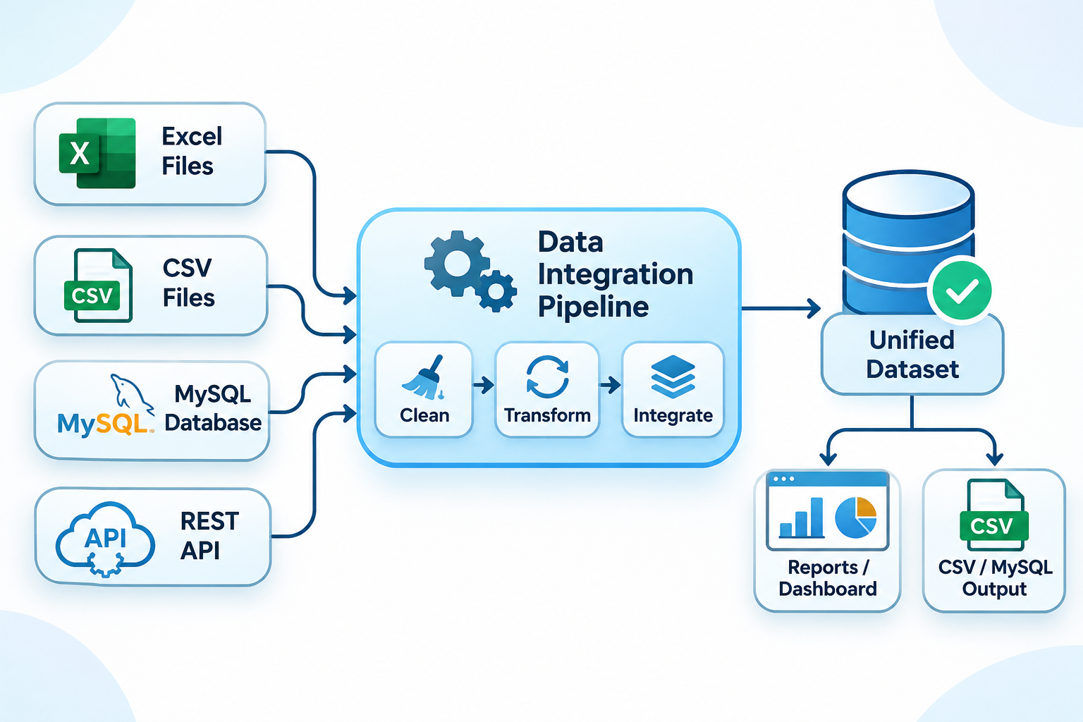


Introduction & Problem Statement
Background
Data is generated from multiple sources such as Excel files, CSV files, MySQL databases, and REST APIs. Managing data in different formats makes it difficult to organize, process, and analyze information efficiently.
Problem Statement
Data collected from multiple sources often contains missing values, duplicate records, and inconsistent formats. Combining and managing this data manually is time-consuming and makes accurate data analysis difficult.
Motivation / Need
The project aims to automate data collection, cleaning, transformation, and integration into a single unified dataset. It reduces manual effort, improves data quality, and helps users make better decisions through organized data and visualization.
Notes:
State the domain, the exact problem and why it matters. Keep it to about 2 minutes. Add one real-world statistic if you can, with a citation.

Slide 3

Objectives & Scope
Objectives
1
To develop a data integration pipeline that collects student data from multiple sources such as Excel, CSV, MySQL, and REST APIs.
2
To clean and transform the collected data by handling missing values, removing duplicate records, and correcting inconsistencies.
3
To integrate data from different sources into a single unified dataset using Python and Pandas.
4
To generate data quality reports and visualize the integrated results through an interactive Streamlit dashboard.
Notes:
Objectives should be measurable and start with action verbs. The scope slide tells the panel what you did and did not attempt.

Slide 4

Literature Survey
S.No | Author(s) & Year | Method / Technique | Key Findings | Limitation / Gap
1 | Marek Macura (2025) | Uses ETL and wrapper layer to integrate heterogeneous data sources | ETL helps convert different source data into a common form for analysis | Handling heterogeneous sources and achieving uniform data remains challenging
2 | Manel Souibgui et al. (2025) | Focuses on data quality checking during ETL from internal and external sources | ETL can handle heterogeneous data, but data-quality problems need to be tracked during the process | ETL can be complex and time-consuming when data has different quality problems
3 | Chen Ye et al. (2024) | Studies duplicate detection, conflict resolution and inconsistency repair in multi-source data | Multi-source data can contain duplicate, conflicting and inconsistent information | More research is needed for combined/complex data errors and multi-source data repair
4 | I Made Putrama & Péter Martinek (2023) | Reviews different heterogeneous data integration approaches, including ETL, databases and semantic methods | Data integration is difficult because of different formats, structures and semantics | More work is needed for unstructured/semi-structured data and semantic integration
Existing studies mainly focus on ETL techniques, data quality checking, duplicate detection, and heterogeneous data integration. However, challenges such as handling inconsistent data, managing multiple data sources, and reducing manual effort still exist. Our project addresses these challenges by developing a unified pipeline that collects, cleans, transforms, and integrates data from Excel, CSV, MySQL, and REST APIs using Python and Panda
Notes:
Summarise four to six relevant papers or existing systems. End with the research gap, because that gap justifies your project.

Slide 5





Proposed System & Methodology
STEP 1
STEP 2
STEP 3
STEP 4
STEP 5
Define Problem
Collect Data
Design
Implement
Test & Evaluate
Identify data integration challenges such as missing values, duplicates, and inconsistent formats.
Collect student data from Excel, CSV, MySQL, and REST API sources.
Design the ETL workflow using Python, Pandas, common schema, and source-priority rules.
Clean, transform, and integrate data into a unified dataset using Python and Pandas.
Validate pipeline functionality using Pytest and display results through a Streamlit dashboard and data quality reports.
Key Novelty / Contribution
The proposed system integrates multiple data sources into a unified dataset through automated cleaning, transformation, and source-priority rules. It combines data quality validation with an interactive dashboard to simplify data management and analysis.
Notes:
Walk through the five steps left to right. Rename the steps to match your project (for example, Requirement Analysis, Design, Coding, Testing, Deployment). End with your novelty.

Slide 6
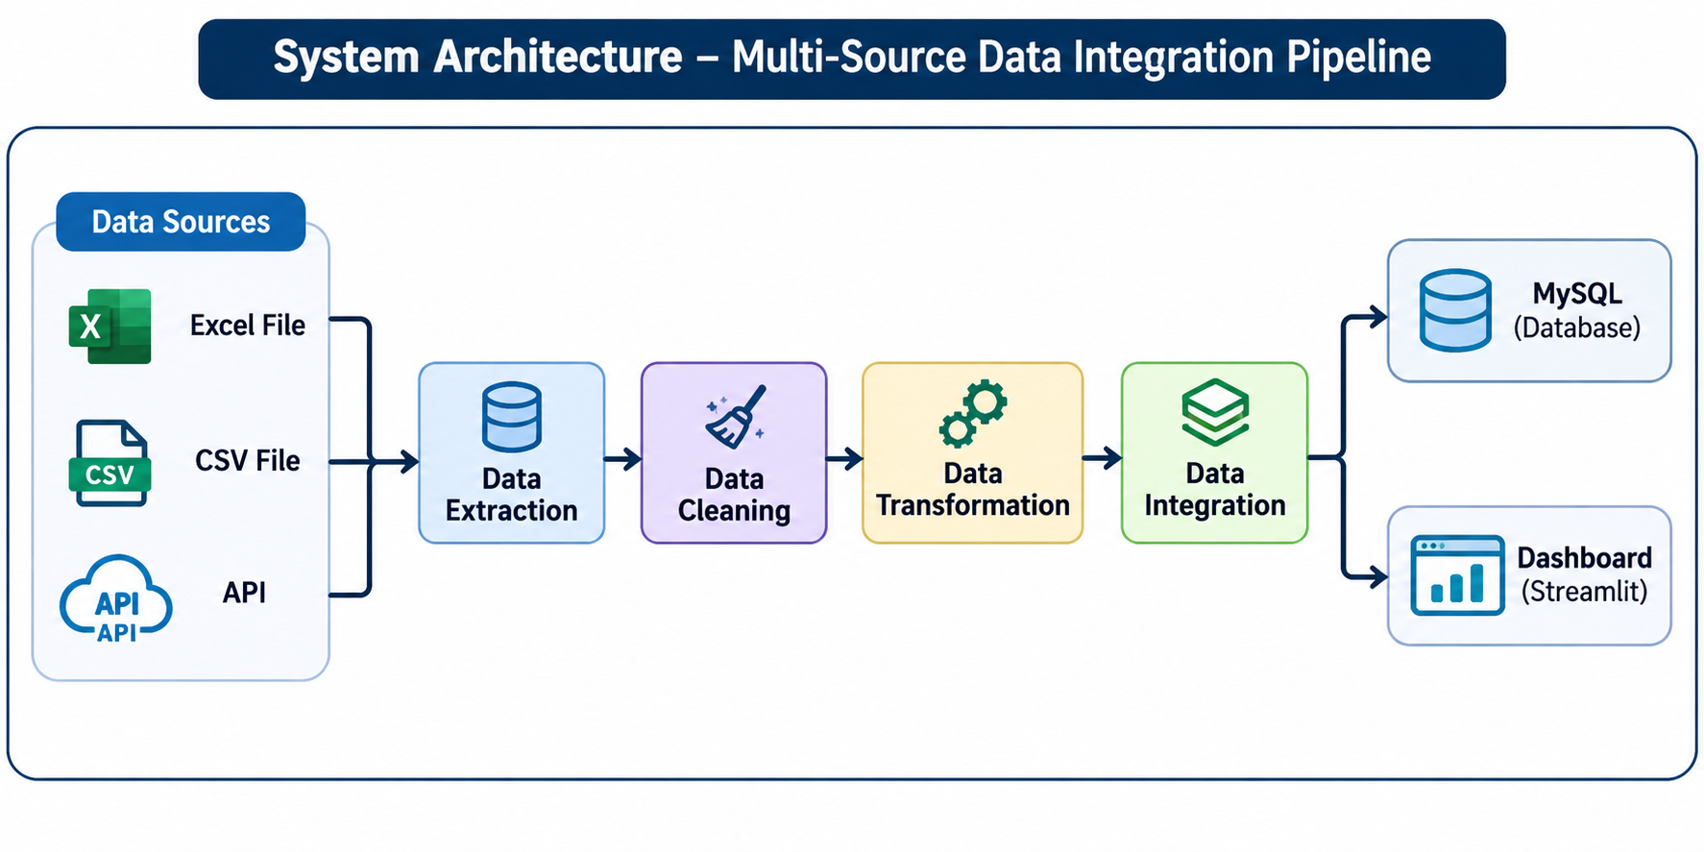
System Architecture
Components
1
Data Sources:
Collects data from Excel, CSV, MySQL and REST APIs.
2
Data Ingestion:
Reads and extracts data from different sources.
3
ETL Processing:
Cleans, transforms and integrates the collected data.
4
Output Module:
Generates a unified dataset, quality reports and dashboard.
Notes:
Insert a clear block diagram: input, processing, storage, output. Number each block and explain them on the right. Redraw the figure yourself rather than copying it.

Slide 7


Hardware & Software Requirements
Hardware
Software & Tools
Libraries / Frameworks
Processor: Intel i3 or above
RAM: Minimum 4 GB
Storage: 256 GB or above
Network: Internet connection
Operating System: Windows 10/11
Programming Language: Python
[IDE: VS Code / Jupyter Notebook
Version Control: Git and GitHub
Pandas – Data manipulation
NumPy – Numerical operations
Streamlit – Dashboard development
Pytest – Pipeline testing
Deployment / Platform: Local Machine – Python Environment – Streamlit Web Dashboard
Notes:
List only what you actually used, with versions. For a pure software project, shorten the hardware list and add cloud or deployment resources.

Slide 8

Dataset / Data Understanding
4
[14]
Data Sources
Excel, CSV, MySQL, REST API
Unified Dataset
Combined student data
ETL
QA
Processing
Extract, Transform, Load
Data Quality
Validation and reporting
Source: Excel, CSV, MySQL and REST APIs.
Features: Student information and related attributes available in the input sources.
Quality: Missing values, duplicate records and inconsistent data formats.
Notes:
Explain where the data came from and what it contains. Show a screenshot of the first rows or the info summary. For non-data projects, replace this slide with “Requirement Analysis” or “Input Specification”.

Slide 9



Data Preprocessing & Exploratory Analysis
Cleaning
Identify and handle missing values.
Remove duplicate records.
Correct inconsistent data formats.
Transformation
Convert data into a common format.
Standardize column names and data types.
Map different source schemas into a common structure.
Feature Selection
Combine records from multiple sources.
Resolve data conflicts using source-priority rules.
Generate a unified dataset.
Notes:
Show two or three plots that tell a story: distributions, correlations, outliers. Explain what each plot told you and what you did about it.

Slide 10
Module-wise Description
1
Data Collection Module
2
Data Cleaning Module
Purpose: Collect student data from multiple sources.
Input → Output: Excel, CSV, MySQL, REST API → Raw datasets.
Purpose: Identify and handle missing, duplicate and inconsistent records.
Input → Output: Raw datasets → Cleaned datasets.
3
Data Transformation & Integration Module
4
Validation & Visualization Module
Purpose: Standardize and combine data from different sources.
Input → Output: Cleaned datasets → Unified dataset.
Purpose: Validate integrated data and display results.
Input → Output: Unified dataset → Quality reports and Streamlit dashboard.
Notes:
Divide the project into three to five modules. For each, state its purpose, inputs, outputs and who built it. Duplicate a card if you have more modules.

Slide 11

Algorithms & Technologies Used
ETL (Extract, Transform, Load)
Data Cleaning & Deduplication
Schema Mapping & Data Integration
Why chosen
To automate the movement and processing of data from multiple sources.
Key parameters
Data extraction, transformation and loading.
Why chosen
To improve data quality and remove duplicate or inconsistent records.
Key parameters
Missing-value handling, duplicate detection and data validation.
Why chosen
To combine different datasets into a common structure.
Key parameters
Column mapping, data-type conversion and source-priority rules.
Selection criteria: Automation, data accuracy, simplicity, scalability and processing efficiency.
Notes:
Name each model, algorithm or technology, say why you chose it, and list the key settings. Then explain how you picked the final one.

Slide 12
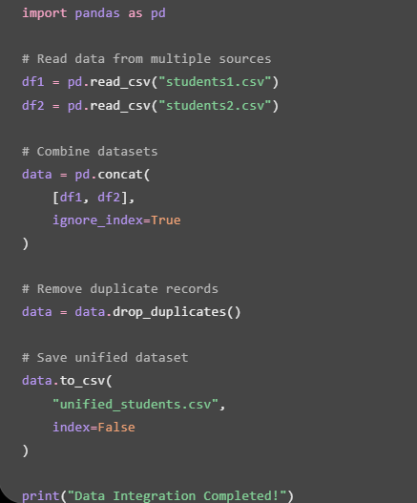
Implementation / Model Building
Data Source Selection
Identify Excel, CSV, MySQL and REST API as input sources.
Code snippet / pseudocode
Preprocessing Pipeline
Handle missing values, duplicate records and inconsistent formats.
Data Integration
Map columns into a common schema and combine the cleaned datasets.
Validation & Configuration
Validate the integrated data and apply source-priority rules.
Notes:
Describe the build in the order you did it. Paste only the most important code or pseudocode, not entire files. For hardware projects, show the circuit or wiring summary instead.

Slide 13
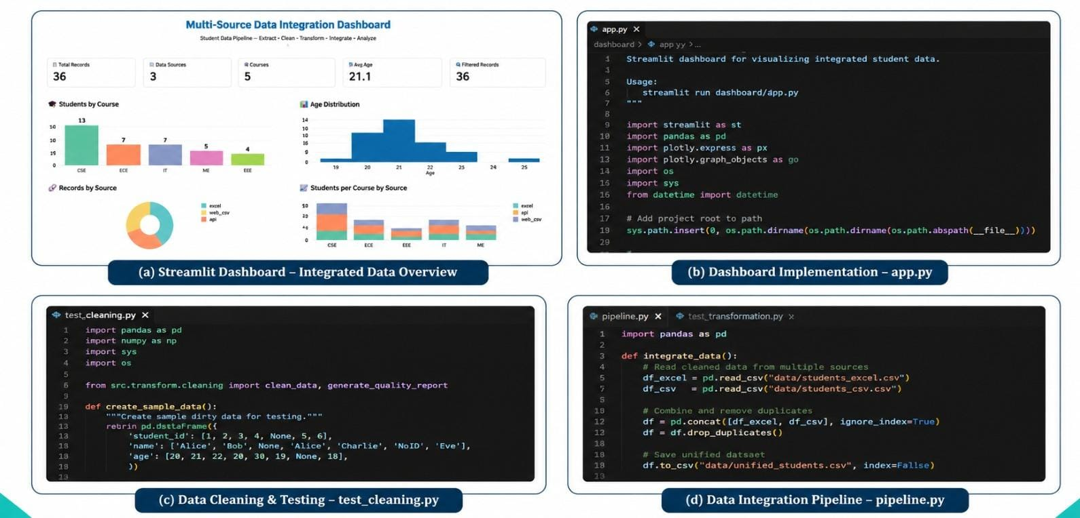
Working Prototype / Output Screens
Notes:
Show real screenshots, photos of the hardware or a short demo video link. Caption each one with what the viewer should notice.

Slide 14


Challenges & Limitations
Challenges Faced
Limitations
Integrating data from multiple sources (Excel, CSV and API) → Used separate data extraction methods.
Handling duplicate and missing records → Applied data cleaning techniques.
Maintaining consistent data formats → Used data transformation and standardization.
Currently supports a limited number of data sources.
Dashboard uses a relatively small sample dataset.
Real-time data integration and automatic updates are limited.
Notes:
Be candid. Pair every challenge with how you solved it, and list limitations that the panel would otherwise spot themselves.

Slide 15

Conclusion
Developed a Multi-Source Data Integration Pipeline to collect student data from Excel, CSV and API sources.
1
36 Records
Successfully Integrated Student Data
3 Data Sources | 5 Courses
Objectives achieved: 4 of 4
Final Outcome
Successfully performed data cleaning, transformation and integration to generate a unified dataset containing 36 records.
2
Developed an interactive dashboard to visualize student information and analyze data using different charts.
3
Notes:
Revisit each objective and say whether you met it. Quote your headline result with numbers. Do not introduce new material here.

Slide 16




Future Scope & Applications
Improve Performance
Optimize data processing speed and improve integration efficiency.
Applications
Student data management in educational institutions.
Combining data from multiple departments.
Generating unified reports and visualizations.
Who would adopt it? Colleges, universities and organizations.
Expand Data / Features
Integrate more data sources such as Excel, CSV, MySQL and external APIs.
Deploy & Build an Interface
Develop a user-friendly web dashboard for real-time data visualization.
Scale & Secure
Implement cloud deployment, data security and support for larger datasets.
Notes:
Give concrete next steps, ideally tied to the limitations. Then name two or three real-world uses.

Slide 17
Team Contribution
Reg. No. | Name | Contribution / Modules Handled
2420030068 | K. Sahasra | Involved in all phases of project development, implementation, testing and documentation.
2420030180 | K. Navya | Involved in all phases of project development, implementation, testing and documentation.
2420030181 | K. Bhavya Sri | Involved in all phases of project development, implementation, testing and documentation.
Notes:
Show that work was planned and shared. Every member should be able to explain their own module.

Slide 18

References
[1] A. Author, B. Author, “Title of the paper,” Journal Name, vol. X, no. Y, pp. 1–10, Year.
[2] A. Author, Title of the Book. City, Country: Publisher, Year.
[3] Organisation, “Dataset or website title,” Year. [Online]. Available: URL
[4] A. Author, “Title of the conference paper,” in Proc. Conference Name, Year, pp. 1–8.
[5] [Add more references as needed]
Project Links
GitHub: [URL]
Dataset: [URL]
Demo video: [URL]
Notes:
Use IEEE style, numbered in order of first citation in the deck. Include datasets, documentation and code repositories.

Slide 19
THANK YOU
Questions & Discussion
[Team email / contact details]
[Guide name and department]
Notes:
Leave this slide up during questions. Make sure every team member can answer questions about their own module.

