Slide 1

HANGMAN GAME USING PYTHON
Name:Navya sree
Regd no:Y22ACM474
Dept:CBDS&AIML
Section:B

Slide 2
CONTENTS:
ABSTRACT
EXISTING SYSTEM
PROPOSED SYSTEM
HIGH LEVEL DESIGNS
FLOW CHAT
CODE
SCREEN SHOTS
REFERENCE

Slide 3
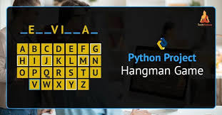
ABSTRACT:
Creating a Hangman game in python invovels implementing a
text-based version of the classic word –guessing game.In this
game, a player tries to guess a word by suggesting letters
Within a certain number of attemps.The player loses if they
Guess incorrectly too many times.

Slide 4
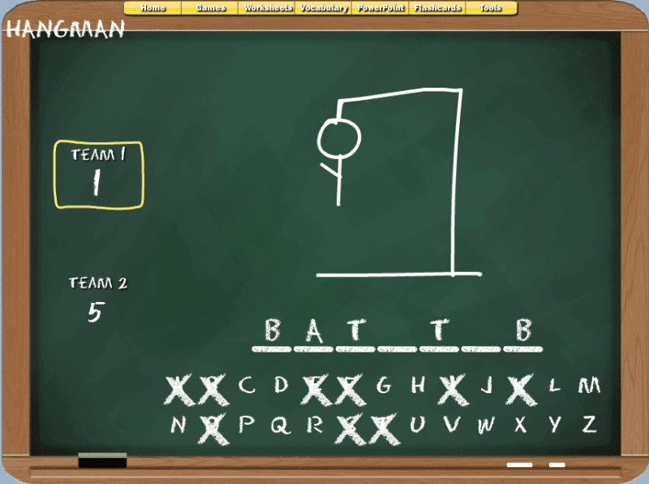
EXISTING SYSTEM:
Here are 5 key points about existing Hangman game systems:
Word to guess is randomly selected from a predefined list.
Players input letter guesses, receiving feedback on correctness.
Correct guesses reveal the letter's position in the word.
Incorrect guesses increment a counter, drawing a hangman figure.
Game ends when the word is guessed or the hangman figure is complete.

Slide 5
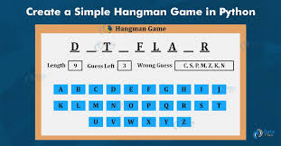
Proposed system:
The proposed Hangman system introduces dynamic word generation, allowing
players to choose from various topics and lengths. An intelligent hint system,
powered by AI, provides subtle clues to aid players. The game features
customizable visual themes, enabling a personalized experience. Real-time
multiplayer capabilities facilitate competitive and cooperative play. Adaptive
difficulty adjustment ensures an optimal challenge for players of all skill levels.

Slide 6
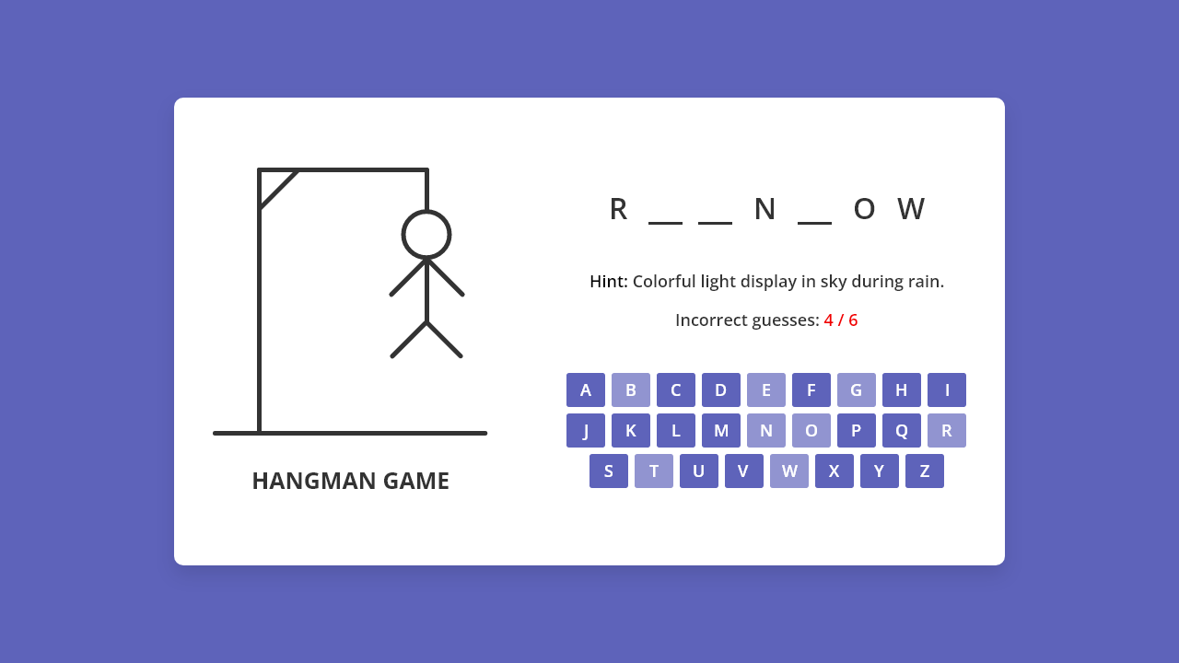
HIGH LEVEL DESIGN:
The high-level design of the Hangman game includes components like User Interface, Game Logic, Word Bank, Scoring System, Multiplayer Functionality, Leaderboard, and Customization Options to create an engaging and interactive gaming experience.

Slide 7
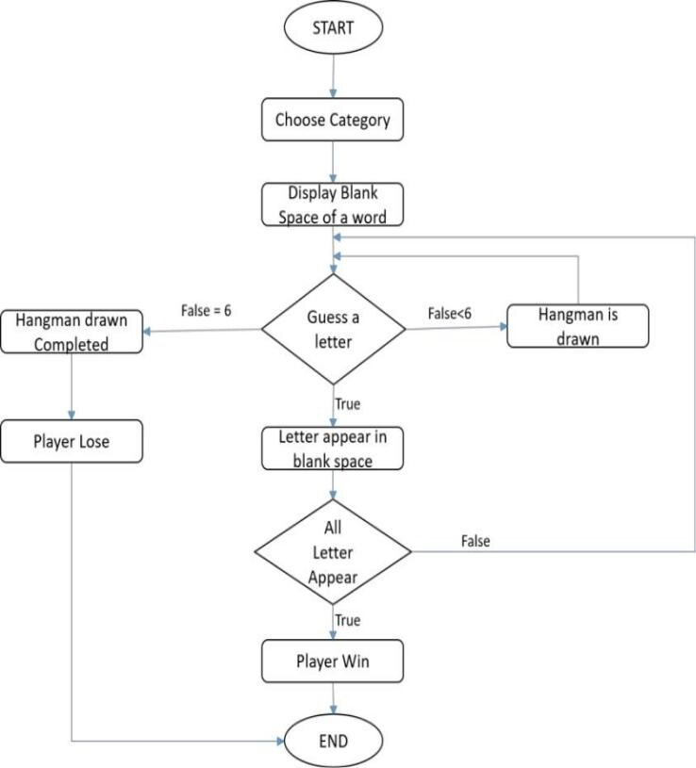
FLOW CHART:

Slide 8
CODE:
word = input("Enter a word for the game: ").lower()
guessed = ['_'] * len(word)
attempts = 6
import random
print("Let's play Hangman!")
while attempts > 0 and '_' in guessed:
print(' '.join(guessed))
guess = input("Guess a letter: ").lower()
if len(guess) != 1:
print("Please guess one letter at a time.")
elif guess in guessed:
print("You already guessed this letter.")
elif guess not in word:
attempts -= 1
print(f"Incorrect! You have {attempts} attempts left.")
else:
for i, letter in enumerate(word):
if letter == guess:
guessed[i] = guess
if '_' not in guessed:
print(' '.join(guessed))
print("Congratulations, you won!")
else:
print(f"Sorry, you lost. The word was {word}.")

Slide 9
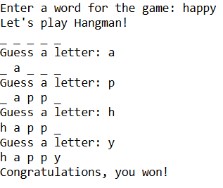
SCREEN SHOT:

Slide 10
REFERENCE:
Since this a simple command-line based application,there is no specific reference
to site. However,the code is written in python and the following resource can be
Useful learning python:
https://www.geeksforgeeks.org/python-program-for-word-guessing-game/
https://github.com/meet244/Hangman-game
https://github.com/jasmin-30/Hangman
https://www.scribd.com/document/607816937/Project-Report-on-Hangman-Game

Slide 11
THANK YOU!

