Slide 1
Crop Production Analysis in India By: Jamalpur Navya Sree CRIN2301980

Slide 2
Introduction
Crop production analysis in India involves studying various aspects of agricultural practices, yields, and trends to understand the performance and challenges of crop cultivation in the country. This analysis provides valuable insights into factors affecting crop production, helps policymakers make informed decisions, and assists farmers in optimizing their agricultural practices.

Slide 3
Main KPIs
Seasons- Different Seasons of Crops
States- States in India
Crops- Different crops grown all over India
Insights drawn:
Major crop grown in India are wheat, rice and jowar in the states Madhya Pradesh, Punjab, Maharashtra.
Highest Crop Production of the country is from Uttar Pradesh.

Slide 4
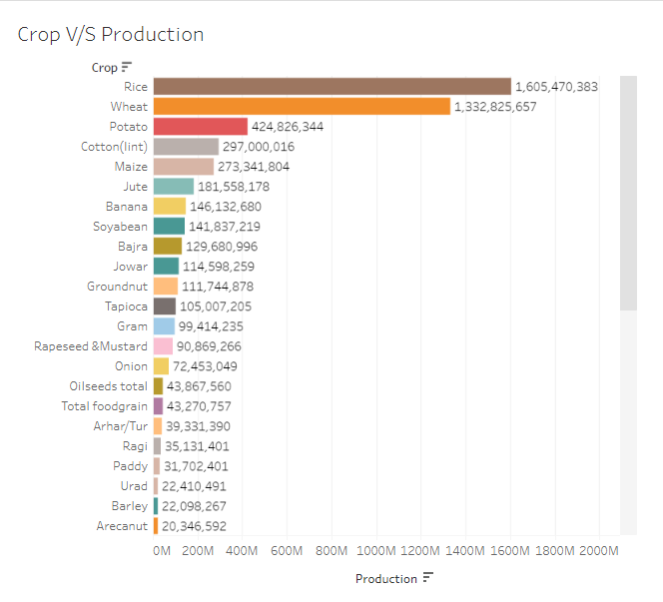
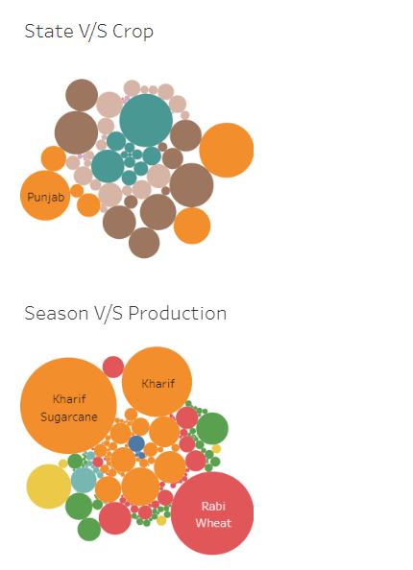
Mock – up Dashboard

Slide 5
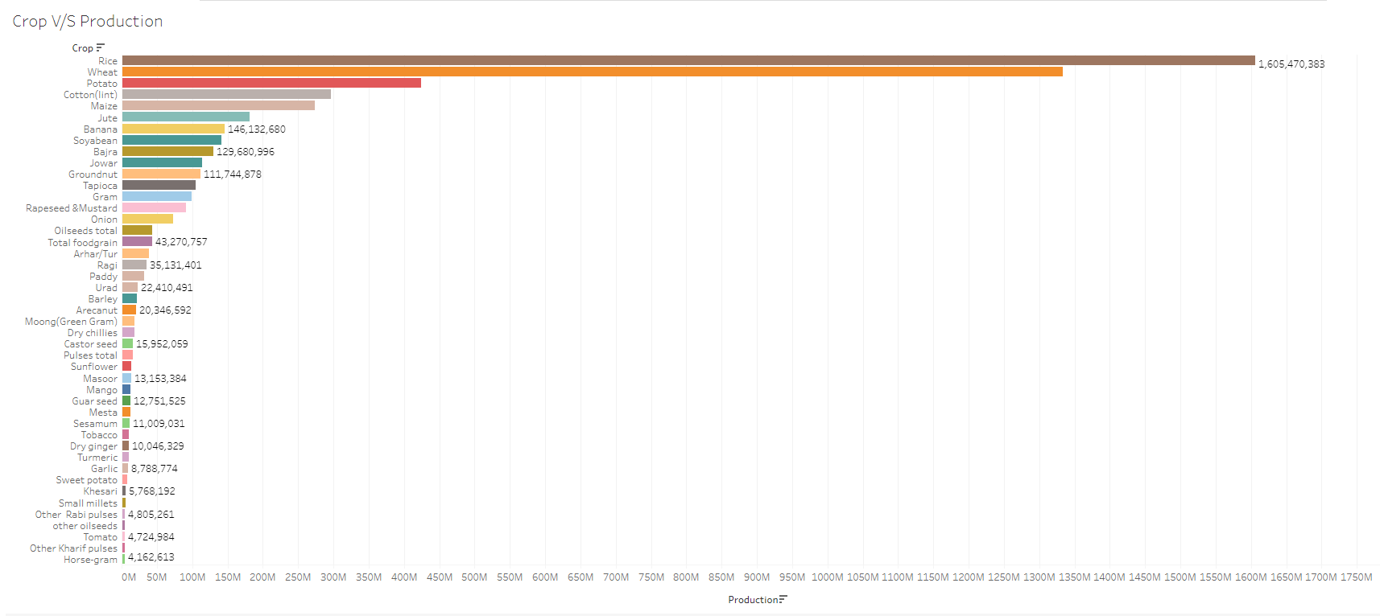
My Design

Slide 6
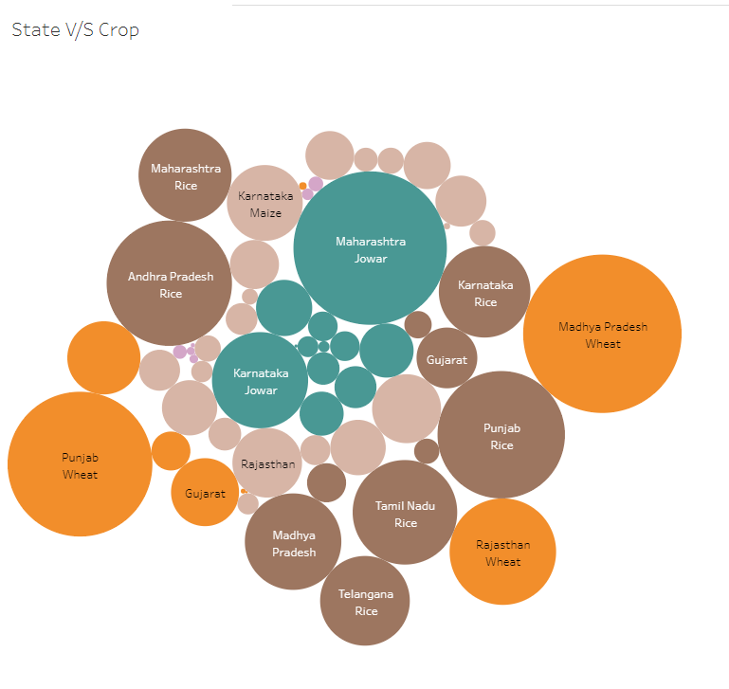
My Design

Slide 7
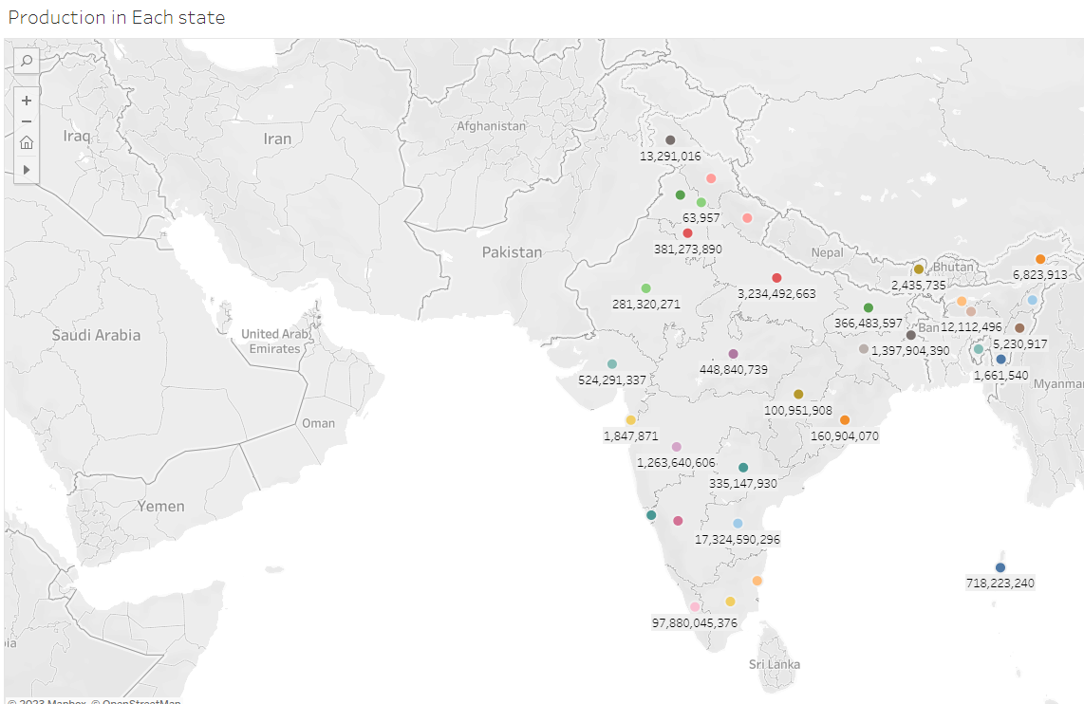

Slide 8
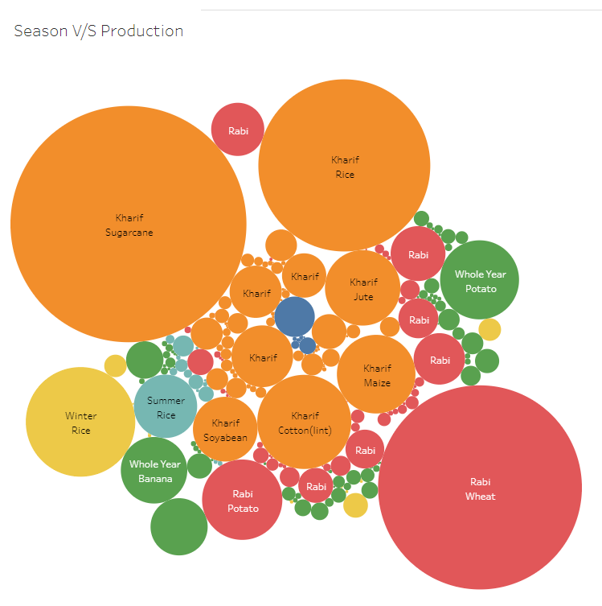

Slide 9
References
Colab link: https://colab.research.google.com/drive/1rUkUJ-kHbYfIYMkC5a6HKlBo4t6rGTmY#scrollTo=atlEp5viqNth
Tableau Links:
https://public.tableau.com/app/profile/navya.sree.jamalpur/viz/CropV_SProduction_16925323599580/CropvsProduction?publish=yes
https://public.tableau.com/app/profile/navya.sree.jamalpur/viz/CropV_SProduction_16925323599580/StatevsCrop?publish=yes
https://public.tableau.com/app/profile/navya.sree.jamalpur/viz/CropV_SProduction_16925323599580/Cropgrownineachstate?publish=yes
https://public.tableau.com/app/profile/navya.sree.jamalpur/viz/CropV_SProduction_16925323599580/Productionineachstate?publish=yes
https://public.tableau.com/app/profile/navya.sree.jamalpur/viz/CropV_SProduction_16925323599580/SeasonvsProduction?publish=yes
https://public.tableau.com/app/profile/navya.sree.jamalpur/viz/CropV_SProduction_16925323599580/CropProduction?publish=yes
https://public.tableau.com/app/profile/navya.sree.jamalpur/viz/CropV_SProduction_16925323599580/Dashboard2?publish=yes
https://public.tableau.com/app/profile/navya.sree.jamalpur/viz/CropV_SProduction_16925323599580/Dashboard3?publish=yes
https://public.tableau.com/app/profile/navya.sree.jamalpur/viz/CropV_SProduction_16925323599580/StateCropStory?publish=yes

Slide 10
Thank you

