Slide 1

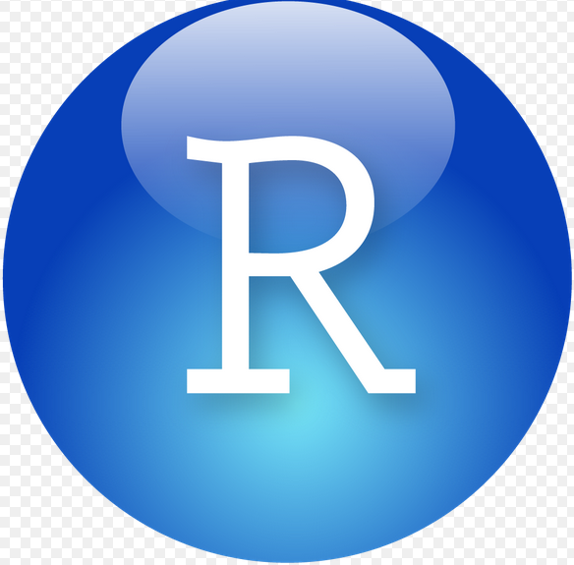

Slide 2
Contents
Introduction of R
What R does and does not
R Objects
R- Data Types
R - Variables
R- Operators
R- Decision Making
R- Data Frames
R and statistics
Data Analysis and Presentation
Advantages
Disadvantages

Slide 3

R programming language is a lot like magic... except instead of spells you have functions.

Slide 4

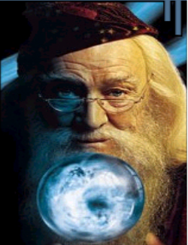
=
Wizard
R users are like wizards. They can rely on functions (spells) that have been developed for them by statistical researchers, but they can also create their own. They don’t have to pay for the use of them, and once experienced enough (like Dumbledore), they are almost unlimited in their ability to change their environment.

Slide 5
R is one of the top programming languages for data scientists and provides powerful tools for cleaning data and searching for relationships. However, R has some peculiarities that remain unknown, even to experienced R programmers.

Slide 6
Introduction of R
R is an interpreted computer language.
Most user-visible functions are written in R itself, calling upon a smaller set of internal primitives.
It is possible to interface procedures written in C, C+, or FORTRAN languages for efficiency, and to write additional primitives.
System commands can be called from within R
R is used for data manipulation, statistics, and graphics. It is made up of:
operators (+ - <- * %*% …) for calculations on arrays & matrices
large, coherent, integrated collection of functions
facilities for making unlimited types of publication quality graphics
user written functions & sets of functions (packages); 800+ contributed packages so far & growing

Slide 7
What R does and does not
Is not a database, but connects to DBMSs
language interpreter can be very slow, but allows to call own C/C++ code
no spreadsheet view of data, but connects to Excel/Ms Office
Data handling and storage: numeric, textual matrix algebra
hash tables and regular expressions
high-level data analytic and statistical functions
class (“OO”)
Graphics
programming language: loops, branching, subroutines

Slide 8

Learning R

Slide 9

R - Help Listserve...

Slide 10
R Objects
Almost all things in R – functions, datasets, results, etc. – are OBJECTS.
(graphics are written out and are not stored as objects)
Script can be thought of as a way to make objects. Your goal is usually to write a script that, by its end, has created the objects (e.g., statistical results) and graphics you need.
Objects are classified by two criteria:
MODE: how objects are stored in R - character, numeric, logical, factor, list, & function
CLASS: how objects are treated by functions (important to know!) - [vector], matrix, array, data.frame, & hundreds of special classes created by specific functions

Slide 11
R- Data Types
The variables are assigned with R-Objects and the data type of the R-object becomes the data type of the variable. There are many types of R-objects. The frequently used ones are −
Homogeneous
Vectors
Factors
Matrices
Arrays
Heterogeneous
Lists
Data Frames
The simplest of these objects is the vector object and there are six data types of these atomic vectors, also termed as six classes of vectors. The other R-Objects are built upon the atomic vectors.

Slide 12
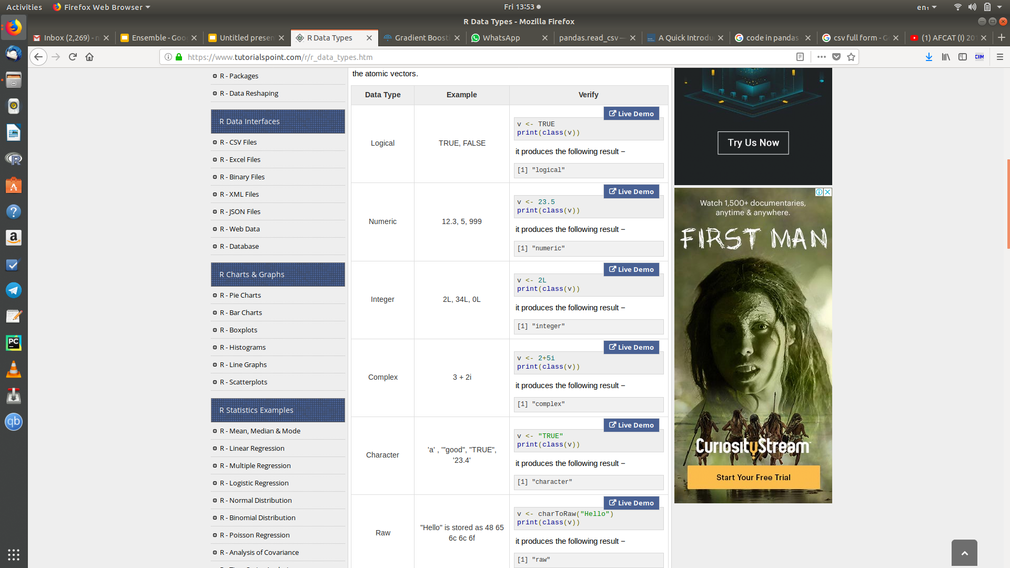

Slide 13
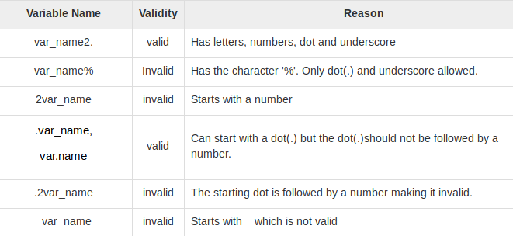
R - Variables

Slide 14
R- Operators
An operator is a symbol that tells the compiler to perform specific mathematical or logical manipulations. R language is rich in built-in operators and provides following types of operators.
Types of Operators
We have the following types of operators in R programming −
Arithmetic Operators
Relational Operators
Logical Operators
Assignment Operators
Miscellaneous Operators

Slide 15
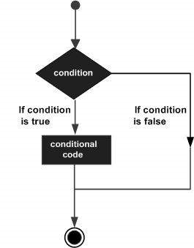
R- Decision Making
Decision making structures require the programmer to specify one or more conditions to be evaluated or tested by the program, along with a statement or statements to be executed if the condition is determined to be true, and optionally, other statements to be executed if the condition is determined to be false.

Slide 16
R- Data Frames
A data frame is a table or a two-dimensional array-like structure in which each column contains values of one variable and each row contains one set of values from each column.
Following are the characteristics of a data frame.
The column names should be non-empty.
The data stored in a data frame can be of numeric, factor or character type.
Each column should contain same number of data items.

Slide 17
R and statistics
Packaging: a crucial infrastructure to efficiently produce, load and keep consistent software libraries from (many) different sources / authors
Statistics: most packages deal with statistics and data analysis
State of the art: many statistical researchers provide their methods as R packages

Slide 18
Data Analysis and Presentation
The R distribution contains functionality for large number of statistical procedures.
linear and generalized linear models
nonlinear regression models
time series analysis
classical parametric and nonparametric tests
clustering
smoothing
R also has a large set of functions which provide a flexible graphical environment for creating various kinds of data presentations.

Slide 19
Advantages
Fast and free.
State of the art: Statistical researchers provide their methods as R packages. SPSS and SAS are years behind R!
Active user community
Excellent for simulation, programming, computer intensive analyses, etc.
Forces you to think about your analysis.
Interfaces with database storage software (SQL)

Slide 20
Disadvantages
Not user friendly @ start - steep learning curve, minimal GUI.
No commercial support; figuring out correct methods or how to use a function on your own can be frustrating.
Easy to make mistakes and not know.
Working with large datasets is limited by RAM
Data prep & cleaning can be messier & more mistake prone in R vs. SPSS or SAS
Some users complain about hostility on the R list serve.

