Slide 1

REAL TIME WEATHER DATA RETRIEVAL,
VISUALIZATION &
ANALYSIS
USING PYTHON
Hmm... I wonder what the weather is like today? 🤔

Slide 2
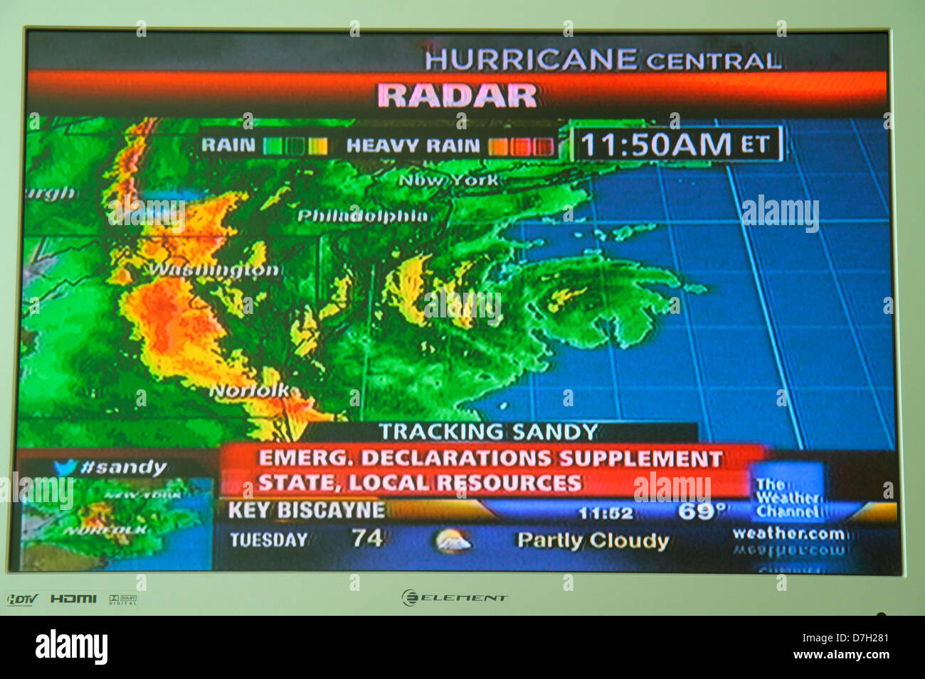
Table Of Contents
Introduction
Objectives
Modules
Source Code
Challenges Faced
Conclusion

Slide 3

Introduction
Our Weather Monitoring and Visualization System provides a comprehensive solution to track and analyze real-time weather data from around the globe. This system leverages the OpenWeather API to collect key meteorological information, such as temperature, humidity, wind speed, UV index, and more, for multiple cities worldwide.

Slide 4

Additionally, the system utilizes several powerful libraries to visualize and enhance the data:
Folium: Used to create interactive weather maps, providing a visual representation of weather conditions in various cities. It allows users to explore weather data on a geographical map.
Plotly and Matplotlib: These libraries are used for data visualization, helping users compare and analyze temperature and humidity trends across different cities with bar and line charts.
Seaborn: A Python data visualization library based on Matplotlib, used to create aesthetically pleasing and informative plots of weather trends.
Schedule: This library automates the process of fetching and updating weather data at regular intervals, ensuring the system stays up-to-date without manual intervention.
Requests: This library is used to interact with the OpenWeather API, fetching weather data and handling HTTP requests.

Slide 5


Key Features
Real-time Weather Updates: The system regularly fetches current weather data, including temperature, wind speed, and weather conditions, for a variety of cities. It updates the weather information every 2 minutes, providing timely insights.
Weather Forecasting: In addition to real-time data, the system also retrieves weather forecasts for specific cities.
Interactive Weather Maps: Using Folium, the system creates interactive maps that visualize weather data for multiple cities.
Temperature and Humidity Comparison: The application compares temperature and humidity levels across different cities using Plotly and Matplotlib.

Slide 6

5. Wind Chill and Sunlight Duration: The system calculates additional weather parameters, such as wind chill (for colder regions with higher wind speeds) and sunlight duration (the time between sunrise and sunset), providing more insights into daily weather conditions.
6. Data Logging: Every weather update is logged in a text file, which allows users to maintain a historical record of weather conditions.

Slide 7
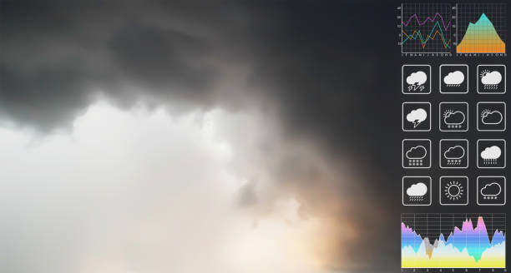
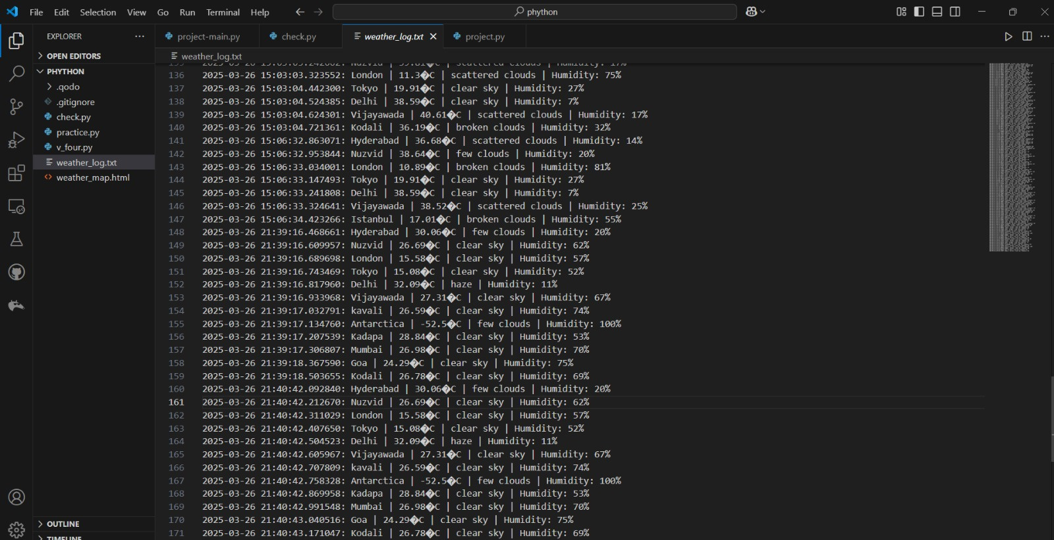
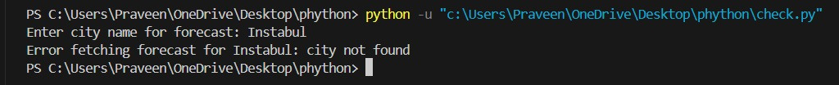

Slide 8

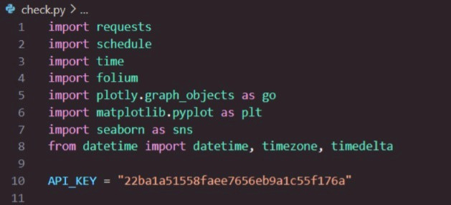
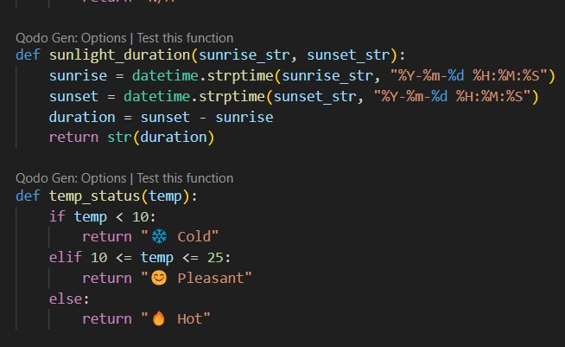
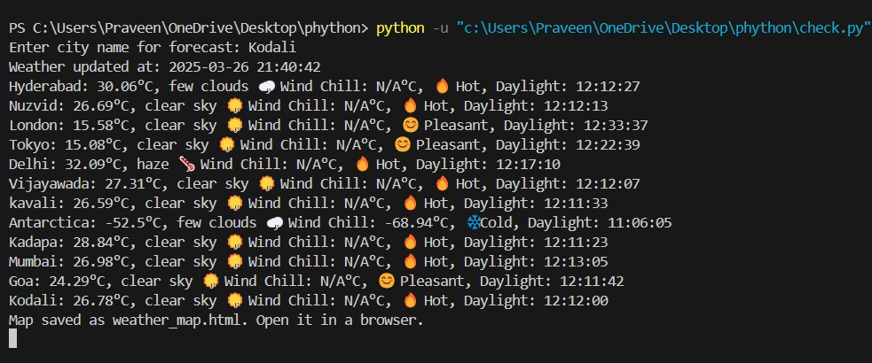

Slide 9
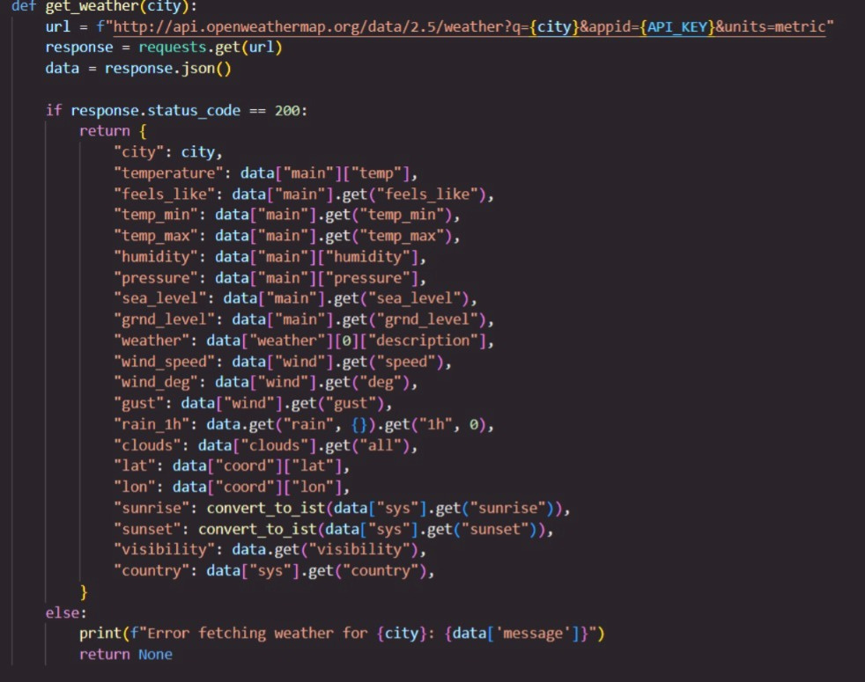
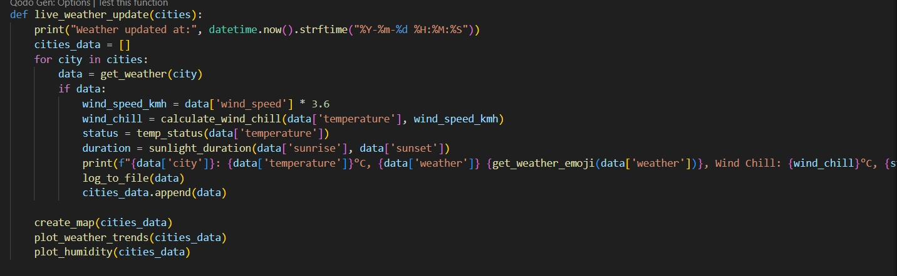
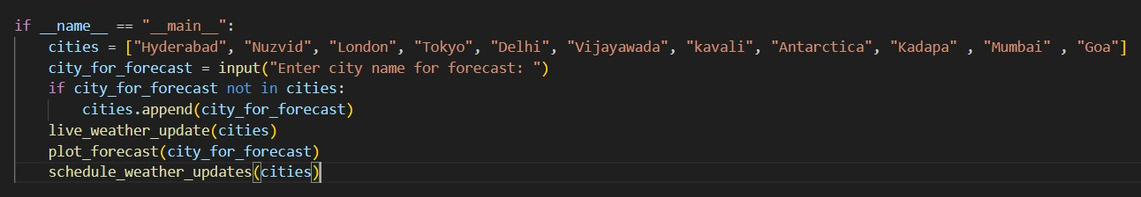
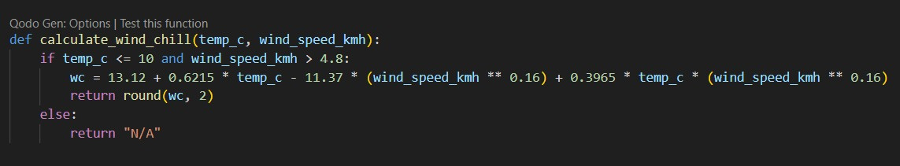

Slide 10
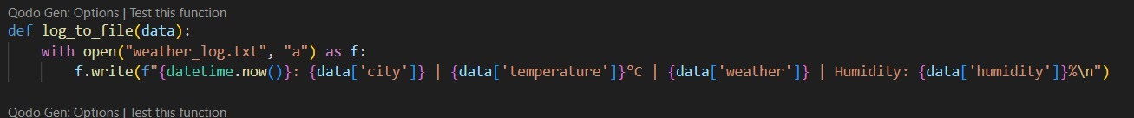
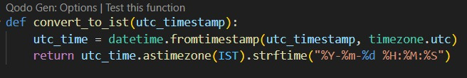
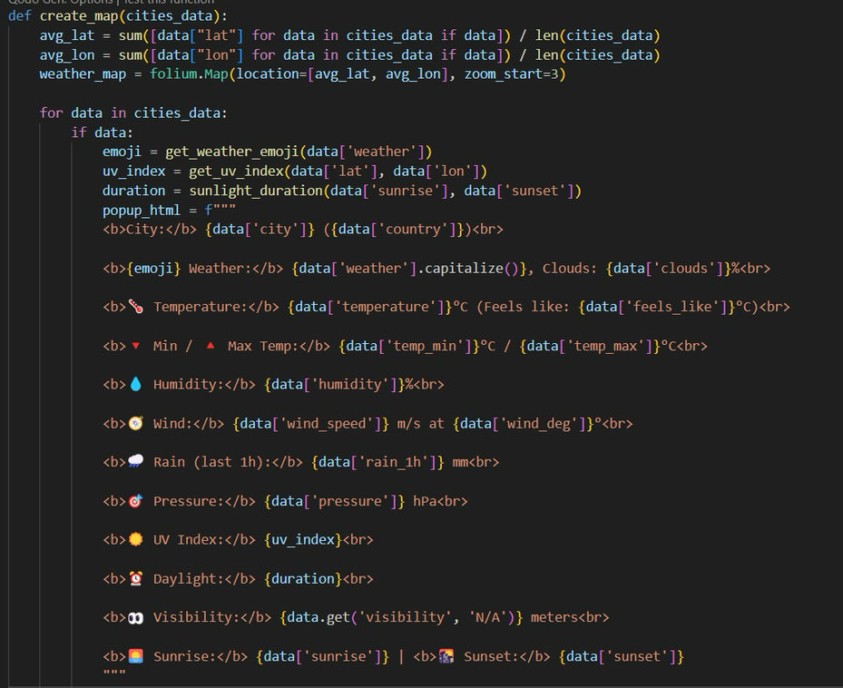

Slide 11
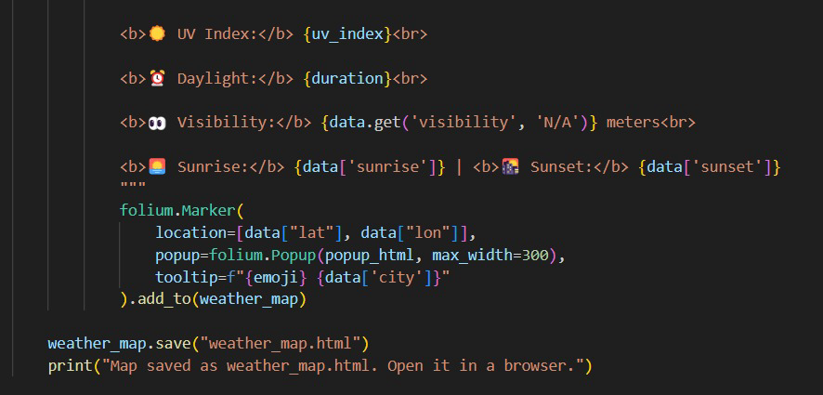
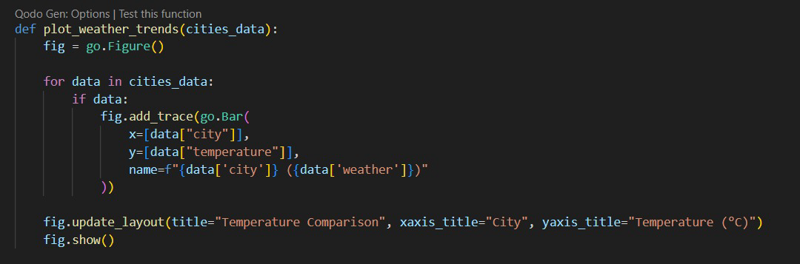

Slide 12
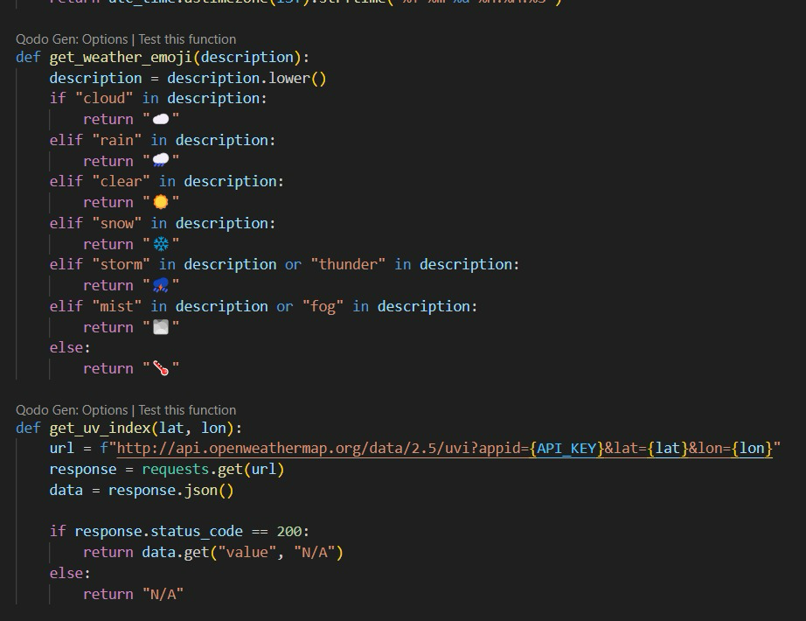

Slide 13
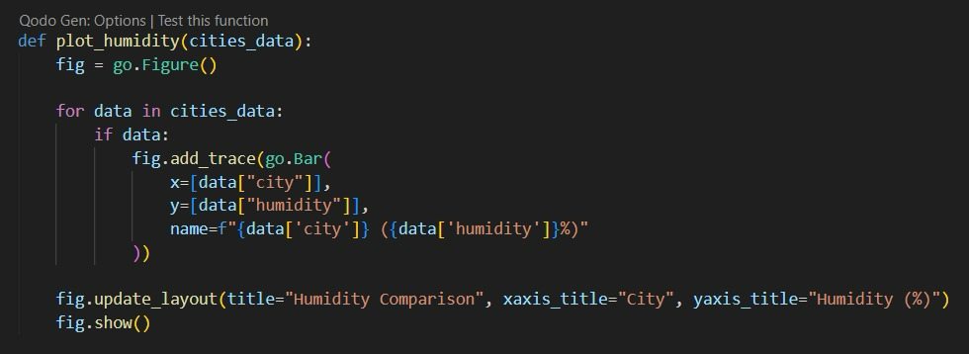
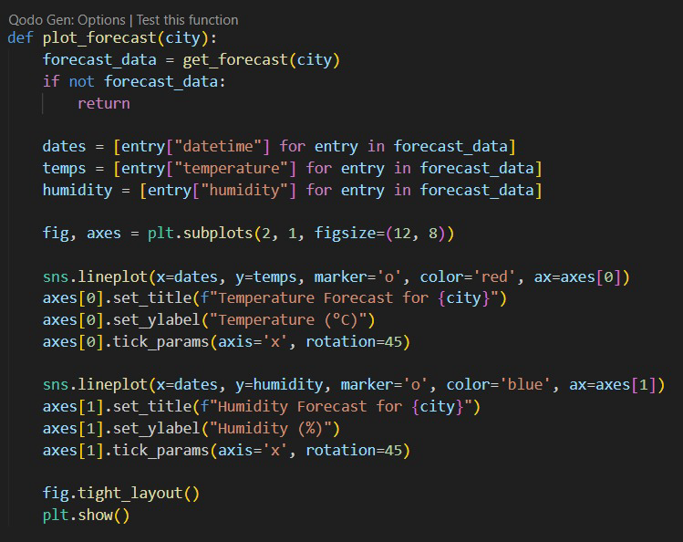

Slide 14
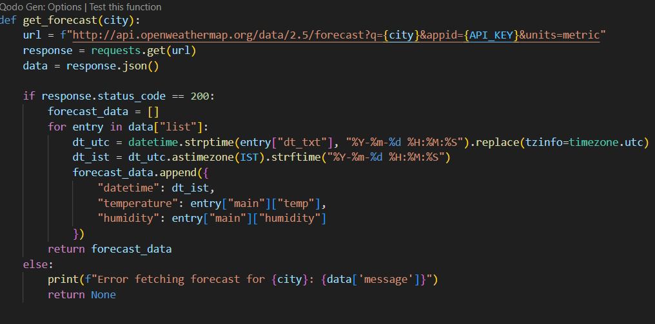
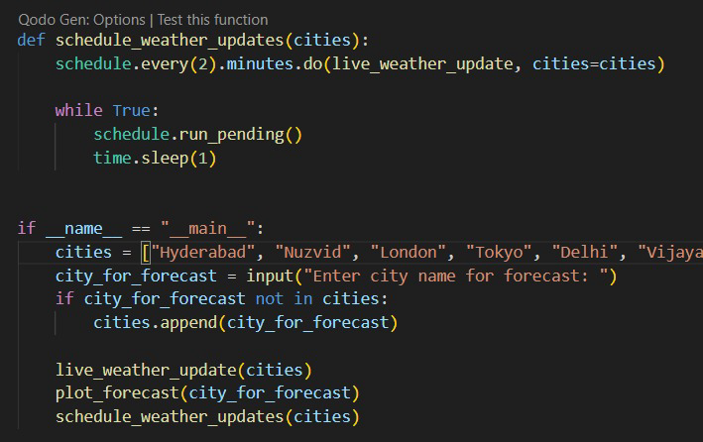

Slide 15
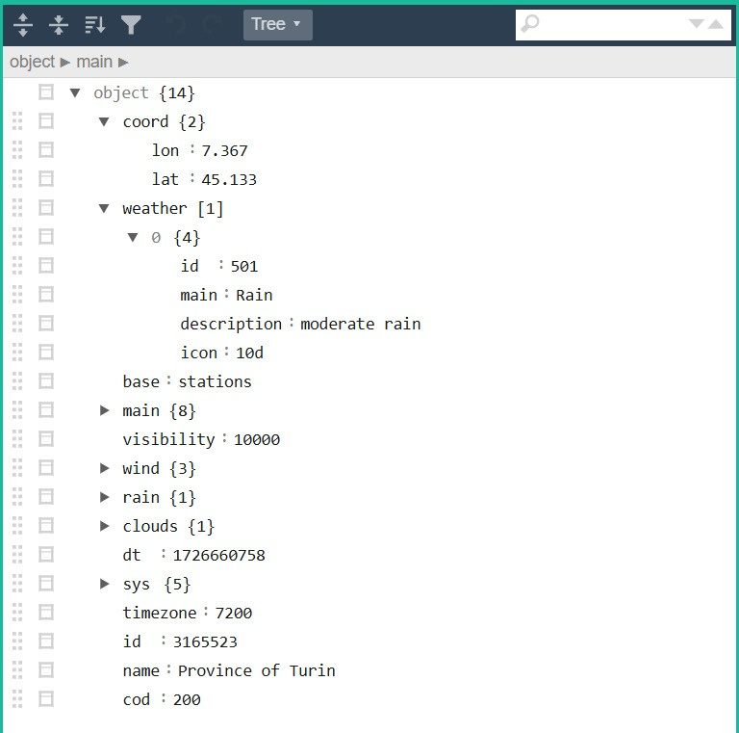
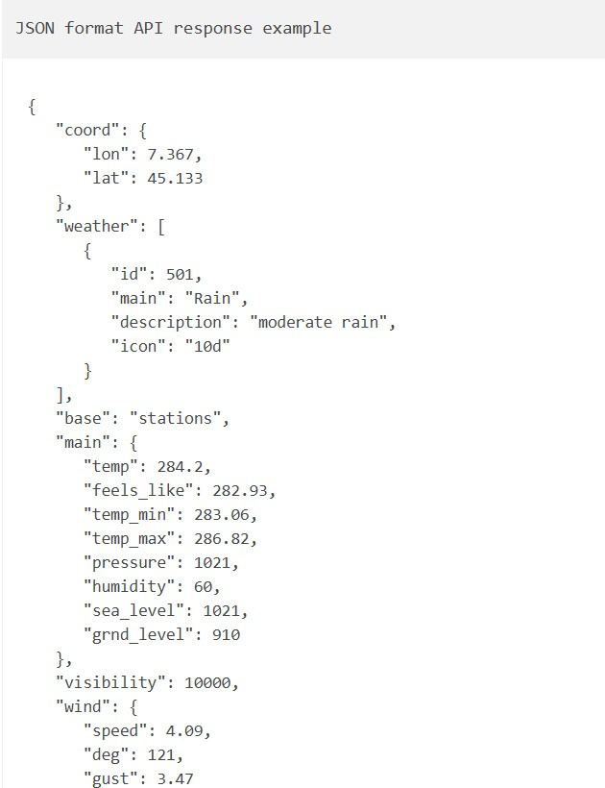

Slide 16
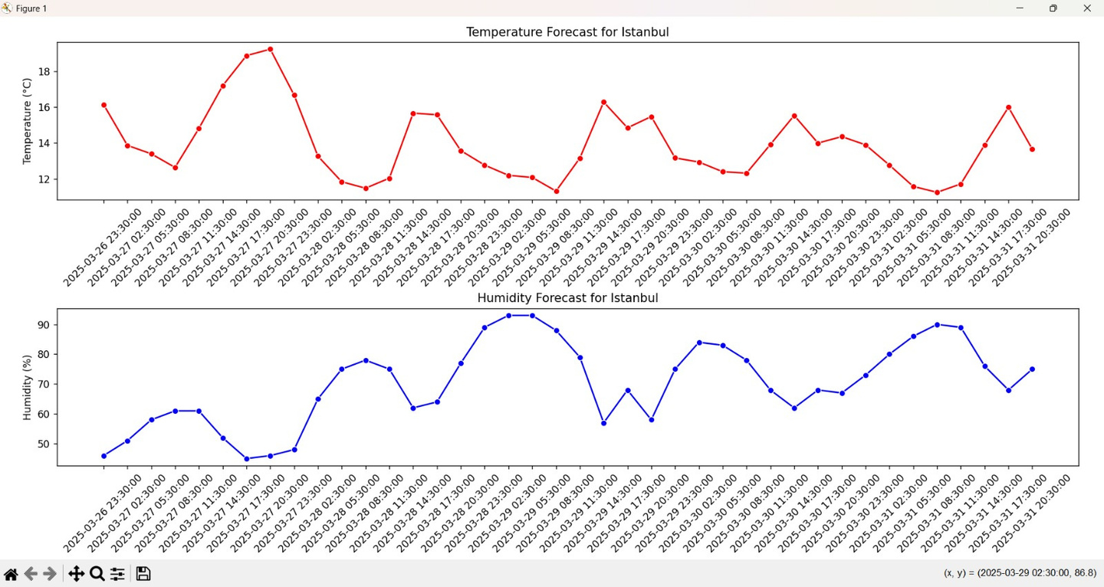
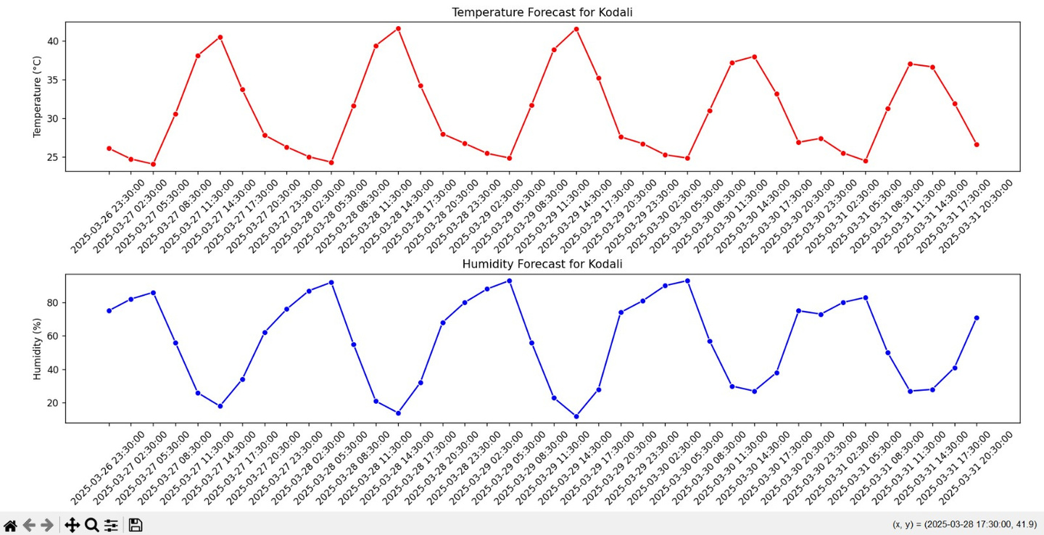

Slide 17
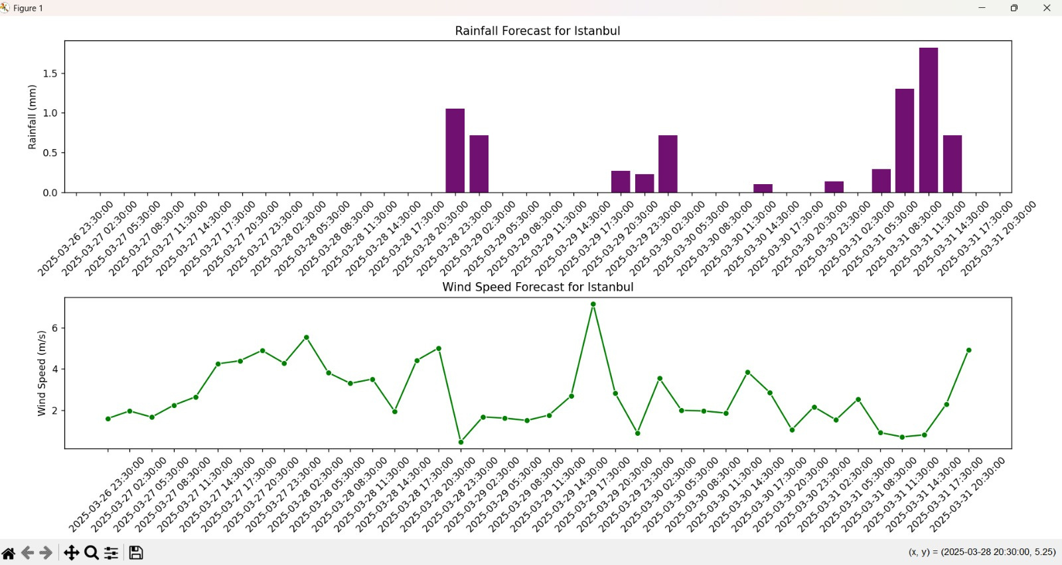

Slide 18
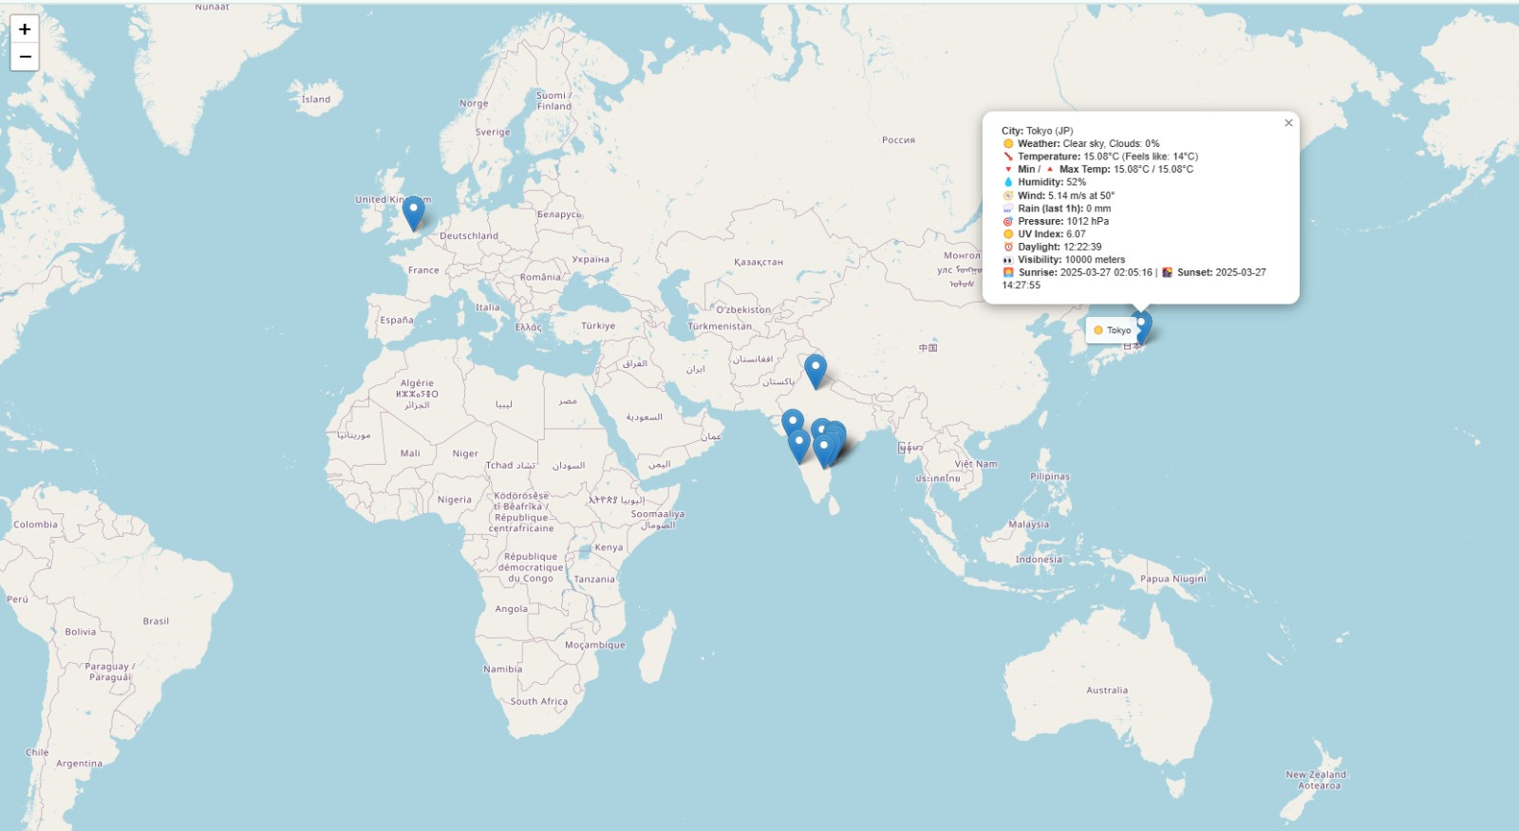

Slide 19
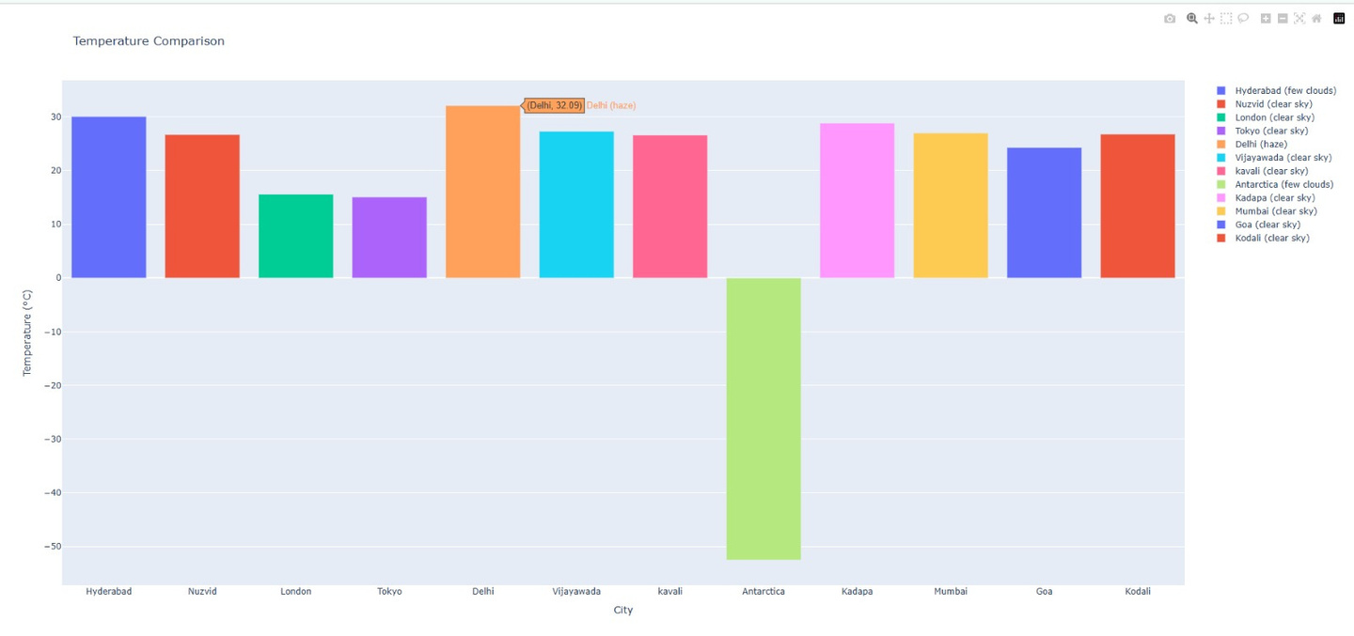
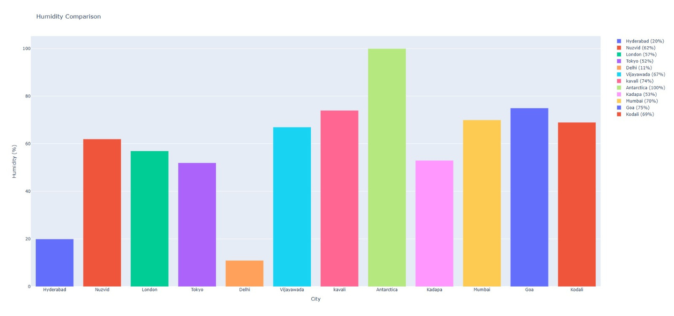

Slide 20

OUTCOMES
Accurate Weather Retrieval:
Successfully fetches real-time weather data for multiple cities.
Provides additional insights like wind chill, UV index, and daylight duration.
Timezone Handling
Converts UTC timestamps to Indian Standard Time (IST) for better readability.
Improved User Experience
Uses emojis for quick weather interpretation.
Displays temperature status (Cold, Pleasant, Hot).
Data Logging & History
Weather data is saved in a text file (weather_log.txt), allowing tracking over time.
Interactive Data Visualisation
Matplotlib & Seaborn create trend graphs for temperature changes.
Folium supports map-based visualization.
Bokeh & Plotly provide interactive charts.
Automated Updates
Uses schedule to fetch live weather data every 10 minutes.
Scalability
Supports multiple cities and allows adding new cities dynamically

Slide 21

CHALLENGES FACED
API Limitations
Free-tier APIs have rate limits, restricting the number of requests per minute.
Some features (e.g., UV index) may require a paid plan.
Handling API Failures
Some cities may not return data due to incorrect spelling or missing records.
Implemented error handling (response.status_code) to manage API failures.
Time Zone Adjustments
Converting UTC to IST was necessary for user-friendliness.
Handled time formatting to ensure proper visualization.
Data Visualisation Complexity
Forecast graphs required proper handling of timestamps.
Seaborn and Matplotlib plots needed rotation of x-axis labels for clarity.
Real-time Updates
Continuous API requests can slow down execution.
Used schedule and time.sleep(10) to ensure periodic updates without overloading.
Wind Chill Calculation Constraints
The formula only applies under specific conditions (temperature ≤ 10°C).
Returns "N/A" when conditions are not met.
User Input Handling
Users may enter an invalid city name, causing API errors.
Implemented a city validation step before making API calls.

Slide 22
Conclusions
Future Enhancements:
🚀 Integrate machine learning models for weather trend predictions
🚀 Improve mobile compatibility by developing a web-based dashboard
🚀 Include push notifications for severe weather alerts
Final Thoughts
This weather forecasting project successfully integrates real-time weather data retrieval, data visualization, and automation to provide an insightful and user-friendly experience. The script fetches weather data for multiple cities, logs historical records, and presents the data in interactive charts, maps, and text reports.

Slide 23


