Slide 1

SPMVV-Exam-Results Portal
శ్రీ పద్మావతి మహిళా విశ్వవిద్యాలయం
SRI PADMAVATI MAHILA VISVAVIDYALAYAM - SOET
(Women's University)
Tirupati, Andhra Pradesh-517502, India
Presented by:
P Navya Sree

Slide 2
Introduction
The Challenge – The current exam management workflow relies heavily on manual processes. These labor-intensive tasks result in significant operational delays, impacting not only the exam section but also causing administrative bottlenecks across multiple departments.
The Idea – To implement a digital transformation initiative aimed at automating exam-related workflows. The goal is to replace manual interventions with a centralized, automated system to improve accuracy, reduce turnaround time, and streamline inter-departmental coordination.
The Solution – The proposed solution is a centralized automation exam management platform to replace manual workflows with a unified, digital system. Key features include automated results publication, circular management, student verification, eligibility tracking, and dynamic hall ticket generation—all designed to maximize administrative efficiency and data accuracy.

Slide 3
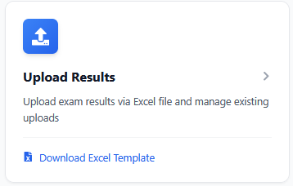
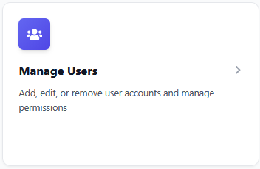
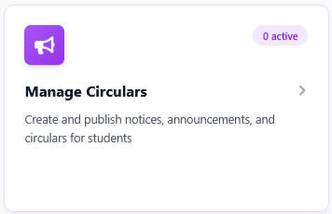
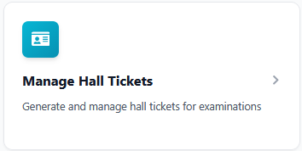
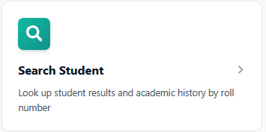
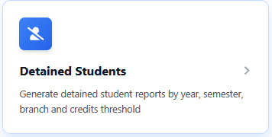
Features of the Application
Designed to modernize the SPMVV SOET exam portal, this solution resolves current operational bottlenecks through the following core functionalities:
Publishing exam results
Announcements through Circulars
User Management System
Manage Circulars
Search Student
Detained Students

Slide 4
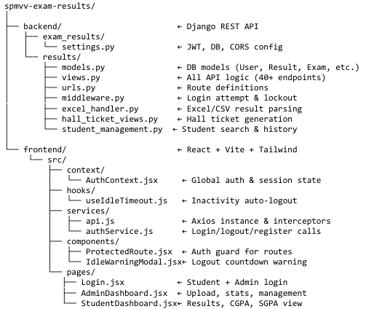
File Structure

Slide 5
Login/Registration Page
Student & Admin login (separate tabs)
JWT-based authentication (access + refresh tokens)
Account lockout after 5 failed attempts (30 min lock)
Auto-logout after 60 minutes of inactivity
Session cleared on browser tab close (sessionStorage)
Password change for logged-in users

Slide 6
Exam Results Statistics
Bulk upload via Excel / CSV file
Automatic SGPA calculation on upload
Row-level validation with error reporting before save
Multi-attempt merging — latest upload overwrites per subject code
Supports multiple years and semesters in single upload
Sample Excel template download for correct format
Per-exam result download (export back as Excel)
Per-exam delete to remove entire batch from DB- Admin-only access

Slide 7
User Management
List all users with role, branch, department, permissions and last login
Create new user with role assignment (admin / student)
Edit user details — name, email, branch, department
Granular permission flags per user: can_upload_results, can_delete_results, can_view_statistics, can_manage_users, can_view_all_branches
Reset any user's password (also clears failed login counter and lockout)
Delete user (cannot delete yourself or default admin account)
Permission-based access — only users with can_manage_users flag can access

Slide 8
Hall Ticket Management
Create and manage exam entries with course, branch, year, semester filters
Add / edit / delete subjects per exam with exam date and time
Bulk student enrollment via Excel upload (Roll Number + Student Name)
Student photo upload from Student portal
Generate hall tickets
Download individual hall ticket as PDF
Download all hall tickets for an exam as a single combined PDF

Slide 9
Search Student
Search by roll number (partial match supported)
View full semester-wise result history — each exam upload shown separately
Shows SGPA, total marks, credits earned, pending subjects per semester
Edit individual subject marks — internal, external, total, grade
Grade validation — only O, A, B, C, D, F, AB (Absent) accepted
Auto-updates overall result when a failed subject is corrected

Slide 10
Detained Students
Filter by year, semester, branch, course
Cumulative credit calculation across all qualifying semesters
Subject-level merging — latest uploaded result wins per subject code
Configurable credit threshold with operators: gt, gte, lt, lte, eq
Shows credit earned vs total per student with failed subject breakdown
Admin-only access (403 for students)- Export results as CSV

Slide 11
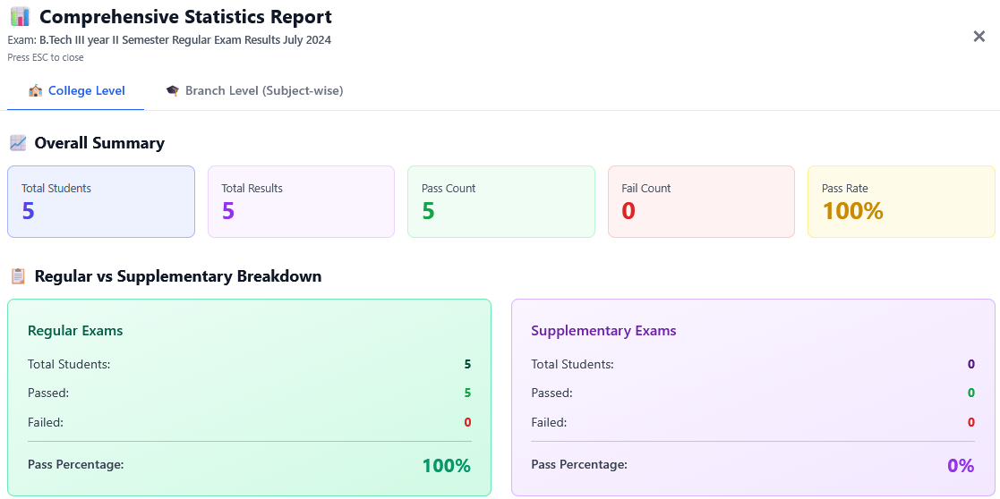
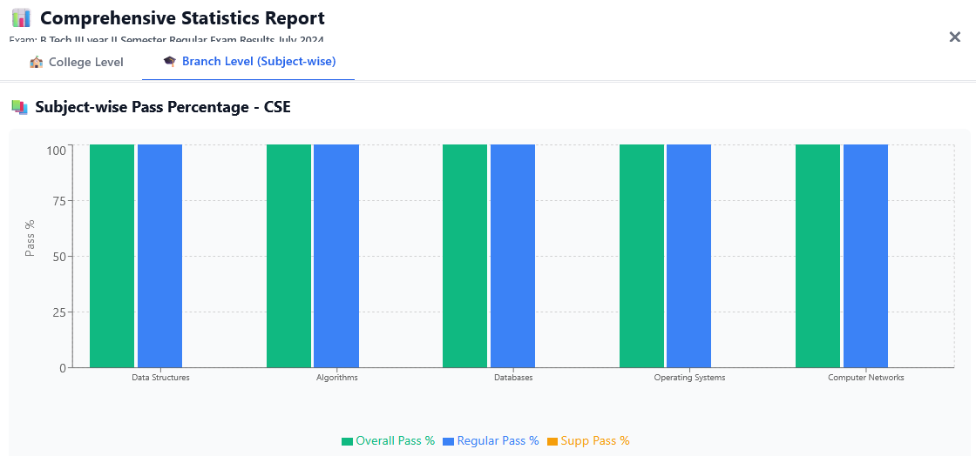
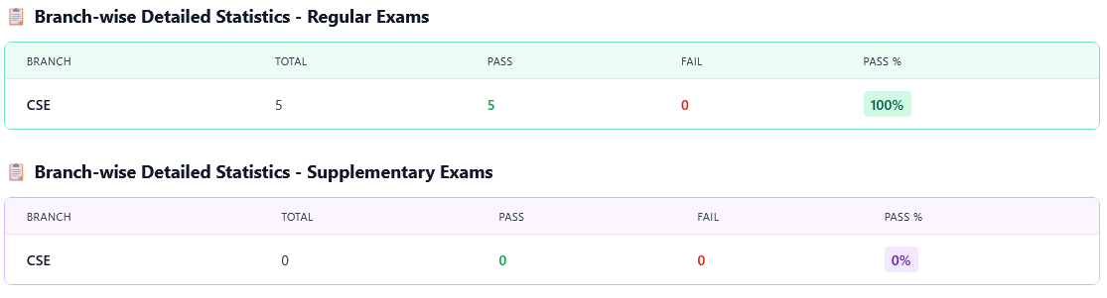
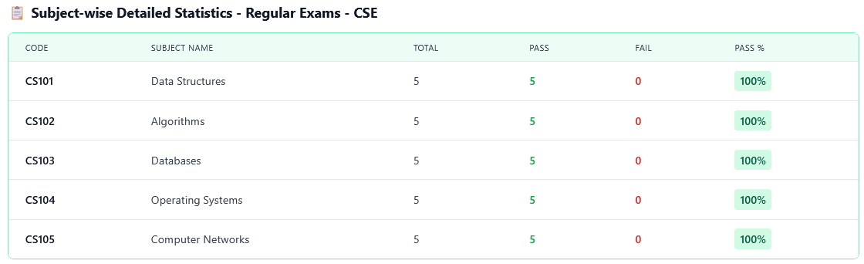
Exam Results Statistics

Slide 12
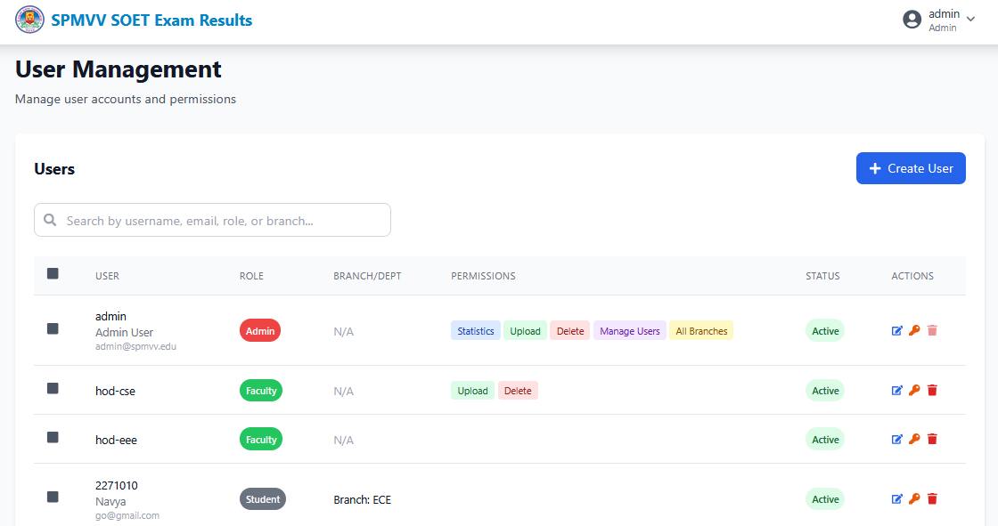
User Management

Slide 13
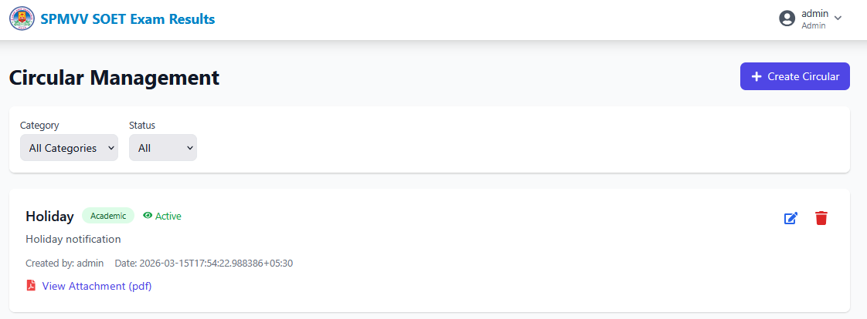
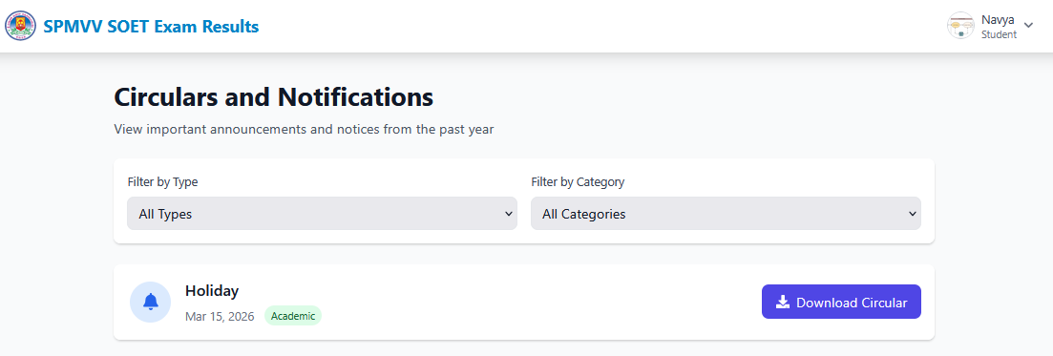
Circular Management

Slide 14
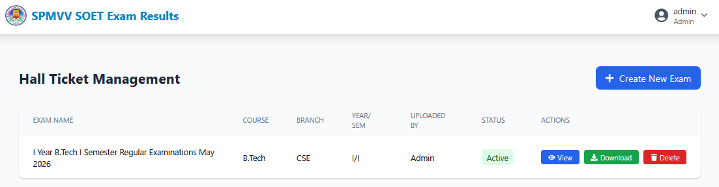
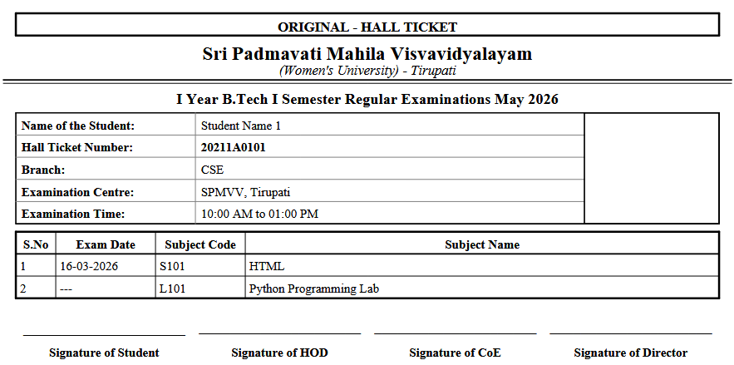
Circular Management

Slide 15
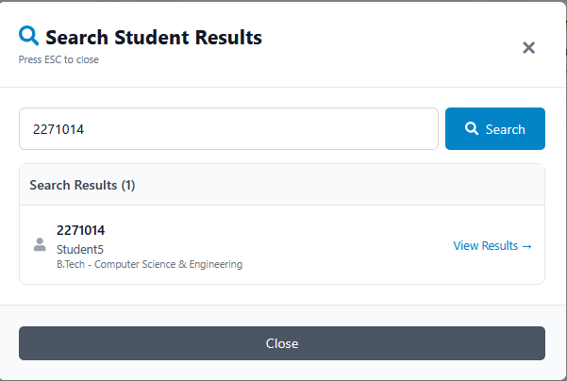
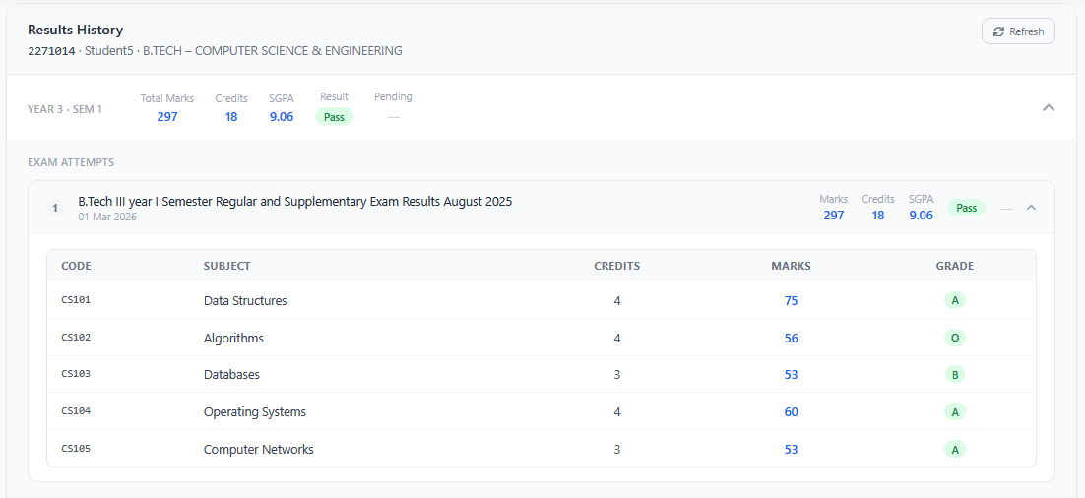
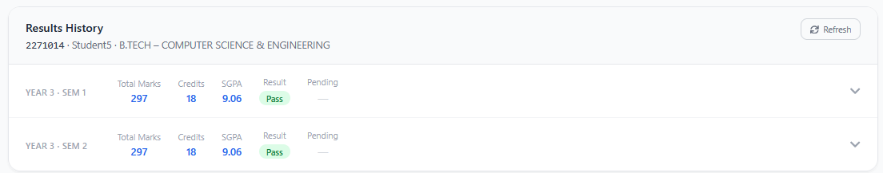
Search Student

Slide 16
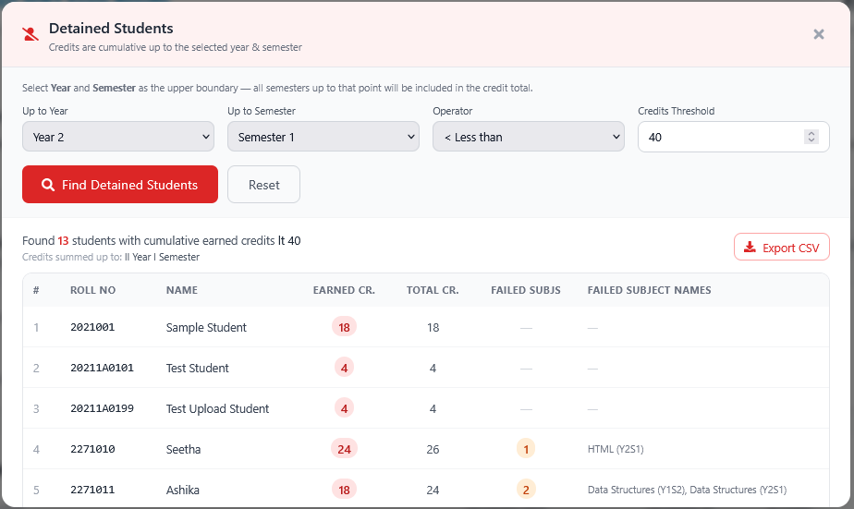
Detained Student

Slide 17
Technical Stack
Layer | Technology | Version
Language | Python | 3.11
Web Framework | Django | 5.0.9
REST API | Django REST Framework | 3.15.2
UI Framework | React | 18.2.0
Build Tool | Vite | 5.0.8
Frontend — React SPA served by Nginx on port 2026
Backend — Django REST API served by Gunicorn on port 8000 (internal)
Database — MariaDB on port 3306 (internal, not exposed to internet)
Deployment — All three layers run as isolated Docker containers on a single Linux VM
Communication — Frontend calls Backend via REST/JSON; Backend talks to DB via ORM

Slide 18
Technical Highlights
Three-tier Docker architecture — Frontend, Backend, Database in isolated containers.
REST API design — stateless, JSON-based, standard HTTP status codes.
Role-based access control with 5 granular admin permission flags- Automatic SGPA/CGPA calculation using grade-point mapping (O=10, A=9 … F=0).
Multi-attempt merging — supplementary results override regular results per subject- Audit trail on every action with IP address, user identity, and timestamp.

Slide 19
Future Scope
Grade Card / Transcript PDF Download
Online Re-evaluation Request
Email Notifications for Result Updates
Two-Factor Authentication (2FA)
Result Comparison Charts (Semester-wise)
Timetable Management
Bulk Student Import via Excel
Automated Database Backup Scheduling
Mobile App (Android / iOS)

