Slide 1
BUSINESS INTELLIGENCE REPORT
Interactive Business Dashboard
Sales Financial Dataset Performance Overview
Prepared by: AntiGravity BI Analyst

Slide 2
SALES FINANCIAL ANALYSIS
Project Objectives & Scope
• Executive Goal: Provide an interactive executive-level Business Dashboard to monitor sales, profit, order volume, and profit margins in real-time.
• Interactive Data Exploration: Equip decision-makers with slicers (Year, Region, Category, Segment) to perform deep-dives into specific business segments.
• Visual Storytelling: Implement professional Power BI charts (Sales Trend, Category Profit, Regional Donut, Top 10 Products) to communicate sales patterns clearly.
• Data-Driven Action: Translate sales statistics into actionable business insights to boost underperforming categories and optimize geographical logistics.

Slide 3
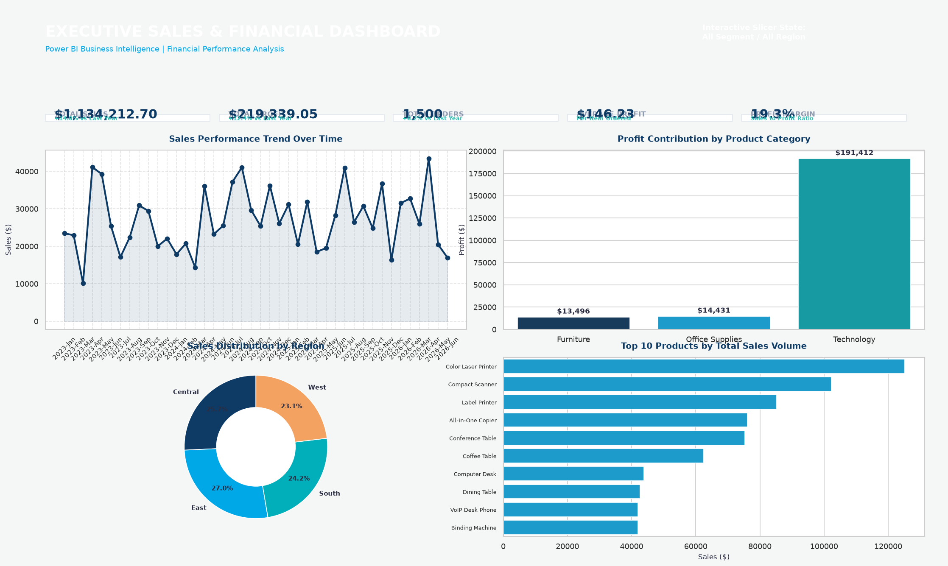
SALES FINANCIAL ANALYSIS
Key Performance Indicators (KPIs)
Dashboard KPIs Summary
Total Sales: $1,134,212.70 (Healthy baseline across all segments)
Total Profit: $219,339.05 (Driven strongly by Technology division)
Total Orders: 1,500 (Volume distribution reflects high retail traffic)
Average Profit: $146.23 (Net profit per item ordered)
Profit Margin: 19.3% (Solid financial health and product pricing)

Slide 4
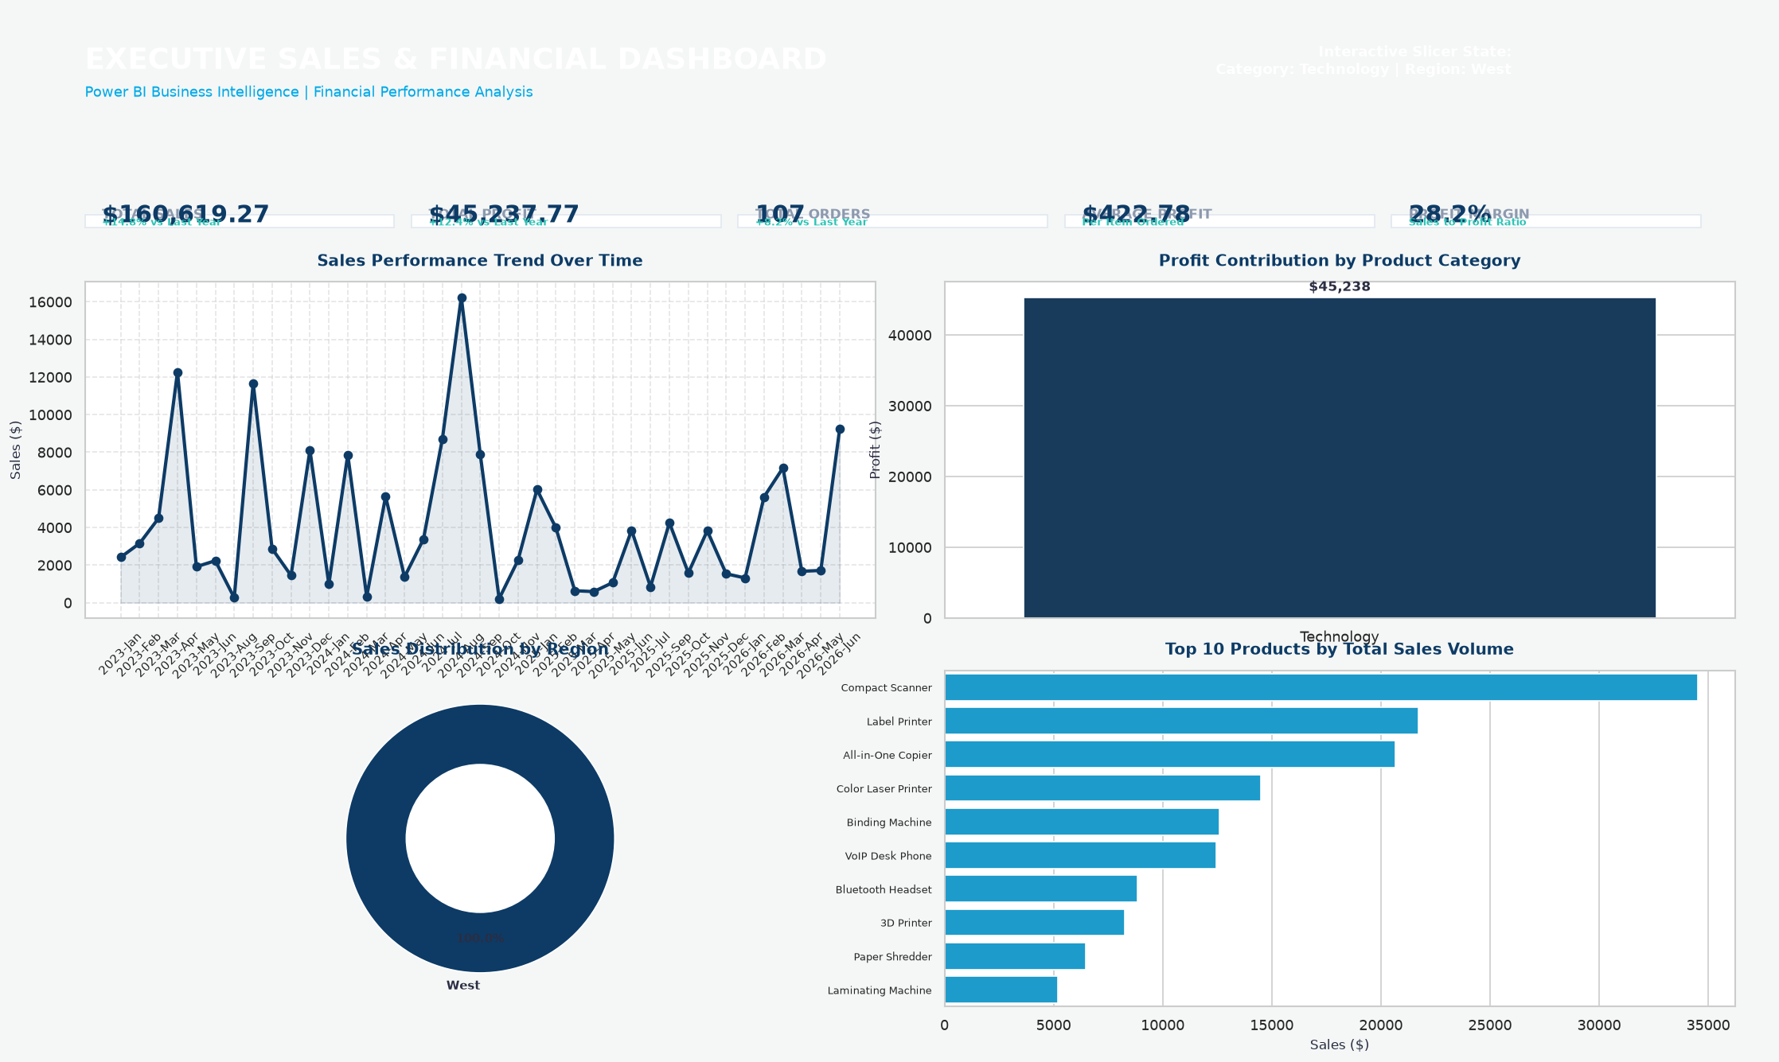
SALES FINANCIAL ANALYSIS
Dashboard Visualizations & Interactive Filtering
Interactive Features
• Multi-Dimensional Slicers Users can filter the report by Year, Region, Category, and Segment to drill down instantly.
• Cross-Filtering Visuals Selecting data in any visual dynamically filters all other elements on the dashboard (demonstrated in the filtered screenshot to the left).
• Focused Sub-reports Detailed layouts for Sales Trend and Profit Analysis let analysts export specific figures for deep-dive reporting.

Slide 5
SALES FINANCIAL ANALYSIS
Business Insights & Conclusion
Key Findings & Recommendations
✔ Technology Leads Profitability: Technology products contribute the highest profit margins (35% base margins), with Copiers and Phones dominating sales volume.
✔ Geographical Performance: The East and West regions represent the major sales drivers. Targeted promotional campaigns are recommended in the South region to tap into underutilized markets.
✔ Furniture Discounting Constraints: Furniture yields a lower net profit due to high shipping costs and frequent discounting. Recommended to revise the discount cap for Furniture tables and chairs to protect margin lines.
✔ Actionable Next Steps: Utilize the dashboard weekly to identify top-performing SKUs and optimize logistics planning based on regional demand signals.

