Slide 1

Drugs
HOW CAN WASTEWATER TESTING BE USED TO MONITOR DRUG CONSUMPTION
Safeen Mridha
Ayda Takehei
Danae McCulloch
Wardah Ali
Navyasri Chinthapatla

Slide 2






WHO WE ARE:
Safeen Mridha
Ayda Takehei
Danae McCulloch
Wardah Ali
Navyasri Chinthapatla
BSc Biological Sciences,
University of Calgary
BSc Geology,
University of Calgary
BSc Biochemistry,
University of Victoria
BSc Computer Science,
Salim Habib University
B Tech Computer Science,
BVR Institute of Technology

Slide 3
1
Project Recap
2
GQ1: What is the level of the drug metabolites detected in the wastewater of each city in a span of 17 months?
Heat Map
AGENDA
3
GQ2: Which are the top three cities with the highest detection of drug metabolites?
4
GQ3: Is the analysis of drug metabolites mostly caused by Prescribed or Unprescribed drugs? What is the overall leading drug?
5
GQ4: What is the predicted drug detection trend in the upcoming X months? Which city is predicted to have the most consumption?
6
Findings & Conclusion

Slide 4


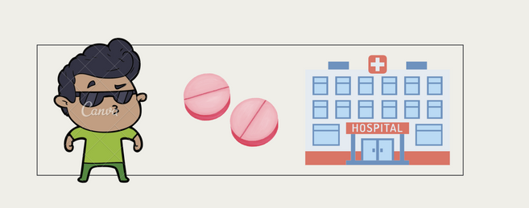


Project Recap
How are drugs used?
Why monitor?
Strongly associated with Public Health
Drug related crime- economic detriment
(Glei and Weinstein, 2019)
Why wastewater?
“Wastewater analysis is a rapidly developing scientific discipline with the potential for monitoring real-time data on geographical and temporal trends in illicit drug use.”
-EUROPEAN UNION DRUG AGENCY (EUDA)

Slide 5
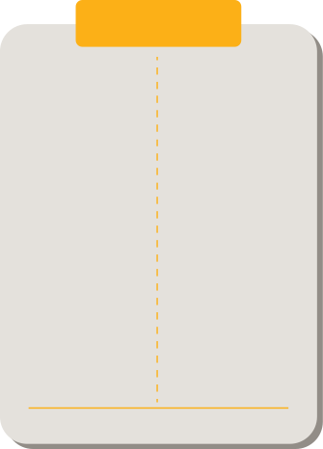
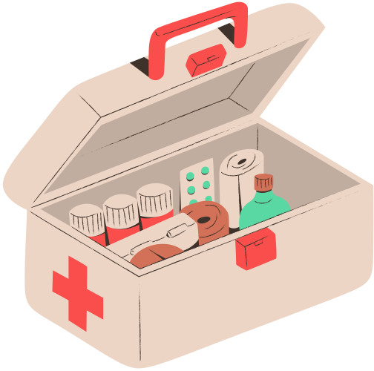




DRUGS
PRESCRIBED
UNPRESCRIBED
Cannabis
Codeine
Fentanyl
Methadone
Morphine
Oxycodone
Amphetamine
Cocaine
Ecstacy
Methamphetamine
Data on Drug Metabolites in wastewater obtained from Statistics Canada!

Slide 6
What is the level of the drug metabolites detected in the wastewater of each city in a span of 17 months?

Slide 7
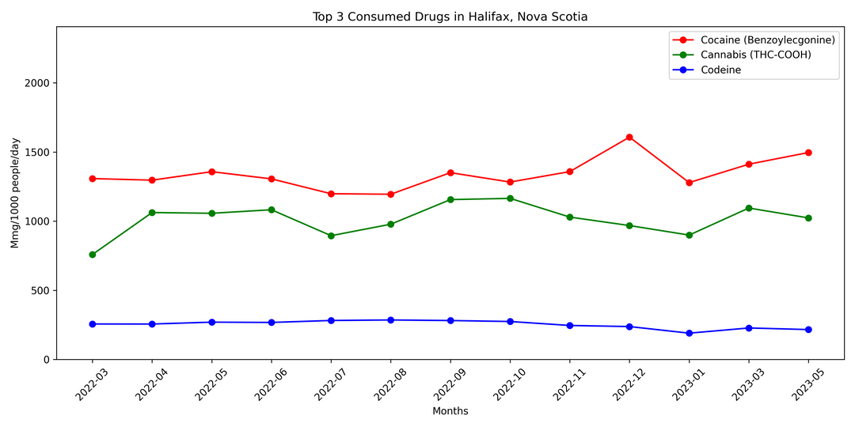
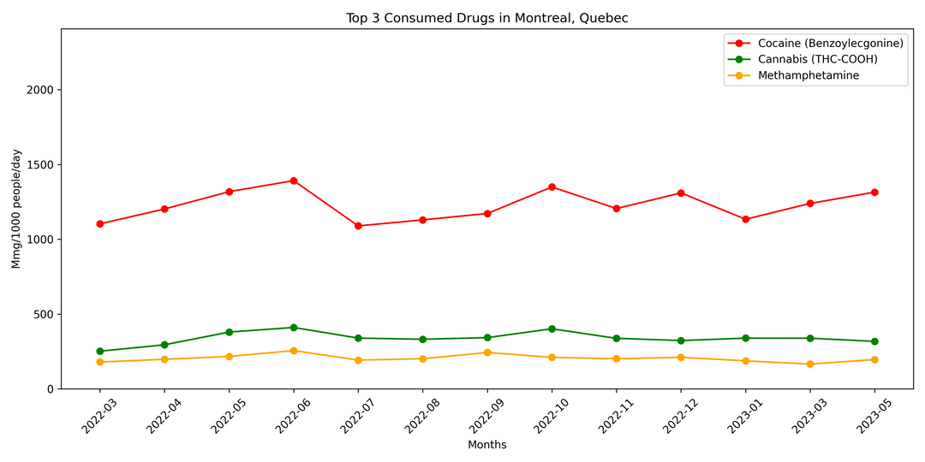
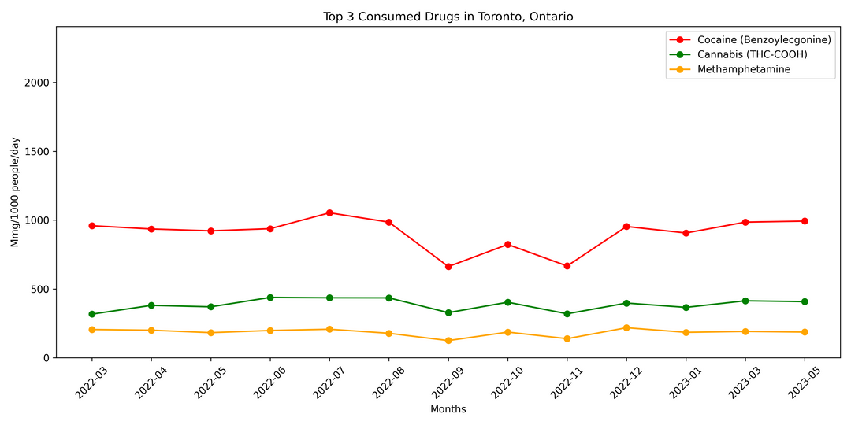
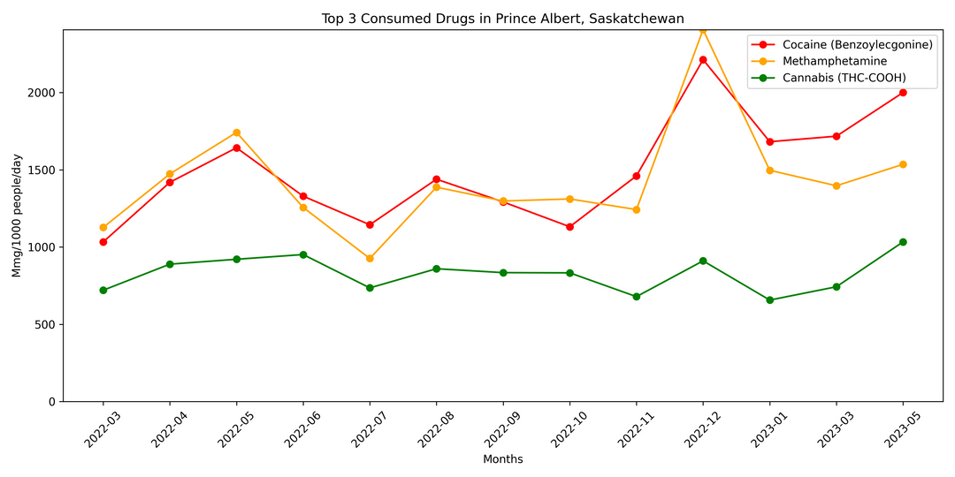
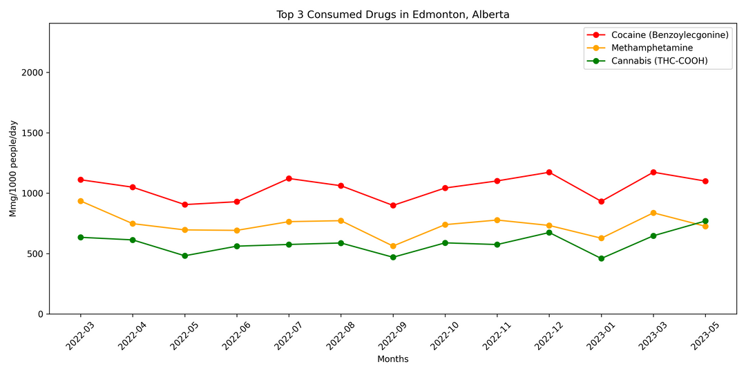
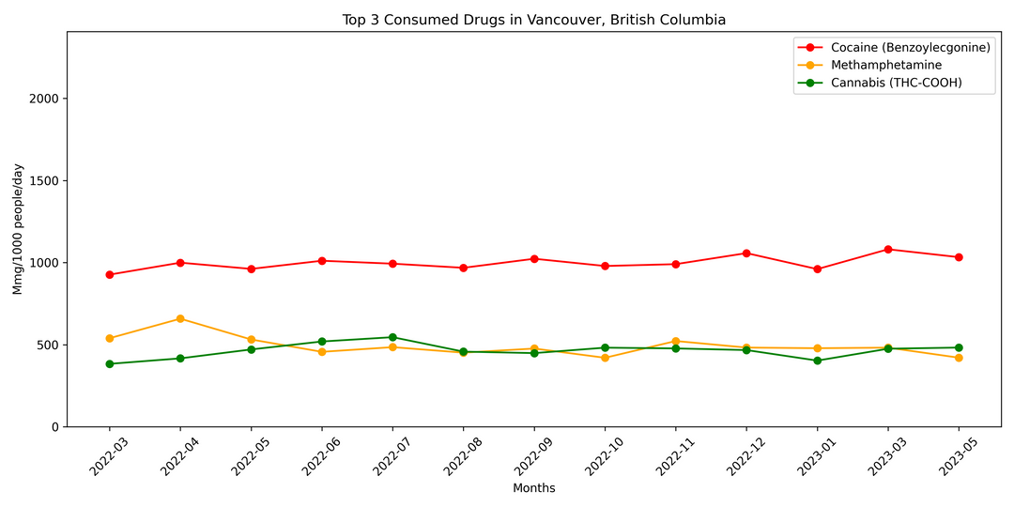
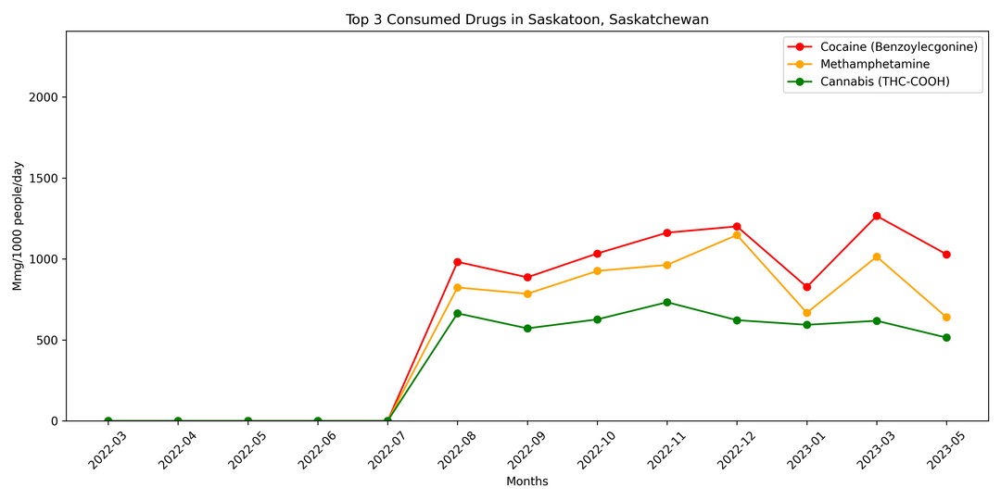
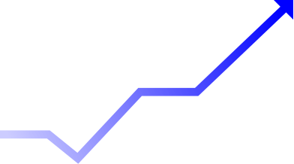
Halifax
Montreal
Toronto
Prince Albert
Edmonton
Vancouver
Saskatoon

Slide 8
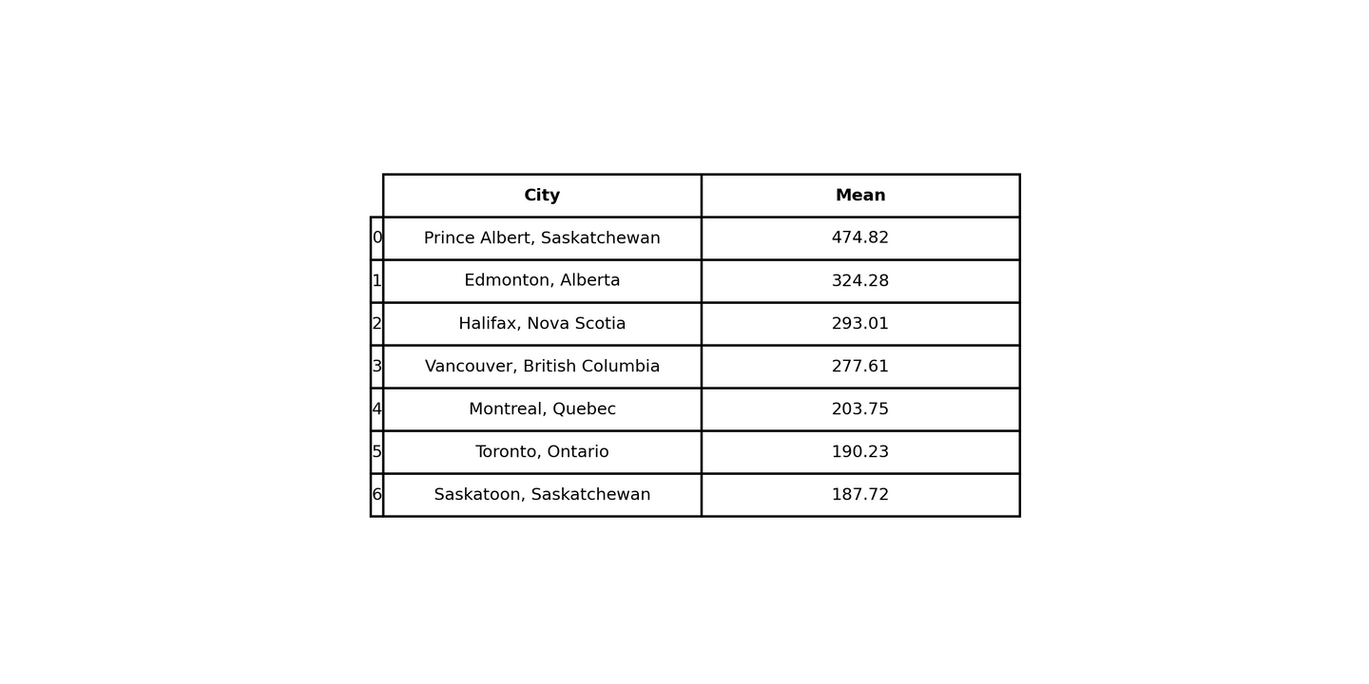

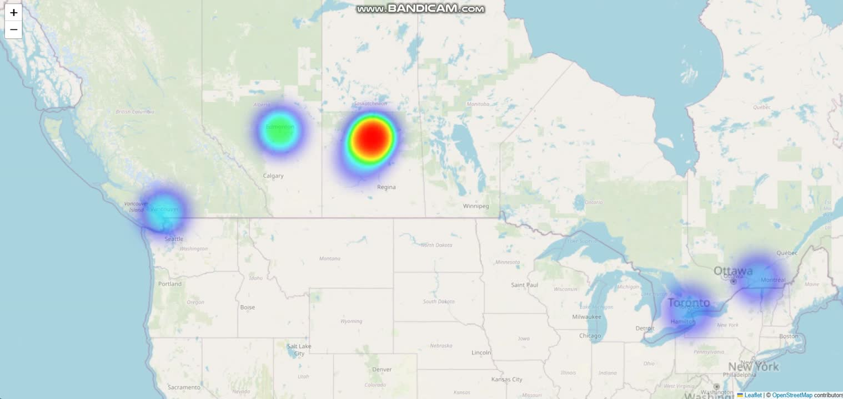
HEAT MAP OF CANADA

Slide 9
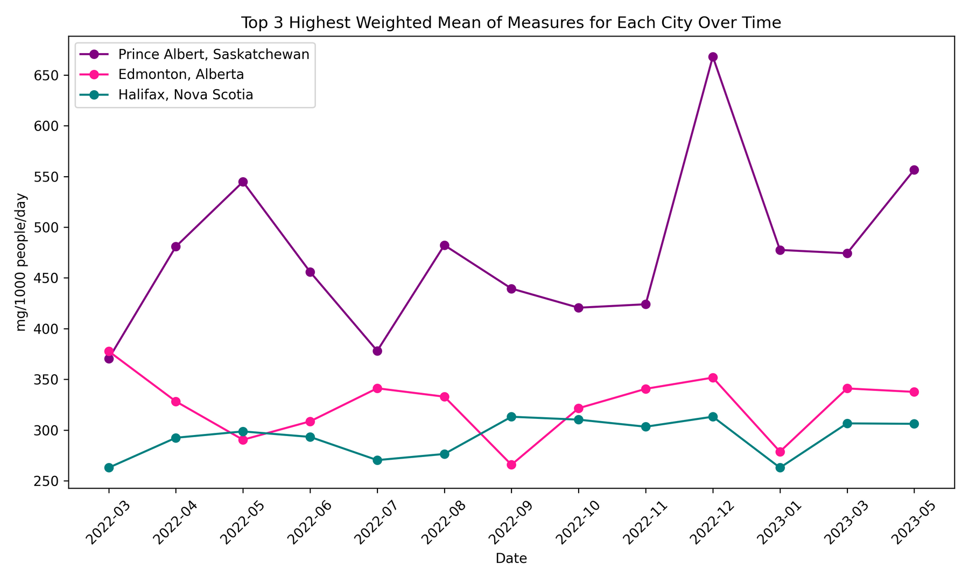
WHICH ARE THE TOP THREE CITIES WITH THE HIGHEST DETECTION OF DRUG METABOLITES?

Slide 10
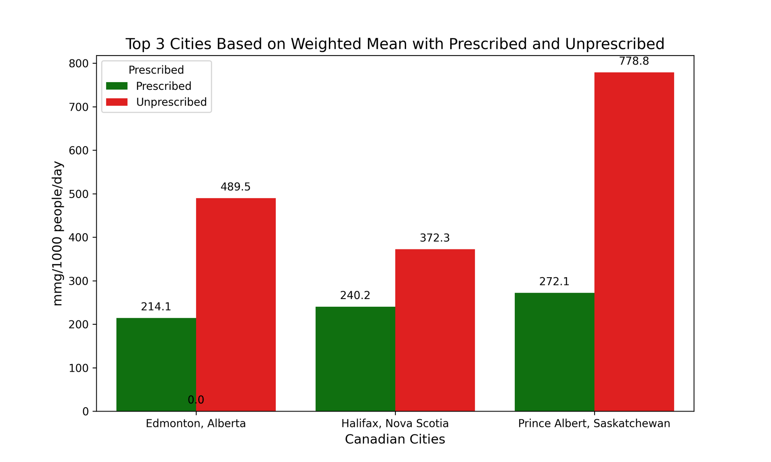
IS THE ANALYSIS OF DRUG METABOLITES MOSTLY CAUSED BY PRESCRIBED OR UNPRESCRIBED DRUGS? WHAT IS THE OVERALL LEADING DRUG?

Slide 11
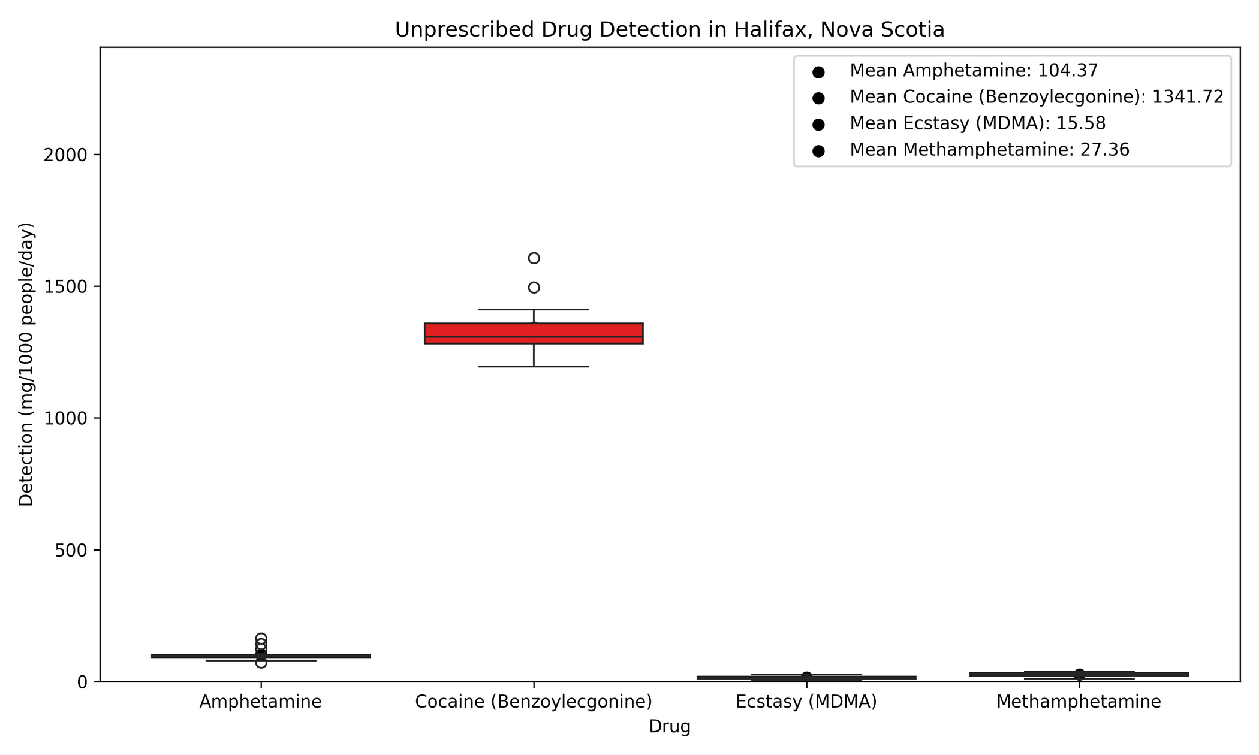

Slide 12
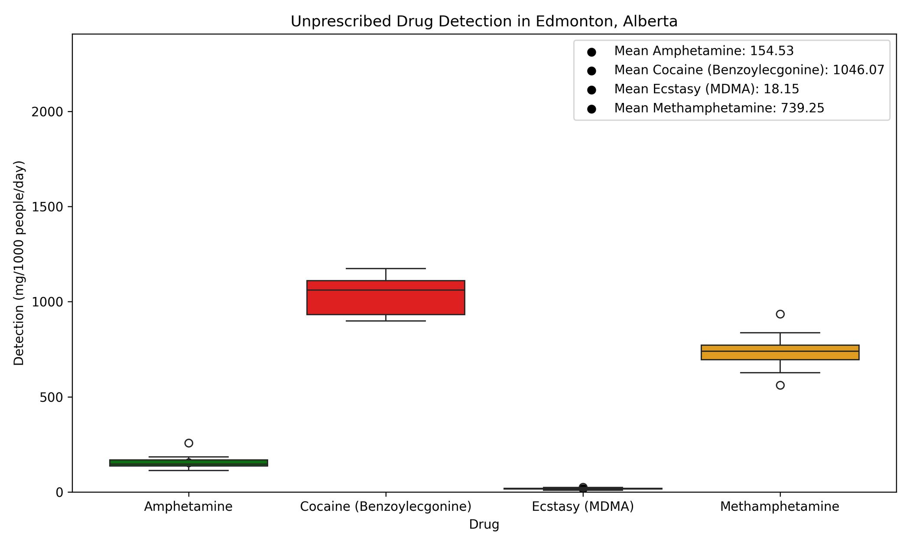

Slide 13
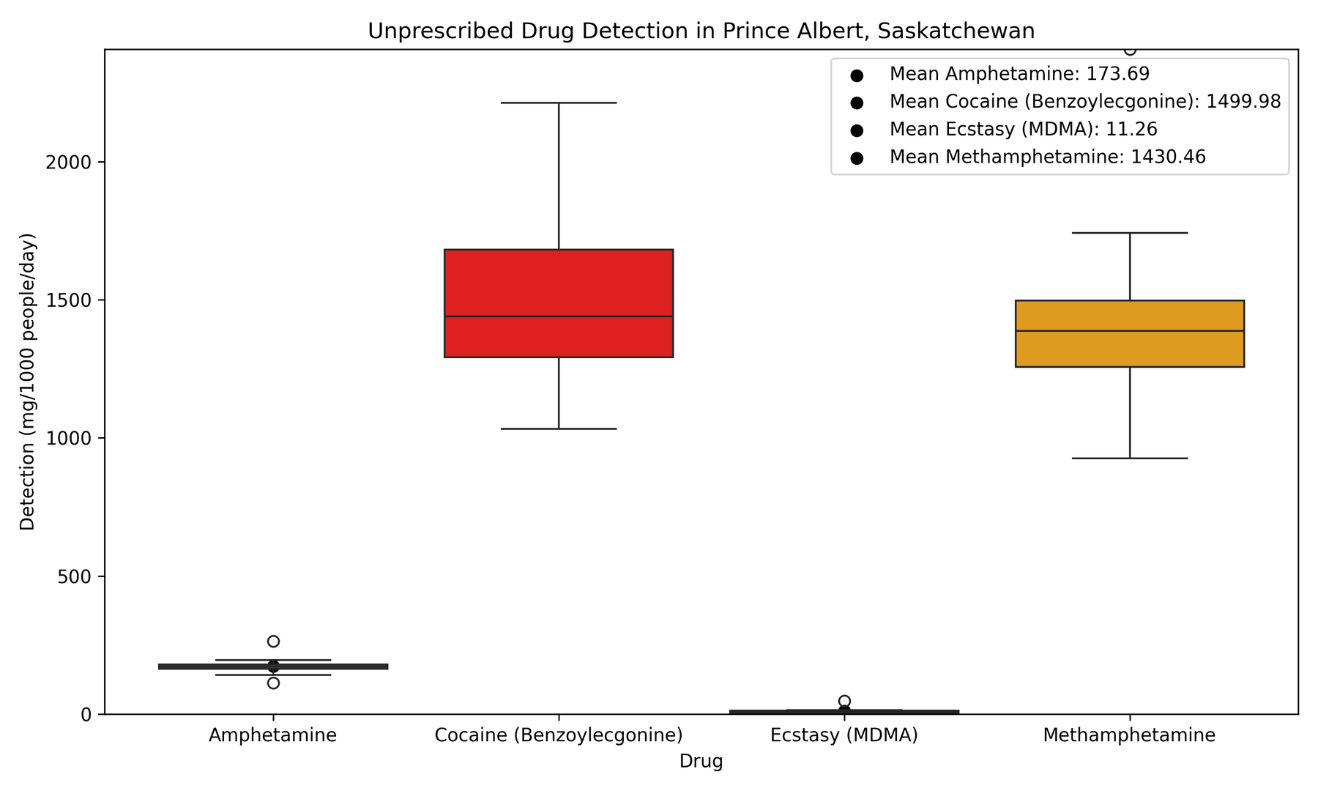

So more people abuse Cocaine, right?
Not quite! Cocaine breaks down easiest, followed by Methamphetamine, Amphetamine and Ecstacy.
(De La Torre et al., 2012)
(Coe et al., 2018)

Slide 14

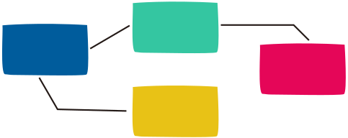
WHAT IS THE PREDICTED DRUG DETECTION TREND IN THE UPCOMING X MONTHS? WHICH CITY IS PREDICTED TO HAVE THE MOST CONSUMPTION?
Model Training & Validation
Regression
Prediction
Feature
Engineering

Slide 15








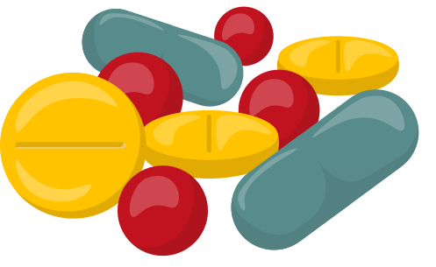
Findings
Prince Albert, Saskatchewan
Top 3 cities with the highest drug concentration:
Edmonton, Alberta
Halifax, Nova Scotia
Cocaine
Highest presence of unprescribed drug metabolite:
Methamphetamine
Amphetamine
Ecstacy

Slide 16
REFERENCES
Coe, M. A., Jufer Phipps, R. A., Cone, E. J., & Walsh, S. L. (2018, February 15). Bioavailability and pharmacokinetics of oral cocaine in humans. OUP Academic. https://academic.oup.com/jat/article/42/5/285/4859571?login=false
De La Torre, R., Yubero-Lahoz, S., Pardo-Lozano, R., & Farre, M. (2012, October 16). MDMA, Methamphetamine, and CYP2D6 pharmacogenetics: What is clinically relevant?. Frontiers. https://www.frontiersin.org/journals/genetics/articles/10.3389/fgene.2012.00235/full
European Union Drug Agency (2024) Wastewater analysis and drugs - A European multi-city study. Available at: https://www.euda.europa.eu/publications/html/pods/waste-water-analysis_en (Accessed: 22 September 2024).
Glei, D. A., & Weinstein, M. (2019). Drug and Alcohol Abuse: the Role of Economic Insecurity. American journal of health behavior, 43(4), 838–853. https://doi.org/10.5993/AJHB.43.4.16
Perez-Iracheta, C. and Oliver, L. (2024) Level of Drugs in the Wastewater of Canadian Cities, Government of Canada, Statistics Canada. Available at: https://www150.statcan.gc.ca/n1/en/catalogue/71-607-X2024021 (Accessed: 19 September 2024)

Slide 17
Thank you!

