Slide 1

Present By
Navya Inguri

Slide 2


E-COMMERCE COMPANY’S
PATH TO SUSTAINABLE GROWTH
Company Overview
E-commerce and online retail encompass the virtual marketplace where businesses and consumers engage in the exchange of products and services over the internet. This mode of commerce removes the necessity of being physically present, granting consumers the ability to explore, compare, and purchase items from any location and at any time. By utilizing platforms such as websites, mobile applications, and social media, e-commerce creates a unified and accessible shopping experience, no matter the device being used.

Slide 3

PROBLEM STATEMENT
The e-commerce company is currently facing several operational challenges that are having a ripple effect on both its growth trajectory and customer satisfaction levels. These issues are interrelated and stem from inefficiencies in core functions such as supply chain management, inventory control, order fulfillment, and customer service.
One of the major problems lies within the supply chain. Delays from suppliers, coupled with unpredictable shipping conditions and logistical constraints, have resulted in inconsistent delivery timelines. This not only affects the company’s ability to fulfill orders promptly but also creates uncertainty for customers who expect reliable and timely service. As a result, customer trust begins to erode, which directly impacts retention and long-term brand loyalty.

Slide 4
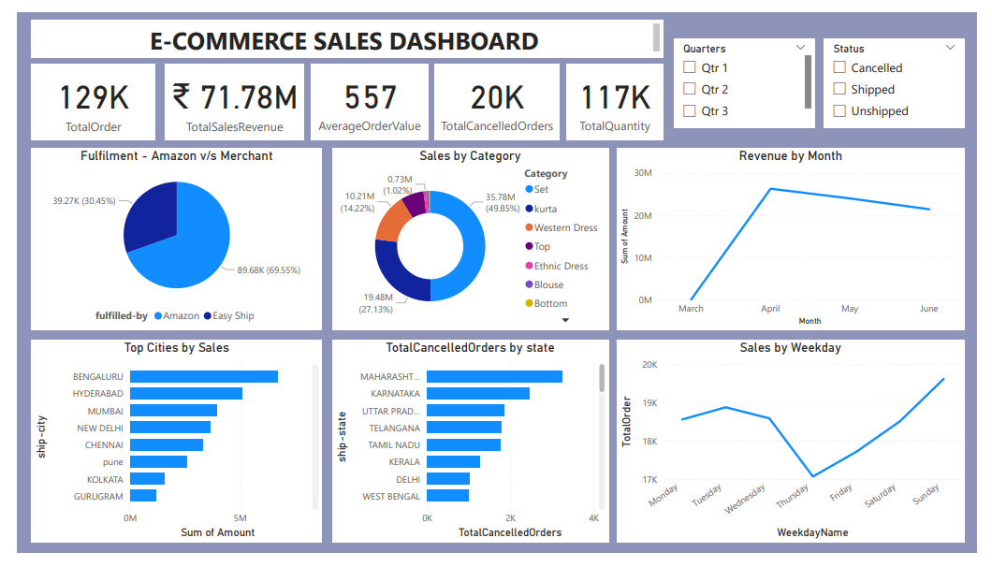

Slide 5
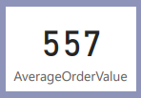
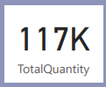

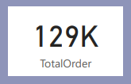

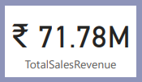
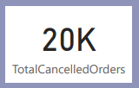
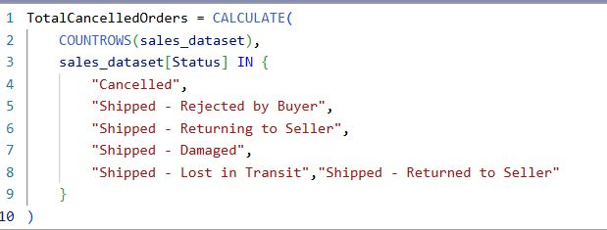
KPI’s
DAX FORMULAS :
AVERAGE ORDER VALUE
  Average Order Value : ₹ 557
  DAX FORMULA :
TOTAL QUANTITY
  Total Quantity : 117K
  DAX FORMULA :
TOTAL ORDER’s
  Total Order : 129K
  DAX FORMULA:
TOTAL SALES REVENUE
  Total Revenue : ₹71.8M
  DAX FORMULA :
TOTAL CANCELLED ORDER
  Total Cancelled Order’s : 20K
  DAX FORMULA :

Slide 6
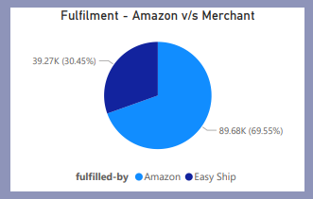
FULFILMENT AMAZON V/S MERCHANT
Fulfilment Strategy: Amazon vs. Merchant
  Amazon Fulfilment Dominates: 69.55% (89.68K units)
  Merchant Fulfilment Significant: 30.45% (39.27K units)
  Key Takeaway: Primary reliance on Amazon's logistics, complemented by substantial merchant-managed operations.

Slide 7
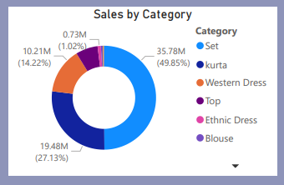
SALES BY CATEGORY
Sales by Category: Key Revenue Drivers
  "Set" Dominates Sales: Contributes nearly half (49.0%) of total sales, making it the primary revenue generator.
  "Kurta" a Strong Second: Accounts for 27.13% of sales, solidifying its position as a major category.
  Combined Strength: "Set" and "Kurta" together drive over 76% of all sales. Western Wear: A distant third, with other categories having minimal contribution.
  Actionable Insight: Focus strategy on maximizing "Set" and "Kurta" categories, while evaluating performance and potential for growth in other segments.

Slide 8
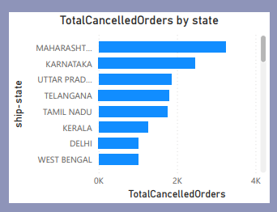
CANCELLED ORDER BY STATES
Cancelled Orders by State: Key Areas for Improvement
  Maharashtra Leads in Cancellations: Records the highest volume of cancelled orders.
  Karnataka Second Highest: Follows closely, indicating significant cancellation issues.
  Uttar Pradesh, Telangana, Tamil Nadu: Show moderate to high cancellation rates.
  Actionable Insight: Focus immediate investigation on Maharashtra and Karnataka to identify and address underlying causes of high cancellations (e.g., logistics, stock issues, customer service).

Slide 9
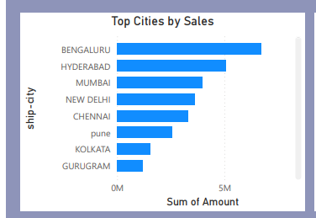
TOP CITIES BY SALE
Top City by Sales Performance
  Bengaluru Leads Significantly: Highest sales volume, well above all other cities.
  Hyderabad a Strong Contributor: Second in sales, showing strong performance.
  Key Urban Markets: Mumbai, New Delhi, and Chennai follow, indicating sales concentration in major metropolitan areas.
  Actionable Insight: Focus marketing/sales efforts on Bengaluru and Hyderabad, while maintaining presence in other top cities.

Slide 10
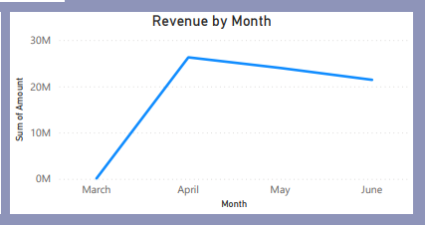
REVENUE BY MONTH
Month" chart:
Revenue by Month: Performance Trends
  Significant April Peak: Revenue surged to its highest point in April, demonstrating strong performance (exceeding ₹25M).
  Subsequent Decline: A clear downward trend observed from May into June, with current revenue in June notably lower than the April peak but still above ₹20M.
  Key Insight: This pattern indicates a potential seasonal high in April or a short-term boost. The post-April decline necessitates investigation into market conditions, sales strategies, or external factors to reverse the trend.

Slide 11
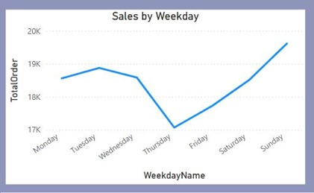
SALES BY WEEKDAY
Sales by Weekday: Performance Patterns
  Strong Weekend Performance: Sunday is the highest sales day (19.6K), with Saturday also strong (15.5K).
  Consistent Early Week Sales: Monday, Tuesday, and Wednesday maintain solid sales above 18K.
  Mid-Week Dip: Thursday records the lowest sales at 17K, indicating a dip in activity.
  Actionable Insight: Optimize staffing and marketing efforts for peak weekend demand. Consider promotions or targeted campaigns to boost sales on Thursdays.

Slide 12

E-COMMERCE PERFORMANCE - STRENGTHS & DRIVERS
Solid Revenue & Dominant Channels
  Overall Performance: ₹71.8M Revenue, 129K Orders, Healthy ₹557 AOV.
  Fulfilment Power: Amazon handles 69.54% of fulfilment.
  Key Markets: Bengaluru and Hyderabad lead sales.
  Sales Peaks: April was the highest revenue month; Sunday is the strongest sales day.

Slide 13

E-COMMERCE PERFORMANCE - RECOMMENDATIONS
Focus Areas for Growth & Efficiency
  High Cancellations: 20K cancelled orders, especially in Maharashtra & Karnataka.
  Revenue Decline: Revenue trending down since April peak. Sales Dip: Thursday is the weakest sales day.
  Category Concentration: "Set" & "Kurta" drive over 76% of sales; others are minimal.
  Action: Address cancellations, revive revenue growth, optimize low-sales days, and refine category strategy.

Slide 14


https://www.linkedin.com/in/navya-inguri-1371b3180/
https://github.com/Navyasriinguri

