Slide 1

EXPLORATORY DATA ANALYSIS ON AMCAT DATA

Slide 2
BUSINESS PROBLEM
Company HR faces challenges in accurately determining salaries for engineering professionals. Current approach lacks precision and neglects crucial factors: market trends, individual performance, and specialized skills. The project aims to analyze the AMCAT data to understand the factors influencing the employability of engineering graduates
OBJECTIVE OF THE PROJECT
This analysis aims to gain insights and understanding from the provided dataset, particularly focusing on the relationship between various features and the target variable, which is Salary. Specifically, the goals of this analysis include:
• Describing the dataset and its features comprehensively.
• Identifying any patterns or trends present in the data.
• Exploring the relationships between independent and target variables (Salary).
• Identifying any anomalies in the data. outliers

Slide 3
SUMMARY OF THE DATA
The Aspiring Mind Employment Outcome 2015 (AMEO) dataset, released by Aspiring Minds, focuses on employment outcomes for engineering graduates. It includes dependent variables such as Salary, Job Titles, and Job Locations, along with standardized scores in cognitive skills, technical skills, and personality skills. With around 40 independent variables and 4000 data points, these variables encompass both continuous and categorical data. The dataset also includes demographic features and identifiers for each candidate. Unique

Slide 4
EXPLORATORY DATA ANALYSIS
Data Cleaning Steps:
In the initial phase of our exploratory data analysis, we focused on cleaning the data to ensure its quality and reliability. This involved the removal of irrelevant variables that did not contribute meaningful insights for our analysis. We also handled missing values by implementing appropriate imputation strategies, ensuring the completeness of our data. Furthermore, we identified and addressed outliers to prevent them from skewing our results and interpretations.
Data Manipulation Steps:
Following data cleaning, we proceeded with data manipulation to enhance the quality of our dataset for more insightful analysis. This involved transforming variables to facilitate easier and more effective exploration. Where necessary, we created new variables by combining or segmenting existing ones, unveiling hidden patterns and correlations instrumental in drawing comprehensive conclusions from our analysis.

Slide 5
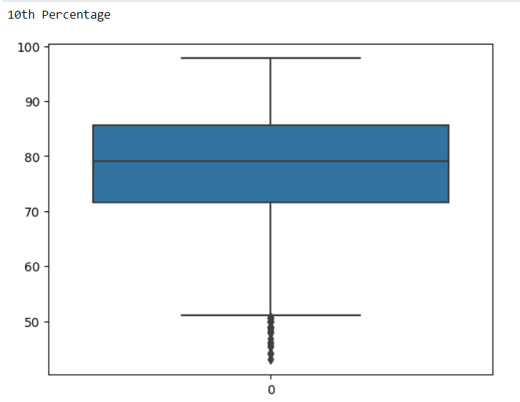
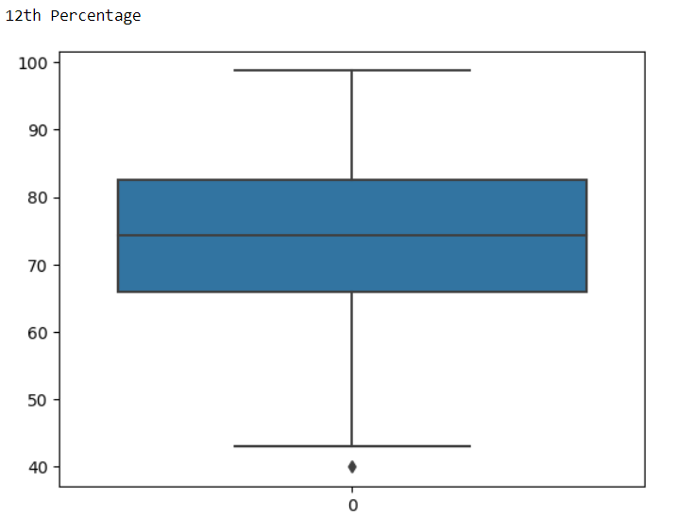
EXPLORATORY DATA ANALYSIS
Univariate Analysis Steps:
In the univariate analysis, I concentrated on the 10th percentage, 12th percentage, and college CGPA. I plotted a graph to visualize the distribution of these variables. This analysis helped me understand the academic performance of the students and its impact on their employability. The graph provided insightful patterns and trends that are instrumental in understanding their influence on employability.

Slide 6
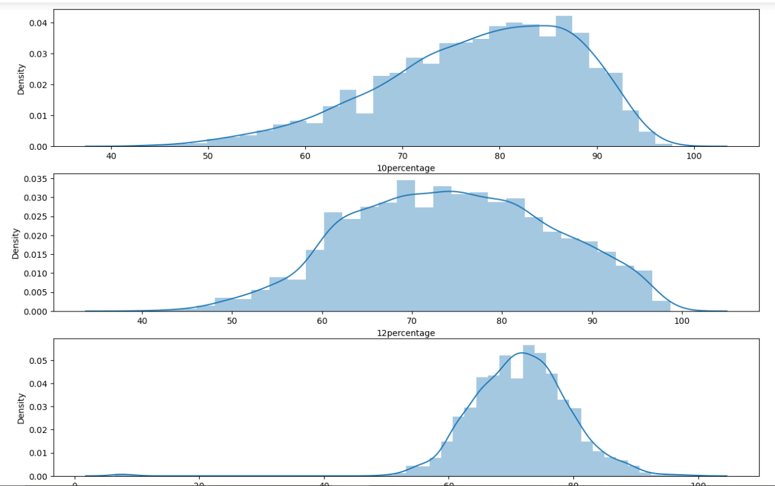

Slide 7
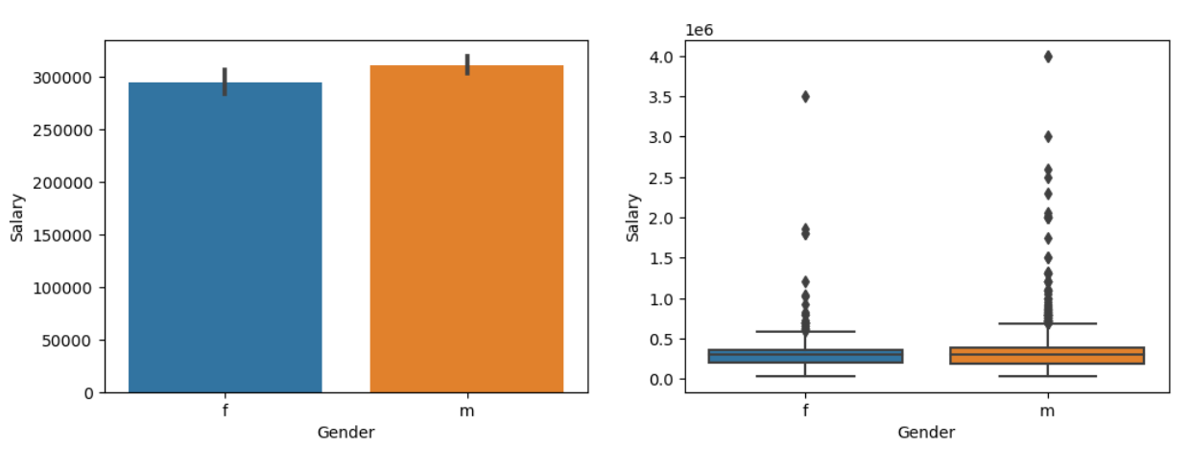
EXPLORATORY DATA ANALYSIS
Bivariate Analysis Steps:
Gender v/s Salary: In my analysis of salary versus gender, I found that males tend to earn more than females, despite the mean ages being equal. This highlights a potential gender wage gap in the industry, an important issue that merits further investigation and action.

Slide 8
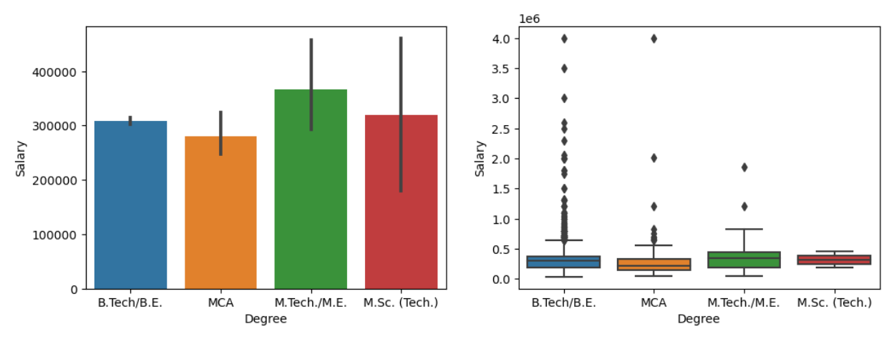
EXPLORATORY DATA ANALYSIS
Bivariate Analysis Steps:
Degree v/s Salary: In my analysis of Salary and Degree, I found an interesting trend. Despite the common perception that higher education leads to higher earnings, my data suggests that individuals with a Bachelor’s degree have more chances to earn better than those with a Master’s degree. This could be due to various factors such as industry demand, practical experience, or the specific roles they are in. It’s a valuable insight that challenges traditional beliefs about education and earnings

Slide 9
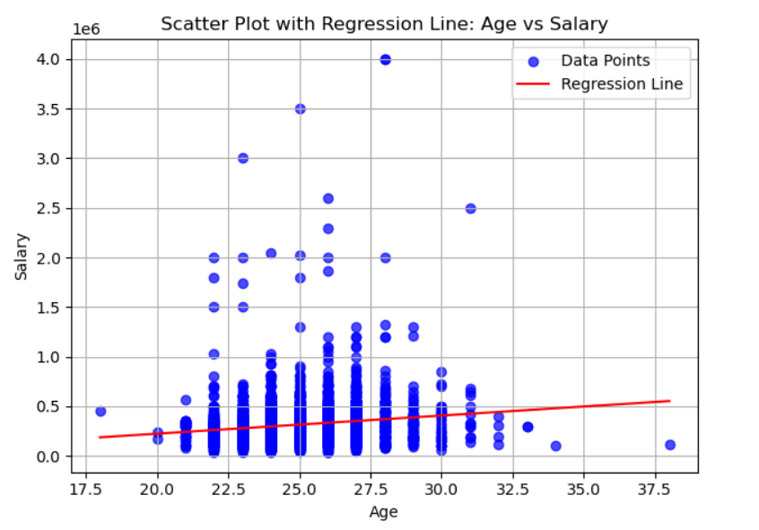
EXPLORATORY DATA ANALYSIS
Bivariate Analysis Steps:
Age v/s Salary: In my analysis of Age and Salary, I found that there is a positive slope indicating that salary tends to increase with age.

Slide 10

RESEARCH QUESTION:
QUESTION:
After doing your Computer Science Engineering if you take up jobs as a Programming Analyst, Software Engineer, Hardware Engineer and Associate Engineer you can earn up to 2.5-3 lakhs as a fresh graduate.
SOLUTION:
I have solved it using inferential statistics, i.e., I have used chi square test to find the relationship between gender and specialization.
Null Hypothesis (H0): There is no association between gender and specialization choice among engineering graduates.
Alternative Hypothesis (H1): There is a statistically significant association between gender and specialization choice among engineering graduates.
Conclusion: So, here we conclude that there is a significant association between gender and specialization, since we fail to accept null hypothesis.

Slide 11
Key Business Question:
After doing your Computer Science Engineering if you take up jobs as a Programming Analyst, Software Engineer, Hardware Engineer and Associate Engineer you can earn up to 2.5-3 lakhs as a fresh graduate
Is there a relationship between gender and salary?
Is there a relationship between gender and specialization?

Slide 12
Conclusion :
Proficiency in English, logical reasoning, and quantitative skills are key to securing higher marks and salary packages.
More agreeable students are often more open to experiences, which can contribute to securing a higher salary package.
Female students with advanced education are likely to earn a higher starting salary as freshers compared to their male counterparts.
A good personality can compensate for a college GPA when it comes to salary prospects.
Students who have completed their 10th and 12th grades from CBSE and ICSE boards are likely to have better skills.
The majority of graduates find employment as software engineers and developers, earning an average salary of 307699.8 Dollars. Graduates from Tier 1 colleges tend to earn higher salaries than their counterparts from Tier 2 colleges
Software Engineer Domain has the largest number of employees, indicating its significance in the job market
On average, females earn around ₹203,648.65, slightly surpassing the mean salary of ₹194,105.26 for males.

Slide 13

THANK YOU

