Slide 1

Code Refactoring and Bug Fixing

Slide 2
SCENARIO:
A group of passionate data scientists initiated a project to create an application using Python, Flask, and HTML. Unfortunately, their limited experience in backend development resulted in difficulties in achieving full functionality. Acknowledging your expertise in backend development, you have been assigned the responsibility of resolving the issues in the code and ensuring the smooth operation of the application.
TASK:
Revise the current codebase and guarantee the effective operation of the note-taking application. Document all identified bugs encountered during the debugging process. It's important to note that the objective is not to recreate the application from the beginning. Instead, the aim is to rectify the issues present in the existing codebase and ensure that the application functions as originally intended.

Slide 3
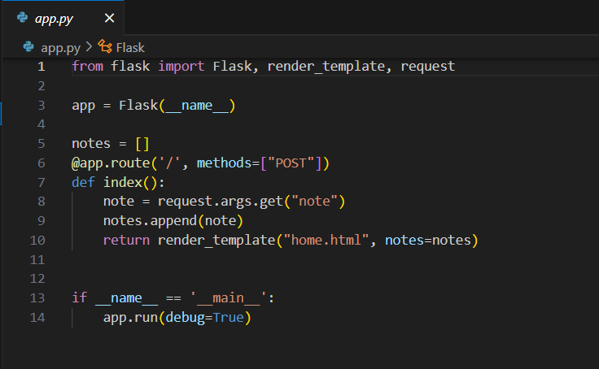
PROVIDED CODE

Slide 4
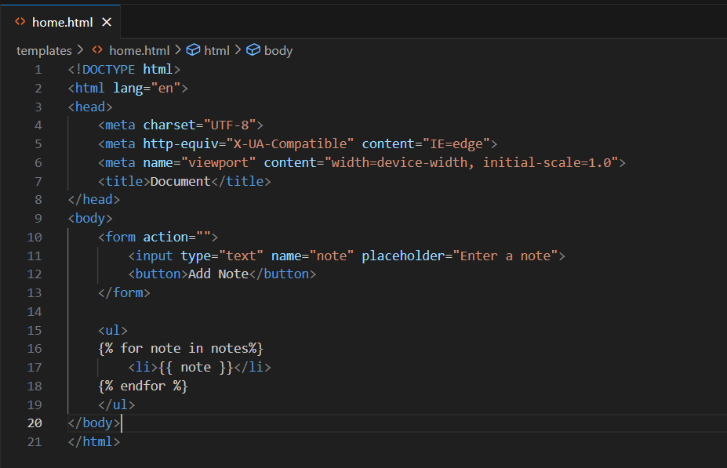
PROVIDED CODE

Slide 5
APPROACH TO SOLVE ERROR
This is the code provided and after running this without any changes there was an error i.e., Method not allowed. The error typically shows that the HTTP method trying to use is not supported.
The HTML file did not specify a method within the "form" tag, indicating that the default method, "GET," was being used. However, to transmit data from the client to the server, it is necessary to employ the "POST" method. Consequently, the code was adjusted accordingly.
Subsequently, I modified the code in the app.py file by substituting "args" with "form" to ensure the transmission of data from the frontend to the backend. Despite making this change, the same error persisted upon execution. Another issue arose, indicating that although the data was successfully sent from the client to the server, the response message back to the client required the use of the "GET" method. Consequently, I incorporated the necessary adjustments into the code.
The code functions even without placing it within the <button> element. However, it is advisable to adhere to best practices by utilizing "type="submit"" for the button inside the form. This ensures that the button is properly recognized as the submit button by the browser.

Slide 6
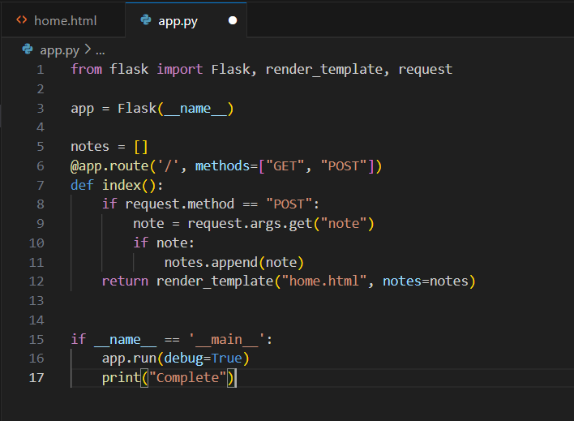
MODIFIED CODE

Slide 7
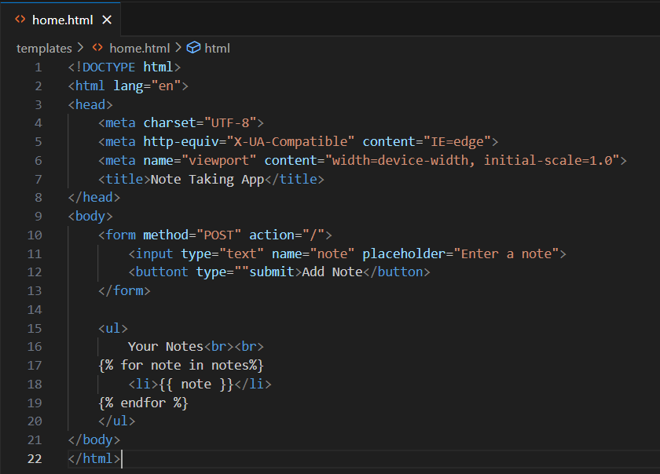
MODIFIED CODE

Slide 8

THANK YOU

