Slide 1

Scientific study on the discipline of flight schedules
Southwest Airlines
January 2020
Nawaf Jamil Nazer

Slide 2
In this project we will study the discipline in the flights schedule, and we will generate graphical report to represent it to the management

Slide 3
we will be using python as a programming language and data science libraries such as import pandas, numpy, matplotlib & seaborn

Slide 4
In this study we will depend on data provided from: kaggle.com https://www.kaggle.com/akulbahl/covid19-airline-flight-delays-and-cancellations
We will be considering only January data for Southwest Airlines

Slide 5
This source provide important data for this study such as: Flight Departure and Arrival Airport Scheduled Departure and Arrival Time Actual Departure and Arrival Time Departure Delay Scheduled Total Flight Time Reason for the delay by Time (Carrier, Weather, Security or National Aviation )

Slide 6
Project Plan: analyzing the requirement gathering the data understand and reading the data cleaning the data generate the reports

Slide 7
Used tools : Python as a programming language pandas and numpy as a data frame librares seaborn as a Python data visualization library based on matplotlib Matplotlib as a comprehensive library for creating static, animated, and interactive visualizations in Python. scikit-learn : tools for predictive data analysis Jupyter as a text editor

Slide 8
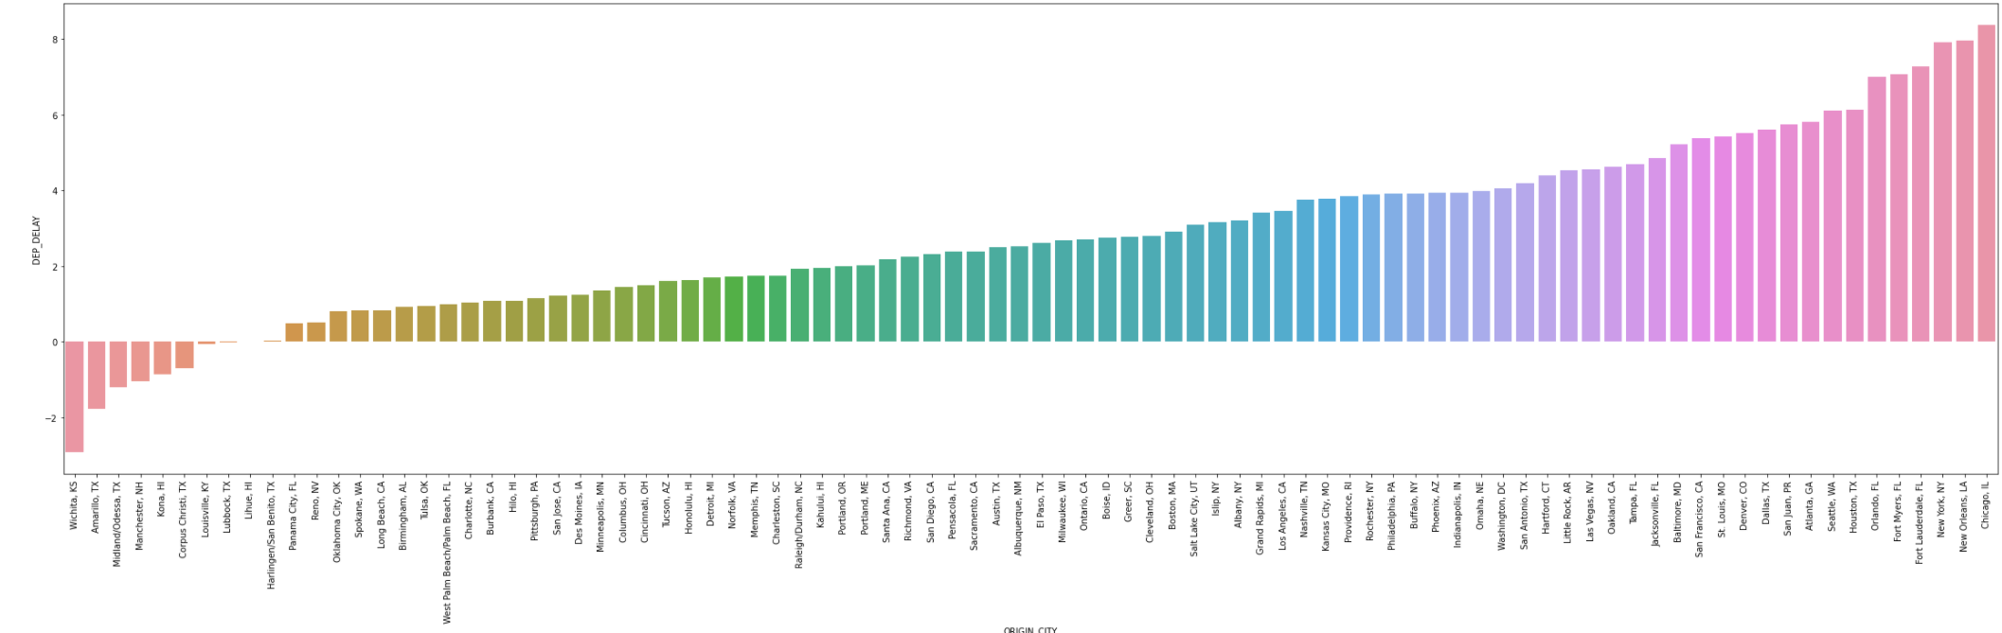
Report Sample
the delay departure time for each city, the minus number means early departure

Slide 9
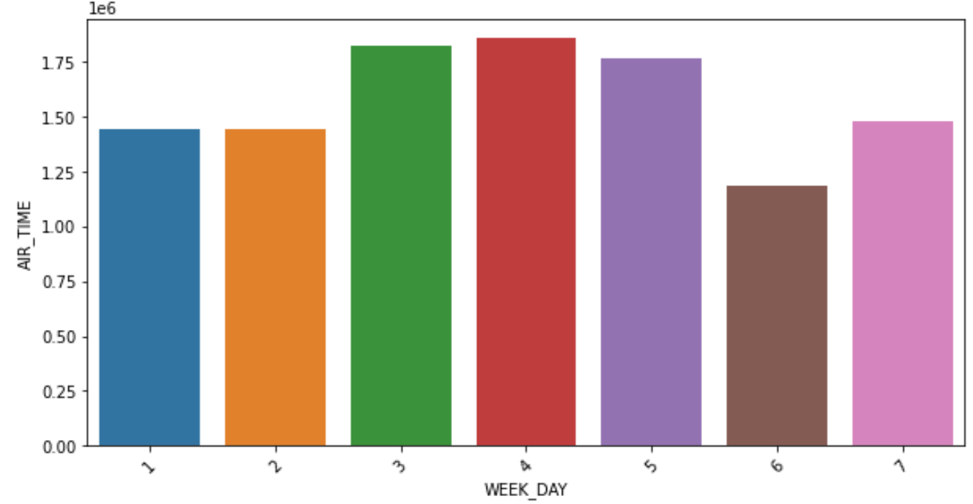
Report Sample
the number of flights time in each day of the week (Air Traffic)

Slide 10
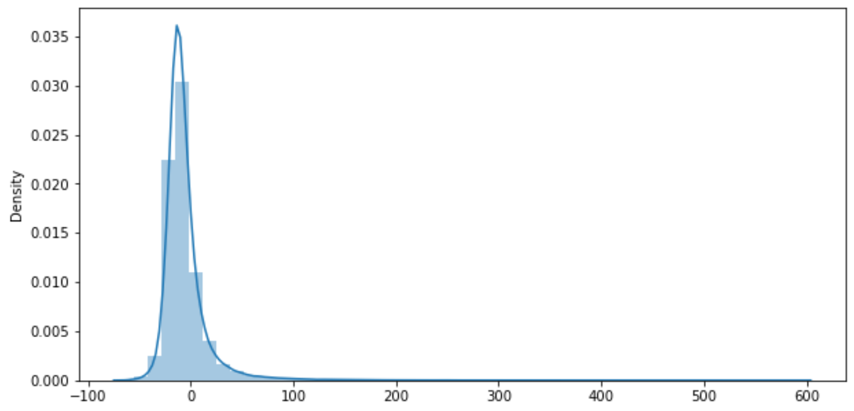
Report Sample
difference between the scheduled access time and the actual time

Slide 11
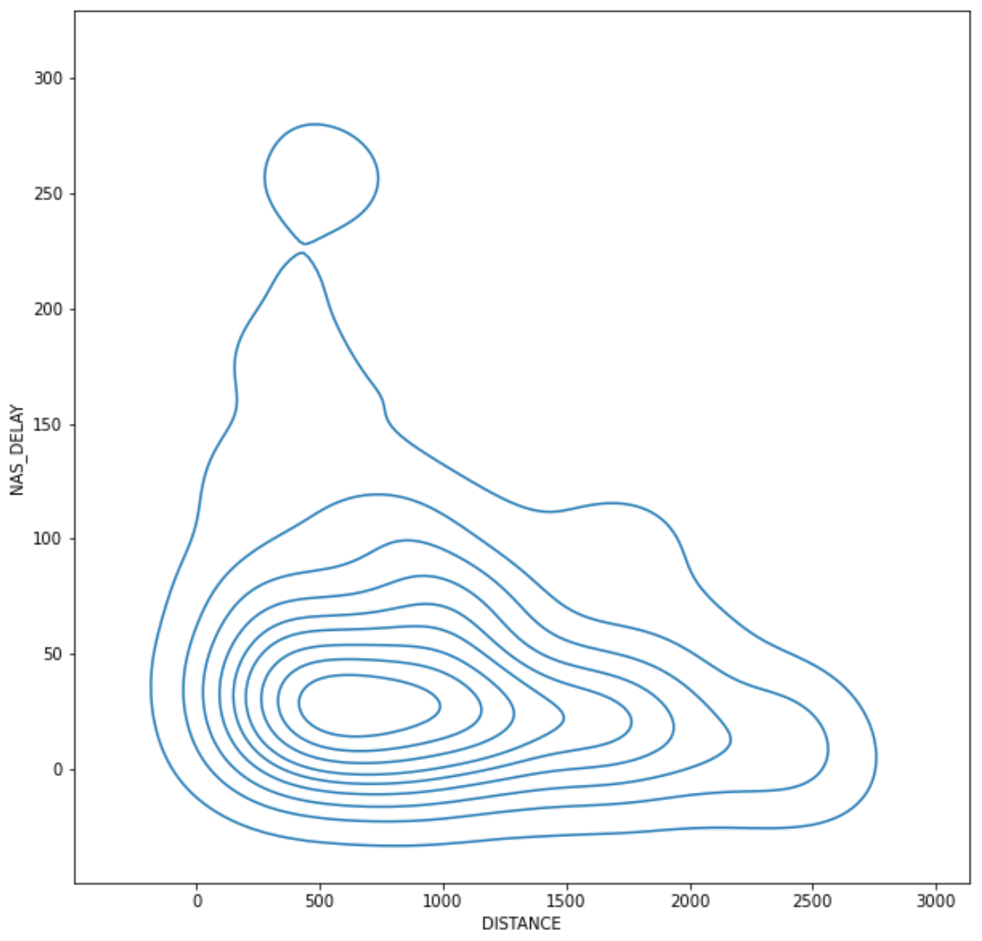
Report Sample
the relationship between flight delays due to civil aviation and the distance between airports

Slide 12
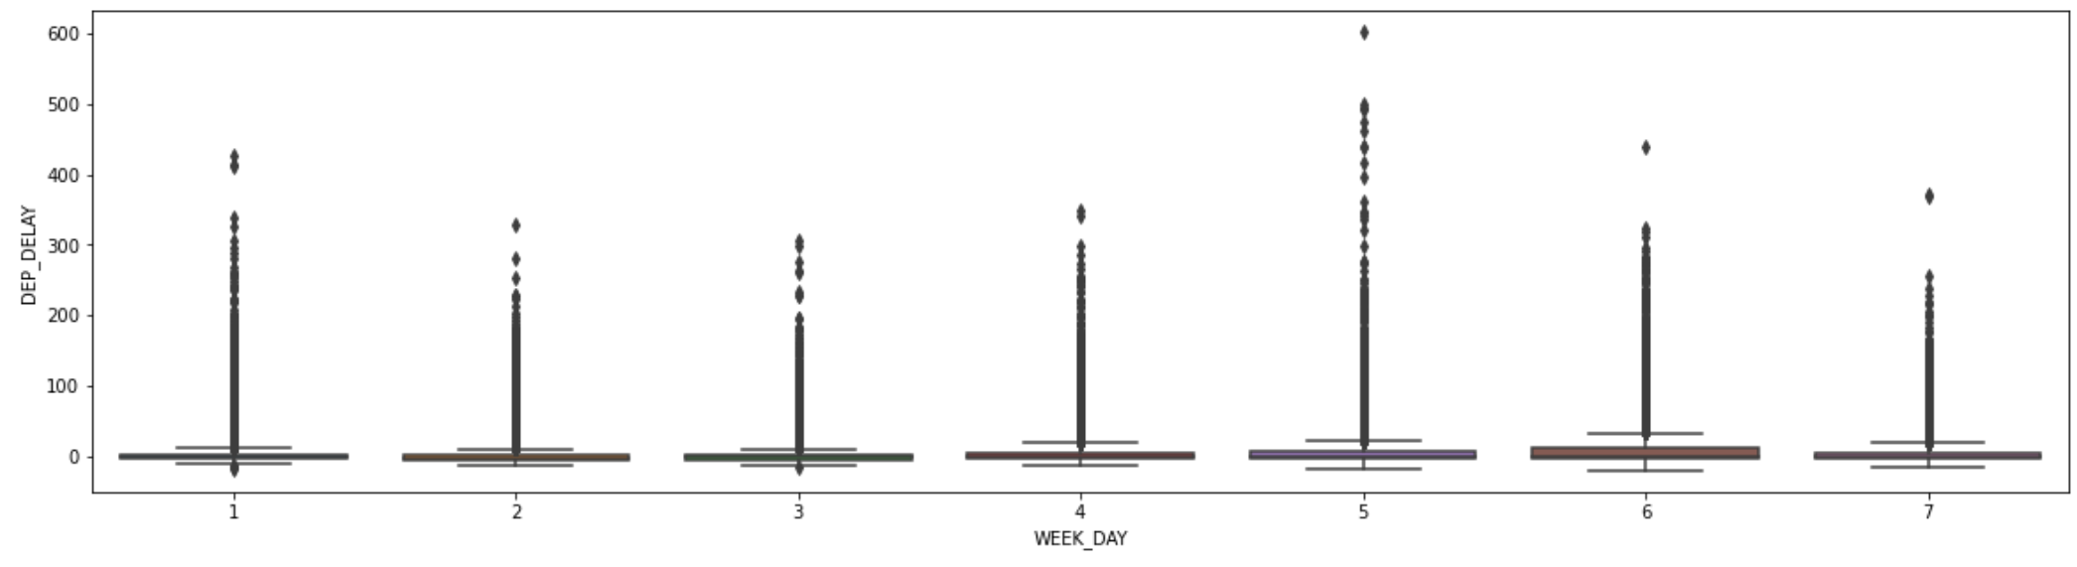
Report Sample
the departial delay for each day of the week

Slide 13
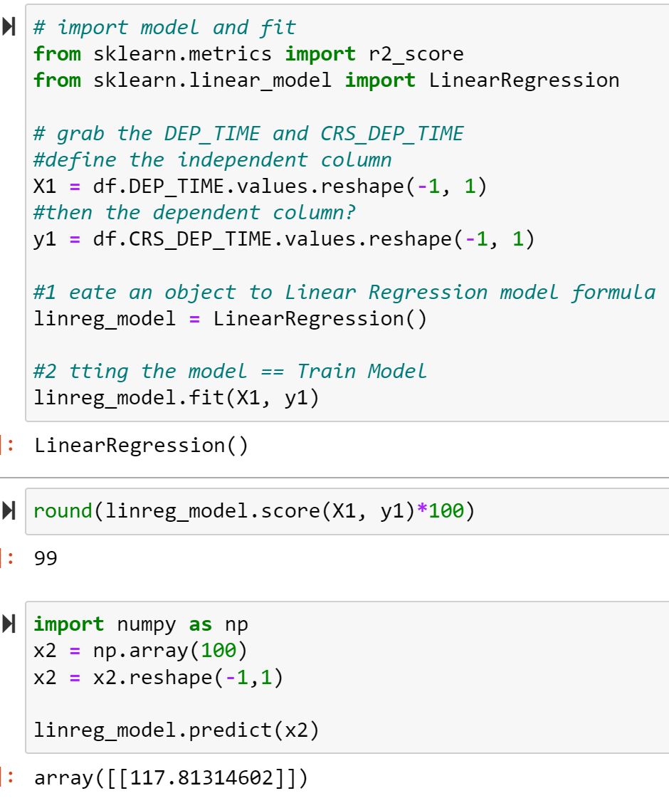
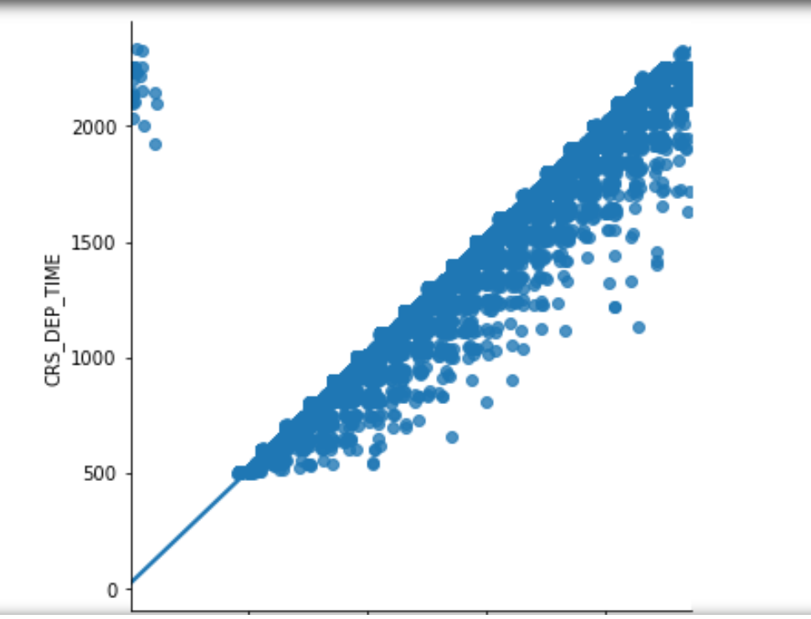
Report Sample
Modeling with sklearn to know the discipline in take-off times

