Slide 1

Data Lake Value Proposition
Medical Data Processing Company
Nawaf Alomeir
Udacity IPS Version 1.0

Slide 2
Agenda
What is a Data Lake
Components of a Data Lake
Data Lake vs Data Warehouse
Business Value of Data Lake Solution
Proposed Data Lake Architecture for Medical Data Processing system
Udacity IPS Ver. 1 2/2020

Slide 3
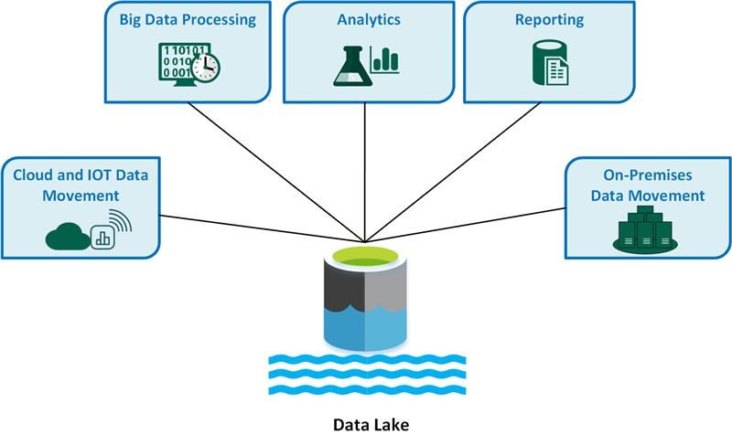
What is a Data Lake

Slide 4
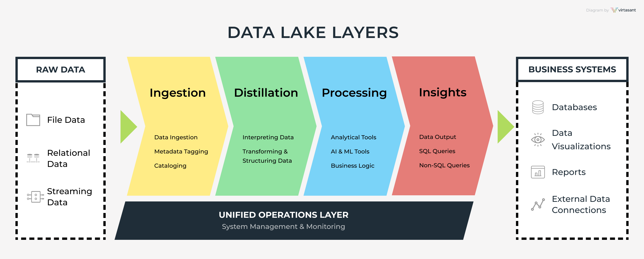
Components of Data Lake

Slide 5
Data Lake vs Data Warehouse
 | Data lake | Data warehouse
Type | Structured, semi-structured, unstructured | Structured
 | Relational, non-relational | Relational
Schema | Schema on read | Schema on write
Format | Raw, unfiltered | Processed, vetted
Sources | Big data, IoT, social media, streaming data | Application, business, transactional data, batch reporting
Scalability | Easy to scale at a low cost | Difficult and expensive to scale
Users | Data scientists, data engineers | Data warehouse professionals, business analysts
Use cases | Machine learning, predictive analytics, real-time analytics | Core reporting, BI

Slide 6
Data Warehouse
Data Lake
Structured
Relational
Schema on write
Processed, vetted
Application, business, transactional data, batch reporting
Difficult and expensive to scale
Data warehouse professionals, business analysts
Core reporting, BI
Structured, semi-structured, unstructured
Relational, non-relational
Schema on read
Raw, unfiltered
Big data, IoT, social media, streaming data
Easy to scale at a low cost
Data scientists, data engineers
Machine learning, predictive analytics, real-time analytics
Udacity IPS Ver. 1 2/2020

Slide 7
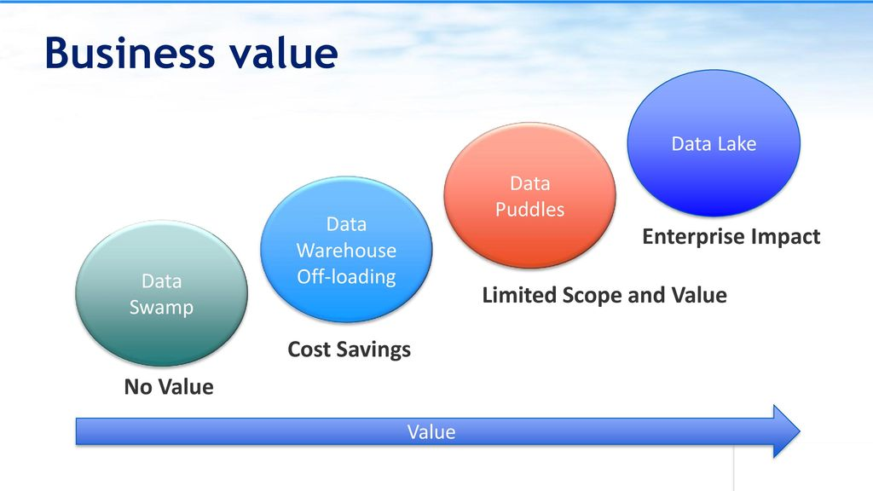
Business Value of Data Lake

Slide 8
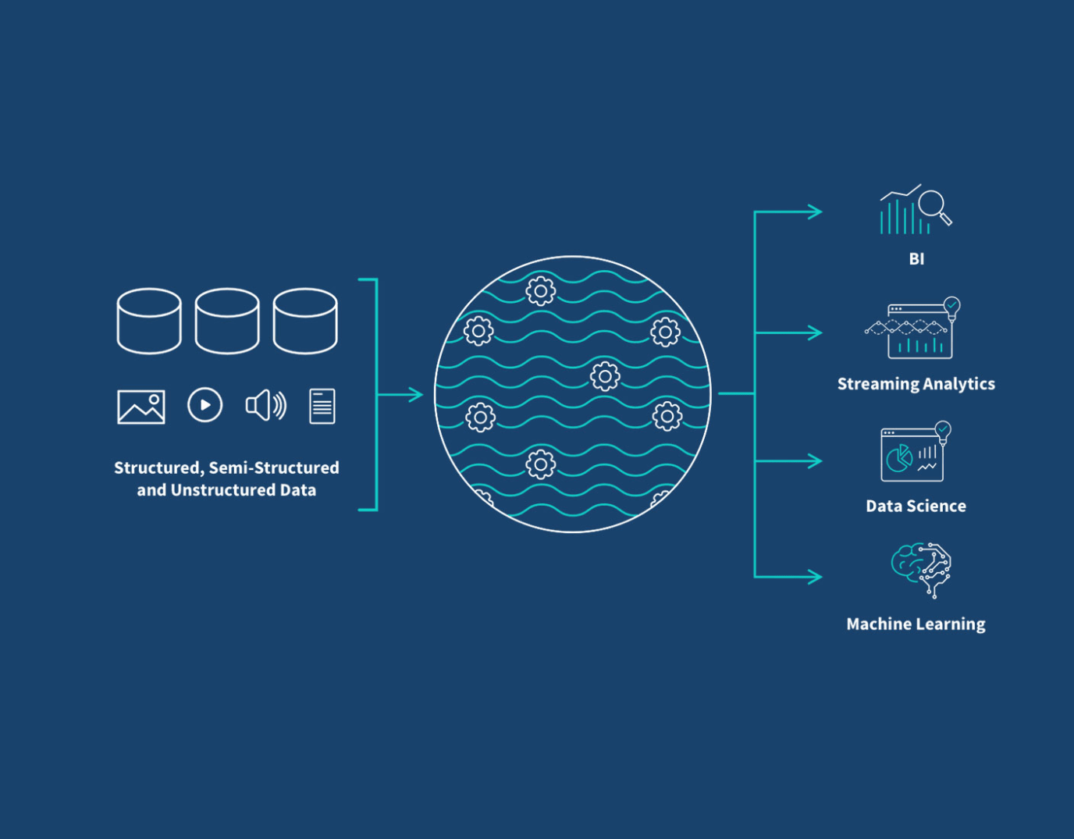
Data Lake Architecture

Slide 9
THANK YOU
Udacity IPS Version 1.0

