Slide 1



DAAD EPOS · PUBLIC HEALTH INITIATIVE · COMMUNITY PHARMACY
Preserving Our Medicines: Safe Antibiotic Use in Rural Communities
THREE PILLARS OF FIELDWORK
Dispensing counselling
Patient education at the pharmacy counter
Flyers & posters
Educating 200 people in five villages of Chakwal District, Pakistan, through pharmacy counselling, flyer & poster drives, door-to-door outreach and free medical camps
Door-to-door visits and posters in dispensaries
Free medical camps
Anila Munir
Screening, diagnosis and safe-use advice
Clinical & Community Pharmacist · Choa Saidan Shah, Chakwal, Pakistan
March – August 2026 · anilamunir15@gmail.com
Notes:
Introduce yourself and the project: a community antibiotic stewardship programme in rural Chakwal, delivered as a pharmacist-led public health initiative under the DAAD EPOS umbrella. Three pillars: counselling at the dispensing point, flyer and poster drives, and free medical camps.
1

Slide 2

OUTLINE
Structure of the presentation
01
Introduction: the threat of antimicrobial resistance
08
Four golden rules for every patient
02
Setting & target communities
09
How to administer antibiotics safely
03
Programme objectives
10
The One Health approach in agriculture
04
How bacterial resistance spreads
11
Community survey: 200 people
05
Key drivers of misuse in rural communities
12
Survey results: knowledge and practice
06
Clearing up dangerous misconceptions
13
Outcomes achieved & sustainability
07
Three-pillar fieldwork strategy
14
Conclusion & references
Preserving Our Medicines · Community Antibiotic Stewardship, Chakwal, Pakistan
2
Notes:
The presentation follows the logic of a public health intervention: problem, setting, objectives, the education content delivered, the survey of 200 community members, results, sustainability and conclusion.
2

Slide 3
01 · INTRODUCTION
The escalating threat of antimicrobial resistance
THE PROBLEM
GLOBAL MORTALITY CRISIS
Standard first-line antibiotics fail against mutated strains, turning mild infections deadly. Limited access to diagnostic labs accelerates empirical over-prescribing and self-medication.
1.27 million
deaths every year are directly caused by drug-resistant bacterial infections (Lancet, 2022)
THE AIM
Empower families to use antibiotics only when needed, exactly as prescribed, and never shared or saved.
In rural Pakistan, antibiotics are bought over the counter, shared between family members and stopped early. Every misuse gives bacteria a chance to adapt, and first-line medicines slowly stop working.
THE APPROACH
A pharmacist-led programme: counselling at the point of dispensing, flyer and poster distribution, door-to-door outreach and free medical camps.
Preserving Our Medicines · Community Antibiotic Stewardship, Chakwal, Pakistan
3
Notes:
Antimicrobial resistance is one of the top global public health threats. The 1.27 million figure is from the Global Research on Antimicrobial Resistance study published in The Lancet in 2022. In rural communities the drivers are structural: no diagnostics, easy over-the-counter access and low awareness.
3

Slide 4
02 · SETTING & TARGET COMMUNITIES
Five villages, three contact points, 200 people
5
3
200
PERIOD
Feb – May 2026
8-week follow-up per village
Villages in Chakwal District
Contact points for education
Community members surveyed
PARTICIPANTS
MULTIPLIERS
DOCUMENTATION
Adults collecting antibiotics at the pharmacy, households visited door-to-door and patients at medical camps.
Local dispensers, community nurses and lady health workers reinforce the messages after each visit.
Every contact is recorded; the 200 survey respondents are logged in the accompanying Excel data sheet.
PHARMACY HUB
DOOR-TO-DOOR
MEDICAL CAMP
DOOR-TO-DOOR
MEDICAL CAMP
Choa Saidan Shah
Saloi
Dalwal
Basharat
Karsal
50 respondents
38 respondents
44 respondents
31 respondents
37 respondents
Preserving Our Medicines · Community Antibiotic Stewardship, Chakwal, Pakistan
4
Notes:
The programme covers five villages around Choa Saidan Shah. Each village has a main contact point, but all three channels were used in every village. Respondent counts per village come from the survey data sheet.
4

Slide 5
03 · PROGRAMME OBJECTIVES
Six objectives guide the programme
01
02
03
Explain what antibiotic resistance is and why it threatens everyone
Stop the use of antibiotics for flu, colds and viral fevers
Ensure every prescribed course is completed as directed
04
05
06
End saving, sharing and over-the-counter purchase of antibiotics
Promote clean water and hygiene to prevent infections in the first place
Reduce the routine use of human antibiotics in livestock
Preserving Our Medicines · Community Antibiotic Stewardship, Chakwal, Pakistan
5
Notes:
Objectives cover knowledge (what resistance is), behaviour (no viral misuse, finish the course, no sharing or saving) and prevention (hygiene, One Health).
5

Slide 6
04 · BIOLOGICAL MECHANISM
How bacterial resistance spreads
01
02
03
Viral misuse
Early cessation
Mutation & spread
Antibiotics are taken for flu or seasonal viral fevers, where they cannot work. Bacteria in the body are exposed for no reason.
The course is stopped as soon as symptoms ease. The weakest bacteria die; the toughest survive.
Surviving germs mutate, multiply and transmit across households, and the medicine stops working for everyone.
KEY MESSAGE
Resistance is not something your body develops. It is the bacteria that become immune, and resistant bacteria spread from person to person.
Preserving Our Medicines · Community Antibiotic Stewardship, Chakwal, Pakistan
6
Notes:
Explain the mechanism in plain language: exposure without need, incomplete killing, selection of survivors. The key message counters the most common misconception, that the person becomes immune.
6

Slide 7




05 · LOCAL DIAGNOSTICS
Key drivers of misuse in rural communities
OTC purchasing
Shared doses
Buying prescription antibiotics at shops and dispensaries without any medical diagnosis.
Passing leftover pills to sick family members and neighbours.
Livestock misuse
Hygiene deficits
Giving human antibiotics routinely to farm animals to boost weight or treat illness.
Unsafe water and poor hygiene increase preventable infections, and so the demand for antibiotics.
Preserving Our Medicines · Community Antibiotic Stewardship, Chakwal, Pakistan
7
Notes:
These four drivers were observed at the pharmacy counter and during door-to-door visits, and were confirmed by the baseline survey: two thirds of respondents had bought antibiotics without a prescription in the previous three months.
7

Slide 8
06 · COMMUNITY EDUCATION
Clearing up dangerous misconceptions
Common belief | What we explain
“Strong antibiotics cure flu” | Flu is viral. Antibiotics provide zero relief, add side effects and waste family income.
“Save extra pills for later” | Leftover partial doses breed resistant superbug strains. Finish the course; never keep leftovers.
“My body gets immune” | Bacteria become immune, not the person. Resistant bacteria spread directly to family members.
“If a neighbour recovered on it, it will work for me” | Different infections need different medicines and doses. Only a health worker can decide.
“Injections and expensive brands work faster” | The right antibiotic at the right dose works; the price or the route does not make it stronger.
Myths recorded during pharmacy counselling and door-to-door visits, March – August 2026.
Preserving Our Medicines · Community Antibiotic Stewardship, Chakwal, Pakistan
8
Notes:
Each myth is answered with one plain sentence so that dispensers and health workers can repeat it. The first three are the most frequent; the last two were added after the first month of fieldwork.
8

Slide 9



07 · FIELDWORK STRATEGY
Three pillars, one message
Dispensing education
Flyer & poster drives
Free medical camps
  Direct patient counselling at the pharmacy counter while handing over antibiotics
  Dose-completion advice and viral vs. bacterial explanation
  Refusal of non-prescription antibiotic sales
  Illustrated flyers distributed door-to-door in Urdu and Punjabi
  AMR warning posters in dispensaries, mosques and community hubs
  Messages reinforced by local dispensers and lady health workers
  On-site screening and diagnostic guidance
  Prescriptions only where an antibiotic is really needed
  Group talks on resistance, hygiene and safe storage
Preserving Our Medicines · Community Antibiotic Stewardship, Chakwal, Pakistan
9
Notes:
The pharmacy counter is the moment of highest attention: the patient is holding the medicine. Flyers and posters carry the message home. Camps reach people who never come to a pharmacy and show that a diagnosis, not a pill, comes first.
9

Slide 10
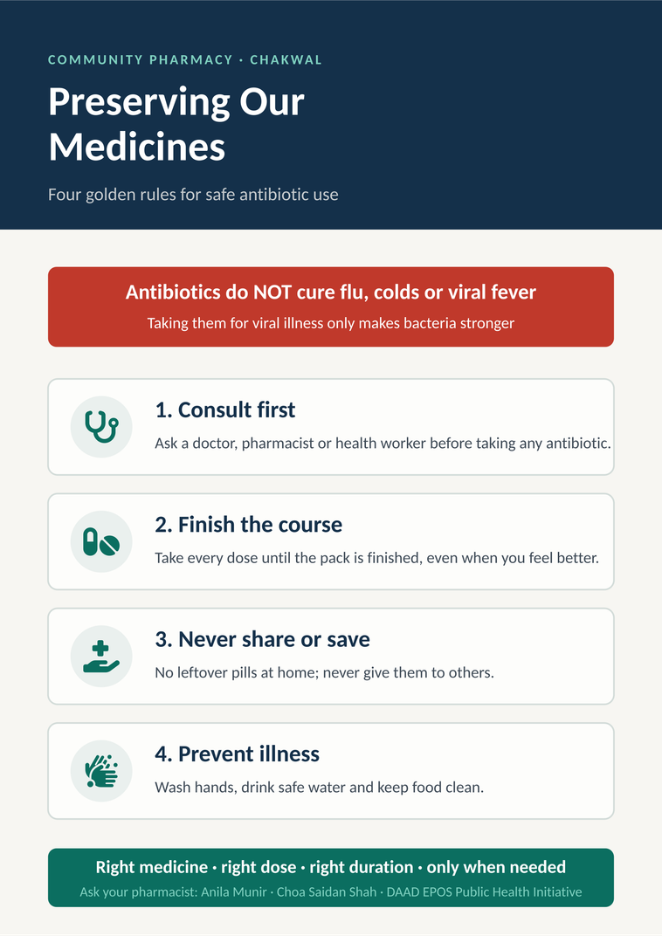
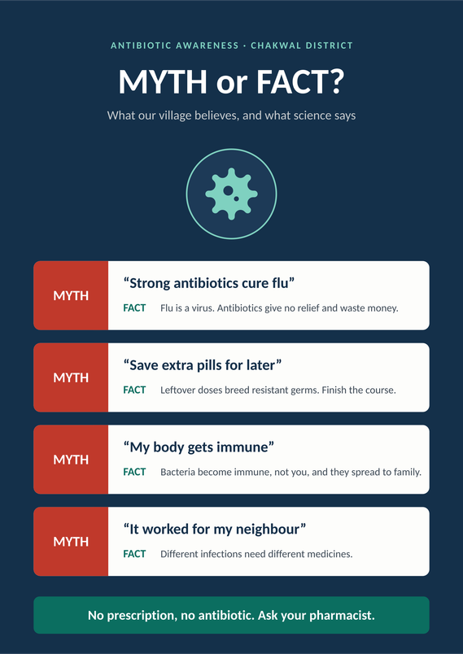
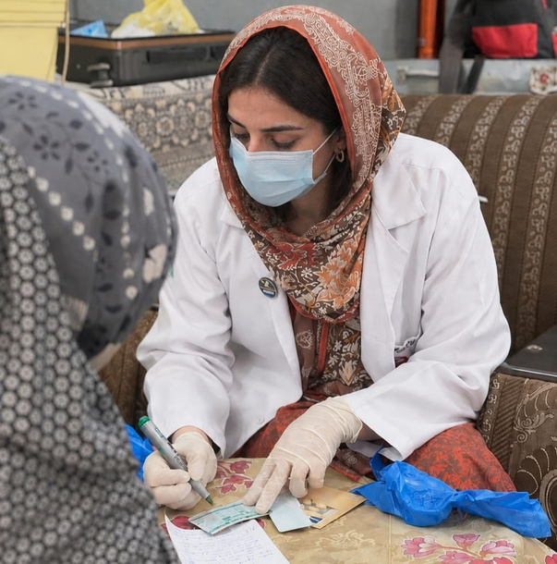
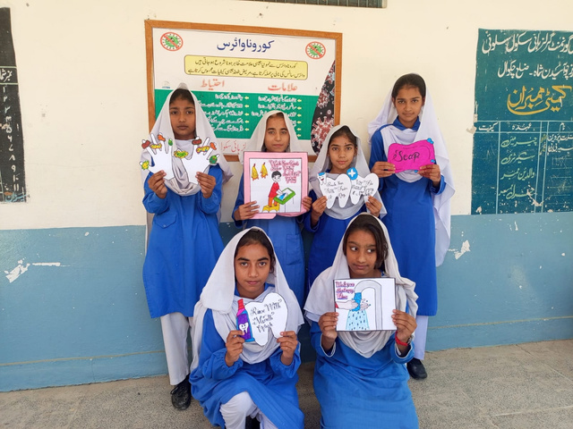
07 · FIELD WORK IN ACTION
Materials used at the counter, the doorstep and the camp
Free medical camp outreach poster with an antimicrobial-resistance street play [2]
Hygiene education session, Chakwal school programme, January 2026 (programme photograph)
Four-golden-rules flyer handed out door-to-door and with every antibiotic dispensed
Myth-or-fact poster displayed in dispensaries, mosques and community hubs
HOW THE MATERIALS ARE USED
The flyer is folded into every antibiotic pack and left at each household. The poster is fixed at eye level next to the dispensing counter. At the camps, a short talk and demonstration walk through the same four rules before any medicine is handed out, and hygiene practice from the school programme is repeated for parents.
Preserving Our Medicines · Community Antibiotic Stewardship, Chakwal, Pakistan
10
Notes:
Show the actual materials: the flyer and poster designed for this programme, the camp outreach format, and the hygiene sessions that feed into golden rule four. Image sources are listed at the end of the deck.
10

Slide 11
08 · PHARMACIST ADVICE
Four golden rules for every patient
01
02
Consult first
Finish the course
Consult a doctor, pharmacist or health worker before starting any antibiotic.
Take every pill until the prescription finishes, even when you feel better.
03
04
Never share
Prevent illness
Never keep leftover doses for later and never give them to anyone else.
Clean water, handwashing and safe food prevent infections and the need for antibiotics.
Programme flyer distributed door-to-door (original design, 2026)
Preserving Our Medicines · Community Antibiotic Stewardship, Chakwal, Pakistan
11
Notes:
The four rules are printed on the flyer and the dispensary poster and repeated at every counselling contact. They form the four practice items in the survey.
11

Slide 12



09 · PRACTICAL PATIENT SKILLS
How to administer antibiotics safely
Equal-hours schedule
Clean water only
Cool, dry storage
Take doses at equal time intervals every day, for example every 8 or 12 hours, so the level in the blood stays effective.
Swallow pills with safe drinking water. Do not crush or split tablets unless the pharmacist says so.
Store medicines away from heat, sunlight and dampness, out of the reach of children. Refrigerate syrups where instructed.
Demonstrated at every dispensing contact, with the timing written on the pack in local language.
Preserving Our Medicines · Community Antibiotic Stewardship, Chakwal, Pakistan
12
Notes:
Practical skills close the gap between knowing and doing. Timing and storage are the two most common practical errors seen at the counter.
12

Slide 13
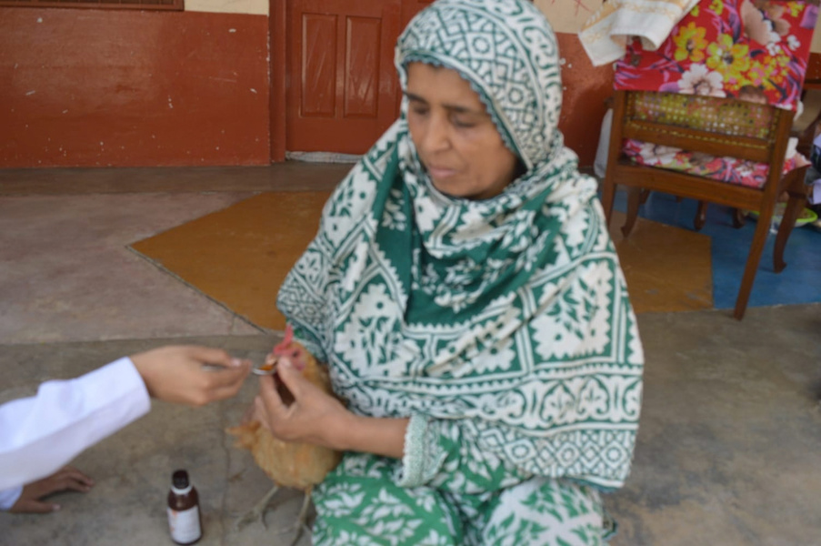
10 · HOLISTIC STANDARD
The One Health approach in agriculture
No growth promoters
Avoid using human antibiotics to boost livestock weight or as routine prevention.
Water source safety
Prevent agricultural pharmaceutical runoff and manure from reaching village drinking wells.
Veterinary supervision
WHY FARMS MATTER
Treat sick farm animals only under trained veterinary guidance, with animal-specific medicines.
Antibiotics given to cattle, goats and poultry reach milk, meat, manure and well water, and resistant bacteria move from animals to people.
Photo: ruminants.ceva.pro [1]
Preserving Our Medicines · Community Antibiotic Stewardship, Chakwal, Pakistan
13
Notes:
One Health links human, animal and environmental health. In farming households the animal shed is part of the medicine cabinet, so the message must cover livestock as well.
13

Slide 14
11 · COMMUNITY SURVEY
Surveying 200 people before and after education
1
2
3
4
5
Enrolment
Baseline survey
Education contact
Post-education survey
8-week follow-up
200 adults in 5 villages, reached at the pharmacy counter (93), door-to-door (60) and medical camps (47)
8-item knowledge questionnaire plus 5 questions on antibiotic practices in the last 3 months
Counselling, flyer, poster and camp talk: the four golden rules and the myths
Same 8 knowledge items repeated immediately after the contact
The 5 practice questions repeated to measure behaviour change
200 people
39% correct
3 channels
89% correct
72% any risk
SURVEY DESIGN Pre/post design · same 8-item questionnaire before and after the education contact · practice questions at baseline and 8-week follow-up · anonymous, reported by village and channel only · full data and formulas: Antibiotic_Stewardship_Community_Survey_Data.xlsx
Preserving Our Medicines · Community Antibiotic Stewardship, Chakwal, Pakistan
14
Notes:
Each of the 200 respondents answered the same 8-item knowledge questionnaire before and immediately after the education contact, and the 5 practice questions at baseline and eight weeks later. The full respondent-level dataset, all calculations and the chart data are in the accompanying Excel workbook.
14

Slide 15
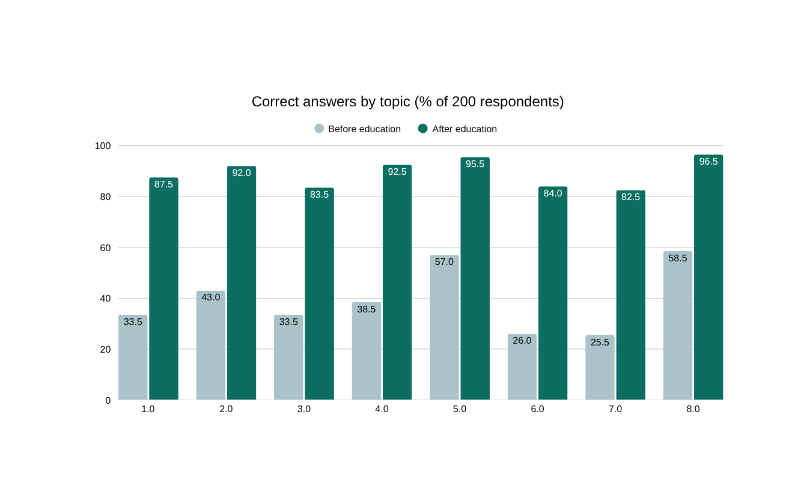
12 · SURVEY RESULTS: KNOWLEDGE
Correct answers more than doubled in every topic
3.2 → 7.1
mean score out of 8, before → after the education contact
99%
of respondents improved their score
4% → 95%
respondents scoring 6 or more out of 8
Largest gains in the topics known least at baseline: livestock use (+58 pp), what resistance is (+57 pp), viral illness and sharing (+54 pp).
Preserving Our Medicines · Community Antibiotic Stewardship, Chakwal, Pakistan
15
Notes:
Overall correct answers rose from 39% to 89%. The weakest baseline topics were resistance itself, livestock use and viral misuse, exactly the misconceptions the myths slide targets. Village and channel breakdowns are in the Demographics sheet of the workbook.
15

Slide 16
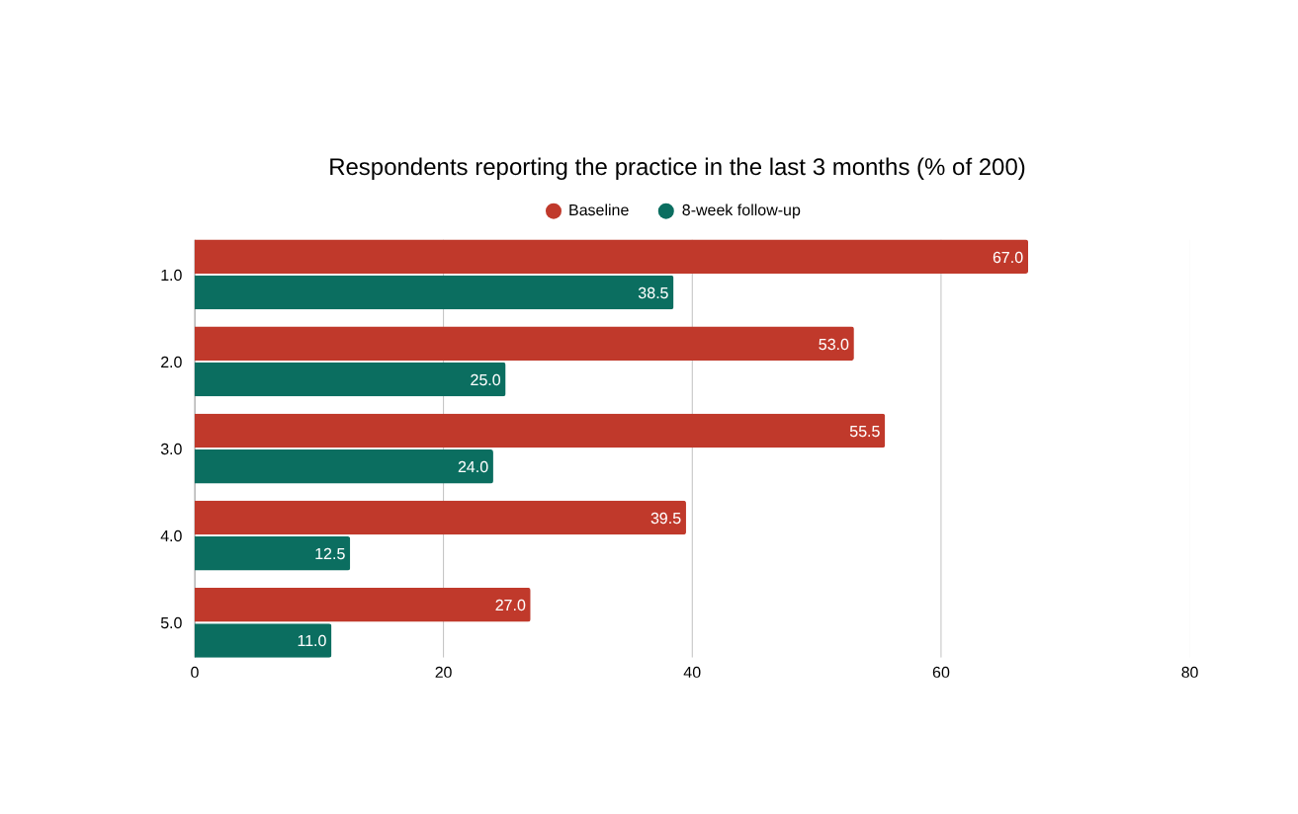
12 · SURVEY RESULTS: PRACTICE
Risky antibiotic practices fell by half within eight weeks
67% → 39%
bought antibiotics without a prescription (–43% relative)
98% → 72%
reported at least one risky practice
40% → 13%
shared leftover antibiotics with family (–68% relative)
Knowledge gains were similar for women (105) and men (95) and across all age groups and villages; over-the-counter buying remains the hardest habit to shift.
Preserving Our Medicines · Community Antibiotic Stewardship, Chakwal, Pakistan
16
Notes:
Behaviour changed less than knowledge, as expected, but every practice fell substantially. Over-the-counter purchase remains the most persistent behaviour and needs counter enforcement by dispensers, not only patient education.
16

Slide 17

13 · OUTCOMES ACHIEVED & SUSTAINABILITY
What changed, and what continues
200
39% → 89%
67% → 39%
99%
people educated and surveyed in 5 villages
correct answers on antibiotic knowledge (before → after)
buying antibiotics without a prescription (baseline → 8 weeks)
of respondents improved their knowledge score
OUTCOMES ACHIEVED
HOW IT IS BEING SUSTAINED
Knowledge of every key message improved in all five villages and all three channels
  Routine workshops: regular village awareness sessions and flyer distributions
  Peer health advocates: local dispensers and community nurses trained as champions
  Counter enforcement: refusing non-prescription sales at all pharmacy counters
  Impact tracking: monitoring compliance and antibiotic utilisation trends
Non-prescription antibiotic sales refused at the programme pharmacy counter
Families report finishing courses and disposing of leftovers instead of saving them
Flyers and posters displayed in dispensaries, mosques and community hubs
Preserving Our Medicines · Community Antibiotic Stewardship, Chakwal, Pakistan
17
Notes:
Outcomes moved from knowledge to behaviour. The sustainability plan follows the four pillars of the long-term action plan: workshops, peer advocates, counter enforcement and impact tracking. Survey figures are from the pre/post questionnaire in the Excel workbook.
17

Slide 18
14 · CONCLUSION
Protect our medicines, protect our future
Antibiotic resistance is preventable. When families understand the four golden rules and pharmacists refuse to sell without a prescription, first-line medicines keep working for the whole community.
EDUCATION
ENFORCEMENT
ONE HEALTH
The dispensing moment is the best time to teach: 200 people, 39% → 89% correct.
Counter refusal of non-prescription sales cut OTC buying from 67% to 39%.
Clean water, hygiene and veterinary supervision reduce the need for antibiotics at all.
NEXT STEP Extend the programme from five villages to the whole of Chakwal District with the district health office, and train every dispenser as a stewardship champion.
Preserving Our Medicines · Community Antibiotic Stewardship, Chakwal, Pakistan
18
Notes:
Close with the three levers: education at the counter, enforcement at the counter, and prevention through One Health. Invite questions.
18

Slide 19
15 · REFERENCES
Sources and guidance
[1]
Murray CJL, et al. (2022). Global burden of bacterial antimicrobial resistance in 2019: a systematic analysis. The Lancet, 399(10325), 629–655.
[2]
World Health Organization (2023). Antimicrobial resistance: fact sheet. who.int [accessed 24.09.2026]
[3]
World Health Organization (2023). The WHO AWaRe (Access, Watch, Reserve) antibiotic book. Geneva: WHO.
[4]
Government of Pakistan, Ministry of National Health Services, Regulations & Coordination (2017). National Action Plan for Antimicrobial Resistance, Pakistan. Islamabad.
[5]
WHO / FAO / WOAH / UNEP (2022). One Health Joint Plan of Action 2022–2026. Geneva.
[6]
Programme records: dispensing log, flyer distribution register, camp attendance and the 200-respondent survey (Antibiotic_Stewardship_Community_Survey_Data.xlsx).
Preserving Our Medicines · Community Antibiotic Stewardship, Chakwal, Pakistan
19
Notes:
Online sources were last checked on the access date shown. The national reference is Pakistan's National Action Plan for AMR (2017).
19

Slide 20
THANK YOU FOR YOUR ATTENTION
Questions & open community discussion
Protect our medicines, protect our future
Anila Munir
anilamunir15@gmail.com · Choa Saidan Shah, Chakwal, Pakistan · March – August 2026
Clinical & Community Pharmacist · DAAD EPOS Public Health Initiative
Notes:
Thank the audience and invite questions.
21

