Slide 1
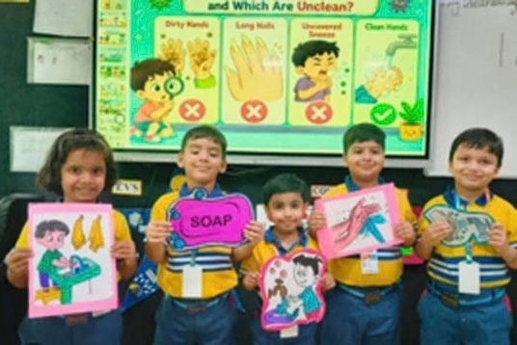
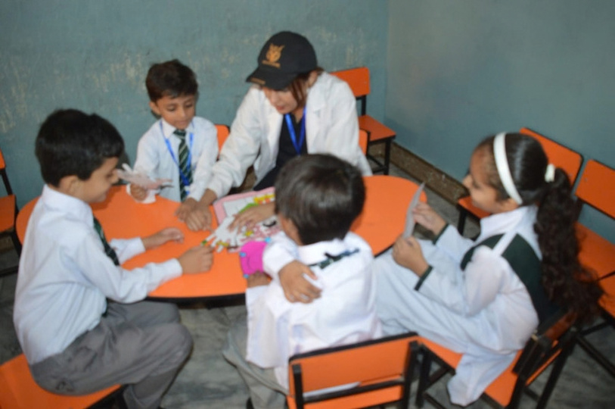
DAAD EPOS · MASTER IN HEALTH · APPLICATION PROJECT
Personal Hygiene & Infection Prevention
A school-based health education programme for children in 5 government and private schools in Chakwal District, Pakistan
Anila Munir
Choa Saidan Shah, Chakwal, Pakistan · 1 January – 1 February 2026
anilamunir15@gmail.com
Notes:
1.7.2013
1.7.2013
Introduce yourself and the project: a school-based hygiene and infection prevention programme, prepared as part of my DAAD EPOS application for a Master of Public Health.
1
‹#›
‹#›

Slide 2
OUTLINE
Structure of the presentation
01 Introduction
08 School-based education activities
02 Target schools & students
09 Implementation plan
03 Programme objectives
10 Ethics & safeguarding
04 Key personal hygiene messages
11 Expected outcomes
05 Correct handwashing technique
12 Monitoring & evaluation
06 Controlling disease spread at school
13 Conclusion & references
07 Safe food & water practices
Personal Hygiene & Infection Prevention · School Health Programme, Pakistan
2
Notes:
1.7.2013
1.7.2013
The presentation follows the logic of a public health intervention: problem and setting, objectives and content, delivery, ethics, and finally outcomes and evaluation.
2
‹#›
‹#›

Slide 3
01 · INTRODUCTION
Schools are key settings for infection prevention
THE PROBLEM
Poor hygiene spreads respiratory, diarrhoeal and skin infections among children.
Children spend many hours together at school. That makes school a place where infections spread easily, and the best place to build lifelong hygiene habits.
THE AIM
Build practical hygiene habits that children use at school and at home.
THE APPROACH
Demonstrations, posters, activities and questions adapted to each age group.
Personal Hygiene & Infection Prevention · School Health Programme, Pakistan
3
Notes:
1.7.2013
1.7.2013
Poor personal hygiene contributes to respiratory infections, diarrhoeal illness, skin infections and other communicable diseases. Schools concentrate children in shared spaces, so they are both a risk setting and an ideal setting for prevention.
3
‹#›
‹#›

Slide 4




02 · TARGET SCHOOLS & STUDENTS
Five schools across two sectors
2
3
5
Government schools
Private schools
Schools in total
PARTICIPANTS
MULTIPLIERS
DOCUMENTATION
Primary and secondary school children, with activities adapted to age.
Teachers and selected student volunteers reinforce hygiene practices.
A school-by-school attendance register records the children actually reached.
PRIVATE
Zainab Education System
1–3 Jan 2026
PRIVATE
Dar-e-Arqam School
18–19 Jan 2026
GOVERNMENT
Govt. High School, Choa Saidan Shah
24–25 Jan 2026
GOVERNMENT
Govt. High School, Saloi
28–29 Jan 2026
PRIVATE
Leader House School System
30Jan–01 Feb 2026
Personal Hygiene & Infection Prevention · School Health Programme, Pakistan
4
Notes:
1.7.2013
1.7.2013
Each of the five schools (two government, three private) issued a No Objection Certificate for the visit. Including both government and private schools allows the programme to reach children in different settings and to compare baseline knowledge and hygiene facilities between the two sectors. Actual student numbers will come from the attendance registers, not estimates.
4
‹#›
‹#›

Slide 5

03 · PROGRAMME OBJECTIVES
Six objectives guide the programme
01
02
03
Explain why personal hygiene matters
Demonstrate correct handwashing and respiratory hygiene
Promote safe drinking water and food practices
04
05
06
Encourage bathing, clean clothing, oral hygiene and nail care
Show how everyday actions reduce the spread of infection
Motivate children to share hygiene messages at home
Personal Hygiene & Infection Prevention · School Health Programme, Pakistan
5
Notes:
1.7.2013
1.7.2013
Objectives cover knowledge (why hygiene matters, how infections spread), skills (handwashing, cough etiquette) and behaviour (daily habits and sharing messages with families and classmates).
5
‹#›
‹#›

Slide 6
04 · KEY PERSONAL HYGIENE MESSAGES
Seven messages every child should know
Area | Key message
Hands | Wash with soap and safe water at key times.
Nails | Keep nails short and clean; avoid biting them.
Body & clothing | Bathe regularly; wear clean clothes and underwear.
Teeth | Brush twice a day, with fluoride toothpaste where available.
Hair & items | Keep hair clean; never share combs, towels or toothbrushes.
Coughs & sneezes | Use a clean tissue, handkerchief or the elbow.
Face | Avoid touching eyes, nose and mouth with unwashed hands.
Personal Hygiene & Infection Prevention · School Health Programme, Pakistan
6
Notes:
1.7.2013
1.7.2013
These messages are deliberately short so that children can remember and repeat them, and so that teachers can reuse them in daily reminders.
6
‹#›
‹#›

Slide 7
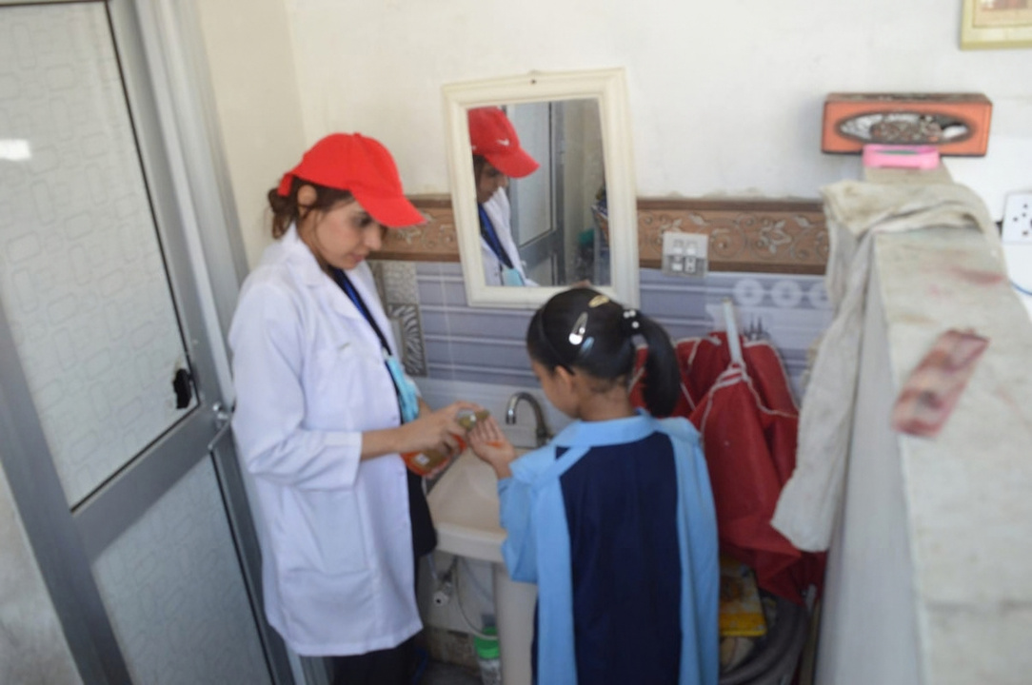

05 · CORRECT HANDWASHING TECHNIQUE
Five steps, about 20 seconds
1
Wet hands with clean running water.
2
Soap and scrub palms, backs, fingers, thumbs and nails.
3
Scrub for about 20 seconds.
4
Rinse thoroughly with clean water.
5
Dry with a clean towel or let hands air-dry.
KEY TIMES
Before eating or preparing food · after using the toilet · after coughing or sneezing · after playing outdoors · whenever hands look dirty
Personal Hygiene & Infection Prevention · School Health Programme, Pakistan
7
Notes:
1.7.2013
1.7.2013
Demonstrate live with soap and water. The 'Give me five' poster turns the five steps into something children can count on their fingers. Technique based on WHO hand hygiene guidance.
7
‹#›
‹#›

Slide 8


06 · MEASURES TO CONTROL DISEASE SPREAD
Breaking the chain of transmission at school
Respiratory hygiene
Personal items
Clean environment
Cover coughs and sneezes with a tissue or the elbow.
Do not share bottles, utensils or toothbrushes.
Keep desks, touched surfaces and shared materials clean.
Dispose of tissues safely, then wash hands.
Stay home when seriously unwell and tell a parent or teacher.
Use safe water; keep toilets and handwashing points clean.
Improve classroom ventilation where practical.
Personal Hygiene & Infection Prevention · School Health Programme, Pakistan
8
Notes:
1.7.2013
1.7.2013
Staying home when unwell should follow the school's and local health authorities' guidance. Each measure interrupts one route of transmission: droplets, shared objects or contaminated surfaces.
8
‹#›
‹#›

Slide 9



07 · SAFE FOOD & WATER PRACTICES
Safe water and clean food, every school day
Water
Food
Speak up
Drink only from a safe, trusted source.
Wash hands before eating.
Tell a teacher about unsafe water, dirty toilets or unhygienic food areas.
Keep lunch boxes clean and covered.
Keep your bottle clean and never share it.
Wash fruit and vegetables; avoid spoiled food.
Personal Hygiene & Infection Prevention · School Health Programme, Pakistan
9
Notes:
1.7.2013
1.7.2013
Children become active partners: besides protecting themselves, they are encouraged to report unsafe water, dirty toilets or unhygienic food areas to teachers.
9
‹#›
‹#›

Slide 10
08 · SCHOOL-BASED EDUCATION ACTIVITIES
Learning by doing, not by listening
Activity | What children do
Handwashing demonstration | Live, step-by-step practice with soap and water
Hygiene quiz | Simple questions and answers on the key messages
Poster competition | “Clean Hands, Healthy School” posters for display
Cough & sneeze etiquette | Demonstration of the tissue and elbow technique
Role-play | How infections spread, and how hygiene stops them
Hygiene checklist | A take-home checklist for school and home
Teacher reminders | 5-minute reminders after the main session
Personal Hygiene & Infection Prevention · School Health Programme, Pakistan
10
Notes:
1.7.2013
1.7.2013
Interactive methods keep children engaged and support retention. Teacher reminders after the session make the programme sustainable.
10
‹#›
‹#›

Slide 11
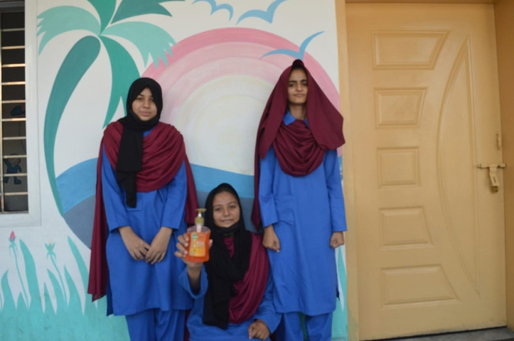
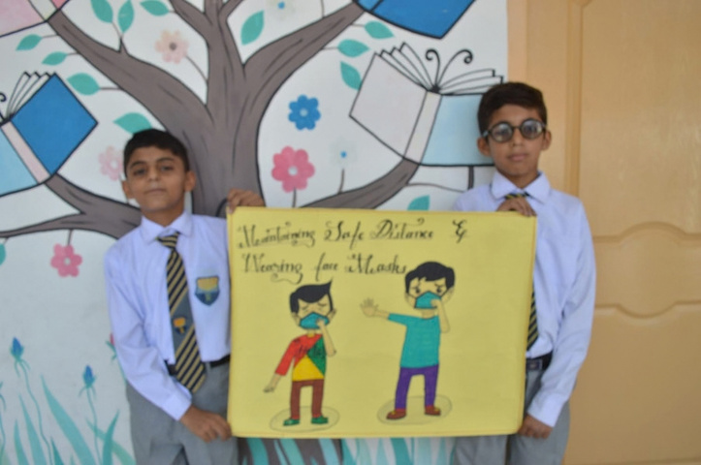

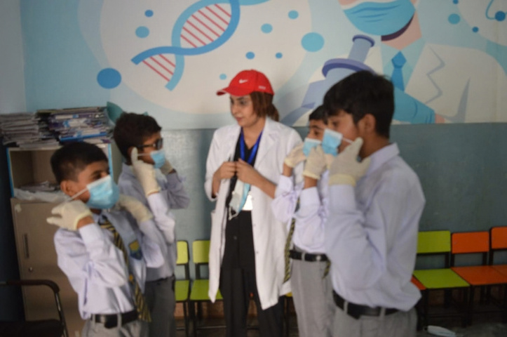
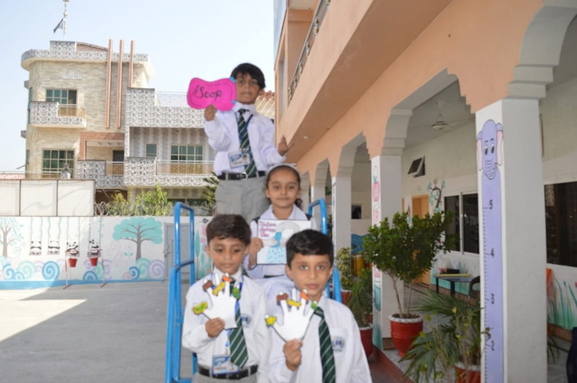
08 · ACTIVITIES IN PRACTICE
Hygiene education in the classroom
“Give me five” handwashing poster
Healthy-habits activity corner
"Clean hand"bright future
Students presenting hygiene posters
Photographs: hygiene sessions at participating government and private schools, Chakwal District · January–February 2026
Personal Hygiene & Infection Prevention · School Health Programme, Pakistan
11
Notes:
1.7.2013
1.7.2013
Examples of the materials and activities used during the January–February 2026 visits to the participating government and private schools: posters, activity corners and craft work that make germs visible for young children.
11
‹#›
‹#›

Slide 12

09 · IMPLEMENTATION PLAN
Six phases across 5 government and private schools
PHASE 1 · WEEK 1
PHASE 2 · WEEKS 1–7
PHASE 3 · WEEKS 1–7
Preparation
Baseline
Education
NOCs signed; materials and visit dates agreed.
Short questionnaire on day 1 of each school visit.
Interactive sessions in all 5 schools.
PHASE 4 · WEEKS 1–7
PHASE 5 · WEEKS 2–8
PHASE 6 · WEEKS 1–8
Demonstration
Reinforcement
Follow-up
Practise handwashing, cough etiquette, safe food and water.
Posters displayed; teachers give regular reminders.
Post-visit assessment; results compiled in Week 8.
SCHOOL VISITS (WEEK 1 = 1 JANUARY 2026)
Wk 1 Zainab Education System · Wk 3 Dar-e-Arqam School · Wk 4 GHS Choa Saidan Shah · Wks 4–5 GHS Saloi · Wks 6–7 Leader House School System
Personal Hygiene & Infection Prevention · School Health Programme, Pakistan
12
Notes:
1.7.2013
1.7.2013
The same six phases are carried out in all five schools, so results are comparable. Week 1 starts on 1 January 2026, and visits are staggered school by school, so phases 2 to 4 run inside each visit. Baseline and follow-up use the same questionnaire and checklist.
12
‹#›
‹#›

Slide 13

10 · ETHICS & SAFEGUARDING
Protecting the children we work with
School permission
Informed parents
Written approval from each school's administration and, where required, the education authority.
An information letter for parents or guardians; consent before any photographs are taken.
Anonymous data
Child-safe conduct
No names on questionnaires; results are reported per school, never per child.
A teacher is present at every session; messages are age-appropriate and non-judgemental.
Personal Hygiene & Infection Prevention · School Health Programme, Pakistan
13
Notes:
1.7.2013
1.7.2013
Working with minors requires clear safeguards. These principles follow good practice in public health research: permission, informed parents, data protection and child-safe conduct.
13
‹#›
‹#›

Slide 14





Achieved Outcomes
What we expect to change
Better knowledge of personal hygiene among participating children
Greater awareness of respiratory hygiene, safe food and safe water
Clearer understanding of how infections spread at school
More student participation in keeping classrooms and toilets clean
More confidence in performing correct handwashing
Simple, repeatable messages that teachers continue afterwards
Personal Hygiene & Infection Prevention · School Health Programme, Pakistan
14
Notes:
1.7.2013
1.7.2013
Outcomes move from knowledge to confidence to behaviour, and finally to sustainability through teachers.
14
‹#›
‹#›

Slide 15
12 · MONITORING & EVALUATION
Measuring reach, knowledge and practice
Indicator | Tool | Timing
Schools and students reached | Attendance register | Every session
Hygiene knowledge | Pre- and post-session questionnaire | Baseline and follow-up
Handwashing technique | Observation checklist | Baseline and follow-up
Hygiene facilities available | Facility checklist | Baseline
Teacher and student participation | Participation record | Every session
Activities conducted | Activity log, posters, photos | Throughout
Comparing baseline and follow-up results shows which topics need further education.
Personal Hygiene & Infection Prevention · School Health Programme, Pakistan
15
Notes:
1.7.2013
1.7.2013
The pre/post design allows a simple before-and-after comparison in each school and between government and private schools. Only aggregated, anonymous data are reported.
15
‹#›
‹#›

Slide 16
13 · CONCLUSION
Small habits, lasting impact
Personal hygiene is a practical, low-cost foundation of infection prevention, and habits learned at school travel home.
STRUCTURE
SUSTAINABILITY
CONDITIONS
5 schools form one platform for education and monitoring.
Teachers carry the messages beyond the programme.
Facilities, safe water and repetition drive impact.
Personal Hygiene & Infection Prevention · School Health Programme, Pakistan
16
Notes:
1.7.2013
1.7.2013
Educating children helps establish healthy habits that extend from school to home and the wider community. Long-term impact depends on sustained teacher involvement, adequate handwashing facilities, safe water and regular health education.
16
‹#›
‹#›

Slide 17
13 · REFERENCES
Sources and guidance
[1]
World Health Organization (2009). WHO Guidelines on Hand Hygiene in Health Care. Geneva: WHO.
[2]
WHO. Infection prevention and control: guidance and resources. who.int [accessed 24.09.2026]
[3]
UNICEF. Water, Sanitation and Hygiene (WASH) in Schools. unicef.org [accessed 24.09.2026]
[4]
WHO/UNICEF Joint Monitoring Programme (JMP). WASH in schools data. washdata.org [accessed 24.09.2026]
[5]
Government of Pakistan, Ministry of Environment (2006). National Sanitation Policy. Islamabad.
[6]
School administration records: student numbers, facilities and attendance (programme data).
Personal Hygiene & Infection Prevention · School Health Programme, Pakistan
17
Notes:
1.7.2013
1.7.2013
Online sources were last checked on the access date shown. The national reference is the Government of Pakistan National Sanitation Policy (2006), which covers sanitation and hygiene promotion, including in schools.
17
‹#›
‹#›

Slide 18
THANK YOU FOR YOUR ATTENTION
Vielen Dank
Questions and discussion
Anila Munir
anilamunir15@gmail.com · Choa Saidan Shah, Chakwal, Pakistan · 1 January – 1 February 2026
Applicant, Master of Public Health (DAAD EPOS)
Notes:
1.7.2013
1.7.2013
Thank the audience and invite questions.
18
‹#›
‹#›

