Slide 1
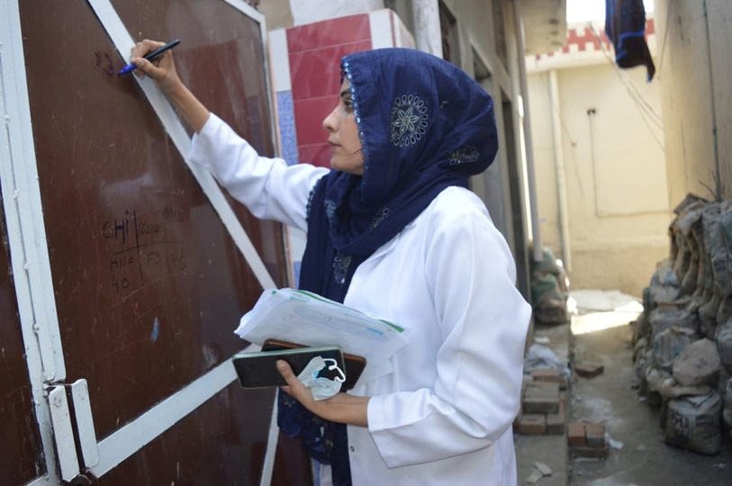
DAAD EPOS · MS Public Health
Community Health Triage & Digital Disease Referral
A bilingual (English–Urdu) mobile app that helps families in rural Chakwal recognise symptoms early, understand the likely illness and reach the right clinic in time.
Anila Munir, PharmD
Marking the door after educating the family about the app
Hospital & Community Pharmacist · Chakwal, Punjab, Pakistan
anilamunir15@gmail.com
Notes:
1.7.2013
Introduce yourself and the project: a community health triage app with digital referral, developed and piloted in Chakwal District, prepared as part of my DAAD EPOS application for an MSc in Global / International Health.
1
‹#›

Slide 2
OUTLINE
Structure of the presentation
01 Introduction: the local health challenge
07 Community field work
02 Target diseases
08 Field pilot outcomes
03 Programme objectives
09 Ethics, safety & data protection
04 How the app works
10 Sustainability & health-system integration
05 Chakwal Health Connect: the app
11 Conclusion & DAAD EPOS way forward
06 From symptoms to referral
12 References
Community Health Triage & Digital Disease Referral · Chakwal, Pakistan
2
Notes:
1.7.2013
The presentation follows the logic of a digital public-health intervention: problem and setting, diseases targeted, objectives, the app itself, how it turns symptoms into a referral, the community field work, pilot results, ethics, sustainability, and how DAAD EPOS will help me take this further.
2
‹#›

Slide 3

01 · INTRODUCTION
Rural families reach care too late
In rural Chakwal, early viral symptoms are often mistaken for routine illness. Families wait, self-medicate, and reach a physician only when complications appear.
THE PROBLEM
Late care-seeking: families misidentify critical prodromal symptoms of measles, dengue and malaria as ordinary fever.
THE GAP
72 hrs
Existing digital health tools have no Urdu localisation and give no structured guidance on vaccine availability or facility locations.
Average treatment delay in rural Punjab, driven by symptom misinterpretation and no localised triage assistance.
THE APPROACH
An offline, bilingual app where people enter their symptoms, learn the likely illness and are referred to the nearest suitable clinic.
Community Health Triage & Digital Disease Referral · Chakwal, Pakistan
3
Notes:
1.7.2013
Explain the local setting: Chakwal is a rural district with long distances to facilities, limited health literacy in Urdu-only households and frequent seasonal outbreaks. The 72-hour figure is the average delay we observed between first symptoms and a physician visit during household sessions.
3
‹#›

Slide 4






02 · TARGET DISEASES
Four high-burden endemic diseases
Measles
Chickenpox
Dengue
Malaria
High fever, cough, red eyes and Koplik spots, followed by a spreading rash.
Itchy fluid-filled blisters, malaise and low-grade fever.
Sudden high fever, retro-orbital pain, muscle pain, bleeding warning signs.
Cyclical chills, sweating and fever after mosquito exposure.
MR / MMR vaccine follow-up
Isolation & home-care guidance
Urgent platelet warning triage
Rapid diagnostic test referral
Selected because they are seasonal, highly transmissible and frequently misread as 'ordinary fever' in the first 48 hours.
Community Health Triage & Digital Disease Referral · Chakwal, Pakistan
4
Notes:
1.7.2013
These four conditions were chosen from district outbreak patterns and from what I see at the pharmacy counter. Each has a recognisable early symptom pattern that a rule-based tool can pick up, and each has a clear next step: vaccination, isolation, urgent physician review or a rapid test.
4
‹#›

Slide 5

03 · PROGRAMME OBJECTIVES
Six objectives guide the programme
01
02
03
Enable early recognition of measles, chickenpox, dengue and malaria symptoms at household level
Provide clear, bilingual guidance on the likely illness and its severity
Refer every user to the nearest suitable clinic, with a map, even without internet
04
05
06
Reduce the average delay between first symptoms and a physician visit
Improve vaccine follow-up through automated, localised reminders
Reduce irrational antibiotic and self-medication use in viral illness
Community Health Triage & Digital Disease Referral · Chakwal, Pakistan
5
Notes:
1.7.2013
Objectives cover recognition (knowing when a fever is not ordinary), navigation (where to go), timing (going earlier) and prevention (vaccine follow-up, avoiding unnecessary antibiotics).
5
‹#›

Slide 6








04 · HOW THE APP WORKS
From symptoms to a clinic in four steps
1
2
3
4
Symptom input
›
Offline engine
›
Severity & referral
›
Vaccine sync
The user enters symptoms by tapping pictures, typing, or speaking in Urdu or English.
A rule-based decision tree matches the symptom pattern to the most likely illness without any internet.
The app shows the likely disease, a risk level, and the nearest clinic that handles it, with a GPS map.
Automated reminders for MR/MMR and other due vaccines, localised to the family's union council.
KEY PRINCIPLE The app does not replace a doctor. It recognises warning patterns early and sends the person to the right physician faster.
Community Health Triage & Digital Disease Referral · Chakwal, Pakistan
6
Notes:
1.7.2013
Walk through one example live: a mother reports high fever, cough and red eyes in a 3-year-old. The engine flags possible measles, marks it high risk, shows the nearest Basic Health Unit with an MR vaccine stock, and later schedules the vaccine reminder for the siblings.
6
‹#›

Slide 7









05 · THE APP
Chakwal Health Connect: the app
Dual-language accessibility
CHAKWAL HEALTH CONNECT
EN | اردو
Urdu audio prompts let non-literate community members report symptoms accurately.
Symptom evaluation / علامات کی جانچ
Zero-data operation
High fever & skin rash / تیز بخار اور خارش
The full decision logic runs offline; only the clinic directory syncs when a signal is available.
Status / صورتحال
Disease-matched referral
Possible measles · Moderate risk · Referral advised
Each result points to the nearest facility able to treat that illness, not just the closest building.
Nearest clinic: BHU Choa Saidan Shah · 3.2 km · Offline mode active
Try the app (pilot link)
https://medico-1aa0a.web.app
Community Health Triage & Digital Disease Referral · Chakwal, Pakistan
7
Notes:
1.7.2013
Show the interface: the user selects or speaks symptoms, the status card gives the likely illness and a risk level, and the bottom card names the nearest suitable clinic with distance. Everything shown works without internet. The link is a placeholder for the pilot build.
7
‹#›

Slide 8
06 · FROM SYMPTOMS TO REFERRAL
What users enter, and where they are sent
Symptom pattern entered | Likely illness shown | Risk level | Referral given
High fever + cough + red eyes + rash behind ears | Measles | High | Nearest BHU/RHC today; MR vaccine for unvaccinated siblings
Itchy blisters in crops + mild fever | Chickenpox | Low–moderate | Home isolation advice; clinic if fever > 3 days or breathing difficulty
Sudden fever + pain behind eyes + bleeding gums or bruising | Dengue | Urgent | Nearest hospital with platelet count facility, same day
Fever with chills every 2–3 days + sweating | Malaria | Moderate | Nearest facility with rapid diagnostic test (RDT)
Any fever with drowsiness, fits or fast breathing | Danger signs | Emergency | Call 1122 / go to DHQ Hospital Chakwal immediately
Every result screen carries the same line in Urdu and English: 'This is guidance, not a diagnosis. Please see a doctor.'
Community Health Triage & Digital Disease Referral · Chakwal, Pakistan
8
Notes:
1.7.2013
These are simplified examples of the decision rules. The rules were written from WHO IMCI danger signs and local clinical practice, then reviewed with two physicians at DHQ Hospital Chakwal before the pilot.
8
‹#›

Slide 9
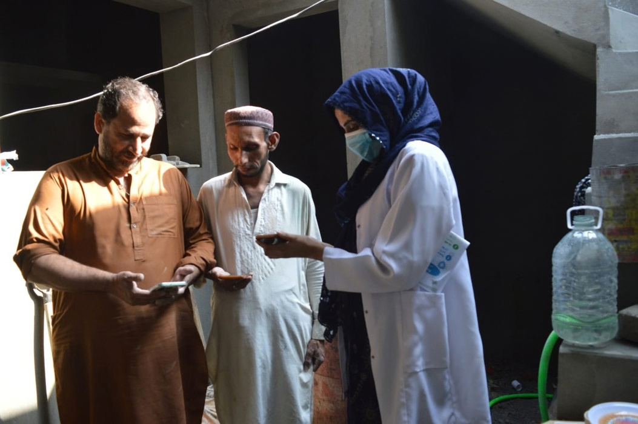





07 · COMMUNITY FIELD WORK
Taking the app door to door
Clinical & algorithmic triage
Translated pharmaceutical and clinical knowledge into the offline decision rules and Urdu wording.
Door-to-door digital literacy
Trained families on installing the app, entering symptoms and reading the referral screen.
Medication & vaccine advocacy
Counselled on fever management, vaccine timing and avoiding unnecessary antibiotics.
Explaining Chakwal Health Connect to a family at a brick kiln, Chakwal District
Community Health Triage & Digital Disease Referral · Chakwal, Pakistan
9
Notes:
1.7.2013
Household sessions were the core of the pilot. Many families had a smartphone but no idea that it could guide a health decision. In each session I installed the app, entered a real or recent symptom episode together with the family, and showed where the referral would send them.
9
‹#›

Slide 10



08 · FIELD PILOT OUTCOMES
What the Chakwal pilot showed
150+
88%
92%
72 → 24 hrs
households educated in door-to-door pharmacist sessions
accuracy in identifying early viral warning signs (triage recognition)
referral compliance: users who sought physician care after an app prompt
target reduction in symptom-to-physician delay for the next phase
OUTCOMES ACHIEVED
HOW RESULTS WERE MEASURED
Families could name the warning signs of measles and dengue after one session
    Short pre/post questionnaire at each household session
    Follow-up call or visit 7 days after any referral prompt
    Anonymised app logs: symptom entries, risk levels, referrals
    Facility check with the BHU in-charge for referred cases
Referred users reached the correct facility type on the first visit
Fewer reports of antibiotics being bought for viral fever
Vaccine reminders led to catch-up MR doses for unvaccinated siblings
Community Health Triage & Digital Disease Referral · Chakwal, Pakistan
10
Notes:
1.7.2013
Pilot figures come from the household sessions and follow-up calls. Numbers are from a small, non-randomised pilot; a properly designed evaluation is exactly what the EPOS training will make possible.
10
‹#›

Slide 11





09 · ETHICS, SAFETY & DATA PROTECTION
Protecting the people who use the app
Guidance, not diagnosis
Danger signs override everything
Every result advises physician review; the app never names a treatment or dose.
Drowsiness, fits, fast breathing or bleeding always trigger an emergency referral.
Minimal, anonymous data
Informed consent
No names or phone numbers stored; symptom logs are anonymised before any sharing.
Verbal consent in Urdu before each household session; families may stop at any time.
Clinically reviewed rules
Transparent limitations
Decision rules checked by two physicians and updated with district health guidance.
Users are told the app has not been validated in a controlled study yet.
Community Health Triage & Digital Disease Referral · Chakwal, Pakistan
11
Notes:
1.7.2013
Safety is the main ethical risk of any triage tool: false reassurance. The rules are deliberately conservative, danger signs override all other logic, and every screen tells the user to see a doctor.
11
‹#›

Slide 12






10 · SUSTAINABILITY & HEALTH-SYSTEM INTEGRATION
From a pharmacist's pilot to a district tool
LHW network
USSD / SMS gateway
District Health Authority
Embed app triage into routine LHW household visits so every family is reached, not only smartphone owners.
A text-based version of the decision tree for basic feature phones, using the same rules.
Share anonymised symptom-trend data with Chakwal Health Authority for early outbreak warning.
NEXT 12 MONTHS
PHASE 1
PHASE 2
PHASE 3
PHASE 4
Clinical validation of rules with DHQ physicians
LHW training in 5 union councils
USSD version & district data dashboard
Controlled evaluation study
Community Health Triage & Digital Disease Referral · Chakwal, Pakistan
12
Notes:
1.7.2013
Sustainability depends on the app living inside existing structures: the LHW programme, the district health information system and basic phones. The pharmacist's role becomes training, rule maintenance and data quality rather than door-to-door delivery.
12
‹#›

Slide 13
11 · CONCLUSION & DAAD EPOS WAY FORWARD
Digital health for community equity
A simple, bilingual, offline triage app can move rural families from 'wait and see' to 'know and go', reaching the right clinic days earlier.
SKILLS
SCALE
RETURN
Epidemiology, biostatistics and evaluation methods to test the app properly.
Health-systems training to take it from one district to Punjab's LHW programme.
I return to Pakistan to build a data-driven early-warning tool for SDG target 3.d.
Community Health Triage & Digital Disease Referral · Chakwal, Pakistan
13
Notes:
1.7.2013
Close with the personal goal: every family in Chakwal District should be able to recognise a dangerous fever and know where to go, in their own language, without needing internet. The DAAD EPOS MSc gives me the methods to evaluate and scale this responsibly.
13
‹#›

Slide 14
THANK YOU FOR YOUR ATTENTION
Vielen Dank
Questions and discussion
Pilot app:https://medico-1aa0a.web.app
Anila Munir, PharmD
anilamunir15@gmail.com · Chakwal, Punjab, Pakistan · Applicant, MSc Global Health / International Health (DAAD EPOS)/Public Health
Notes:
1.7.2013
14
‹#›

