Slide 1
Binary Classification with a Bank Churn Dataset
Team Members:
Muhammad Aammar Tufail (Ph.D.)
Maximilian Beikirch
Nawar Habboush
Abdullah Al Amin

Slide 2
Outline
Intro to Kaggle Competition
AIMs of the project
EDA of the Data
Data Wrangling and Feature Engineering
Models we would like to use
Random forest
Neural Network
XGBoost
CATboost
LightGBM
How the accuracy improved?
Conclusion

Slide 3
Intro / aims
Competition Link
Data from 165000 customers
Synthetic dataset
From 12 data points, will a given customer close his account?
Understand churn => prevent churn => lower costs / higher profits
repeat business = profitable business

Slide 4
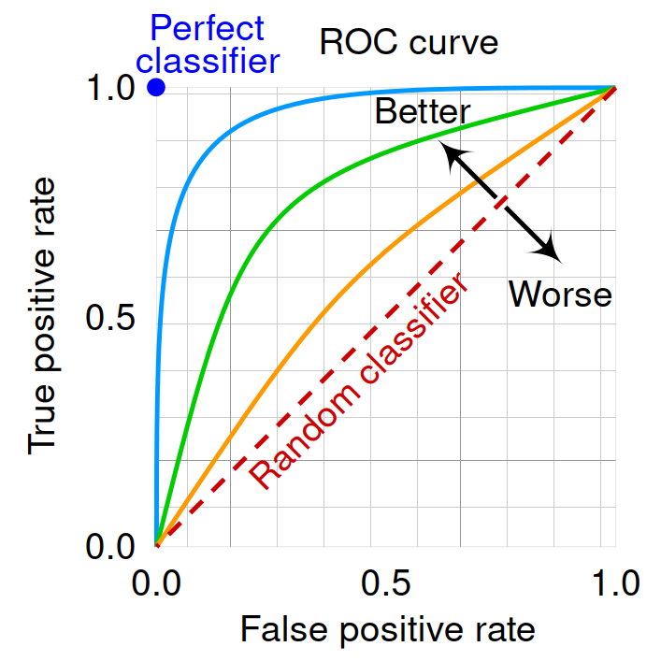
Metric
ROC (receiver operating characteristics)
binary classification model => {0,1}
For ROC: model => [0, 1]
m.predict() / m.predict_proba()
Compute TPR/FPR for various alpha
Target metric: AUC

Slide 5
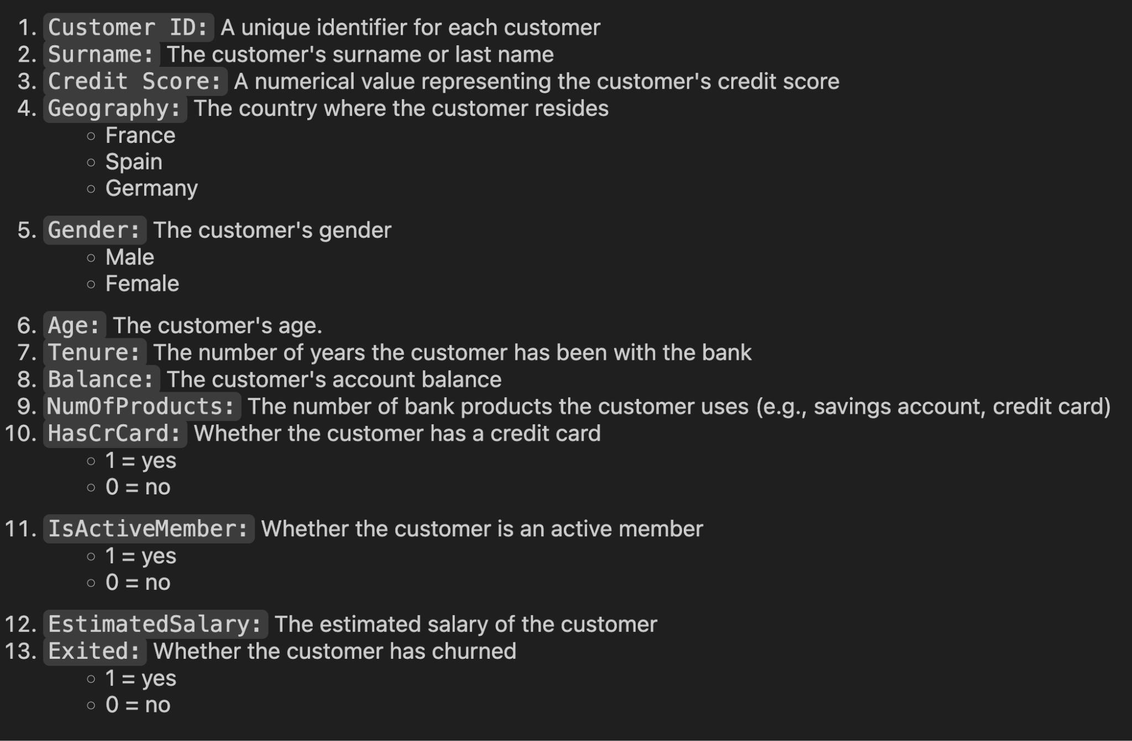
Data Description

Slide 6
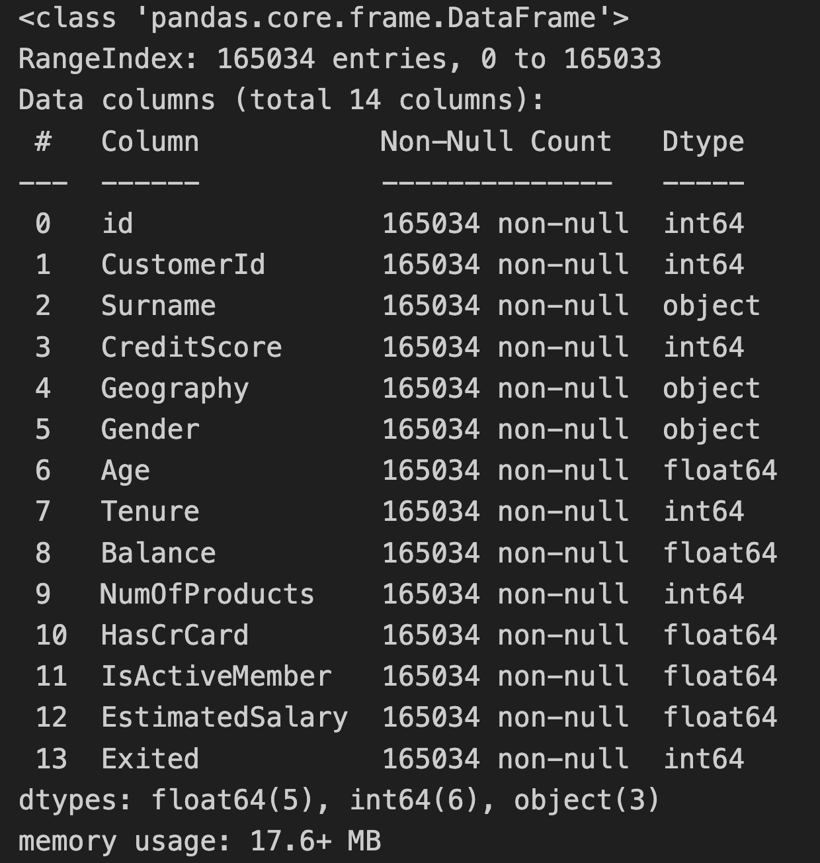
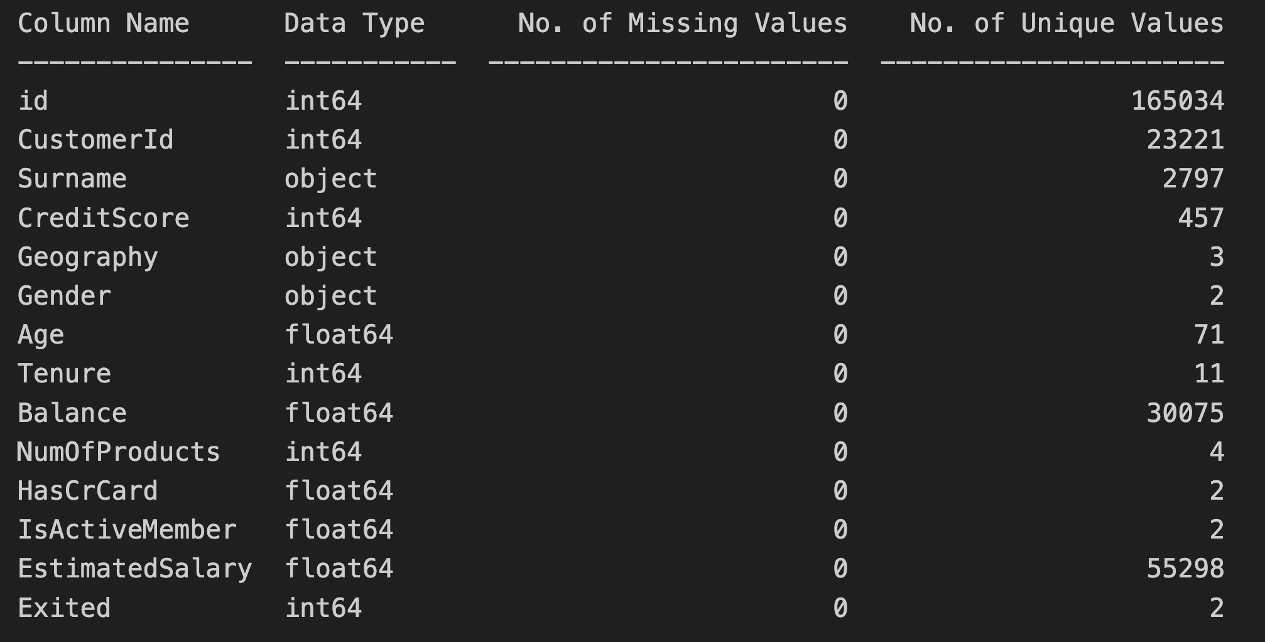
Exploratory Data Analysis

Slide 7
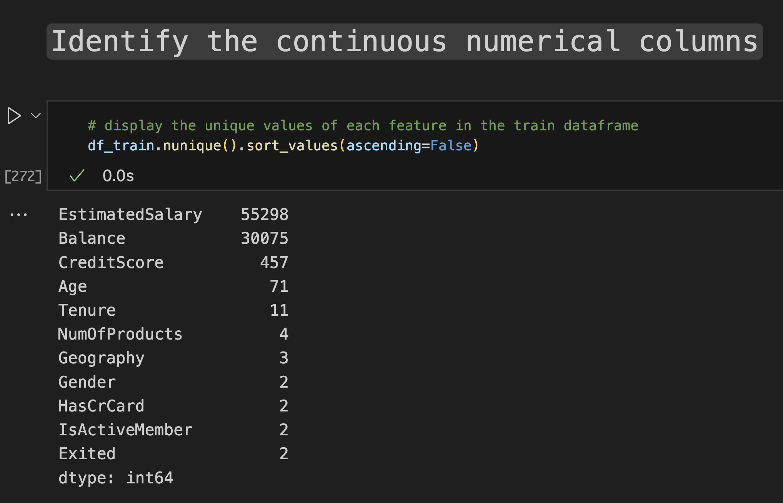
Exploratory Data Analysis

Slide 8
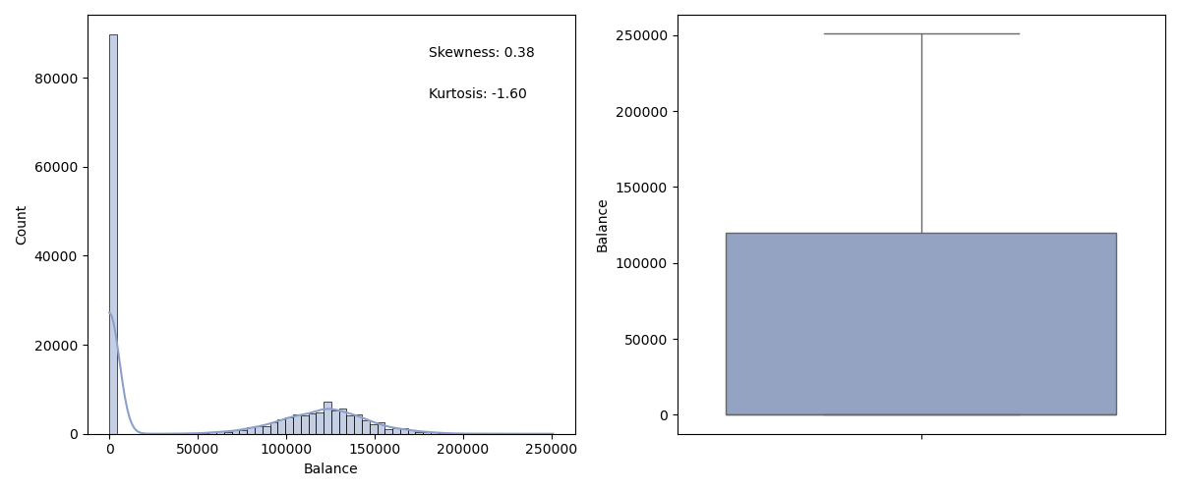
Exploratory Data Analysis
There are 89648 (54%) customers having no/zero balance in their accounts.

Slide 9
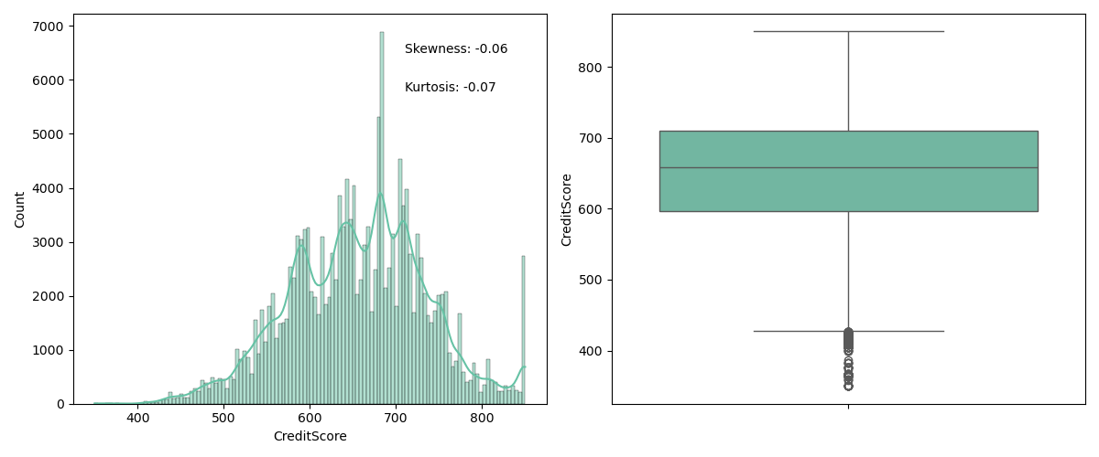
EDA of Continuous Numeric Features

Slide 10
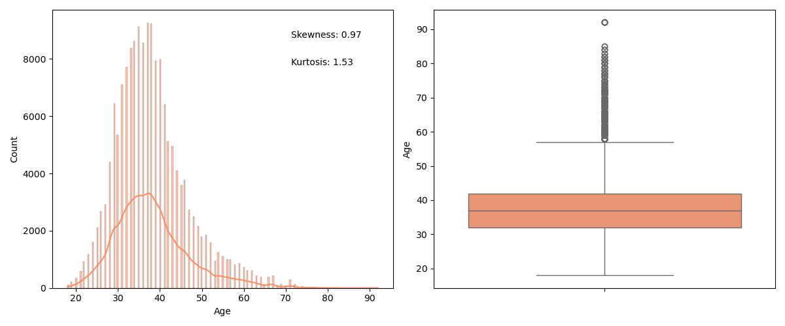
EDA of Continuous Numeric Features

Slide 11
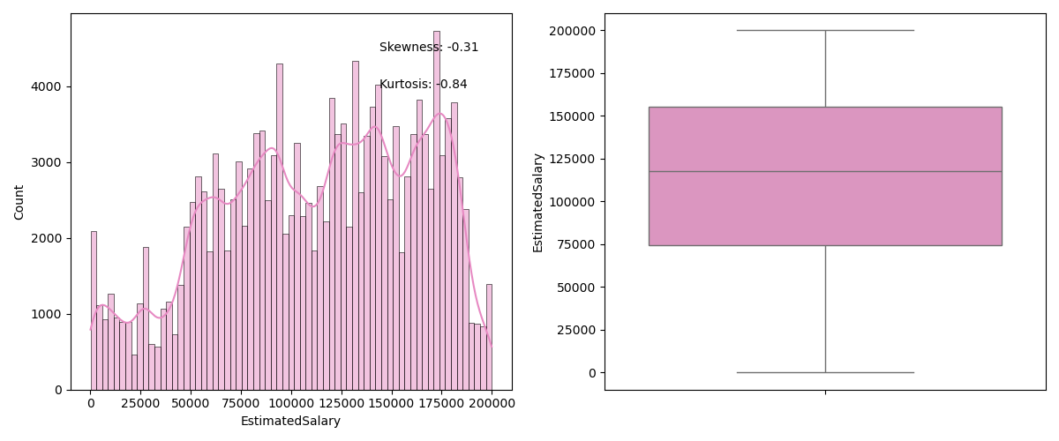
EDA of Continuous Numeric Features

Slide 12
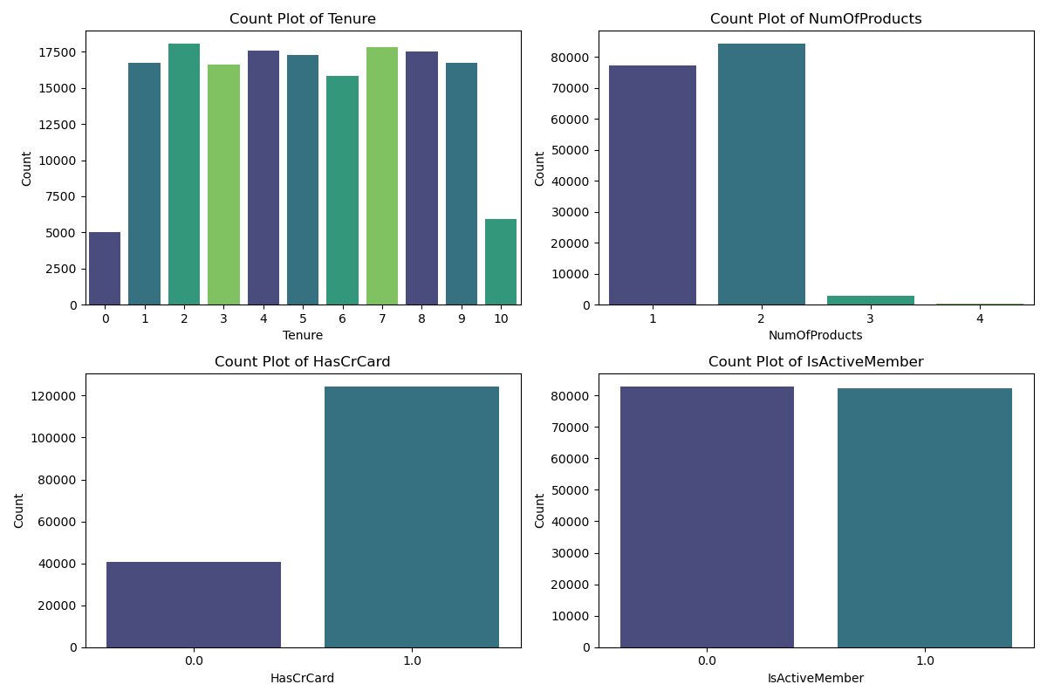
EDA of Discrete Features

Slide 13
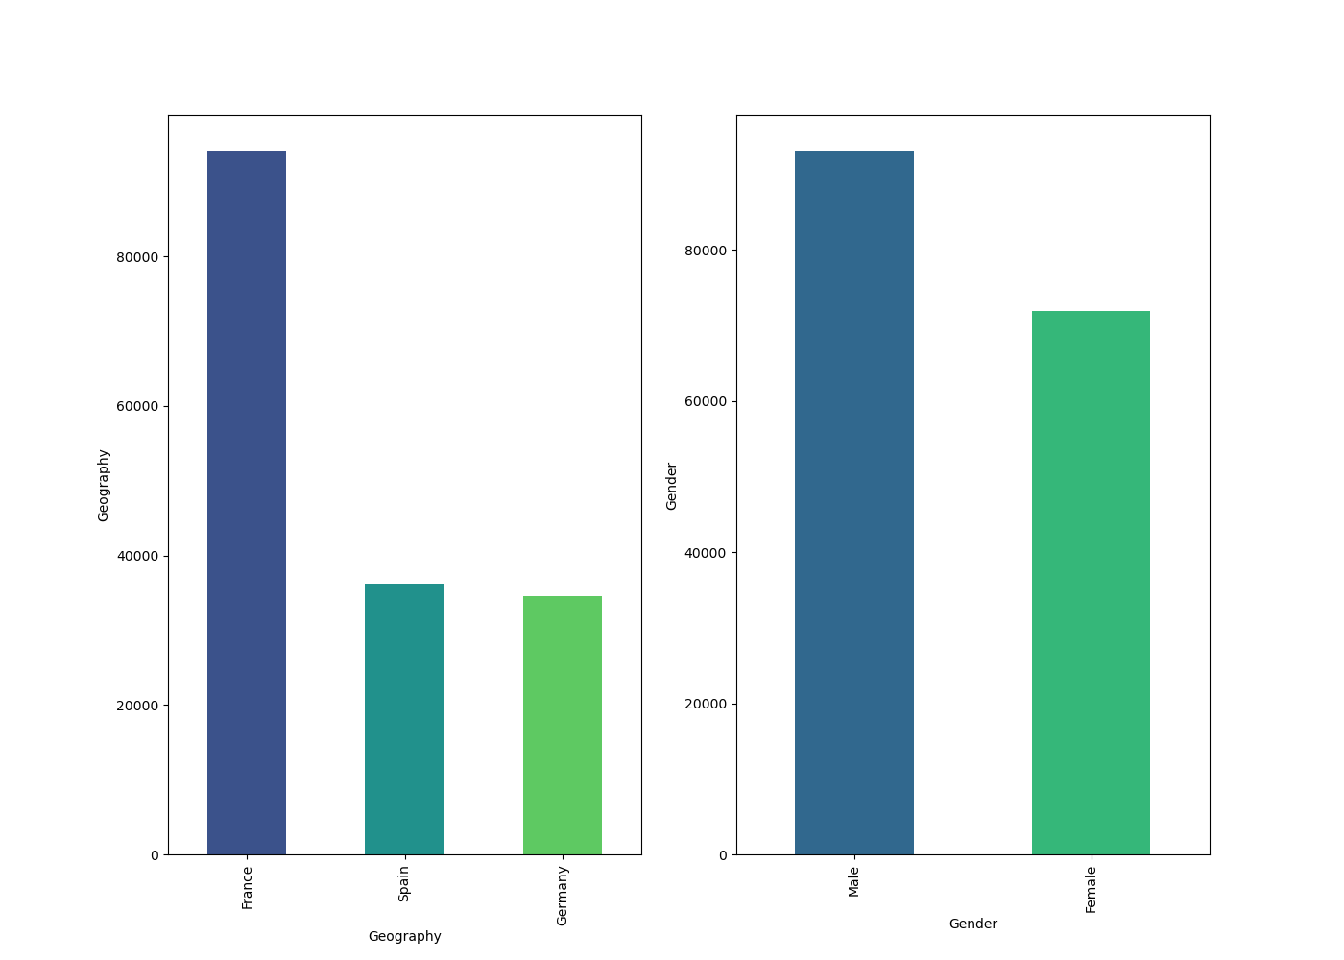
EDA of Categorical Features

Slide 14
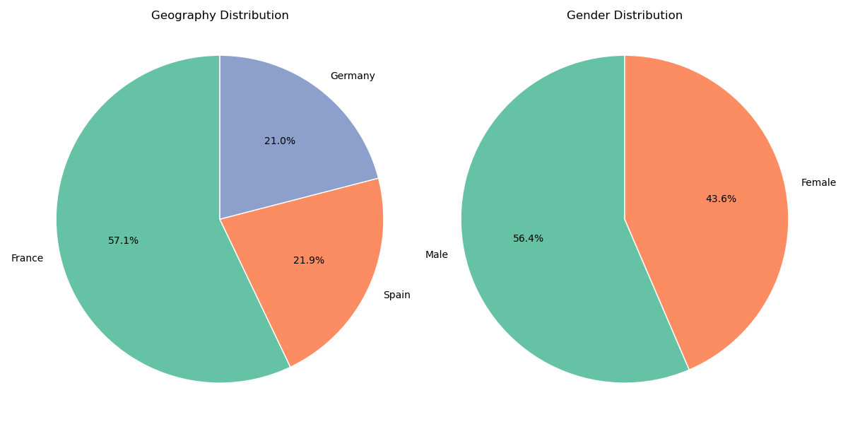
EDA of Categorical Features

Slide 15
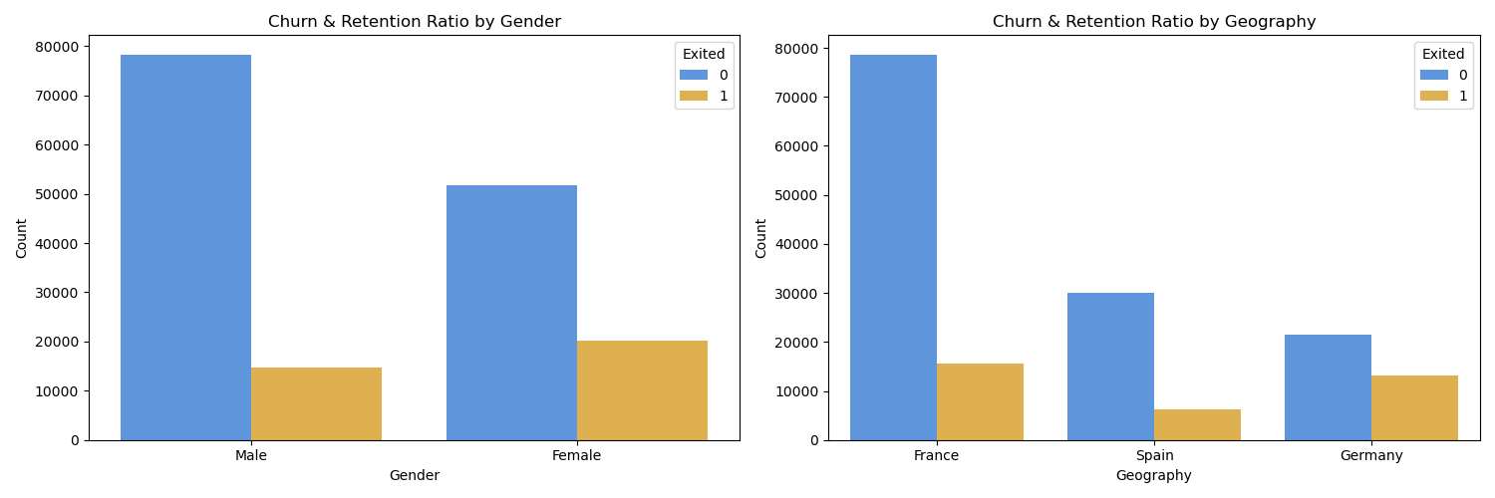
Features vs. Churn Ratio

Slide 16
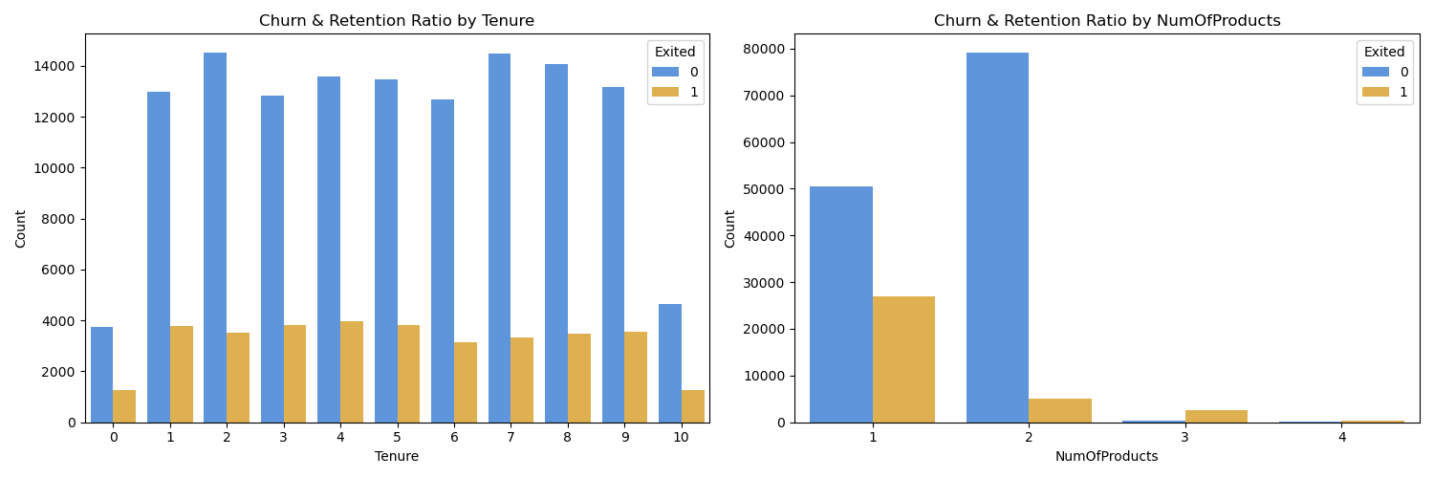
Features vs. Churn Ratio

Slide 17
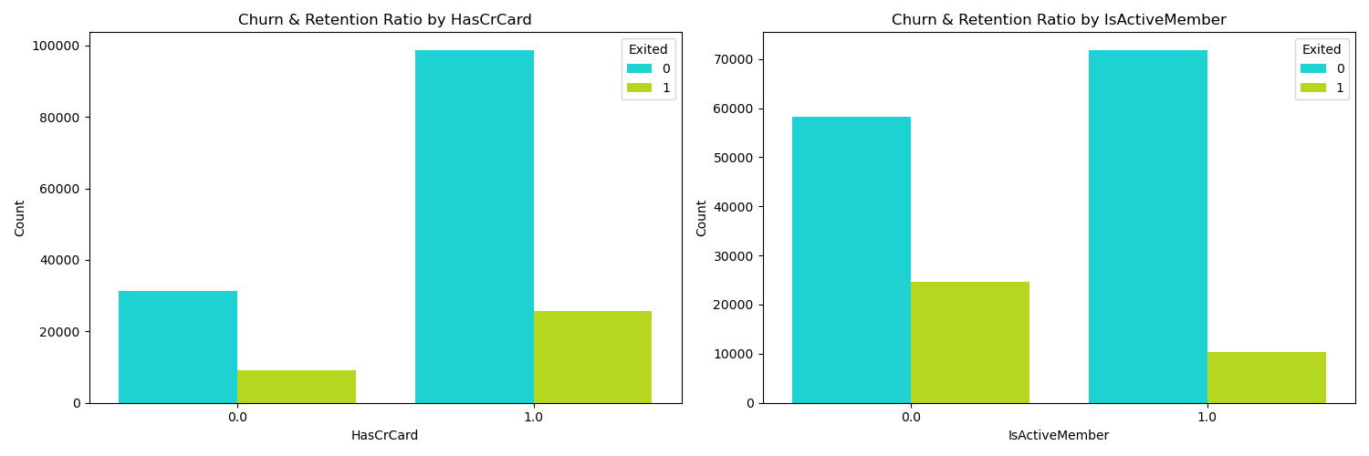
Features vs. Churn Ratio

Slide 18
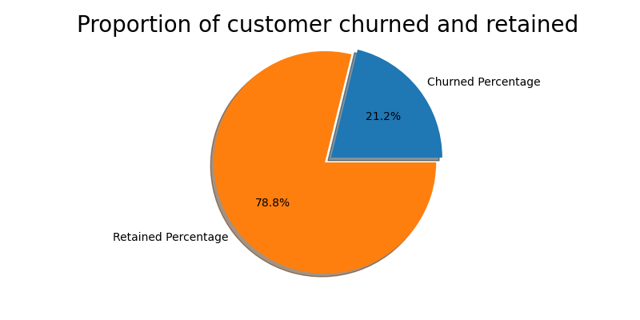

Slide 19
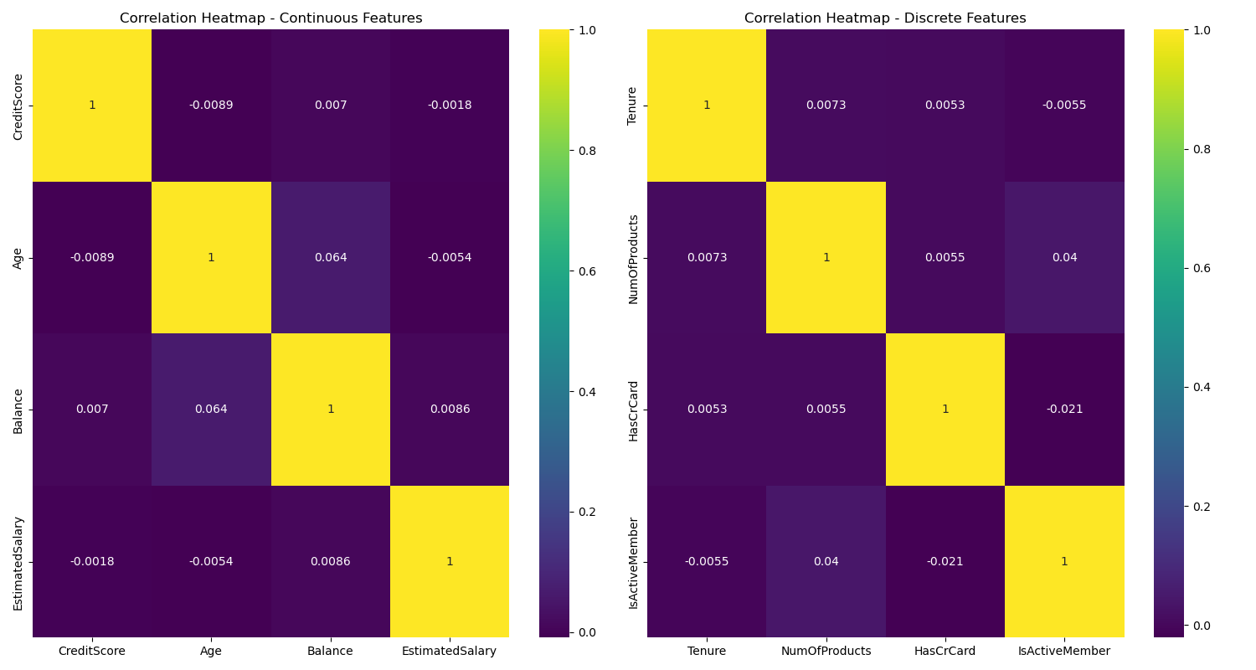
Correlation of features

Slide 20
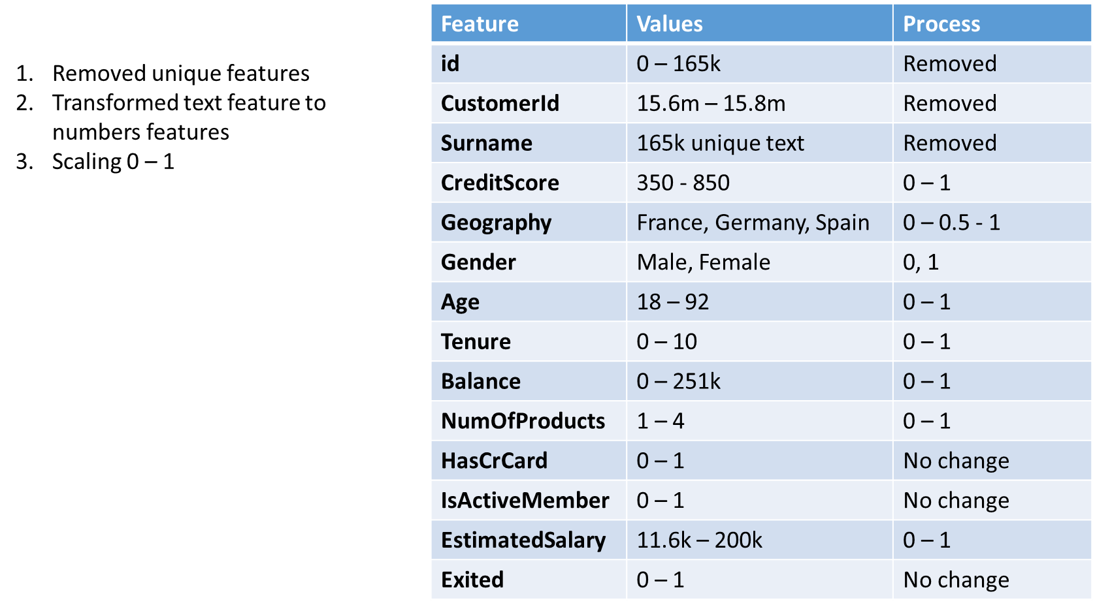
Feature Engineering / Preprocessing

Slide 21
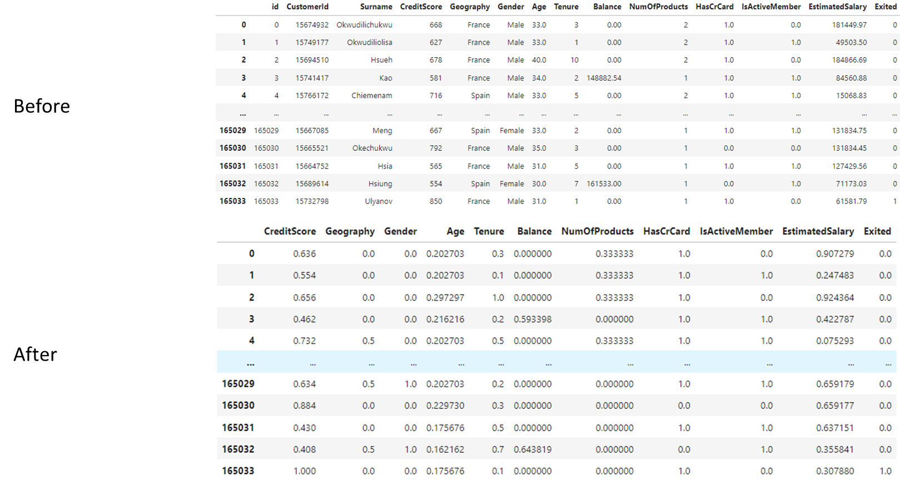
Feature Engineering / Preprocessing

Slide 22
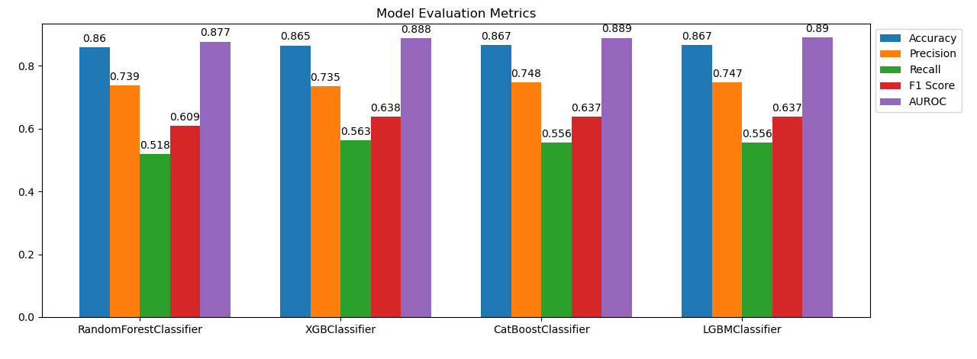
Models and Metrics
1. Random Forest Classifier
2. XGBoost Classifier
3. LightGBM Classifier
4. CatBoost Classifier
5. Neural Network with PyTorch

Slide 23
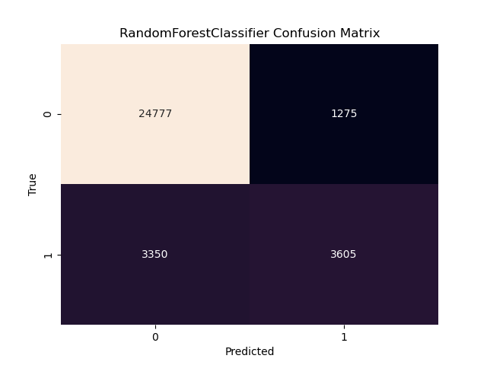
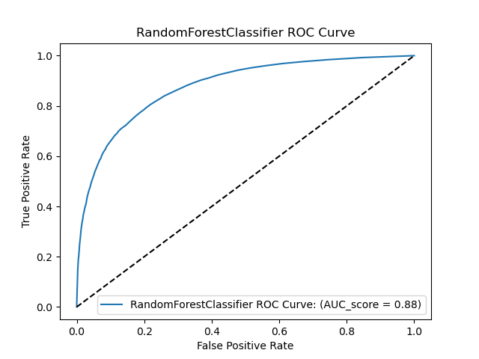
Random Forest Classifier

Slide 24

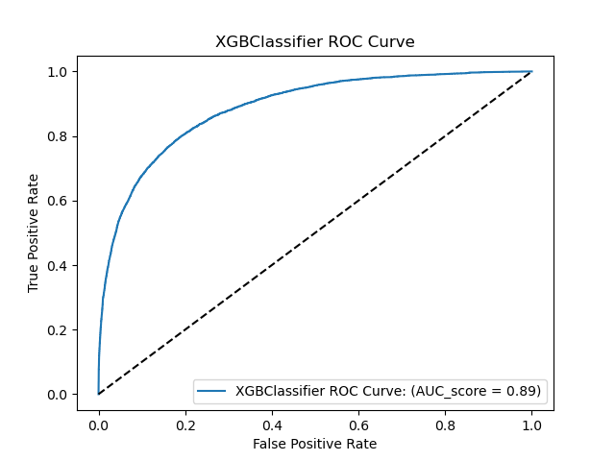
2. XGBoost Classifier

Slide 25


3. lightGBM Classifier

Slide 26

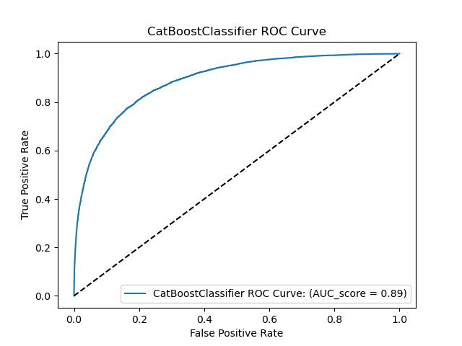
4. catBoost Classifier

Slide 27
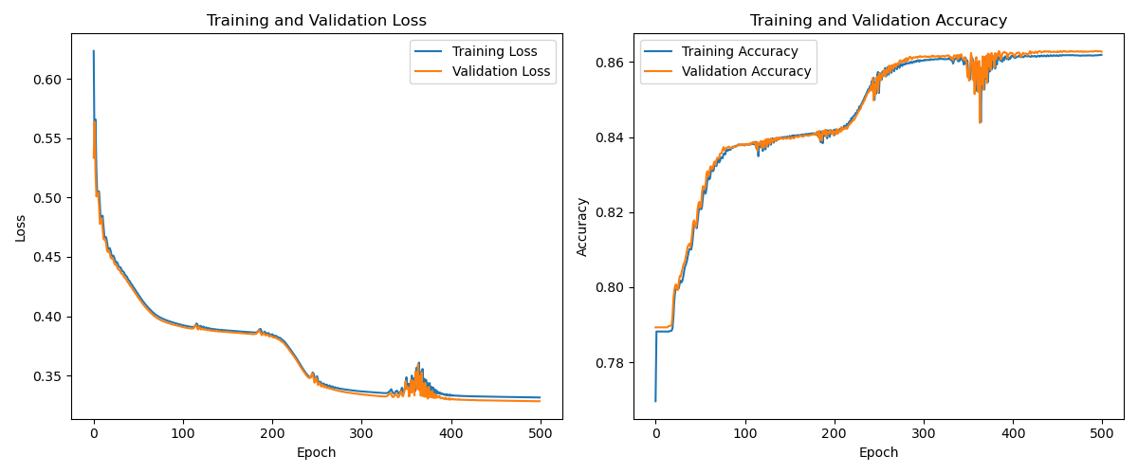
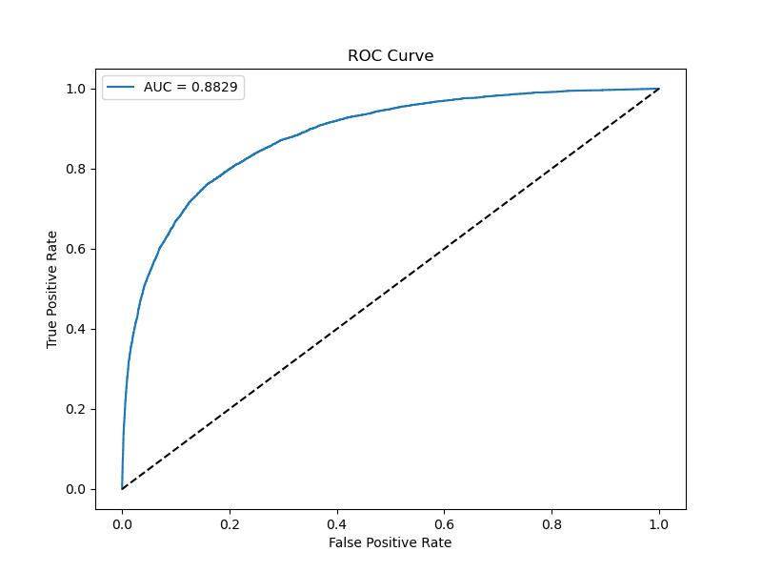
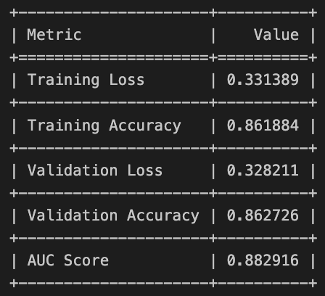
5. Neural Network with Pytorch

Slide 28
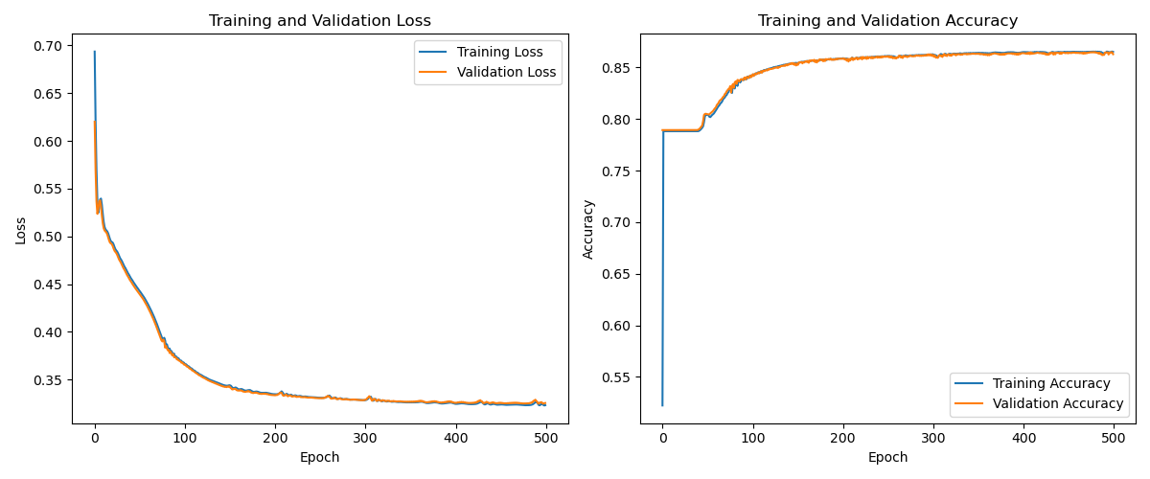
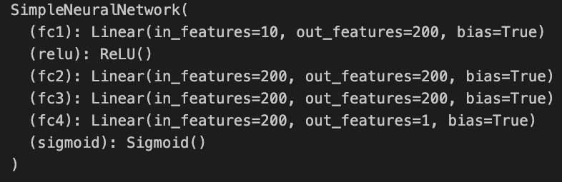
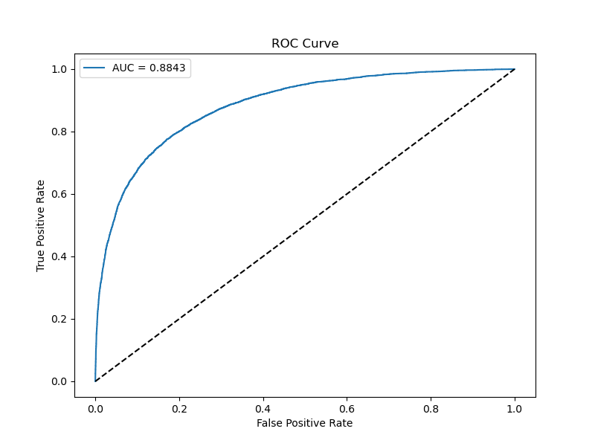
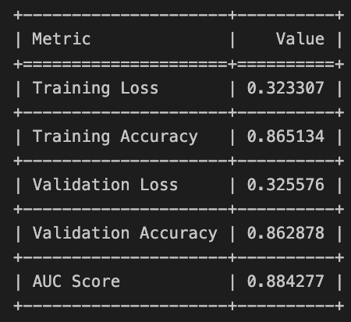
5. Neural Network with Pytorch

Slide 29
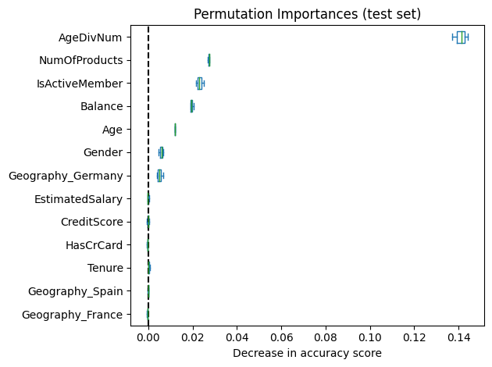
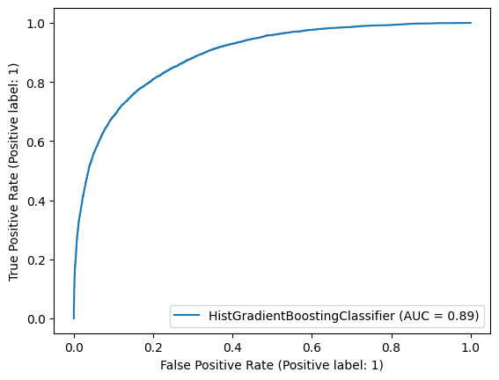
Random forests
 | precision | recall | f1 | support
non-churn | 0.94 | 0.82 | 0.87 | 26052
churn | 0.54 | 0.79 | 0.64 | 6955

Slide 30
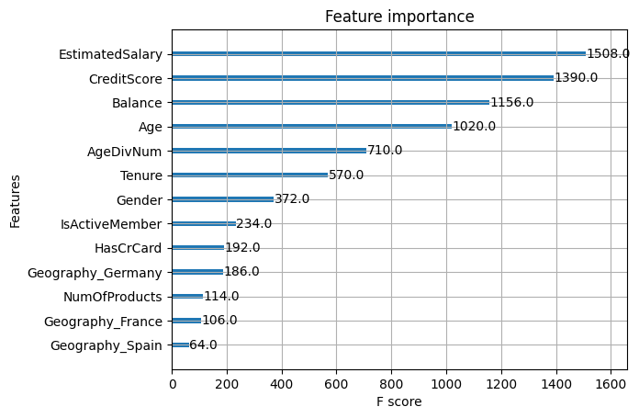
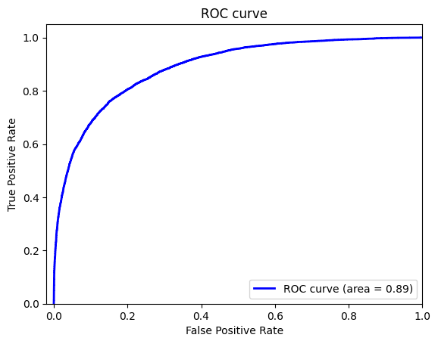
XGBoost
 | precision | recall | f1 | support
non-churn | 0.89 | 0.95 | 0.92 | 26052
churn | 0.74 | 0.56 | 0.64 | 6955

Slide 31
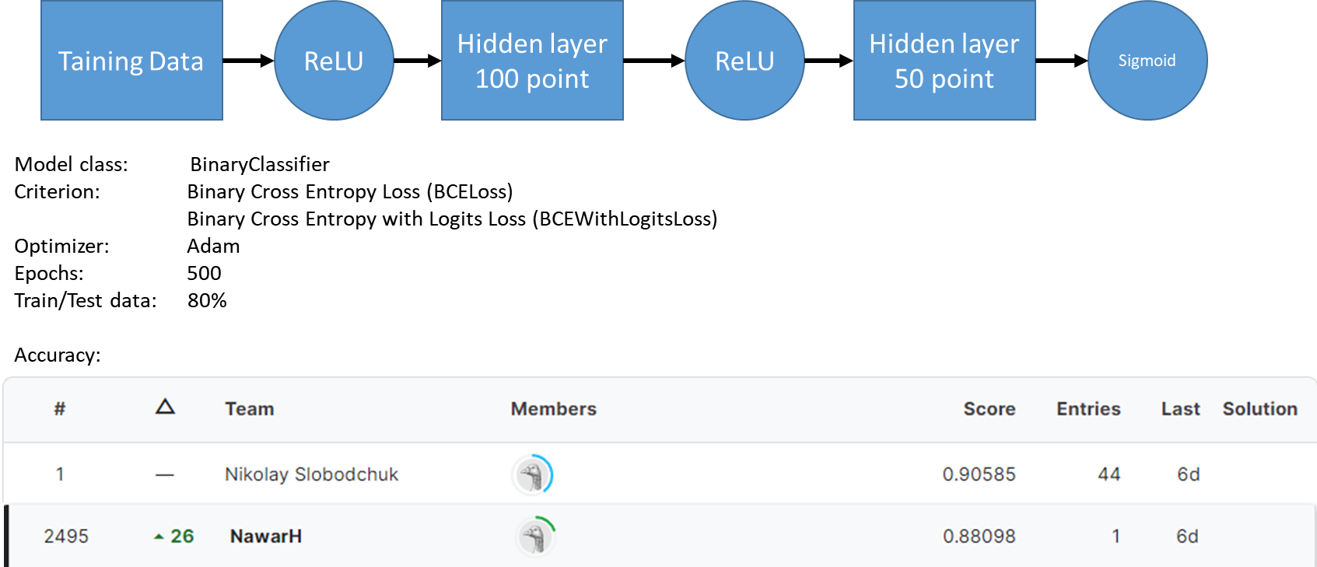
Neural Network (PyTorch): Model Parameters and Results

Slide 32
Neural Network (PyTorch lightning): Model Description
Description:
Architecture:
Input layer
Single hidden layer (15 neurons) with ReLU activation
Output layer with sigmoid activation for binary probability predictions
Loss Function: Trained with Binary Cross Entropy (BCE) loss to measure prediction accuracy.
Optimization: Utilizes Adam optimizer for efficient parameter updates during training.
Metrics Monitoring: Tracks training and validation accuracy to assess model performance.
Implementation: Developed in PyTorch and PyTorch Lightning for clean, organized, and efficient training code.
Efficient Training: Streamlined PyTorch Lightning implementation for rapid experimentation and deployment.

Slide 33
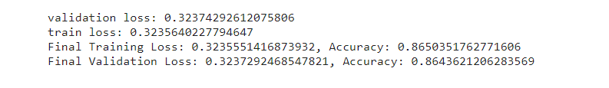
Neural Network (PyTorch lightning): Results
Training Epoch: 20, batch size: 10

Slide 34
Comparison between Pytorch and Pytorch lightning
Advantages of PyTorch Lightning:
Abstraction of Training Loop
Simplified Training Configuration
Built-in Features (logging, early stopping, and checkpointing)
Integration with Accelerators
Community Support
Disadvantages of PyTorch Lightning:
Learning Curve
Customization Limitations
Abstraction Overhead
Early-Stage Ecosystem

Slide 35
Conclusion
catBoost or lightGBM were the best models
Neural Network with pytorch did not improve the metrics.
Neural Network (PyTorch) could not get the best accuracy for the challenge but still a powerful tool
Neural Network (PyTorch) accuracy was better using the BCELoss criterion than the BCEWithLogitsLoss
While experimenting with Neural Network (PyTorch), the results improved when using a lower learning rate and higher number of epochs.
Pytorch lightning is a powerful abstraction for rapid prototyping and experimenting.

