Slide 1
AI-Enhanced Public Transit Demand Delay Prediction in Toronto
Team Members
Dejina Ghale
Santosh Basnet
Shishir Aryal
Nawaraj Bedari
Professor: Sanjeev Kumar
Course : AIDI1011– AI Project

Slide 2
PROJECT SUMMARY
AI-Enhanced Public Transit Demand Prediction in Toronto, is to apply AI to forecast the number of subway users at various periods. To identify trends and gain a better understanding of transportation demand, we are utilizing actual TTC data regarding subway delays. The objective is to assist the city in enhancing subway timetables, cutting down on wait times, and simplifying everyone's commute.
Dataset Path:
TTC Subway Delay Data - City of Toronto Open Data Portal

Slide 3




TEAM MEMBERS
DEJINA GHALE
TEAM LEAD
SANTOSH BASNET
RESEARCH & DATA ANALYST
SHISHIR ARYAL
DATA ENGINEER
NAWARAJ BEDARI
VISUALIZATION AND REPORTING

Slide 4
Problem Statement and Objectives
Problem Statement:
Toronto faces frequent subway delays
Unpredictability disrupts riders and transit operations
Our goal: Predict delays and optimize subway scheduling using AI
Objectives:
Predict delay categories using TTC data
Integrate time, station, and operational features
Deploy predictive API + Dashboard for insights
Improve timetable accuracy, reduce wait times, and enhance commuter experience.

Slide 5
Methodology Overview
Data Collection: TTC Delay Data + Station Info + Code Descriptions.
Data Processing: Cleaning, encoding, feature engineering.
Modeling: XGBClassifier(XGBoost)
Evaluation: Precision, Recall, F1-score, Confusion Matrix.
Deployment: Flask API + Dashboard.

Slide 6

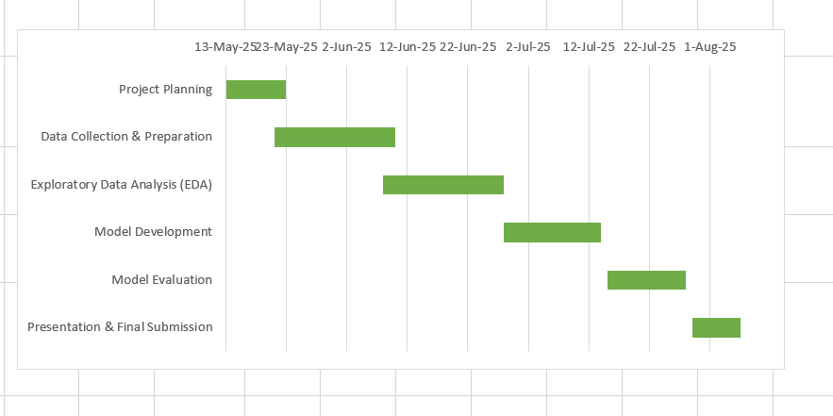
High Level Task/ Gantt chart

Slide 7
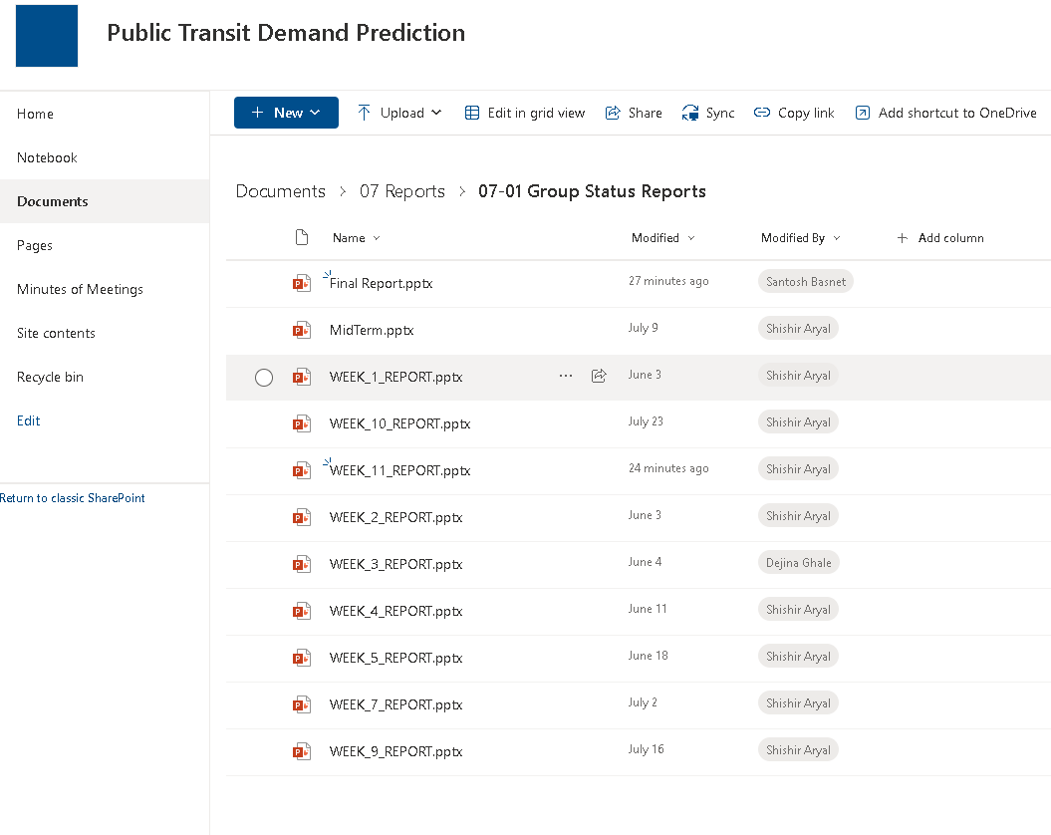
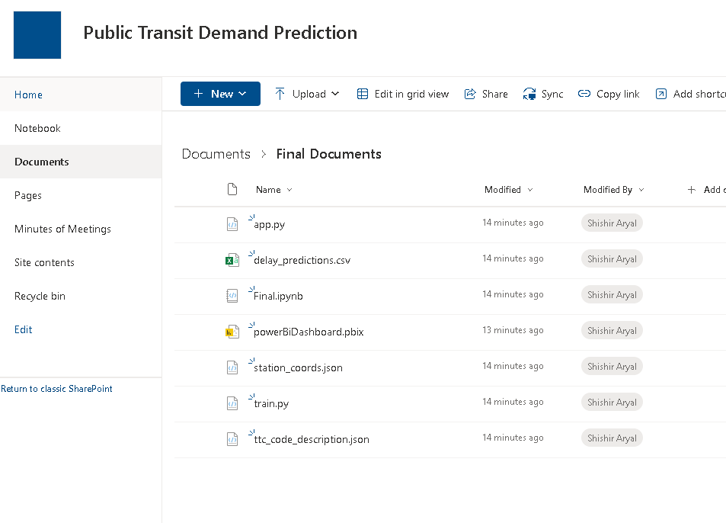
SharePoint
Link: https://georgiancollege.sharepoint.com/:u:/r/sites/GC-ApplicationinTransportation/Public%20Transit%20Demand%20Prediction/SitePages/Home.aspx?csf=1&web=1&e=ygWyku

Slide 8
Machine Learning Model
Model Used: Pre-trained classification model (Delay Category prediction)
Encoders: Label encoding for categorical features
Feature Engineering:
Time-based features (Hour, Day, Month, Peak Hours)
Station, Line, Bound, Vehicle
Holiday & Weather adjustments (Rule-based override)
Accuracy: 99%
Output Classes: Short, Medium, Long delays

Slide 9
Key Features
Hourly Forecast: From selected time until midnight
Rule-based Enhancements:
Weather impact (snow, rain)
Weekend & holiday patterns
Interactive Map: Shows station location
Color-coded Chart & Table: For easy interpretation
Legend: Green=Short, Orange=Medium, Red=Long

Slide 10
Web Application (Flask)
- User Input Form: Date, Time, Station dropdown
Backend:
Loads ML model & encoders
Generates hourly predictions
Applies rule-based overrides
Output on Webpage:
Map
Hourly Delay Chart (Color-coded)
Forecast Table

Slide 11
Real-Time Logging
CSV Logging:
timestamp, date, time, station, delay_category
Appends new predictions on each run
Purpose:
Historical tracking
Power BI integration

Slide 12
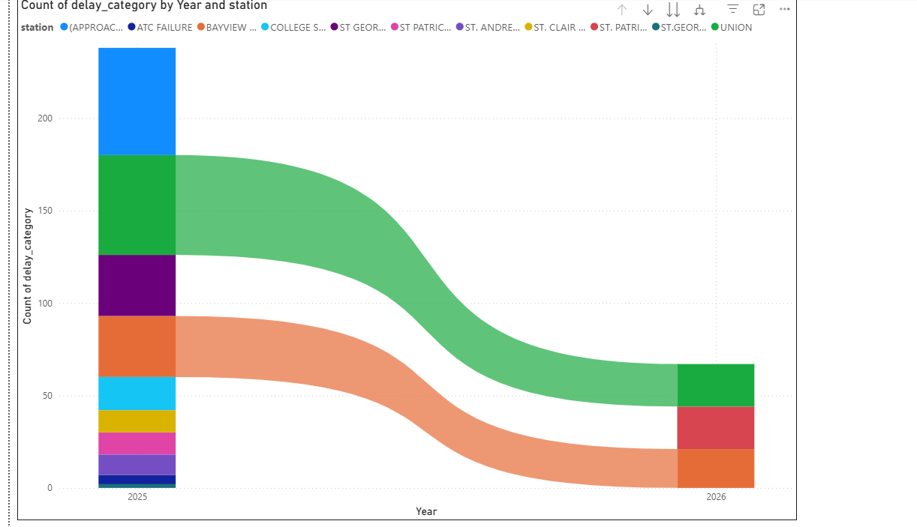
Power BI Integration
Live Streaming Dataset: Predictions sent directly to
Power BI
Dashboard Features:
Live updating visuals (bar charts, tables, filters)
Historical & current trend analysis
Filter by station, date, delay category
Benefits:
Stakeholders get up-to-the-minute insights
No manual refresh required

Slide 13
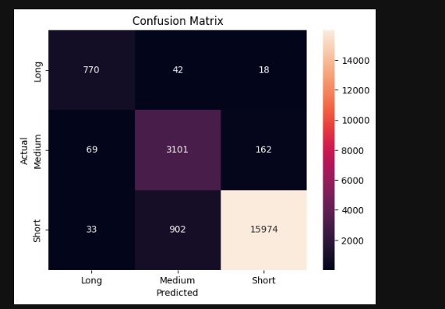
Results & Accuracy
Model Performance:
Accuracy: 99% Short, 88% Long & 77% Medium
Confusion Matrix (optional image)
Impact of Rule-based Logic:
Improved real-world reliability
Better prediction in adverse weather & holidays

Slide 14
Conclusion
Conclusion:
Successfully built an end-to-end AI-powered delay prediction system
Combined ML + business rules + real-time visualization
Deployed a user-friendly web interface
Future Improvements:
Integrate more live data (real-time TTC feeds)
Enhance model accuracy with deep learning
Add commuter alerts via SMS/email
Expand to buses & streetcars

