Slide 1
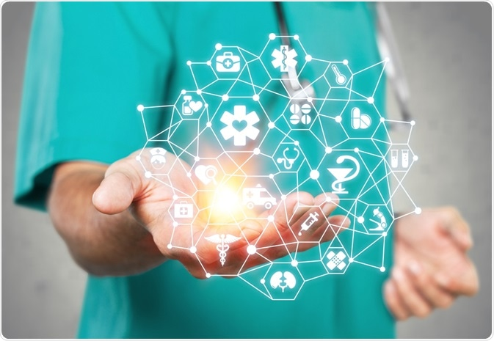
INTELLIGENT HEALTHCARE ASSISTANCE
Today mobile healthcare applications can assess data from patient and administration, records and history for proper hospitality.
They can also take charge of appointment and be alerting, specialists and their accessibility. It can take care of other back-end processes as well.
Almost every sector is influenced by artificially intelligent chatbots for providing valuable information and assistance in real time.
Intelligent healthcare chatbots and personal one to one assistance can be used very efficiently to provide a proper information exchange between health related data. Improving diet, lifestyle and almost every common health problems.

Slide 2
PROBLEM STATEMENT
Title | A personal healthcare assistance.
Description | Life is a personal android healthcare application enabling one to book one-on-one consultation with doctors and connect to similar patients by using an intelligent chatbot.
Expected Solutions | With the advent of Life, patients are expected to do the following: Book one-on-one consultation with doctors (both online and offline) Check timetable, slot availability and fees of doctors in their area Use the built-in chatbot for effective query searching and setting pill reminder Stay updated on various health issues with up to date articles
Technologies & Tools | Java, Android application and Artificial intelligence

Slide 3
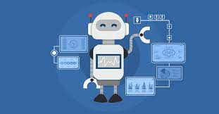
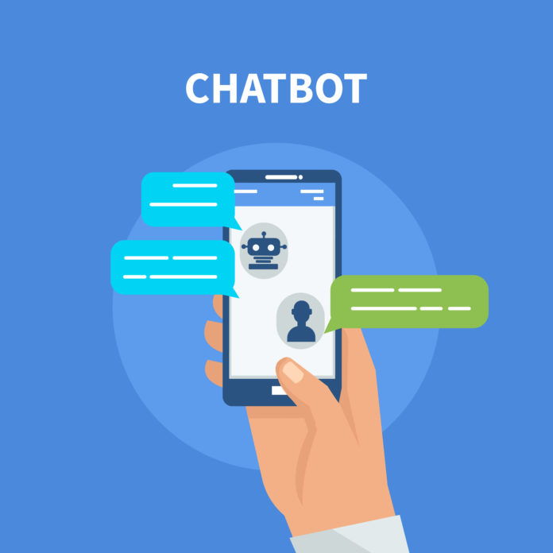
CHATBOT IN HEALTHCARE
According to a 2016 report from CB Insights , about 86% of healthcare are currently using AI in some way, Developers have launched more than 33,000 facebook messenger chatbots since April 2016 .
What’s more, 80% of brands across industries will be using chatbots for customers interactions by 2021, according to research conducted by oracle.
Chatbots in the healthcare field are providing patient assistance and care. AI-powered medical assistant can book appointment , monitor a patient health status and perform other time-intensive responsibilities such as inventory , billing and claims management.

Slide 4
SOLUTION ARTITECTURE
START
Admin Section
CHATBOT
ONE TO ONE INTERACTION
Report Dispatcher
ARTIFICIAL INTELLIGENCE
LIVE CHAT AND CALLS
Inference
Generated Report
& Alerts
HEALTH ADVICES
QUERY RESOLVES

Slide 5
PROPOSED SOLUTION
An android app for personal healthcare and assistance enables one to use one on one interaction with doctors and meet similar patient’s lounge. With advanced machine learning algorithms and natural language processing enabled, the chatbots provided can create maps linking symptoms and diseases.
Chatbot for medical care which helps you answer some standard questions, book appointments, set pill reminder, resolve queries and help create a profile based on age, sex, and medical history. They can record the user's history and analyze symptoms based on user's inputs. They can also use image and voice processing to record and match symptoms against the database.
One on one interaction with doctor where data like reports, medicine and health advice can be shared for further assistance and checkups. This app does the following -
Helps you ask your health care and medical questions to specialists for diagnosis, treatment and medical advice.
Find doctors in your region, their offline timing location and visit fees. One-on-one consultation/ chat system.
Articles about common healthcare problems and their remedies, pill reminder system so that you never miss your pill

Slide 6
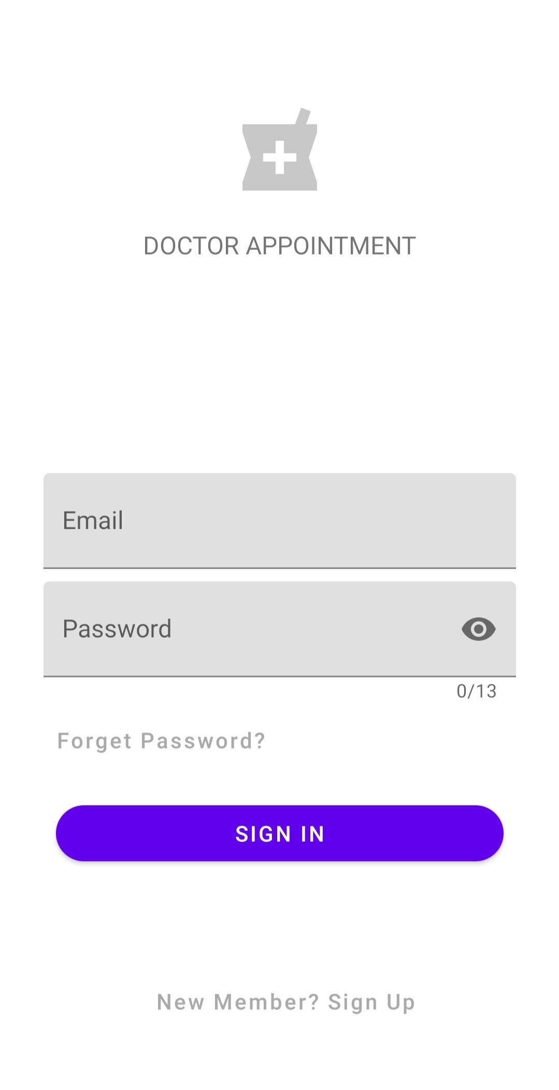
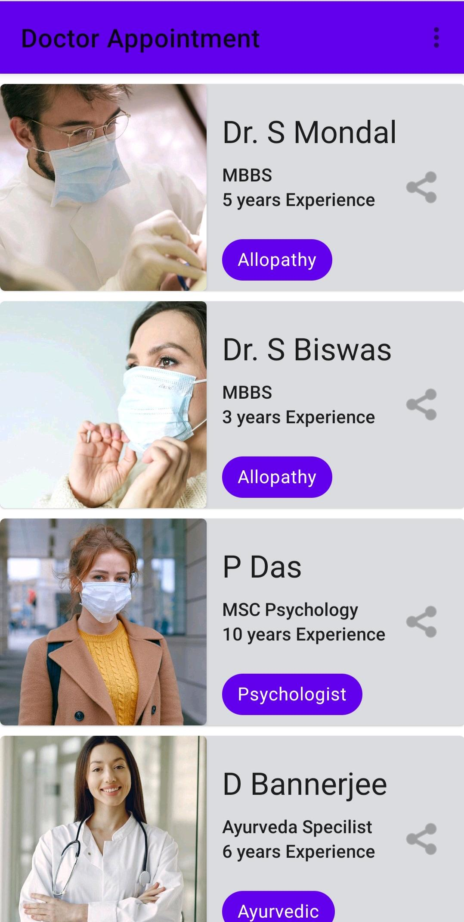
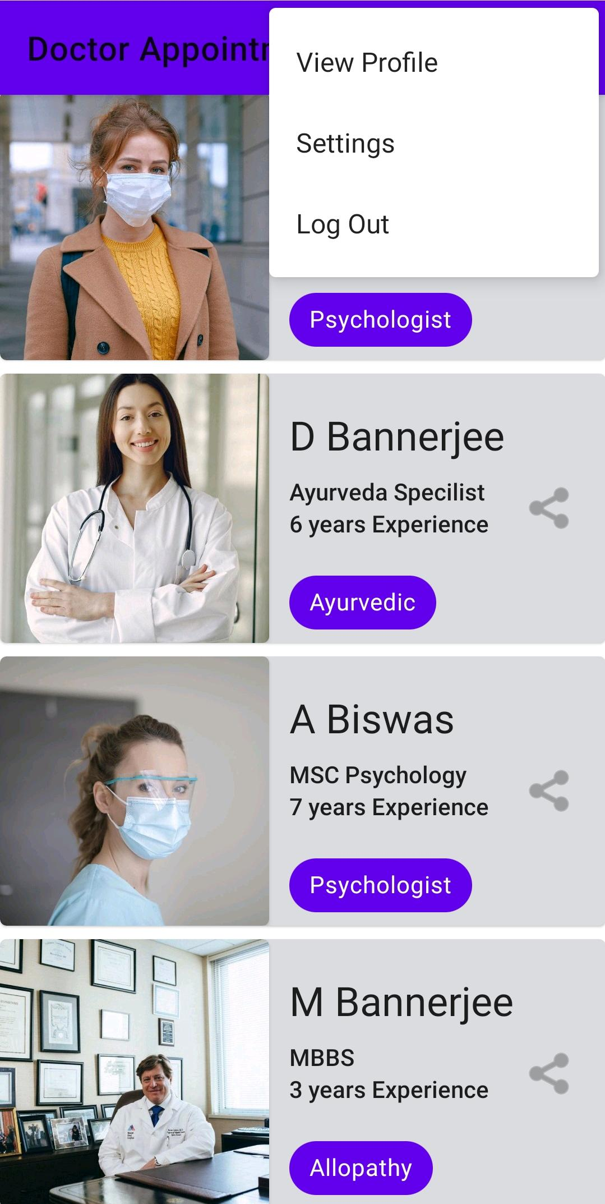
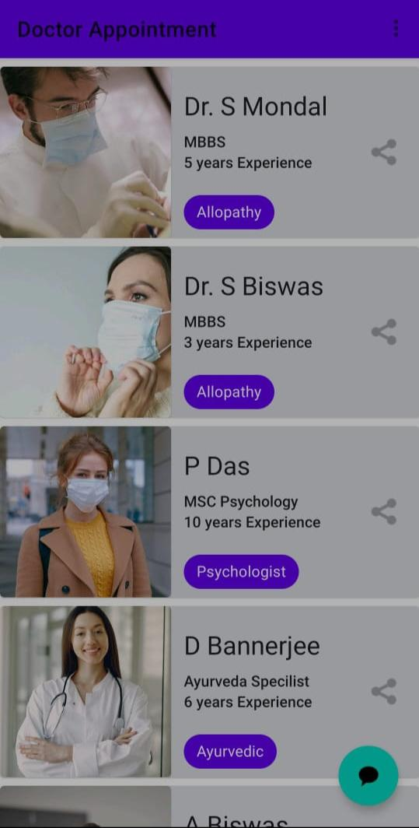
SOLUTION IMAGES

Slide 7
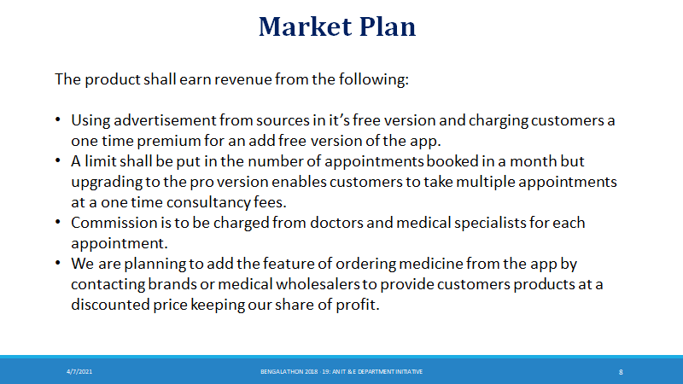

Slide 8
