Slide 1

Sir Mukhtiar Zamin
Teacher
Muhammad Nawaz Khan
FA20-BSE-073
Irfan Khan
FA20-BSE-070
Thread Pool Pattern
Concurrency Pattern

Slide 2

Agenda
Concurrency Design Pattern
Thread Pool Pattern
Structure Diagram
Example
Code Demonstration

Slide 3

Concurrency Design Pattern

Slide 4

Concurrency Design Pattern
concurrency patterns
concurrency patterns are those types of design patterns that deal with the multi-threaded programming paradigm.
Thread
A thread is the smallest unit of processing that can be performed by an operating system.
Multi-Threaded
Multithreading is the ability of a central processing unit (CPU) to provide multiple threads of execution concurrently, supported by the operating system.

Slide 5
Thread Pool Pattern

Slide 6
Thread Pool Pattern
Intent
It is often the case that tasks to be executed are short-lived and the number of tasks is large. Creating a new thread for each task would make the system spend more time creating and destroying the threads than executing the actual tasks.
Thread Pool solves this problem by reusing existing threads and eliminating the latency of creating new threads.
In plain words
Thread Pool is a concurrency pattern where threads are allocated once and reused between tasks.

Slide 7
Thread Pool Pattern
Thread pool is a software design pattern for achieving concurrency of execution in a computer program to improve performance.
Also Known As:
a replicated workers or worker-crew model,
Applicability
You have a large number of short-lived tasks to be executed in parallel.
If the number of tasks is large, creating a thread for each may become impossible or impractical, so the best answer is a thread pool.

Slide 8
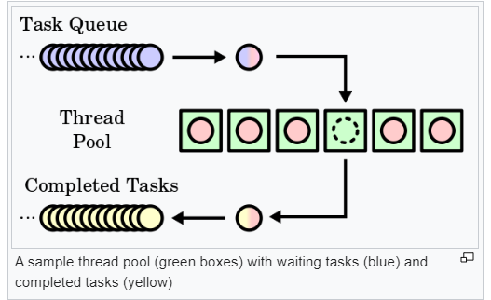
Thread Pool Pattern

Slide 9
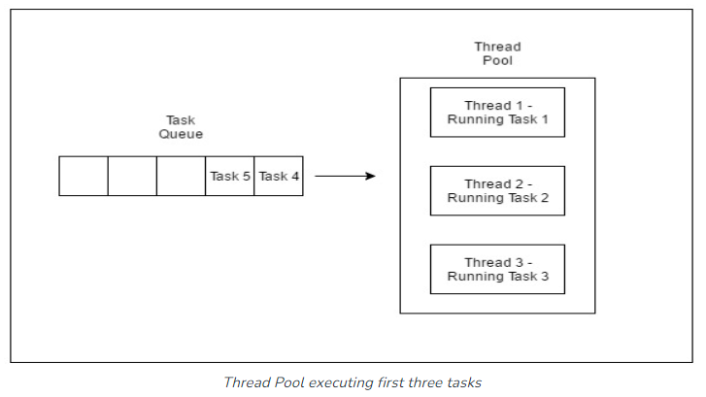
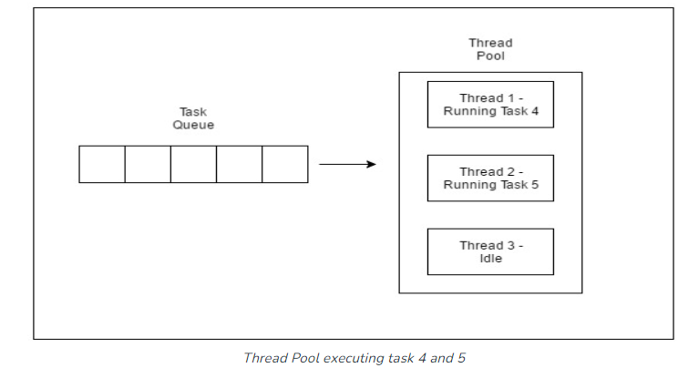
Thread Pool Pattern

Slide 10
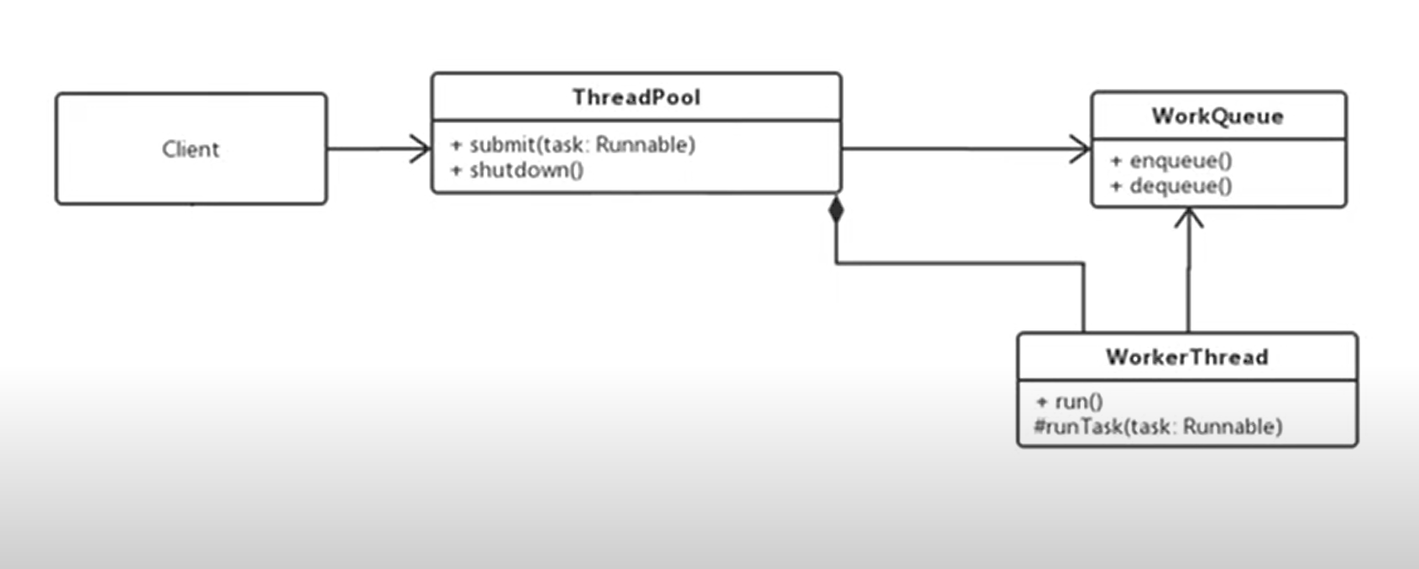
Thread Pool Pattern

Slide 11
Implementation

Slide 12



Thank you!
Questions!

