Slide 1


Madanapalle Institute of Technology & Science, Madanapalle
UGC-AUTONOMOUS INSTITUTION
Affiliated to JNTUA, Ananthapuramu & Approved by AICTE, New Delhi
M I T S
Department of Computer Science and Technology
VIVA VOCE
Medical Text Classification System for Categorizing Health Queries Using NLP
Presenting by:
22691A28C7. - Shaik . Nawaziya

Slide 2
Abstract
The rapid growth of online healthcare platforms has resulted in a large volume of unstructured and informal medical queries, making manual categorization inefficient and error-prone.
This System proposes a Medical Text Classification System using Natural Language Processing (NLP) and deep learning to automatically categorize health-related queries into classes such as symptoms, diseases, diagnosis, medications, and treatments.
The system performs text preprocessing to remove noise, normalize medical language, and improve data quality for accurate classification.
Meaningful features are extracted using TF-IDF, Word2Vec, and BERT embeddings, enabling the model to capture semantic and contextual information.
Advanced deep learning models including LSTM, Bi-LSTM, CNN, and transformer-based architectures are trained for effective medical text classification.
The proposed system significantly reduces manual workload and improves response time, enhancing efficiency for healthcare platforms.
The solution is scalable and suitable for real-time integration with medical chatbots, telemedicine systems, and online healthcare applications.

Slide 3
Objective
The objective and scope of this System are to design and develop an NLP-based system that automatically classifies health-related text queries into predefined categories such as symptoms, diseases, diagnosis, medications, and treatments. The system processes unstructured and informal patient queries using text preprocessing and deep learning models. It focuses only on text-based inputs and does not provide diagnosis or medical advice. The final outcome is an accurate and efficient classification system for medical queries.
The System also aims to support healthcare platforms and telemedicine systems by organizing large volumes of patient queries. The classified output helps in routing queries to the appropriate doctors or departments, reducing manual workload. The system acts as a backend support tool and can be integrated into real-time healthcare applications. Overall, it improves response time, efficiency, and usability of digital healthcare services.

Slide 4
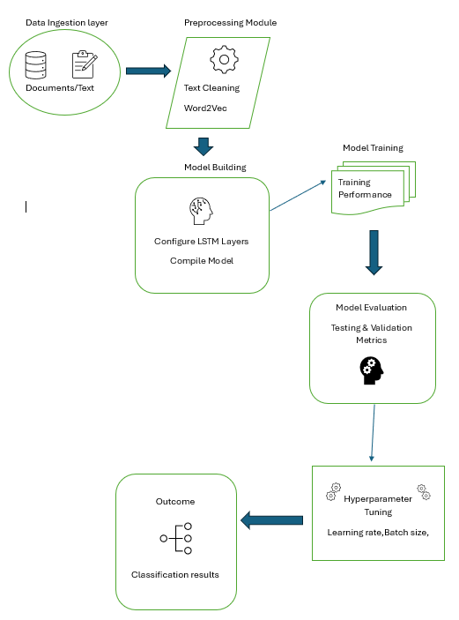
System Architecture

Slide 5
Methodology of the proposed work
The proposed system aims to automatically classify informal medical queries into predefined medical categories using Natural Language Processing (NLP) and deep learning techniques. The methodology consists of the following stages:
1. Data Collection : A large dataset of medical queries is collected from reliable online healthcare platforms and publicly available healthcare datasets. The collected data includes informal, patient-generated queries covering symptoms, diseases, medications, diagnosis, and treatments.
2. Data Preprocessing : The raw medical queries often contain noise such as stop words, punctuation, numbers, URLs, and unnecessary symbols. Preprocessing is performed to clean the data and improve model performance. This step ensures that only meaningful medical terms are retained for further analysis.
3. Text Normalization and Tokenization : The cleaned text is broken down into individual tokens. Techniques such as lemmatization and normalization are applied to convert words into their base forms, helping the system handle variations in medical terminology and informal language usage.

Slide 6
Methodology of the proposed work
4. Feature Extraction
The preprocessed text is transformed into numerical representations that machine learning models can understand. Feature extraction is performed using:
TF-IDF to capture term importance
Word2Vec to learn semantic relationships between medical terms
BERT embeddings to capture contextual meaning in medical queries
5. Model Training
The extracted features are fed into deep learning models such as LSTM, Bi-LSTM, CNN, and transformer-based architectures. These models learn patterns and dependencies in medical text to accurately classify queries into appropriate categories.
6. Dataset Splitting
The dataset is divided into training, validation, and testing sets. The training set is used to train the models, the validation set is used for tuning parameters, and the testing set is used for unbiased performance evaluation.
\

Slide 7
Methodology of the proposed work
7. Model Evaluation
The performance of the trained models is evaluated using standard classification metrics including accuracy, precision, recall, and F1-score, ensuring the reliability and effectiveness of the system.
8. Deployment and Prediction
The best-performing model is deployed to classify new, unseen medical queries. When a user submits a query, the system automatically predicts the appropriate medical category.
Example:
“I have chest pain and breathing problem.
What should I do now?”
Explanation:
The system reads the user’s query written in simple, informal language.
It understands the key medical words like chest pain and breathing problem.
Based on these words, the system classifies the query into the correct category.
Final Output
Category: Symptoms / Diagnosis

Slide 8
Algorithm
The proposed system uses BERT (Bidirectional Encoder Representations from Transformers)
for medical query classification.
User medical queries are accepted as raw, unstructured natural language text.
Only minimal text cleaning is applied, as BERT is pretrained on large-scale language data.
The BERT tokenizer splits text into subword units to handle complex medical terms.
Special tokens [CLS] (classification) and [SEP] (separator) are added to the input sequence.
Text is converted into token IDs, attention masks, and segment IDs.
Sequences are padded or truncated to a fixed length for uniform input size.
This encoded input is prepared for transformer-based contextual learning.

Slide 9
Algorithm
The encoded input is passed through multiple BERT transformer encoder layers.
BERT applies self-attention mechanisms to capture word relationships.
Bidirectional processing enables understanding of both left and right context.
The embedding of the [CLS] token represents the overall meaning of the query.
A fully connected dense layer is used for category prediction.
Dropout regularization is applied to reduce overfitting.
A softmax activation function generates class-wise probabilities.
The system outputs the final medical category with confidence score.

Slide 10
Input
The input to the proposed system consists of unstructured medical queries collected from online healthcare platforms, forums, and user submissions. These queries are usually written in informal language and may include abbreviations, spelling mistakes, and incomplete sentences. The system accepts raw text data related to symptoms, diseases, diagnosis, medications, and treatments. The input can be provided through datasets (like CSV files) or real-time user queries in applications. Proper handling of input data is important to ensure accurate processing and classification.
Example:
“I have a headache and fever for 2 days, what medicine should I take?”
This type of query is given as input to the system, which will then process and classify it into the appropriate category (e.g., Symptoms or Medications).

Slide 11
Implementation & Demo
The Medical Text Classification System automatically categorizes unstructured healthcare queries using NLP and deep learning. Medical queries are preprocessed to remove noise and normalize language, then represented using BERT embeddings to capture rich contextual meaning. A deep learning–based classification model uses these embeddings to accurately classify queries into categories such as symptoms, diseases, diagnosis, medications, and treatments. The real-time demo shows how user queries are instantly processed and classified, highlighting the system’s efficiency and suitability for medical chatbots, telemedicine platforms, and online healthcare support systems.

Slide 12
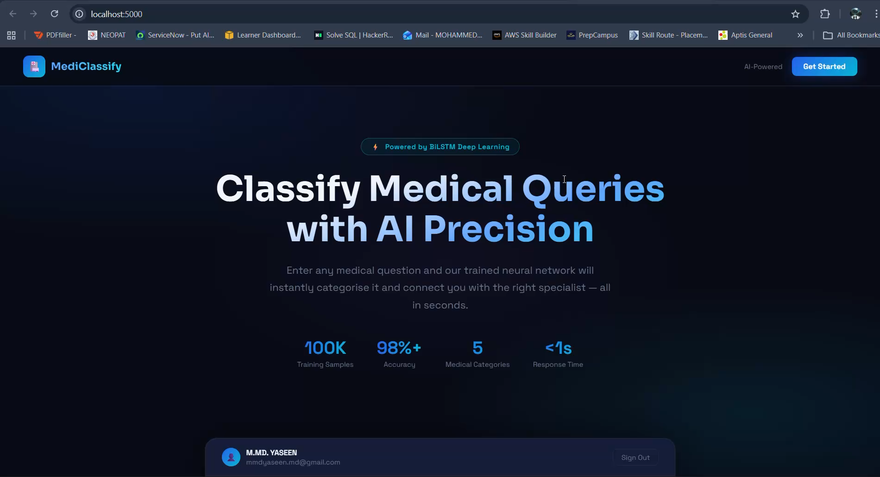

Slide 13
Result
The proposed Medical Text Classification System successfully classifies unstructured health queries into appropriate categories such as symptoms, diseases, diagnosis, medications, and treatments with high accuracy, demonstrating the effectiveness of NLP and deep learning techniques.
By applying advanced preprocessing and feature extraction methods like TF-IDF, Word2Vec, and BERT, the system captures semantic and contextual meaning, resulting in reliable and context-aware classification of real-world medical queries.
The trained deep learning models, including LSTM and Bi-LSTM, significantly reduce manual workload and response time, enabling faster and more efficient handling of large volumes of healthcare queries.
The final system is scalable and ready for real-time deployment, making it suitable for integration with medical chatbots, telemedicine platforms, and online healthcare applications to enhance overall healthcare service efficiency.

Slide 14
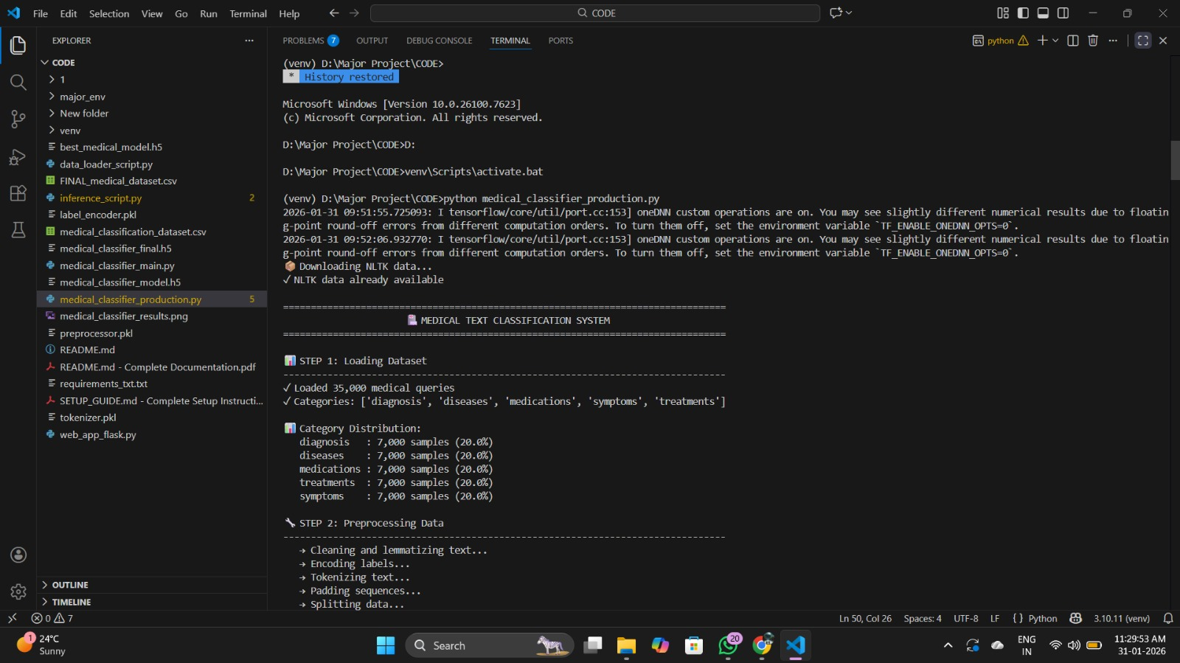
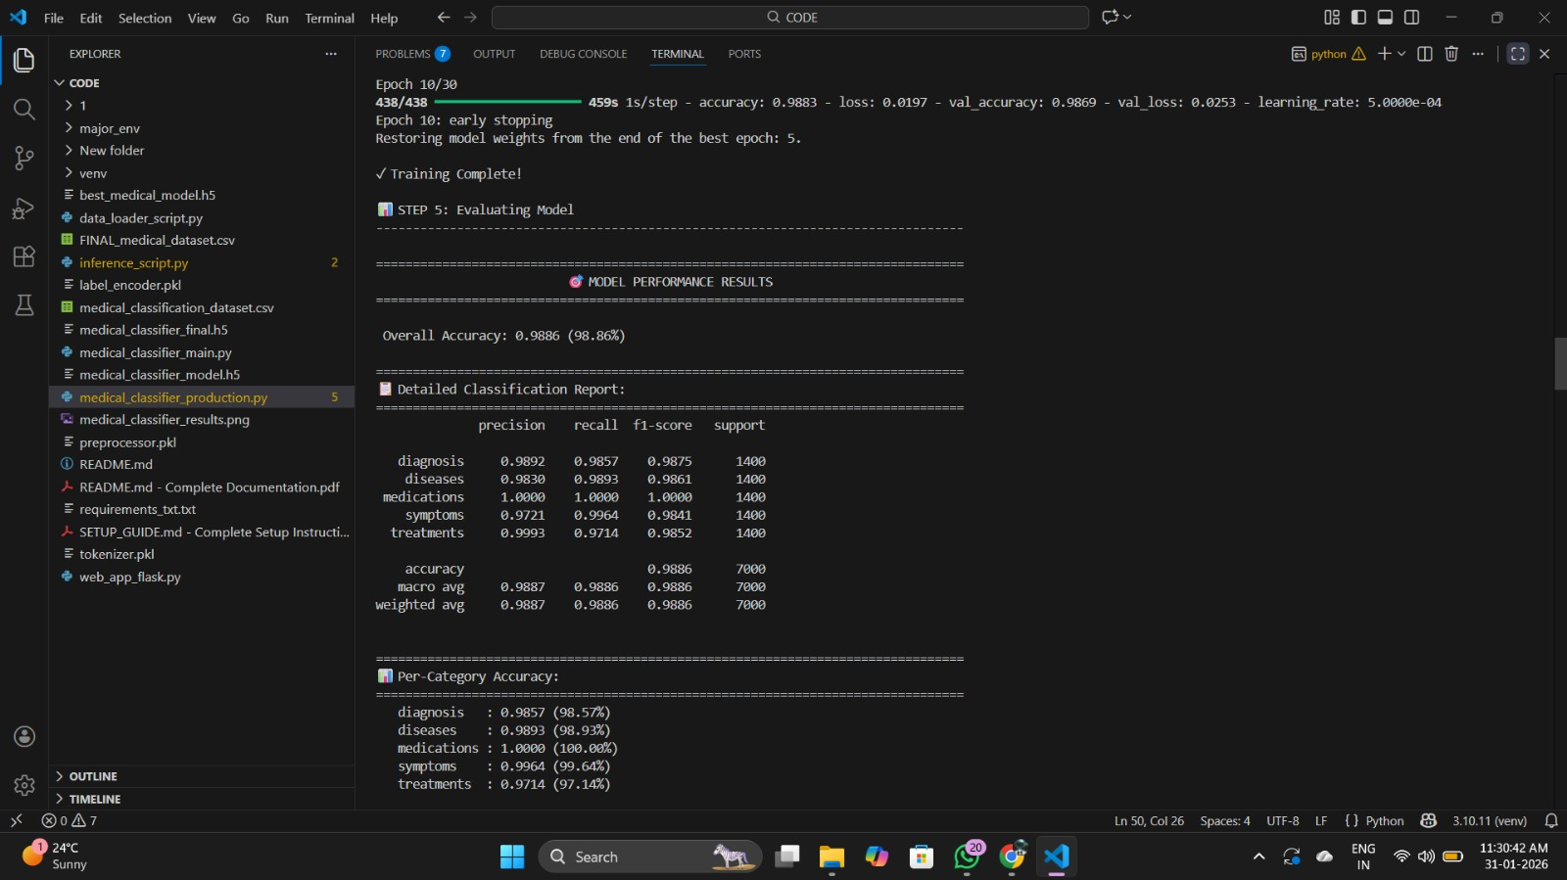
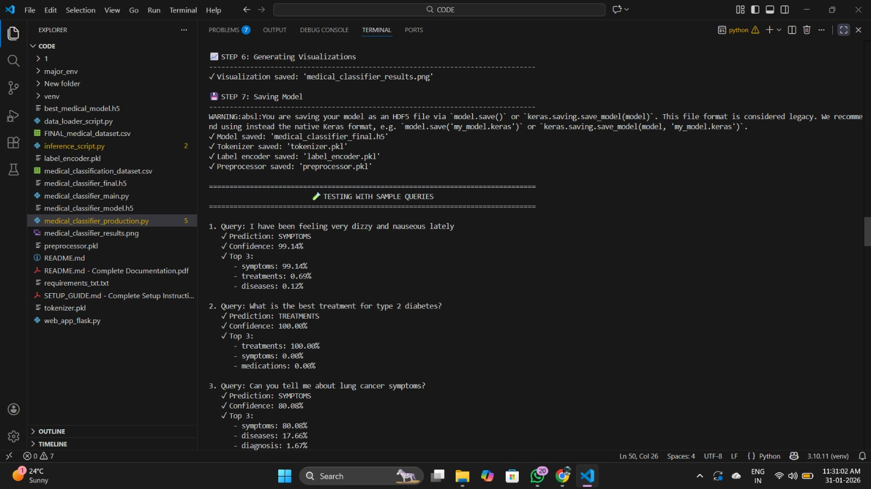
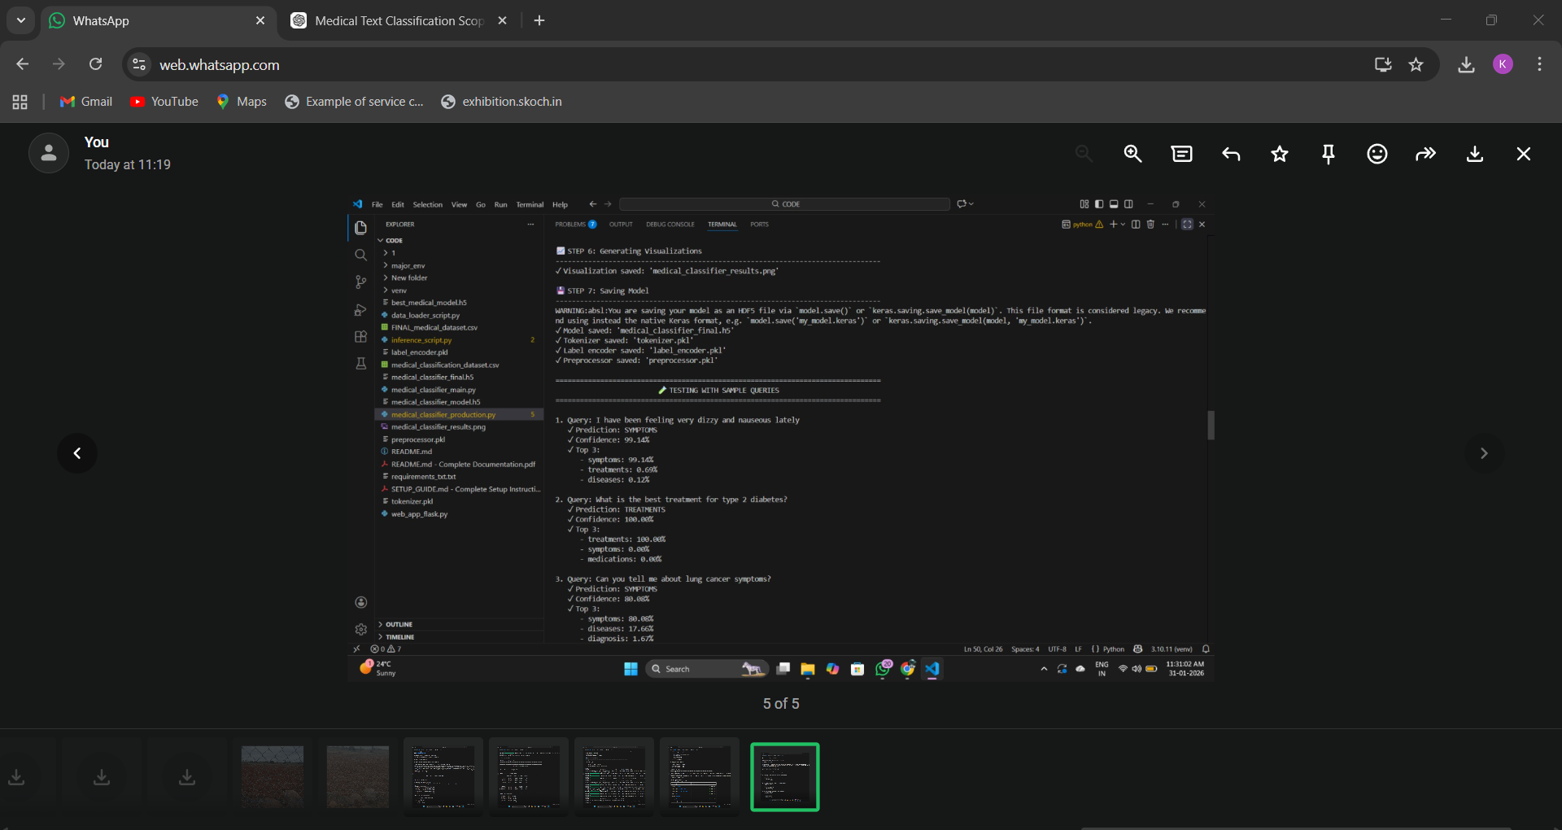
Result

Slide 15
Conclusion
The proposed Medical Text Classification System effectively addresses the challenge of handling large volumes of unstructured medical queries by using NLP and deep learning techniques. By applying preprocessing and advanced feature extraction methods like TF-IDF, Word2Vec, and BERT, the system accurately understands and classifies medical text. The use of models such as LSTM, Bi-LSTM, CNN, and transformers ensures high performance and reliability. Overall, the system reduces manual effort, improves response time, and provides a scalable solution that can be integrated into real-time healthcare applications like chatbots and telemedicine platforms.
Additionally, the system improves consistency in classification compared to manual methods, minimizing human errors. It can handle diverse and complex medical queries with better contextual understanding. The model’s adaptability allows it to be extended with new data and categories in the future. It also supports better decision-making for healthcare professionals by organizing information efficiently. Furthermore, the system lays a strong foundation for future enhancements such as multilingual support and more advanced AI-driven healthcare solutions.

Slide 16
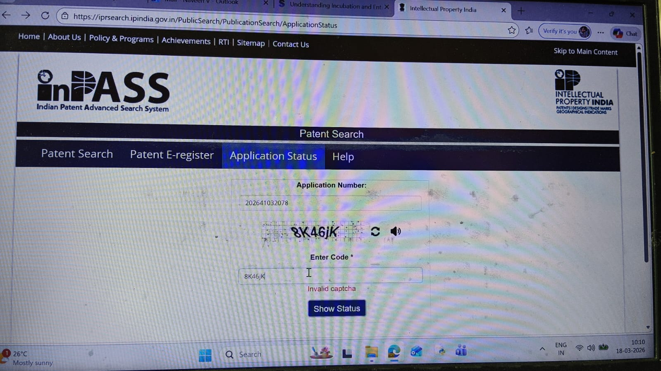
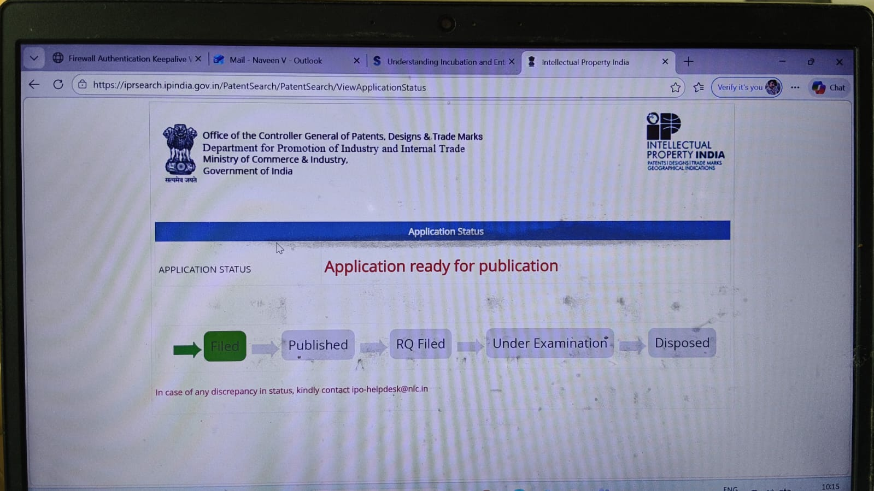
Publication details

Slide 17
References
Al-Doulat et al. (November 2019) proposed a supervised deep learning approach for unstructured medical text classification using linguistic analysis and domain-specific features, demonstrating improved performance for multi-class medical document categorization at the document level.
Link: https://ieeexplore.ieee.org/document/9035282
Mohammed et al. (December 2020) explored deep learning–based approaches for multi-label text classification and demonstrated the effectiveness of neural architectures combined with word embedding techniques for handling high-dimensional and unstructured textual data.
Link: https://ieeexplore.ieee.org/document/9378266
Wang et al. (September 2021) developed a BERT-based automatic medical triage system that classifies patient symptom descriptions into predefined categories, effectively reducing hospital triage workload and improving medical resource utilization.
Link: https://ieeexplore.ieee.org/document/9035282
Shen et al. (July 2022) proposed a feature-enhanced medical text classification model based on an improved BERT architecture and feature fusion, achieving high accuracy by integrating char-word tokenization, attention mechanisms, and CNN-based feature extraction.
Link: https://ieeexplore.ieee.org/document/9902780
Zhou et al. (September 2022) reviewed Natural Language Processing techniques for smart healthcare, covering NLP pipelines, major healthcare applications, and key challenges such as data privacy, scalability, and real-world deployment.
Link: https://ieeexplore.ieee.org/document/9696145

Slide 18
References
Kaur et al. (May 2023) explored the application of text analytics and NLP techniques in modern healthcare, discussing healthcare data sources, analytical methods, challenges, and the potential of NLP-driven systems to improve patient care and clinical decision-making.
Link: https://ieeexplore.ieee.org/document/10182715
Vinod et al. (October 2023) presented a comprehensive review of text classification techniques, analyzing traditional machine learning, rule-based, and deep learning approaches, and highlighting their strengths, limitations, and applicability to healthcare-related text data.
Link: https://ieeexplore.ieee.org/document/10461820
De Santis et al. (February 2025) conducted a comparative study from Bag-of-Words models to transformer-based architectures for healthcare discussions on social media, showing that transformer models achieve superior performance in handling noisy, short, and imbalanced medical text data.
Link: https://ieeexplore.ieee.org/document/10596950
Mohamed et al. (July 2025) proposed an ensemble transformer-based approach for Arabic medical text classification, demonstrating that combining multiple pre-trained transformer models significantly improves classification accuracy and robustness in telehealth question answering systems.
Link: https://ieeexplore.ieee.org/document/11167203

Slide 19
References
10. Shinji Sakai and Lam, 2024. Large Language Models for Healthcare Text Classification. Available at: https://consensus.app/papers/large-language-models-for-healthcare-text-classification-sakai- lam/612cf42adf645019b4e0ccafb0109e5f/
11. Wang and Wang, 2023. Medical Text Classification Based on the Discriminative Model. Available at: https://consensus.app/papers/medical-text-classification-based-on-the-discriminative-wang- wang/bbfd2d8265955eb7b723e3c1f5368217/
12. Roji Kumar, 2023. Medical Symptom Text Classification through NLP. Available at: https://consensus.app/papers/medical-symptom-text-classification-through-nlp-in-roji- kumar/8b2d8c0af1ec5c4caec65446f32c1778/
13. Abdennour Gasmi, 2024. An Optimal Model for Medical Text Classification Based on Deep Learning. Available at: https://consensus.app/papers/an-optimal-model-for-medical-text-classification-based-on- abdennour-gasmi/b2c6b0845592578d80626fada257210f/
14. Kucuk Cicek, 2023. Comparative Analysis of Machine Learning Algorithms for Medical Text Classification. Available at: https://consensus.app/papers/comparative-analysis-of-machine-learning-algorithms-for- kucuk-cicek/9e4cdcd0abf859a681748063ecbb4491/
15. Mahankal Wadkar, 2024. Leveraging NLP for Medical Text Analysis and Diagnosis. Available at: https://consensus.app/papers/leveraging-nlp-for-medical-text-analysis-and-diagnosis-mahankal- wadkar/e2148843791752d4814135d878f9a647/

Slide 20


