Slide 1

My Analytics Project
A comprehensive data analytics project analyzing patient data to identify trends and patterns using Python, SQL, and Power BI Desktop.

Slide 2

📋 Overview
What This Project Does
A patient data analytics initiative that bridges raw clinical records with actionable insight — designed to be accessible for first-time contributors and rigorous enough for real-world use.
Analyzes patient data to uncover meaningful trends and patterns
Combines data processing with interactive visualizations
Provides actionable insights for decision-making

Slide 3




🎯 Project Objectives
Identify Trends
Find Correlations
Surface key patterns in patient data across time and demographics
Discover meaningful relationships and patterns hidden in the data
Build Dashboards
Drive Decisions
Create interactive Power BI dashboards for intuitive data exploration
Support evidence-based, data-driven decision making in healthcare

Slide 4
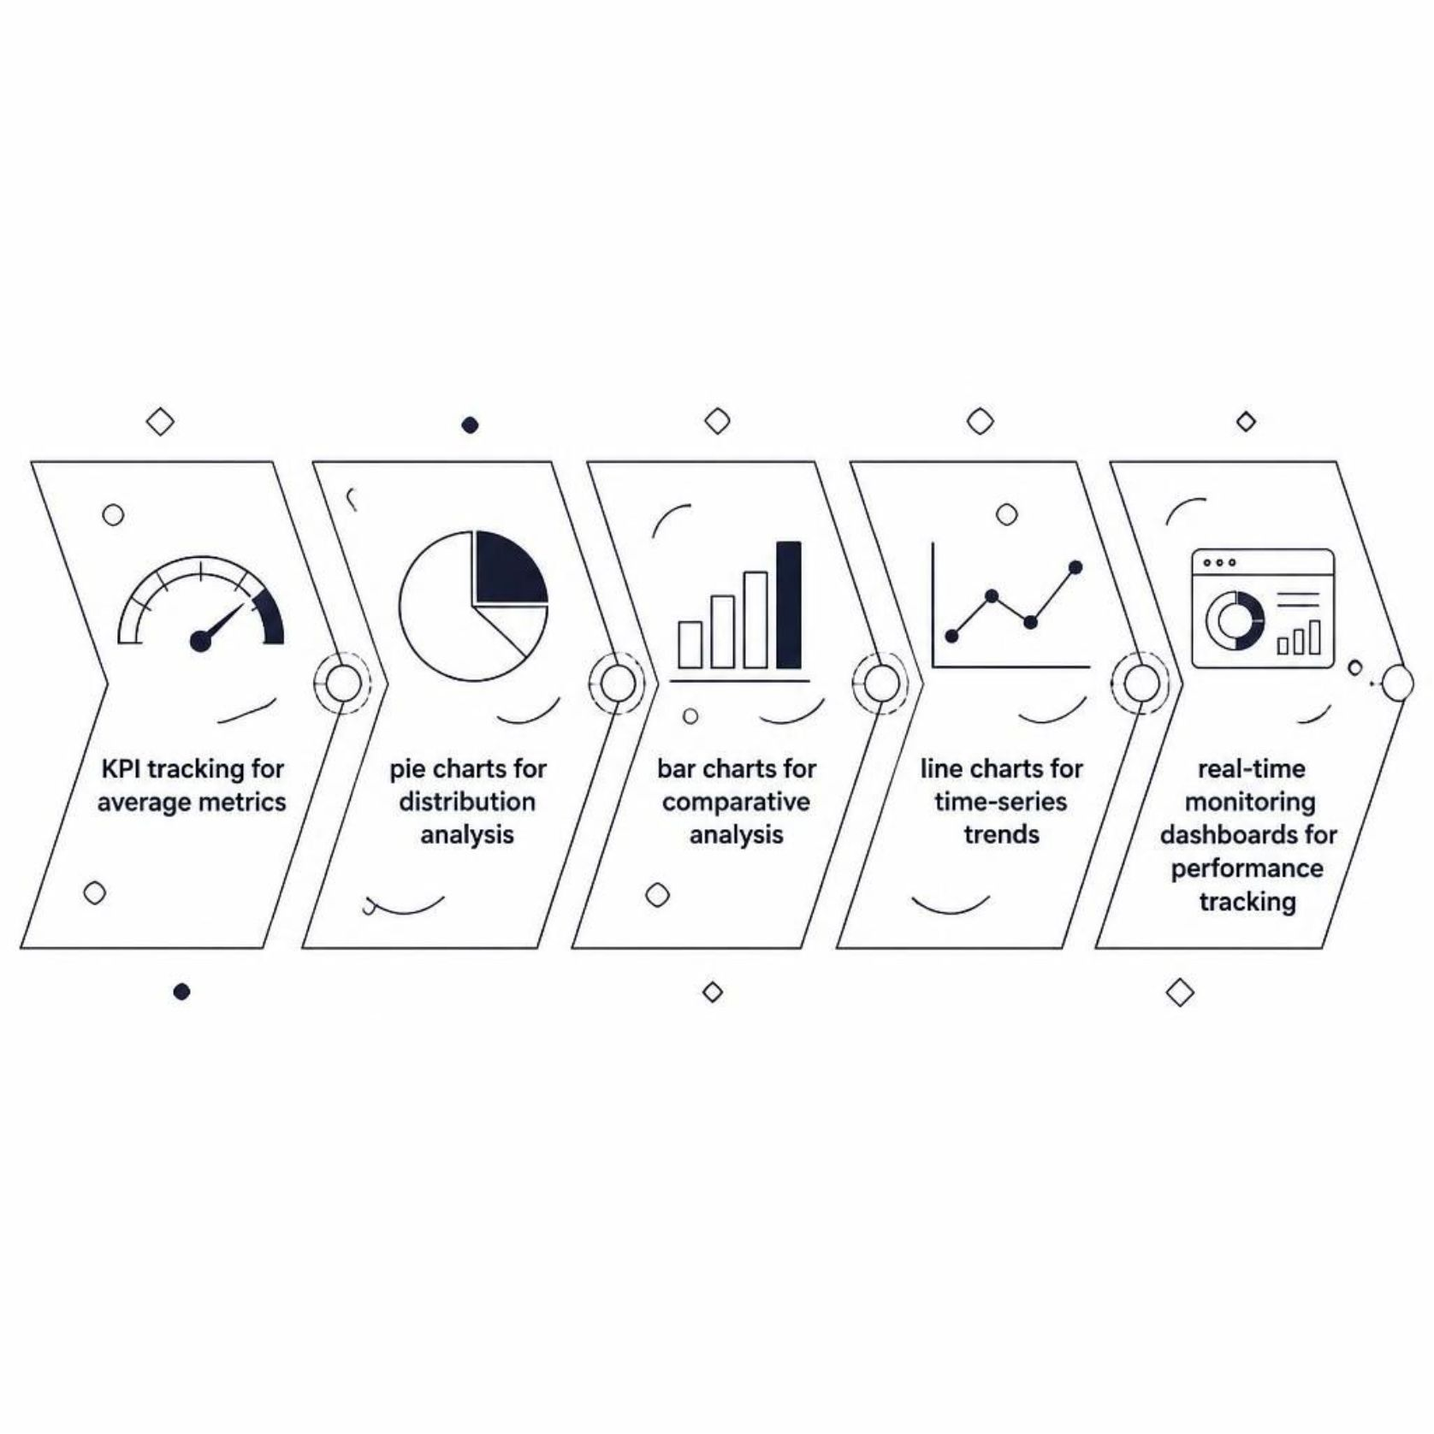
📊 Key Metrics & Visualizations
A Multi-Layered View of Patient Data
Each visualization type serves a distinct analytical purpose, layering together to give a complete picture of patient population health.
Average metrics: Multiple KPIs tracked across dimensions
Distribution analysis: Pie charts showing data composition
Comparative analysis: Bar charts for cross-category comparisons
Time-series trends: Line charts tracking patterns over time
Performance tracking: Real-time monitoring dashboards

Slide 5

🛠️ Technologies Used
🐍 Python
Data processing, analysis, and automation of the full analytics pipeline
🗄️ SQL
Database queries and structured data extraction from clinical sources
📊 Power BI
Interactive dashboard creation and publication for stakeholder consumption
🐼 Pandas
Data manipulation, cleaning, and transformation at every pipeline stage

Slide 6

📁 Project Structure
Repository Layout
Folder / File | Purpose
data/ | Raw and processed data files
scripts/ | Python scripts for data processing
queries/ | SQL queries for data extraction
dashboards/ | Power BI dashboard files (.pbix)
notebooks/ | Jupyter notebooks for EDA
README.md | Project documentation
The project follows a clean, modular folder structure that separates concerns and makes onboarding straightforward for new contributors.
Each folder has a single responsibility — keeping code, data, and documentation easy to navigate from day one.

Slide 7

🚀 Getting Started
Clone Repo
Configure DB
Copy project repository to your machine
Set up and test the database connection
Install deps
Run scripts
Install required Python packages with pip
Execute data processing and ETL scripts
Most users can complete the full setup in under 15 minutes. Follow the steps above in order — each stage builds on the last.

Slide 8


📋 Prerequisites
What You'll Need Before Starting
Ensure the following tools and libraries are available in your environment before cloning the repository.
Python 3.8 or higher
SQL database access — MySQL, PostgreSQL, or SQL Server
Power BI Desktop (free version available from Microsoft)
Python libraries: pandas, numpy, sqlalchemy, pyodbc
Power BI Desktop is free to download from the Microsoft Store — no license required to get started.

Slide 9

💾 Data Requirements
Patient Demographics & Clinical Info
Time-Stamped Records
Relevant demographic attributes and clinical fields required for meaningful segmentation and trend identification.
All records must include timestamps to enable temporal trend analysis and seasonal pattern detection.
Clean, Validated Format
Privacy & Compliance
Data should be provided in CSV format or accessible via a connected database. Pre-validate for nulls and duplicates.
Ensure all data handling follows applicable data privacy regulations (e.g., HIPAA, GDPR) before ingestion.

Slide 10

📈 Key Findings
Multi-Segment Metrics
Multiple KPIs tracked and compared across distinct patient segments, revealing meaningful performance differences.
Clear Distribution Patterns
Categorical data reveals consistent groupings and distributions — providing a reliable baseline for further analysis.
Temporal Variations
Time-based analysis uncovers seasonal trends and cyclical patterns in patient activity and outcomes.
Comparative Performance
Cross-dimensional comparisons highlight which segments and time periods outperform others — guiding prioritization.

